Slide 1

Georgia Department of Transportation
Statewide Travel Demand Model
Statewide Travel
Demand Model
Georgia Planning Conference
Sept 26, 2012
Presented by
Patti Schropp

Slide 2
Purpose of the Statewide Model
Intercity Person, Passenger Car and Truck Travel Patterns
Daily Highway Volumes on State Highways and Interstates
Ability to Evaluate Major Changes in Land Use and Economic Policies on Person, Truck and Goods Movements
Ability to Evaluate Major Highway and Interstate Improvements outside of MPO areas
Provide General Intercity Intermodal Freight Movements
  Evaluate Shift of Freight Traffic between Highway and Rail

Slide 3
What the Statewide Model
CANNOT Provide
  Detailed Personal and Vehicle Travel Patterns and Demands within MPO areas
  Identification of Future Bottlenecks within MPO areas
Detailed Intermodal Freight Movements within MPO areas

Slide 4
Type of Studies
Sample GDOT studies that the model has been used for
GDOT Freight Plan
Dade County Study
Connect Central Georgia Study
I-75 North Corridor Study-Atlanta-Chattanooga
I-75 South Corridor Study-Atlanta-Macon

Slide 5
User Model Inputs
Socio-Economic Data by TAZ
  Population
  19 Employment Types
Highway Network
  Number of Lanes
  Functional Classification
Freight Rail Network
Inter-City Passenger Rail Network
Airline Network

Slide 6
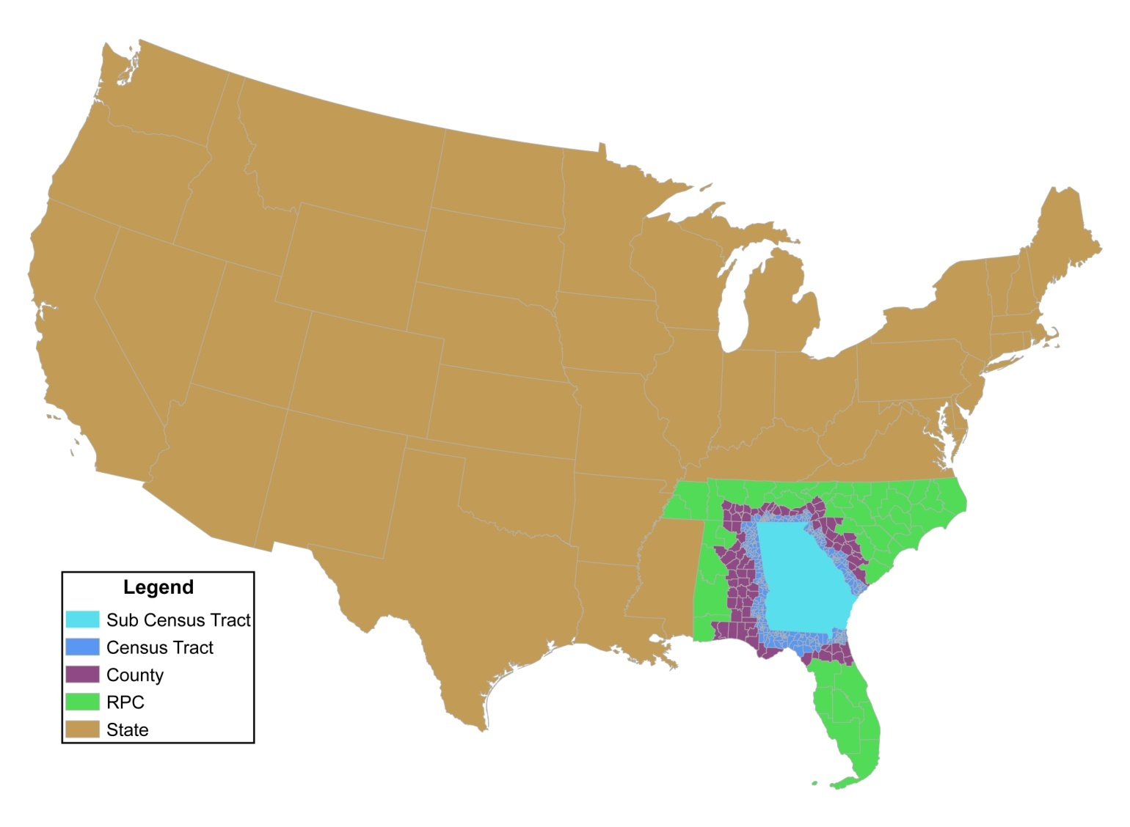
Traffic Analysis Zones (TAZ)
  Covers contiguous U.S. (48 states)
  Total 2,242 zones
  Georgia zones 1,715
  Census tract and highway network as boundaries in Georgia
  Different level of detail for states surrounding Georgia
  Census tract
  County
  Group of counties

Slide 7
Highway Network
  Covers contiguous U.S. (48 states)
  More Level of Detail for Georgia and then States surrounding Georgia
  Roadway Facilities
    Interstates
    Principal Arterial
    Minor Arterials
    Major Collectors
  Network Mileage
    State of Georgia – 18,600 (State Hwy System)
    Surrounding 5 States – 25,100
    Outlying States – 36,700
    Total Mileage – 80,400

Slide 8
Base Year Highway Network
Legend
Interstates
Principal Arterials
Minor Arterials
Collectors
Locals

Slide 9
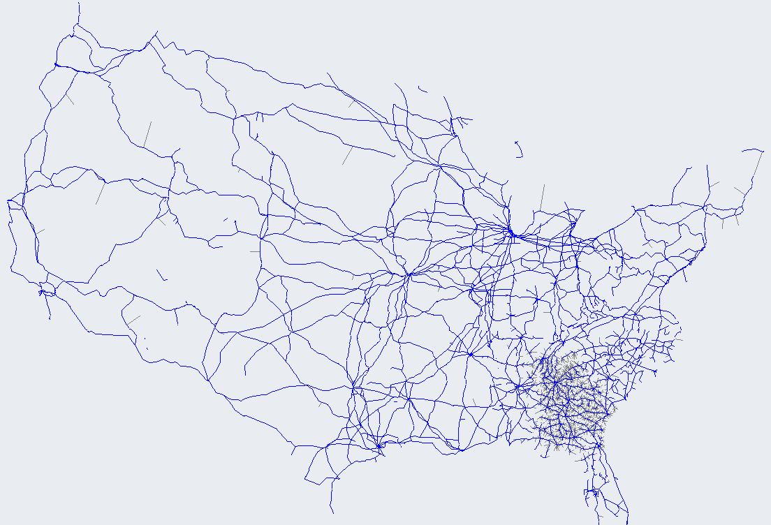
Rail Network
National Railway Network
Same network coding as highway
  Centroid
  Centroid connectors
Covers contiguous U.S. (48 states)
  Focused details within and around Georgia

Slide 10
Statewide Model Structure
Freight Model
Passenger Model
Freight Generation
Trip Generation
Freight Distribution
Trip Distribution
Freight Mode Choice
Trip Mode Choice
Highway Assignment
Mode Feedback Check
Public Transport Assignment

Slide 11
Passenger Model
Traditional 4-step model, independent of freight model except during highway traffic assignment process
Added Mode Choice for general travel movements – use with Caution – more for general trends and not specific numbers
  Air (only direct flights>100 miles within Georgia)
  Train (Inter-city only & > 50 miles long)

Slide 12
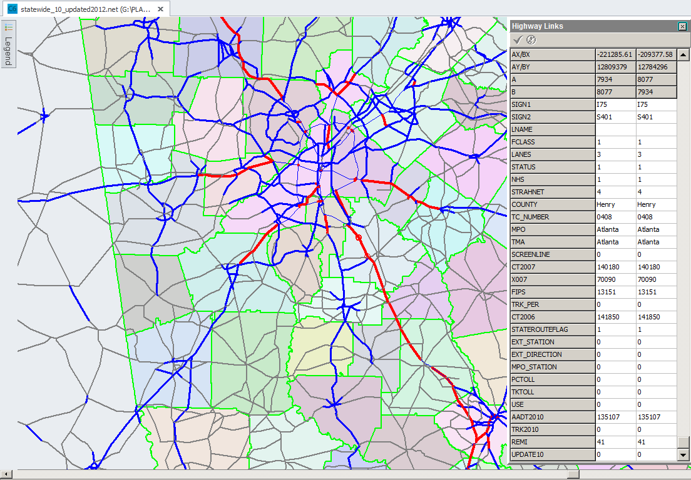
Highway Network Variables

Slide 13
Model Outputs
Person Trips
Vehicle Trips
  Passenger Car
  Commercial Truck
  Heavy Duty Truck (Freight)
  Annual Rail Tonnage
Traffic Volumes by Link
  Total Volumes
  Passenger & Commercial Vehicle Volumes
  Heavy Duty (Freight) Volume
  Congested Time and Speed
  VMT and VHT

Slide 14
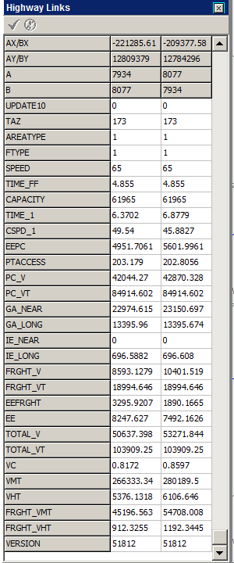
Highway Network Output Variables
Output
Input

Slide 15
To Run the Statewide Model
  Need Cube Software License
    Run in Application Manager Mode
    Scenario Manager

Slide 16
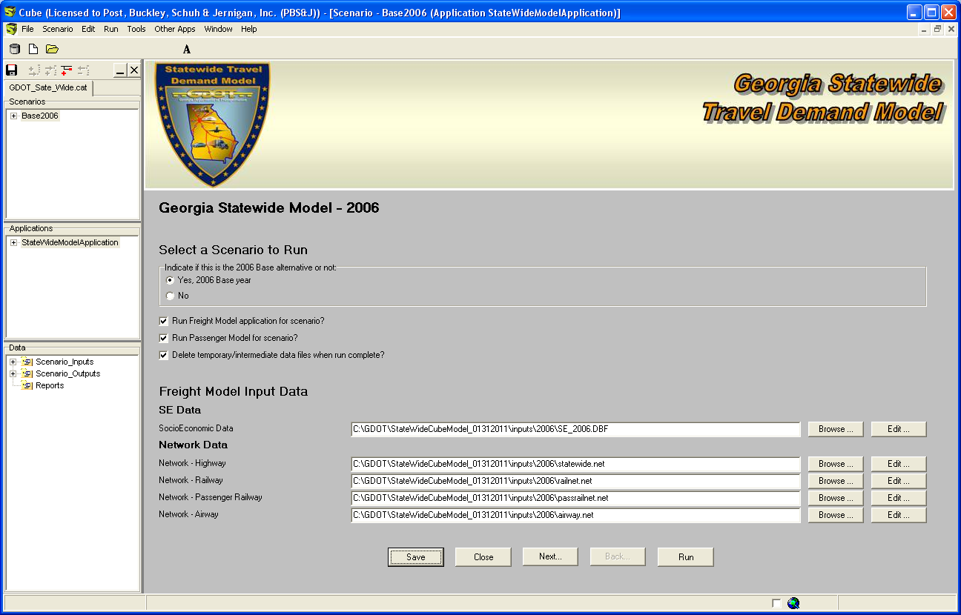

Slide 17
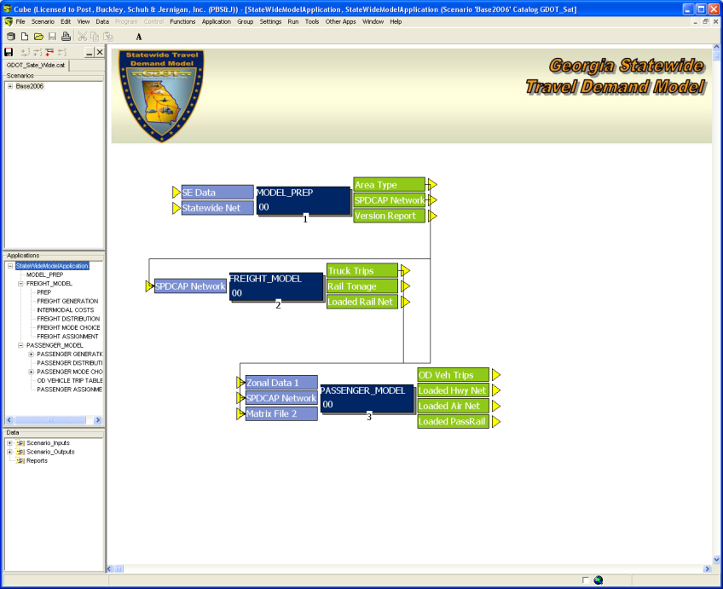

Slide 18
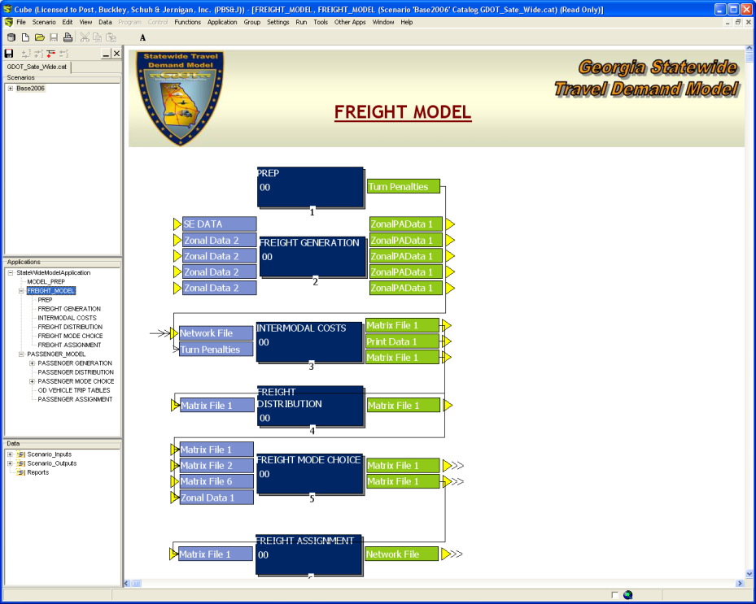

Slide 19
Model Capabilities
  Has ability to customize for Corridor and Sub-area Studies
    Can add additional TAZs
    Will need to create socio-economic data for these new TAZs and update existing as necessary
    Update highway network

Slide 20
Current Activities
  Model was built for 2006 Conditions
  Update Base Year to 2010 Conditions
    Update Highway Network
    Update Socio-Economic Data
  Develop Procedure to Dis-aggregate future REMI socio-economic data at the region level to statewide TAZs

Slide 21
For MoreInformation
Statewide Travel
Demand Model
Phil Peevy ppeevy@dot.ga.gov
Habte Kassa hkassa@dot.ga.gov

Slide 22

Questions

