Slide 1
Make No Little Plans: The Development of the Moscow International Business District
Katherine Dydak
UNC Chapel Hill

Slide 2
Notes:
Canary Warf, London

Slide 3
Notes:
New York

Slide 4
Pudong, Shanghai
Notes:
Pudong, Shanghai

Slide 5
Notes:
Paris

Slide 6
Notes:
Pacific Place, Hong Kong

Slide 7
Notes:
Moscow

Slide 8
Introduction

Slide 9
Research Question
Is the urban form of post-Soviet Moscow converging with the urban form of cities in the West and around the world?
Are Russian planning process and institutions becoming more similar to the ones used in America?

Slide 10
Main Points
Due to privatization and globalization, Moscow’s urban form is becoming more like the urban form of other world cities.
Processes used to plan projects like the Moscow International Business District are similar to ones used in America and around the world.
However, significant institutional differences remain.

Slide 11
Presentation Outline
Globalization
Moscow’s Urban Development
Case Study: Moscow-City (Москва-Сити)
Moscow International Business Center (MIBC)
Conclusions

Slide 12
Globalization and the Development of World Cities

Slide 13
Globalization

Slide 14
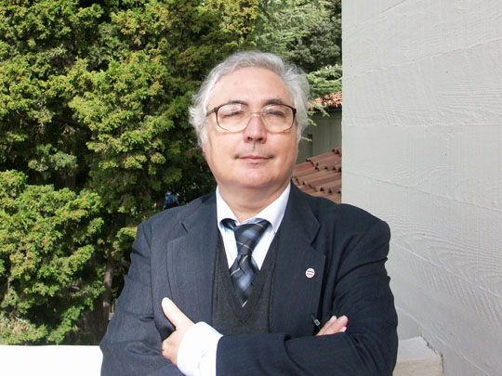
GLOBALIZATION

Slide 15
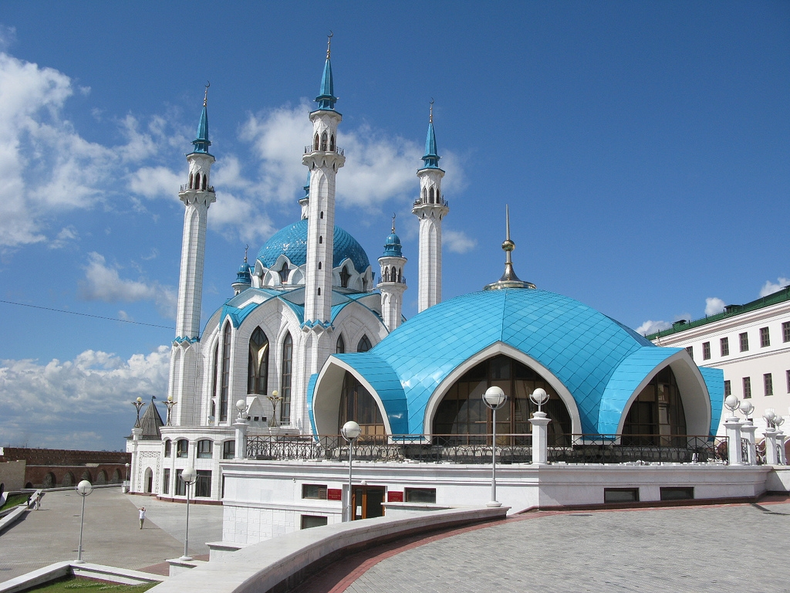
GLOBALIZATION

Slide 16
The History of Moscow’s Urban Development

Slide 17
Moscow’s Urban Development
Notes:
1572

Slide 18
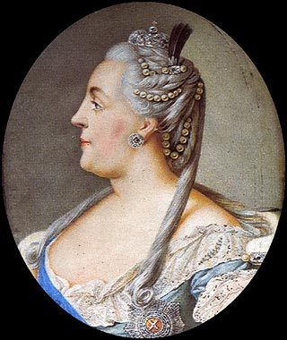
Moscow’s Urban Development

Slide 19
Moscow’s Urban Development
Notes:
1836, http://historic-cities.huji.ac.il/russia/moscow/moscow.html

Slide 21
Moscow’s urban development

Slide 22
Moscow’s urban development

Slide 23
Moscow’s urban Development

Slide 24
Moscow’s urban Development

Slide 25
Moscow’s urban Development
Characteristic City Forms
Outdated industry in the center city
“No-go” zones in the central city
Large apartment blocks in rings on the city outskirts
Low-quality housing
Parks and greenspace
Outdoor retail space
Characteristic City Planning Methods
Insufficient resources, lag in services
Secrecy and insufficient coordination
Dominance of certain “priority” sectors
Consistent underestimation of population size
Little efficacy

Slide 26
Moscow-City (Москва-Сити)

Slide 27
Moscow-City

Slide 28
Moscow-City

Slide 29
Moscow-City

Slide 30
Moscow-City
Notes:
http://www.google.com/imgres?num=10&hl=en&biw=1440&bih=714&tbm=isch&tbnid=qBKN78sq5BULwM:&imgrefurl=http://www.juggle.com/moscow&imgurl=http://cf.juggle-images.com/fit/white/600x600/wg-moscow-5.jpg&w=600&h=450&ei=zdxIUJOiDIKu8ATg6ICYDA&zoom=1&iact=hc&vpx=652&vpy=202&dur=1344&hovh=194&hovw=259&tx=116&ty=101&sig=111948373941666055507&sqi=2&page=1&tbnh=154&tbnw=193&start=0&ndsp=20&ved=1t:429,r:3,s:0,i:83

Slide 31
Moscow-City

Slide 32
Moscow-City

Slide 33
Moscow-City

Slide 34
Moscow-City

Slide 36
CONCLUSIONS

Slide 37
Conclusions
Is the urban form of post-Soviet Moscow converging with the urban form of cities in the West and around the world?
Yes, due to privatization and globalization, Moscow’s urban form is becoming more like the urban form of established capitalist cities.
Are Russian planning process and institutions becoming more similar to the ones used in America?
In some cases, like the Moscow City Development, yes, but not uniformly and not for the average Russian city planner.

Slide 38
I’m ready for Questions.

