Slide 1
SPRAWL REPAIR
Auburn - Alabama
Quito - Ecuador
Juan Diego Donoso T.

Slide 2
First, before I start
a little bit of my background
  Where I come from?
  How I lived before coming to USA?
  Quito was founded by the Spaniards based on the the Law of Indies code, nowadays it has an Americanized culture (car dependence).
  The result of this mixture is me.
  Auburn
  The quality of life of a human being can’t depend on a machine.

Slide 3
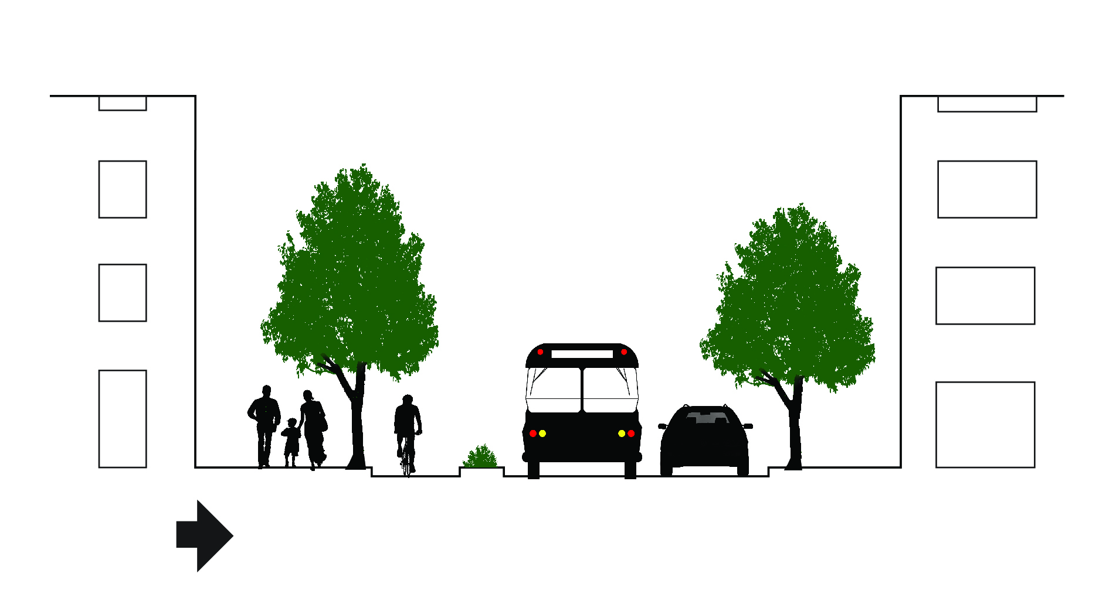
Urban priority

Slide 4
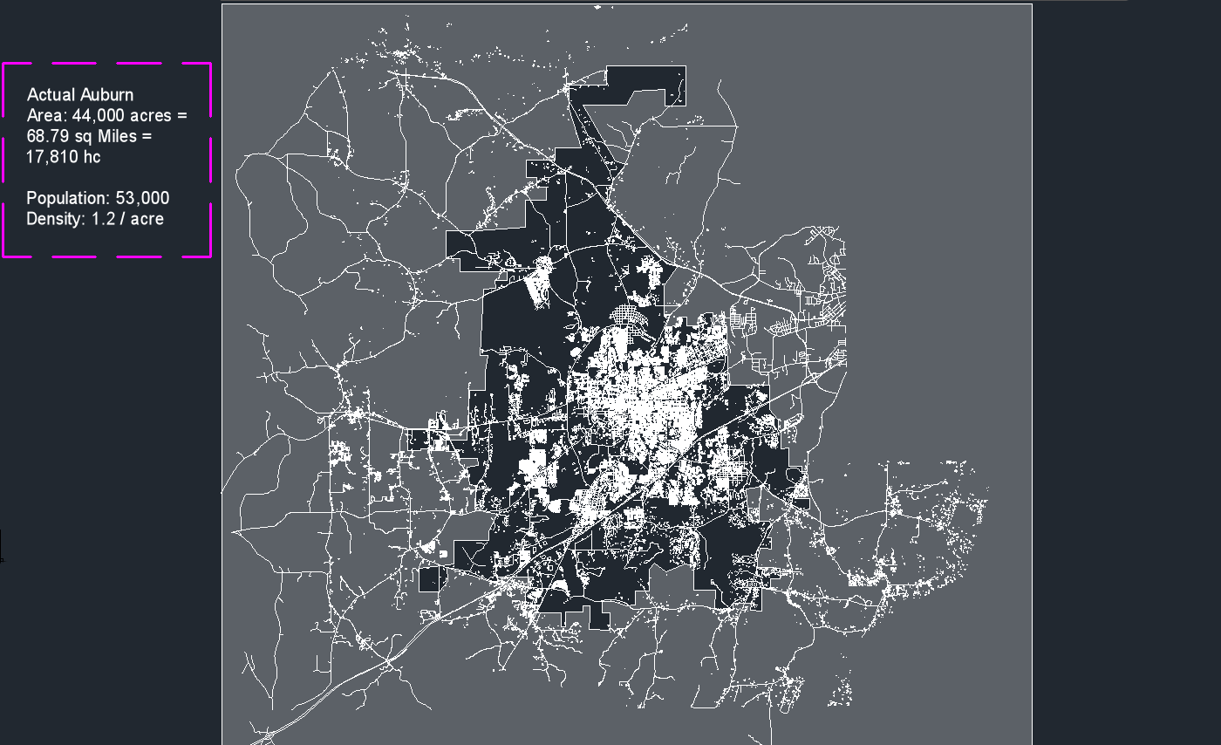
Auburn - Alabama

Slide 5
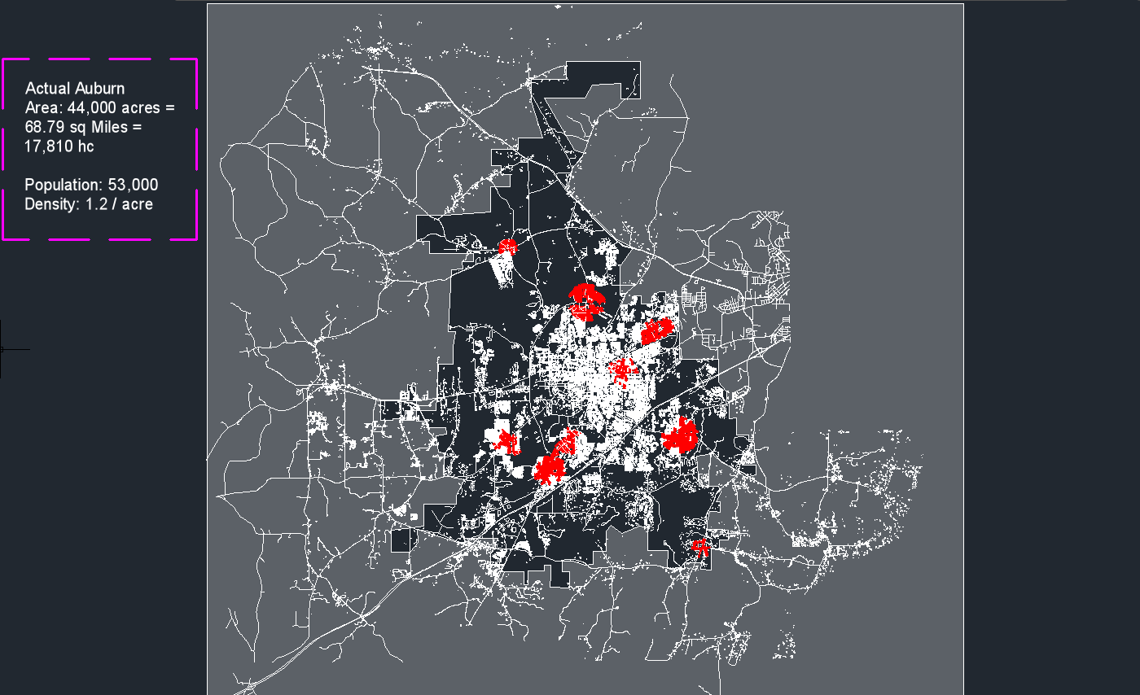
Auburn - Alabama

Slide 6
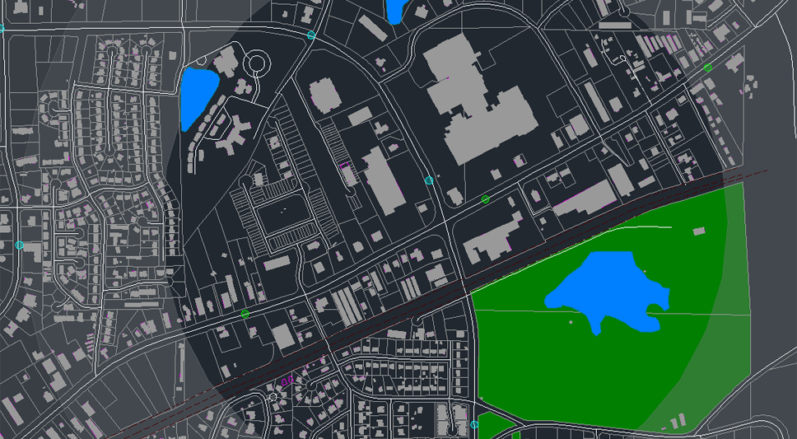
Mall zone, actual conditions

Slide 7
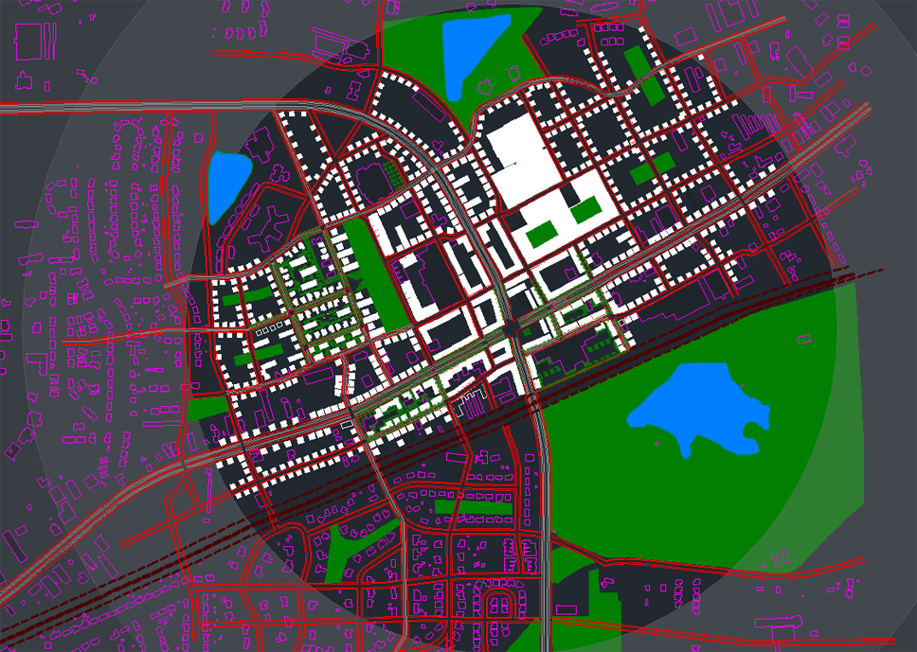
Proposed mall zone area

Slide 8
City scale

Slide 9
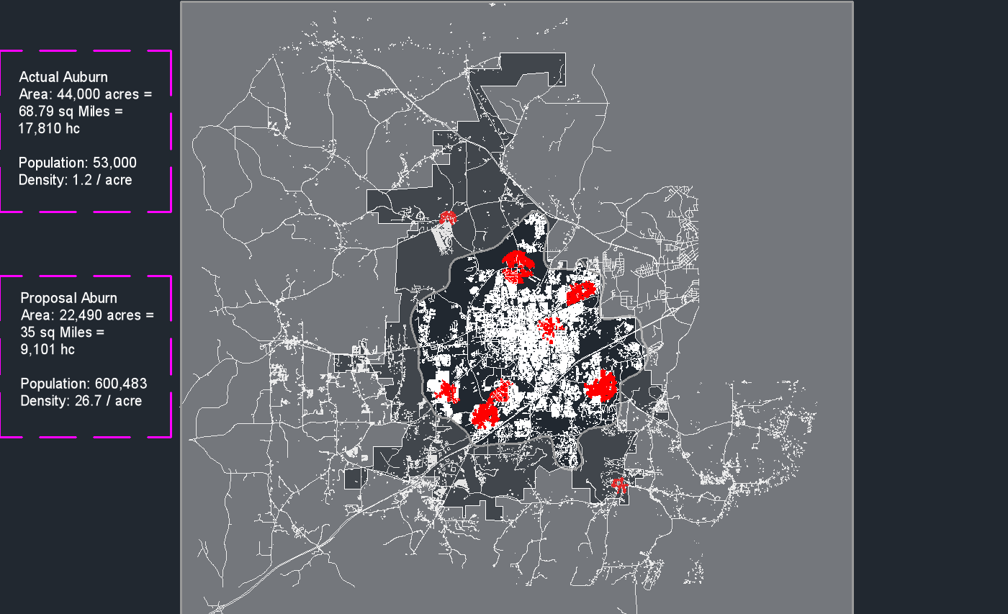
Urban growth boundary

Slide 10


Slide 11
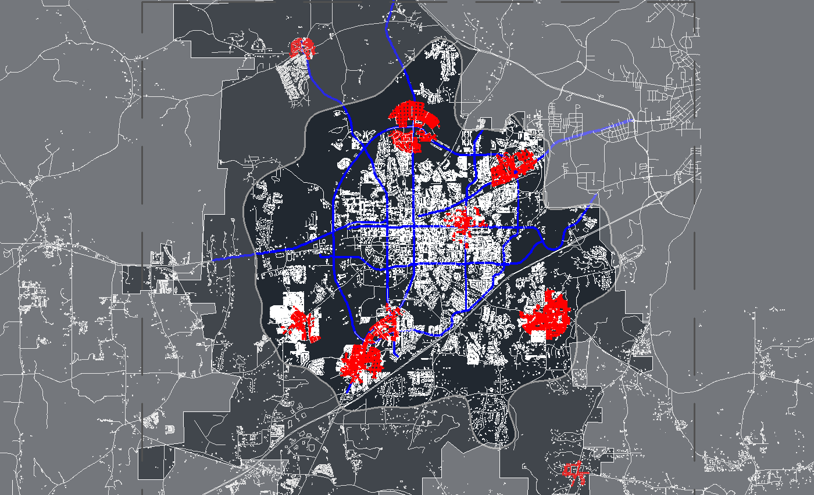

Slide 12
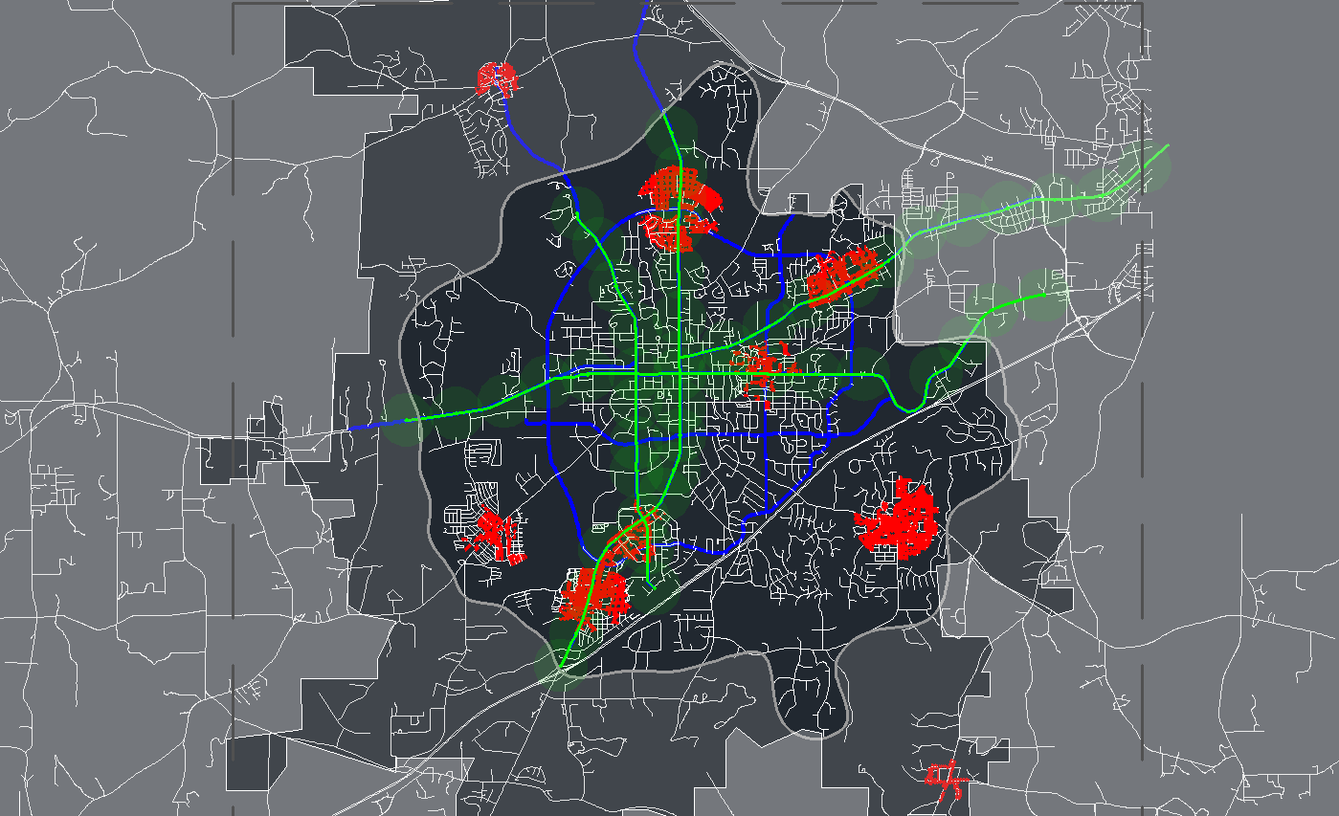
Main corridors

Slide 13
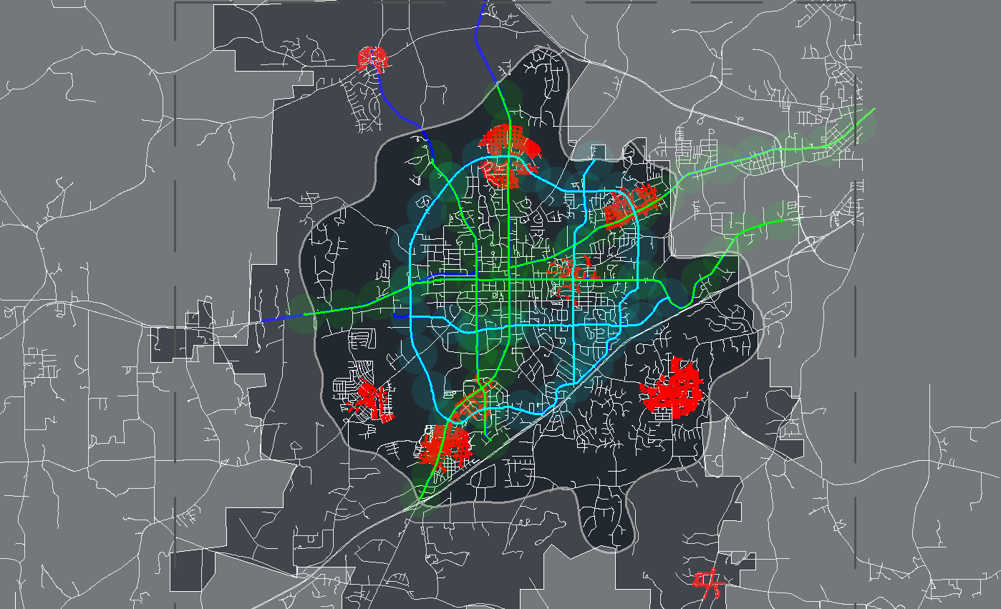
Secondary system

Slide 14
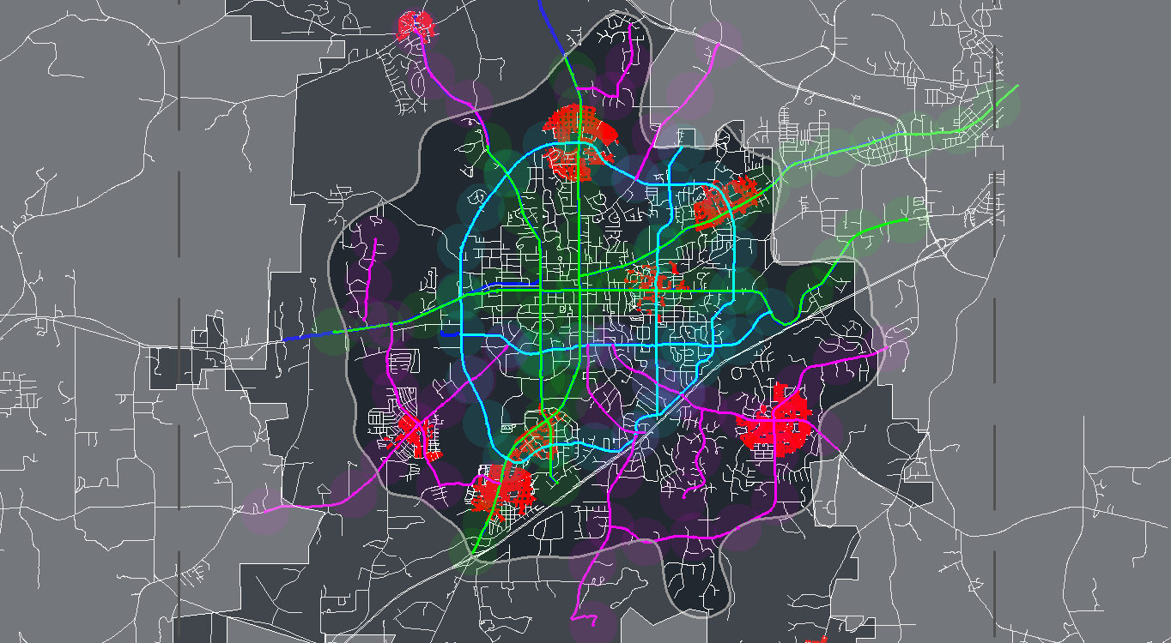
Third system, collector

Slide 15
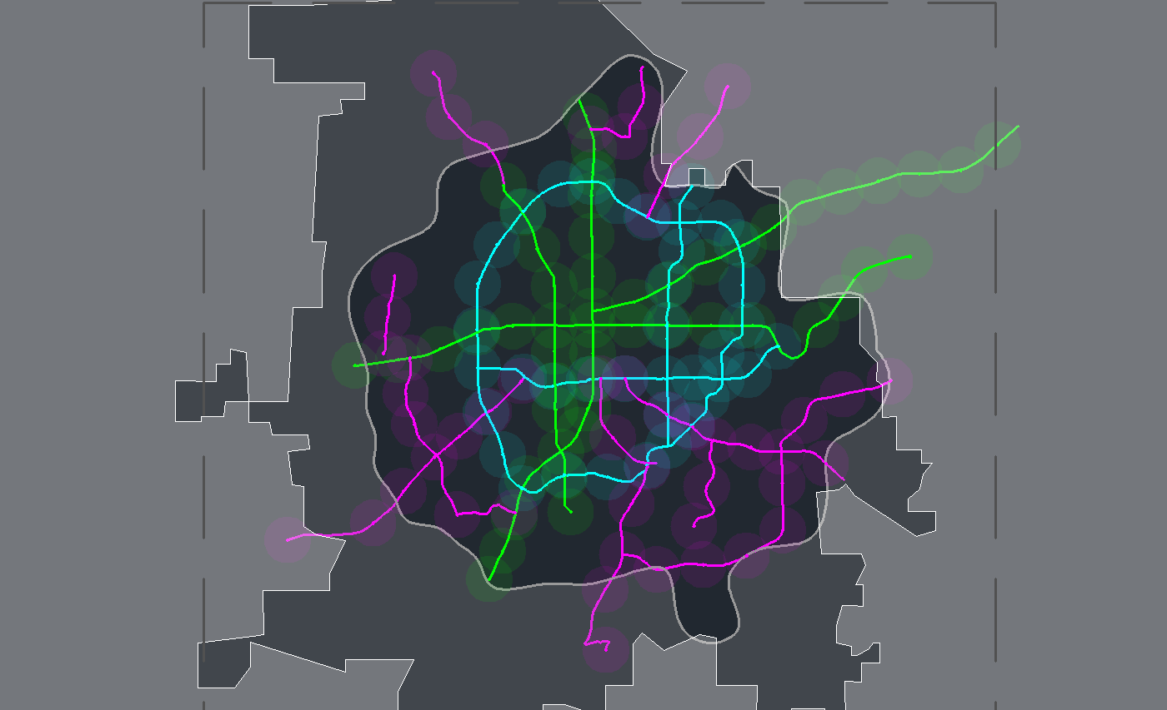
5 minute walk to a bus or BRT station

Slide 16
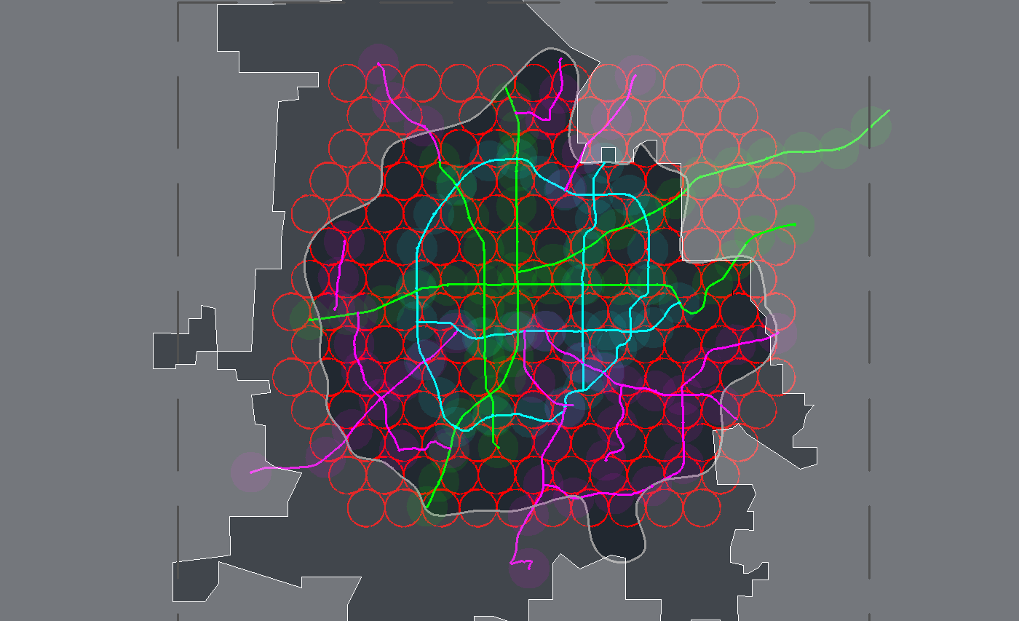
10 minute walk grid

Slide 17
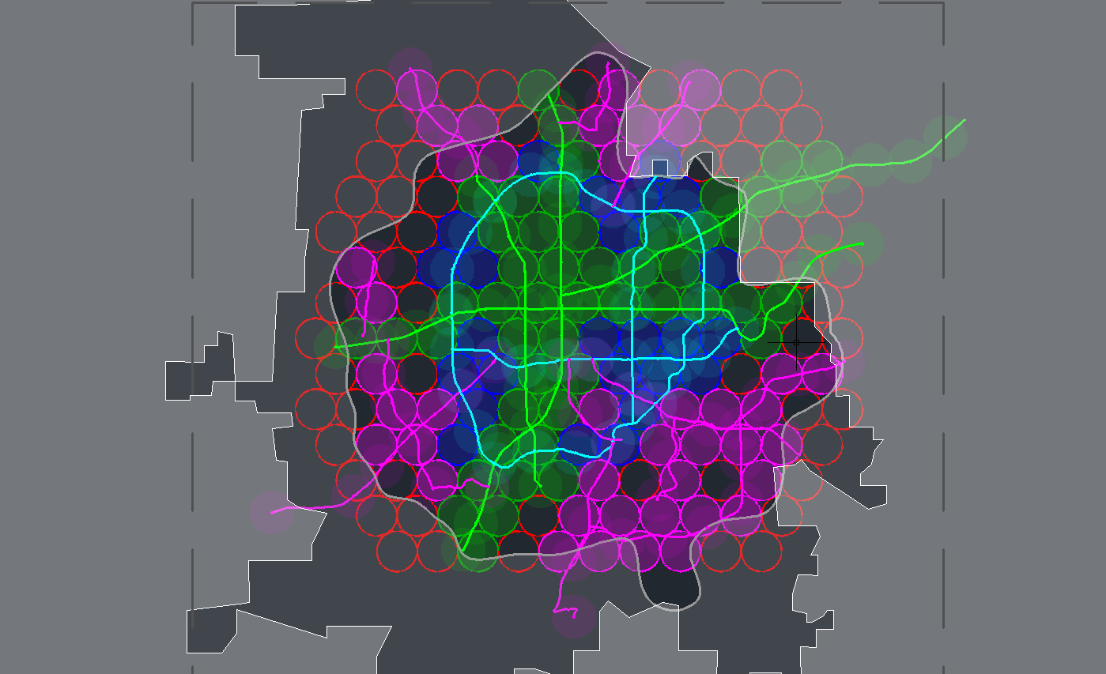
10 minute walk to a station

Slide 18
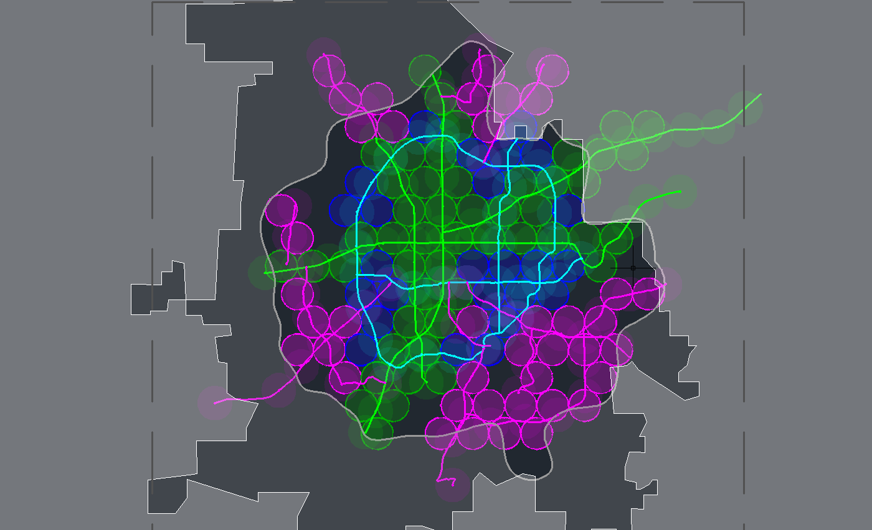
10 minute walk to a station

Slide 19
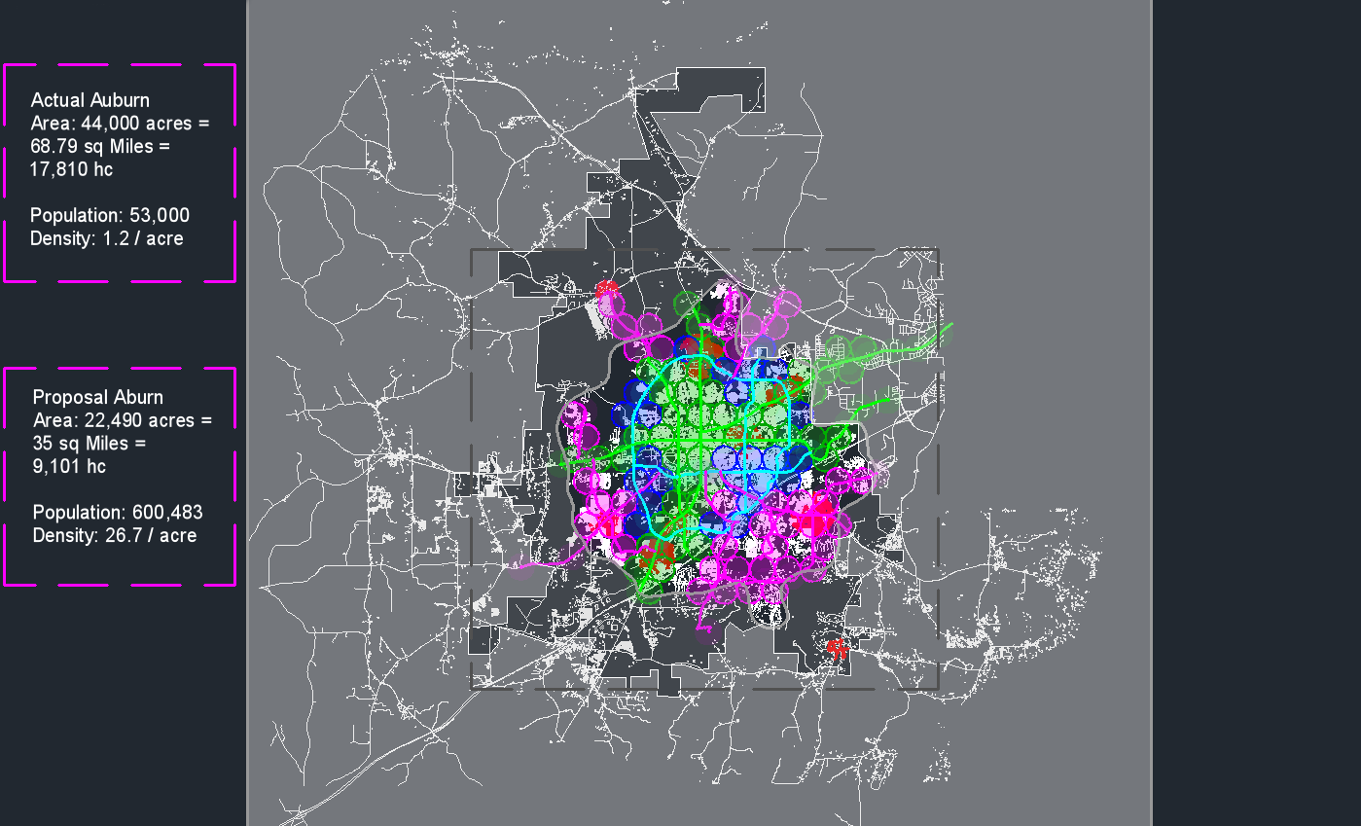
Auburn sprawl repair, city scale

Slide 20
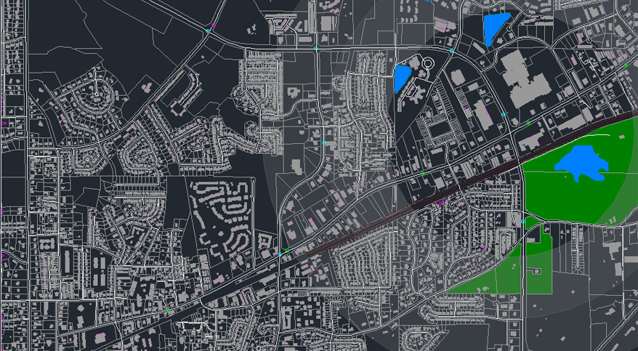
Half mile ratio

Slide 21
Mall zone area

Slide 22
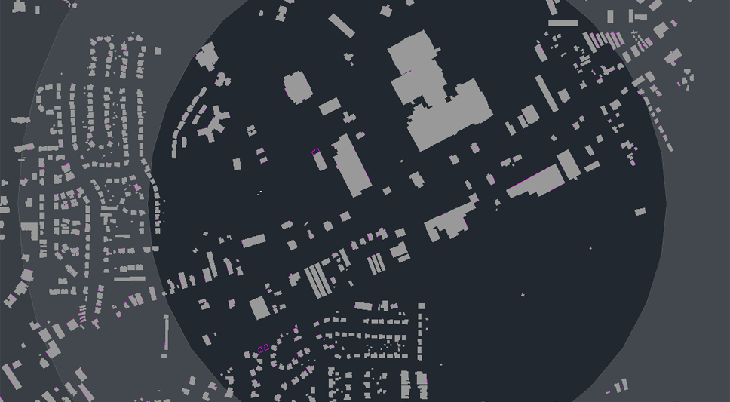
Figure ground

Slide 23
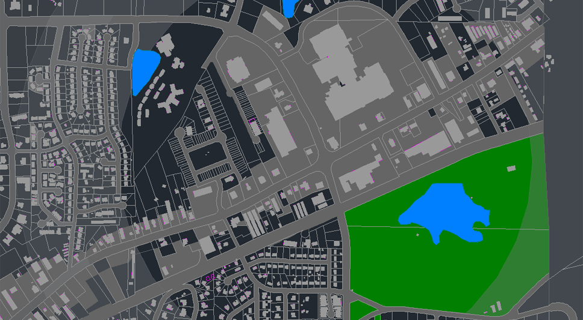
Void analysis

Slide 24
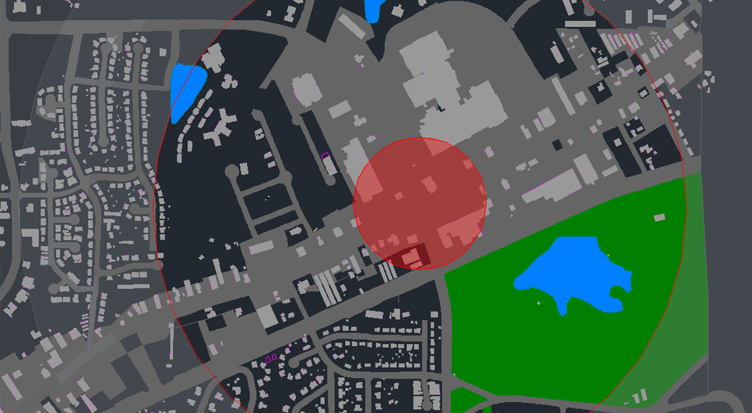
Important node, and possible community center

Slide 25
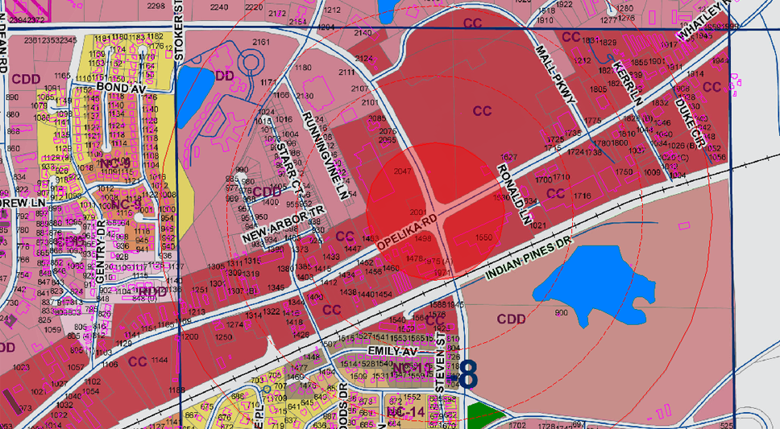
Actual land use

Slide 26
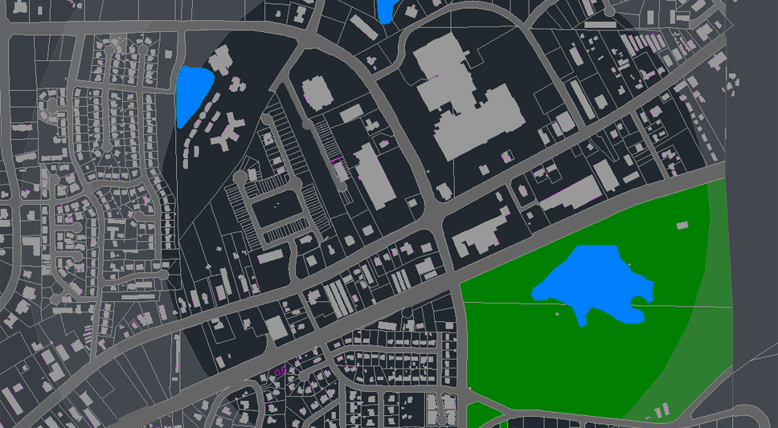

Slide 27
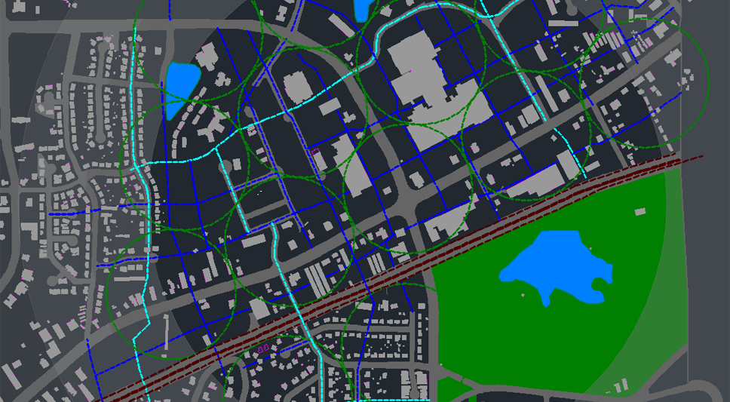
Connectivity and park system (blue and light blue layout)

Slide 28
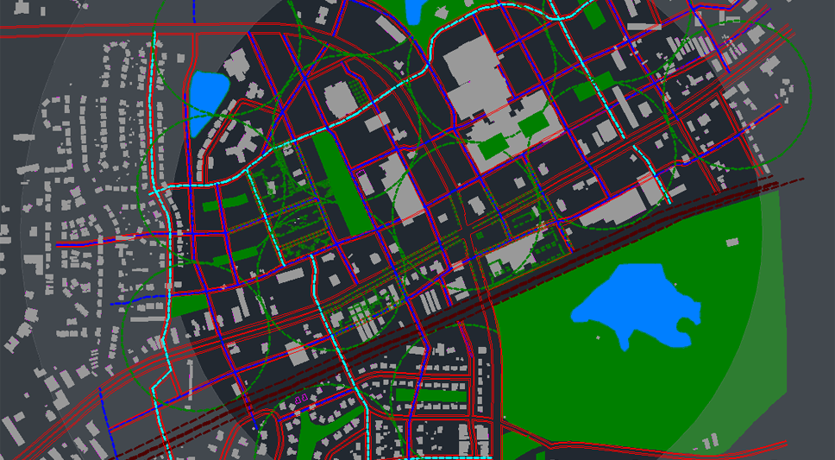
Connectivity and park system

Slide 29
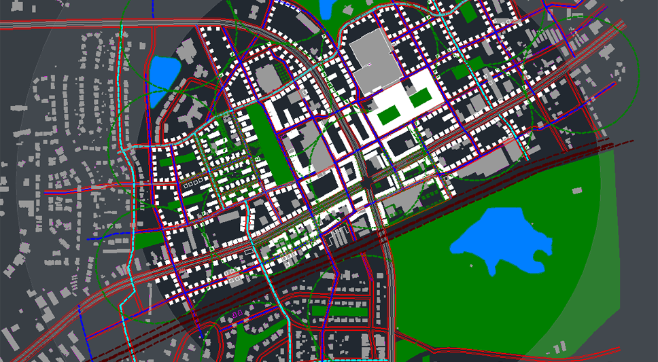
Old and new buildings, building defining the blocks

Slide 30
Final community scale repair

Slide 31

New figure ground

Slide 32
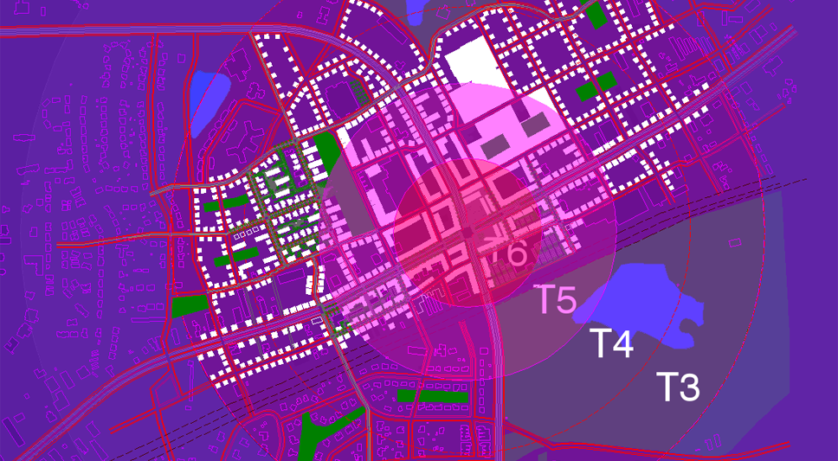
New land use code

Slide 33
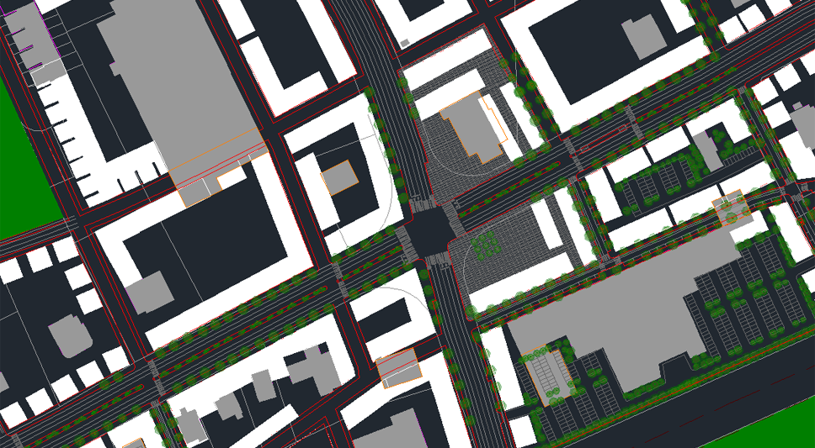
Center, old and new layout

Slide 34
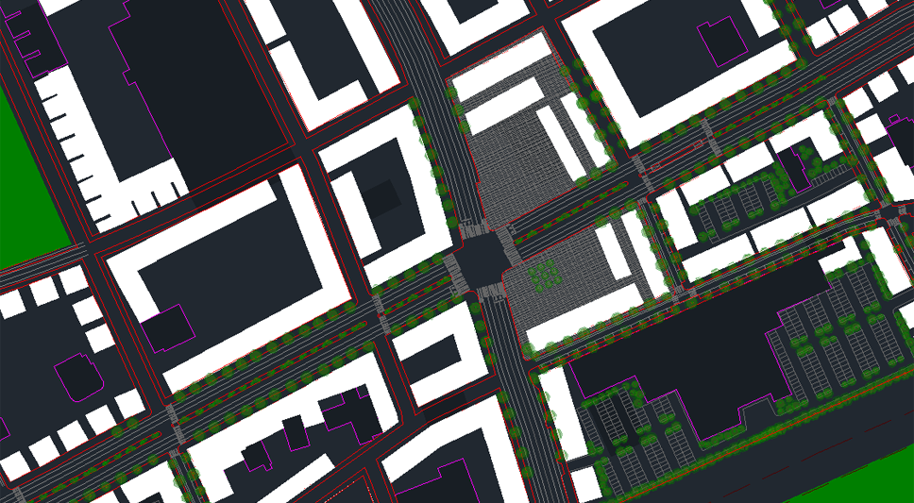
New layout

Slide 35
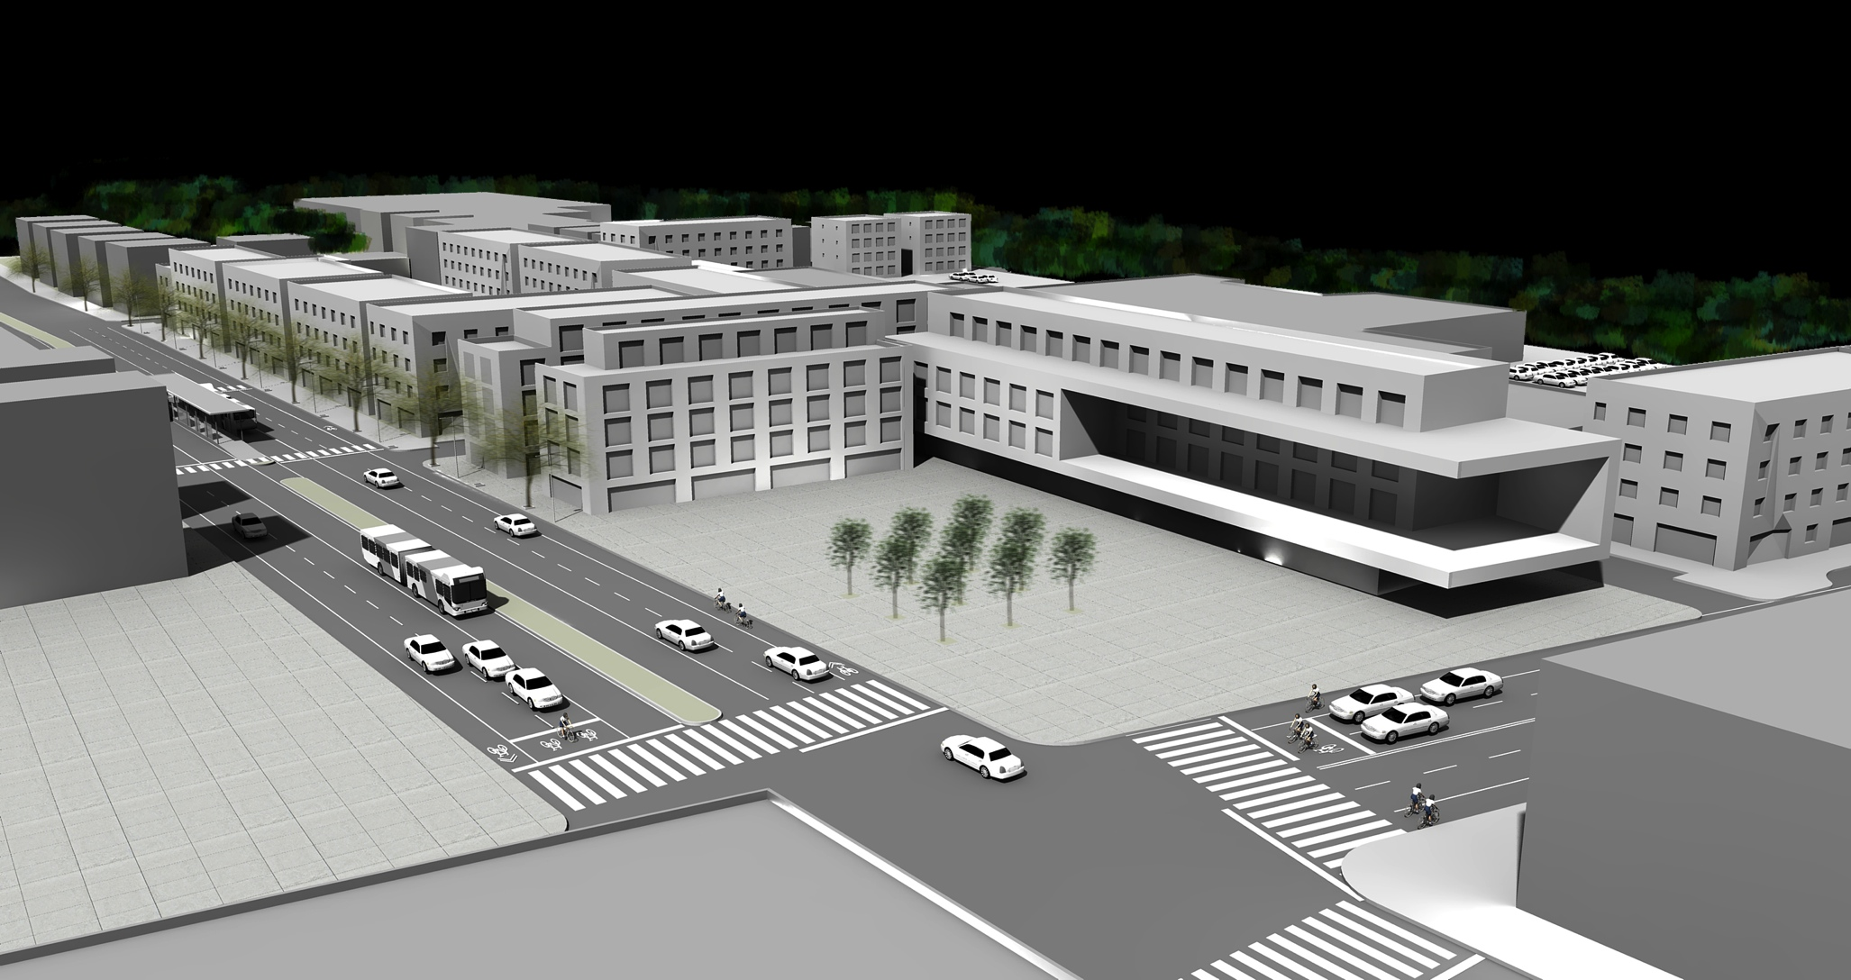
Plaza

Slide 36
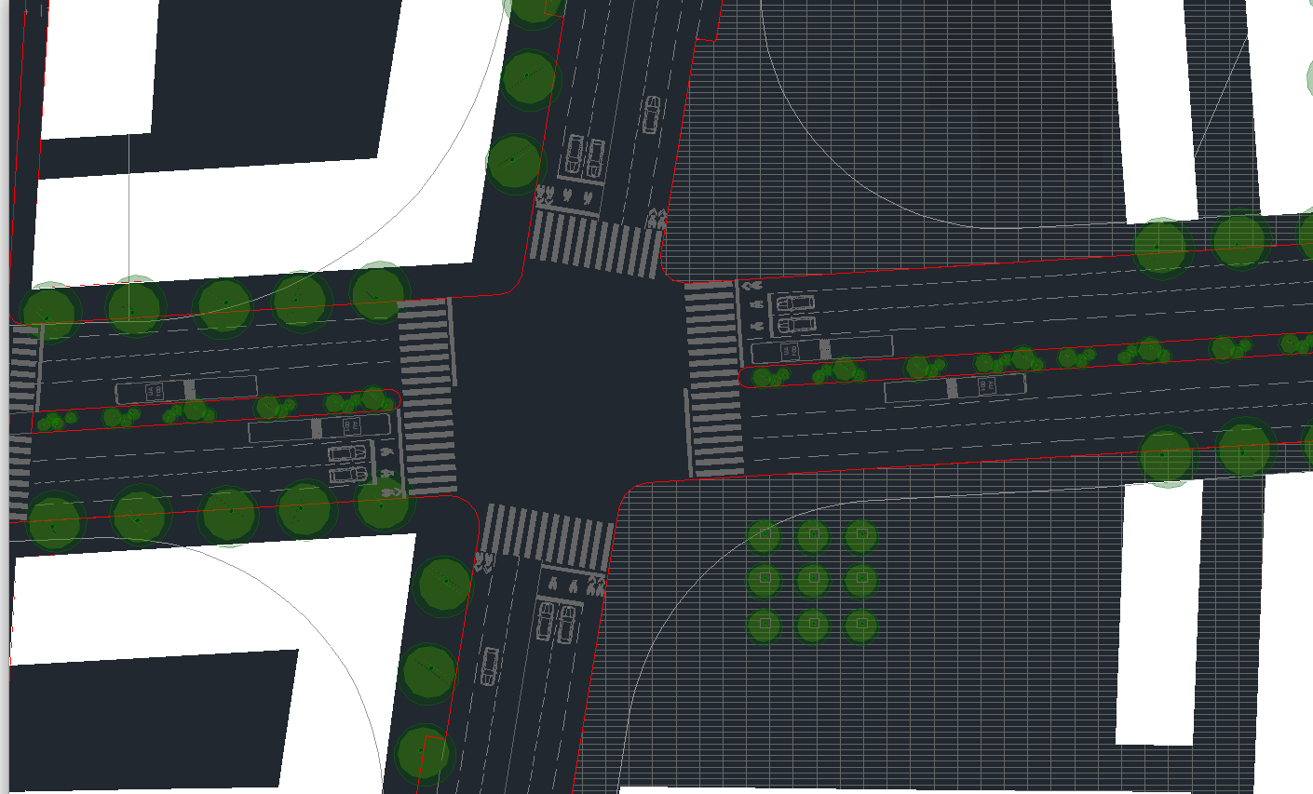
Street diet and layouts

Slide 37
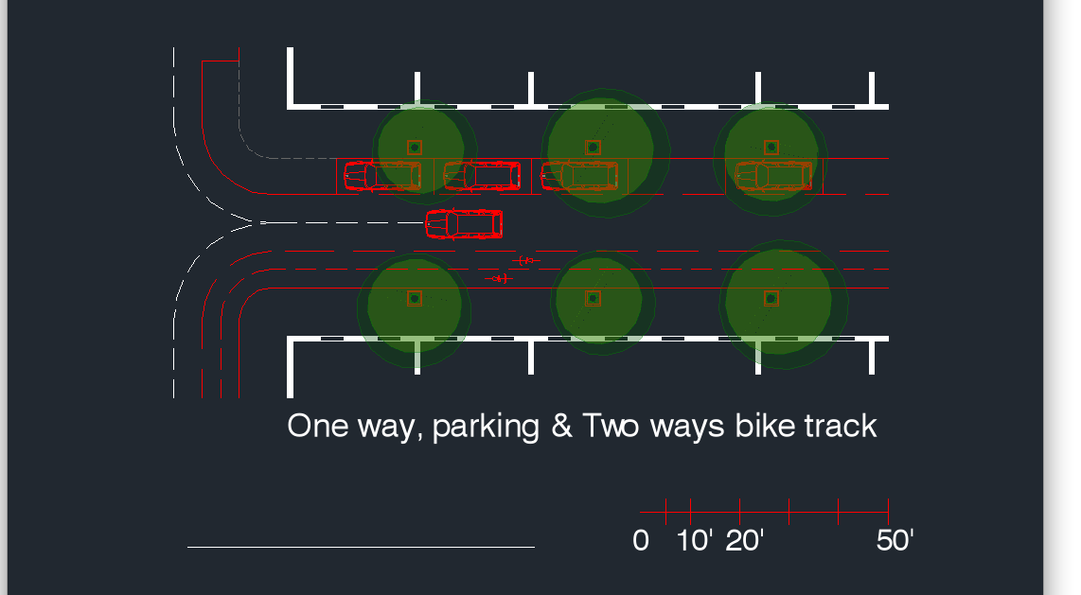
New streets (blue)

Slide 38
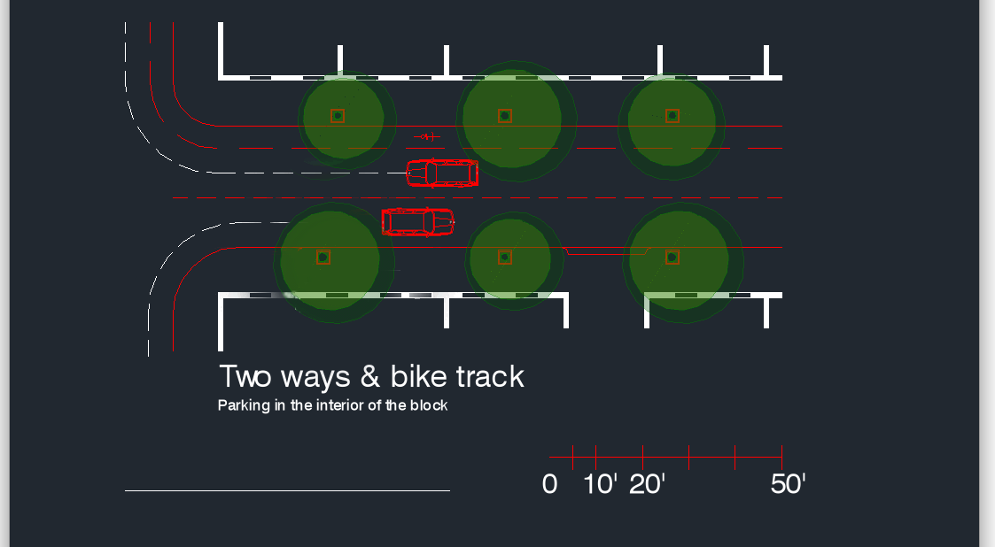
New streets (blue)

Slide 39
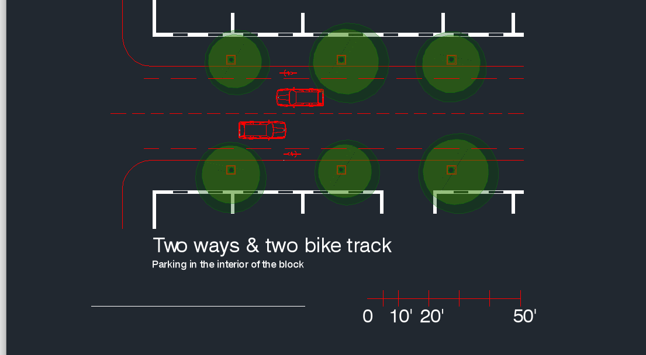
New streets (light blue)

Slide 40
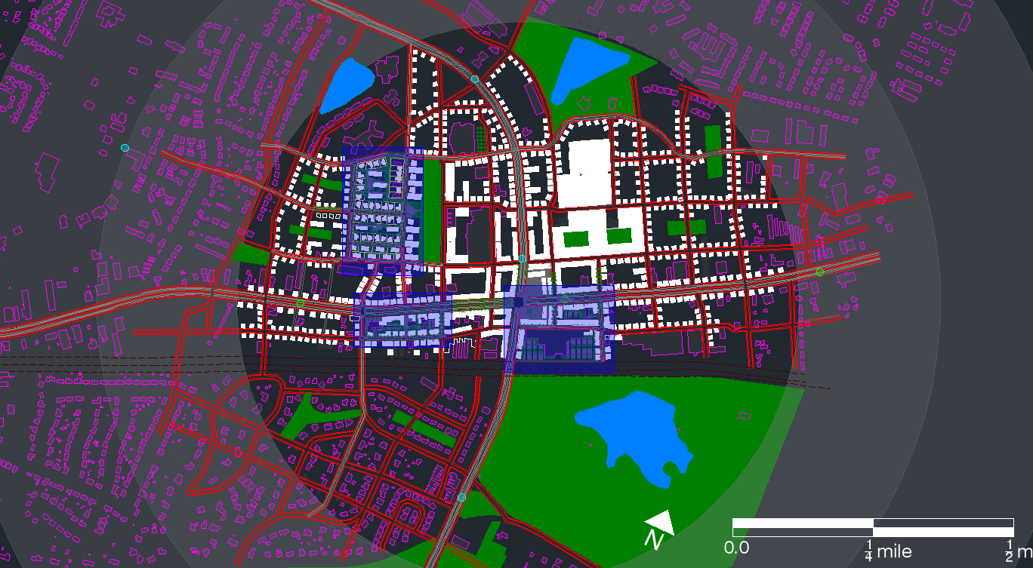
Block scale: A, b, c.
A
b
c

Slide 41
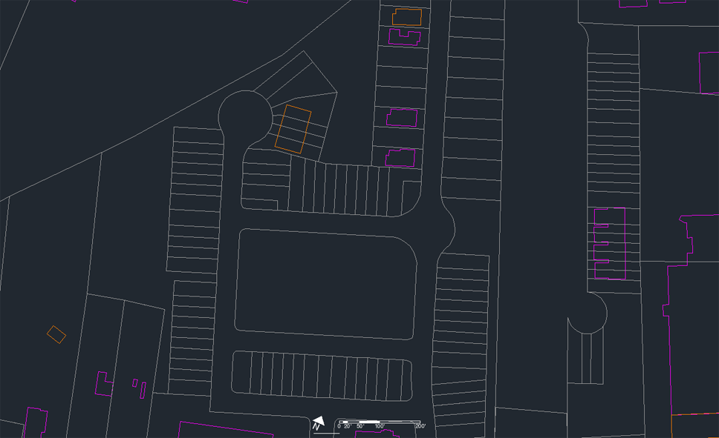
Block A, actual conditions

Slide 42
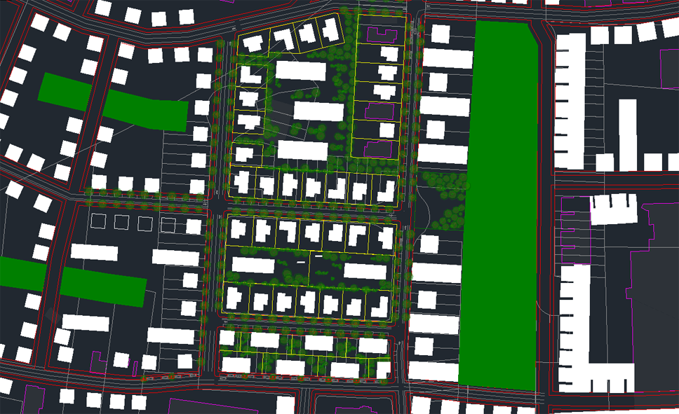
Actual and proposed

Slide 43
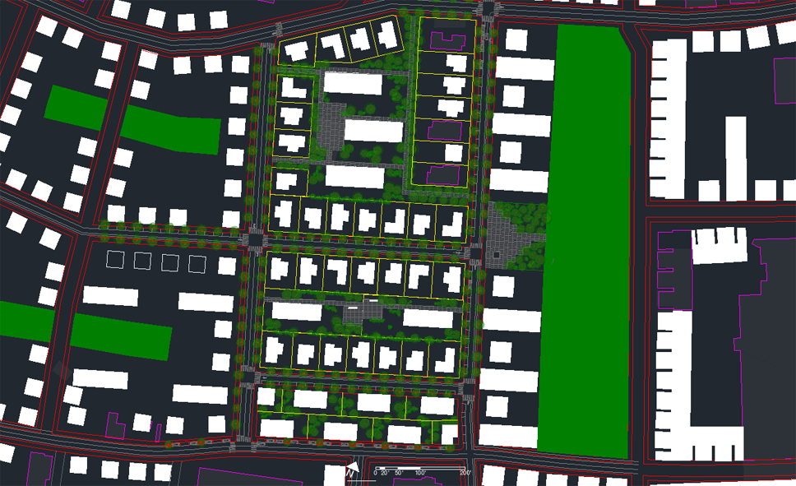
Proposed

Slide 44
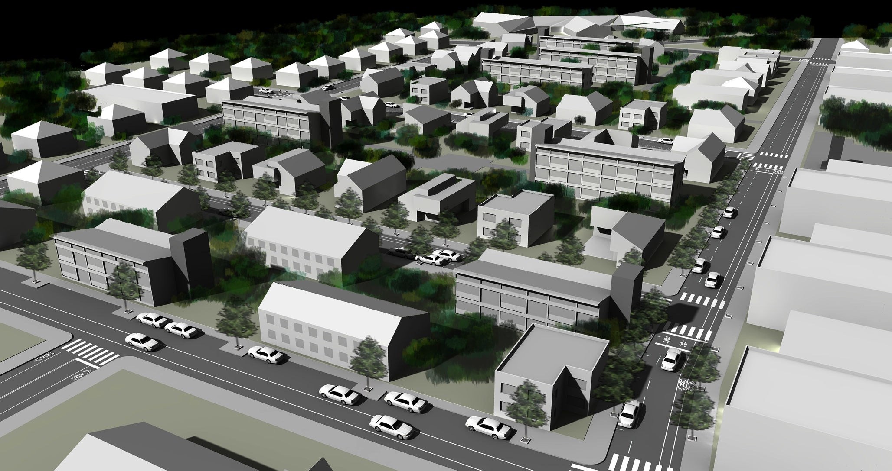
South east bird view

Slide 45
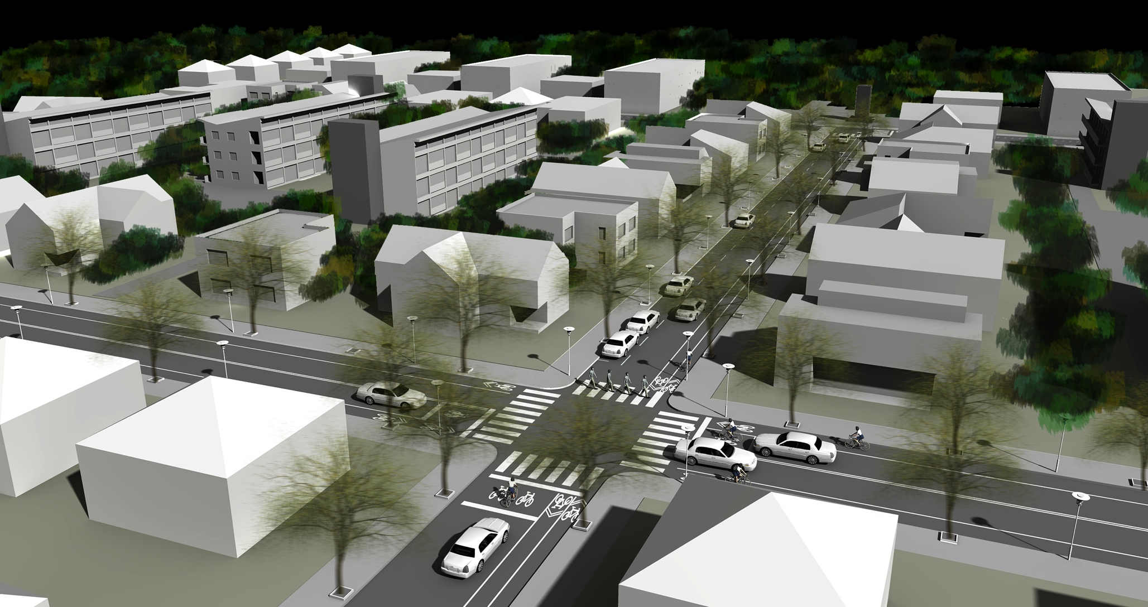
West view

Slide 46
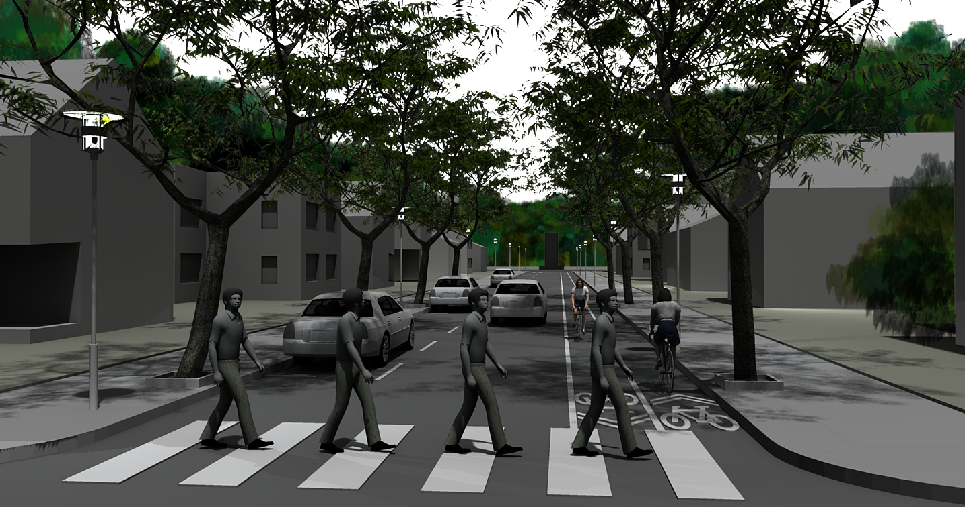
Blue layout street

Slide 47
Block scale: a, B, c.
a
B
c

Slide 48
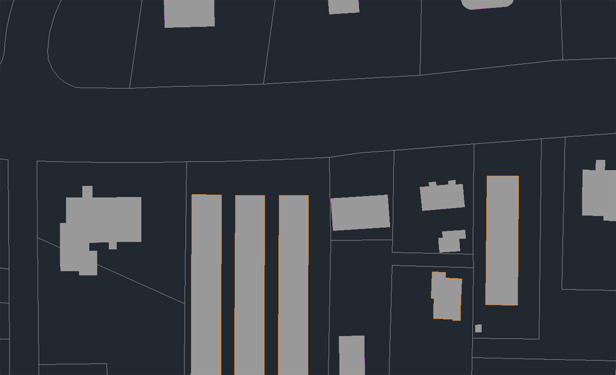
Original stage block B

Slide 49
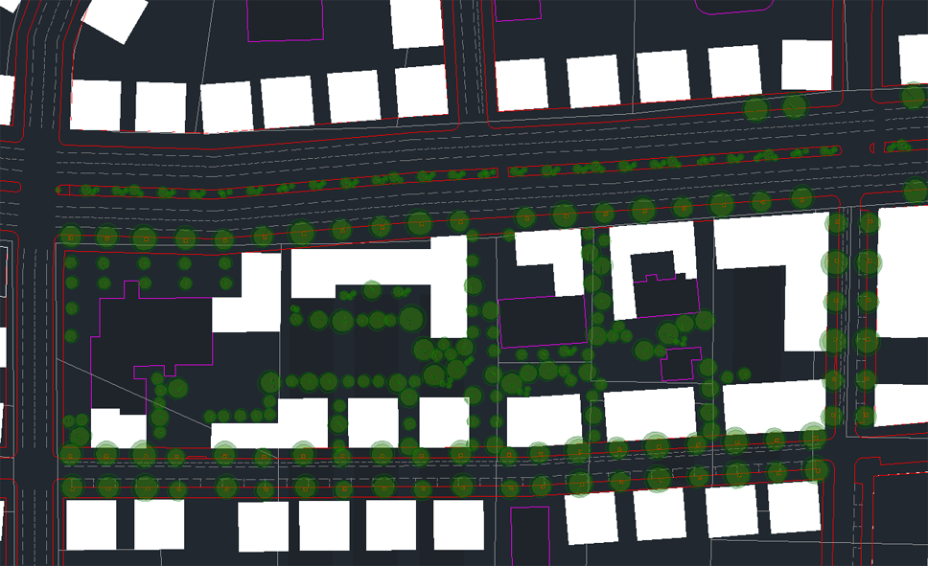
Proposed block

Slide 50
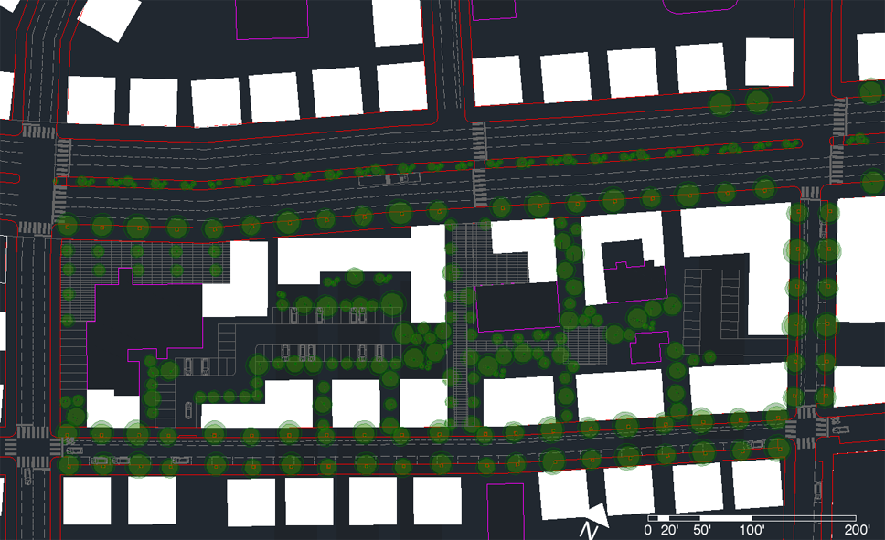
Proposed block

Slide 51
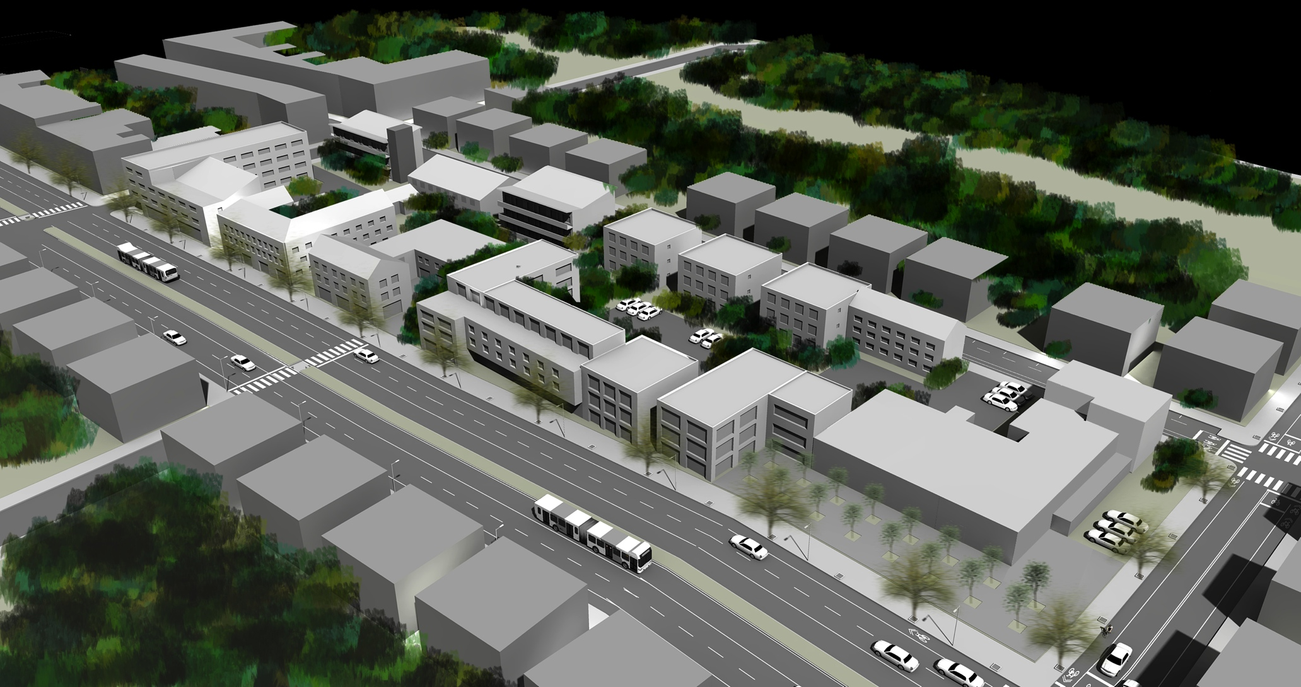
Opelika road view

Slide 52
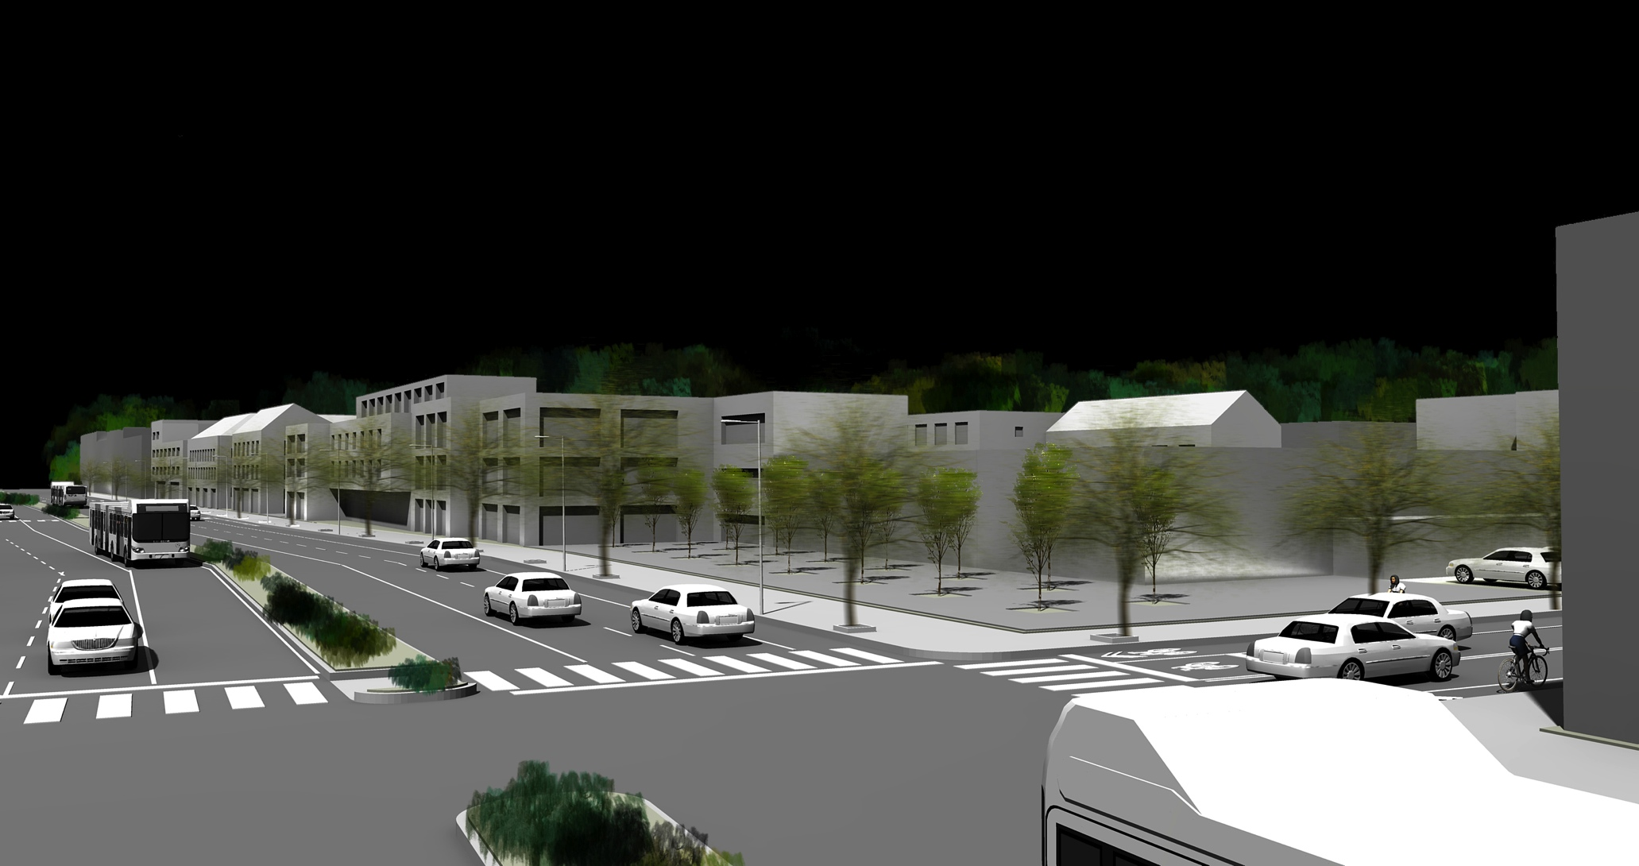
Opelika rd. BRT corridor

Slide 53
Block scale: a, b, C.
a
b
C

Slide 54
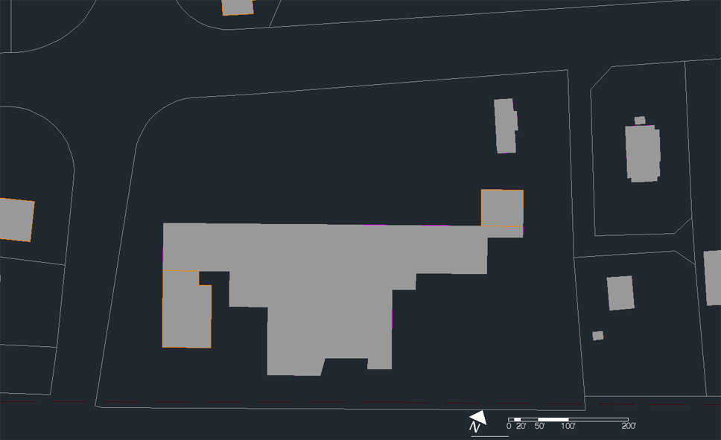
Actual conditions block C, earth fare market

Slide 55
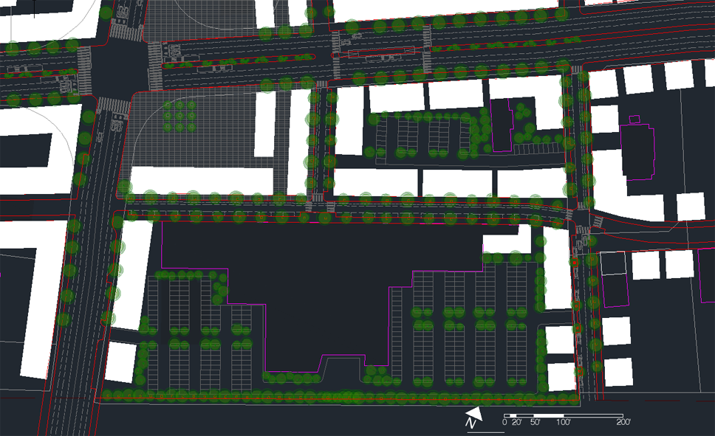
Proposed conditions

Slide 57
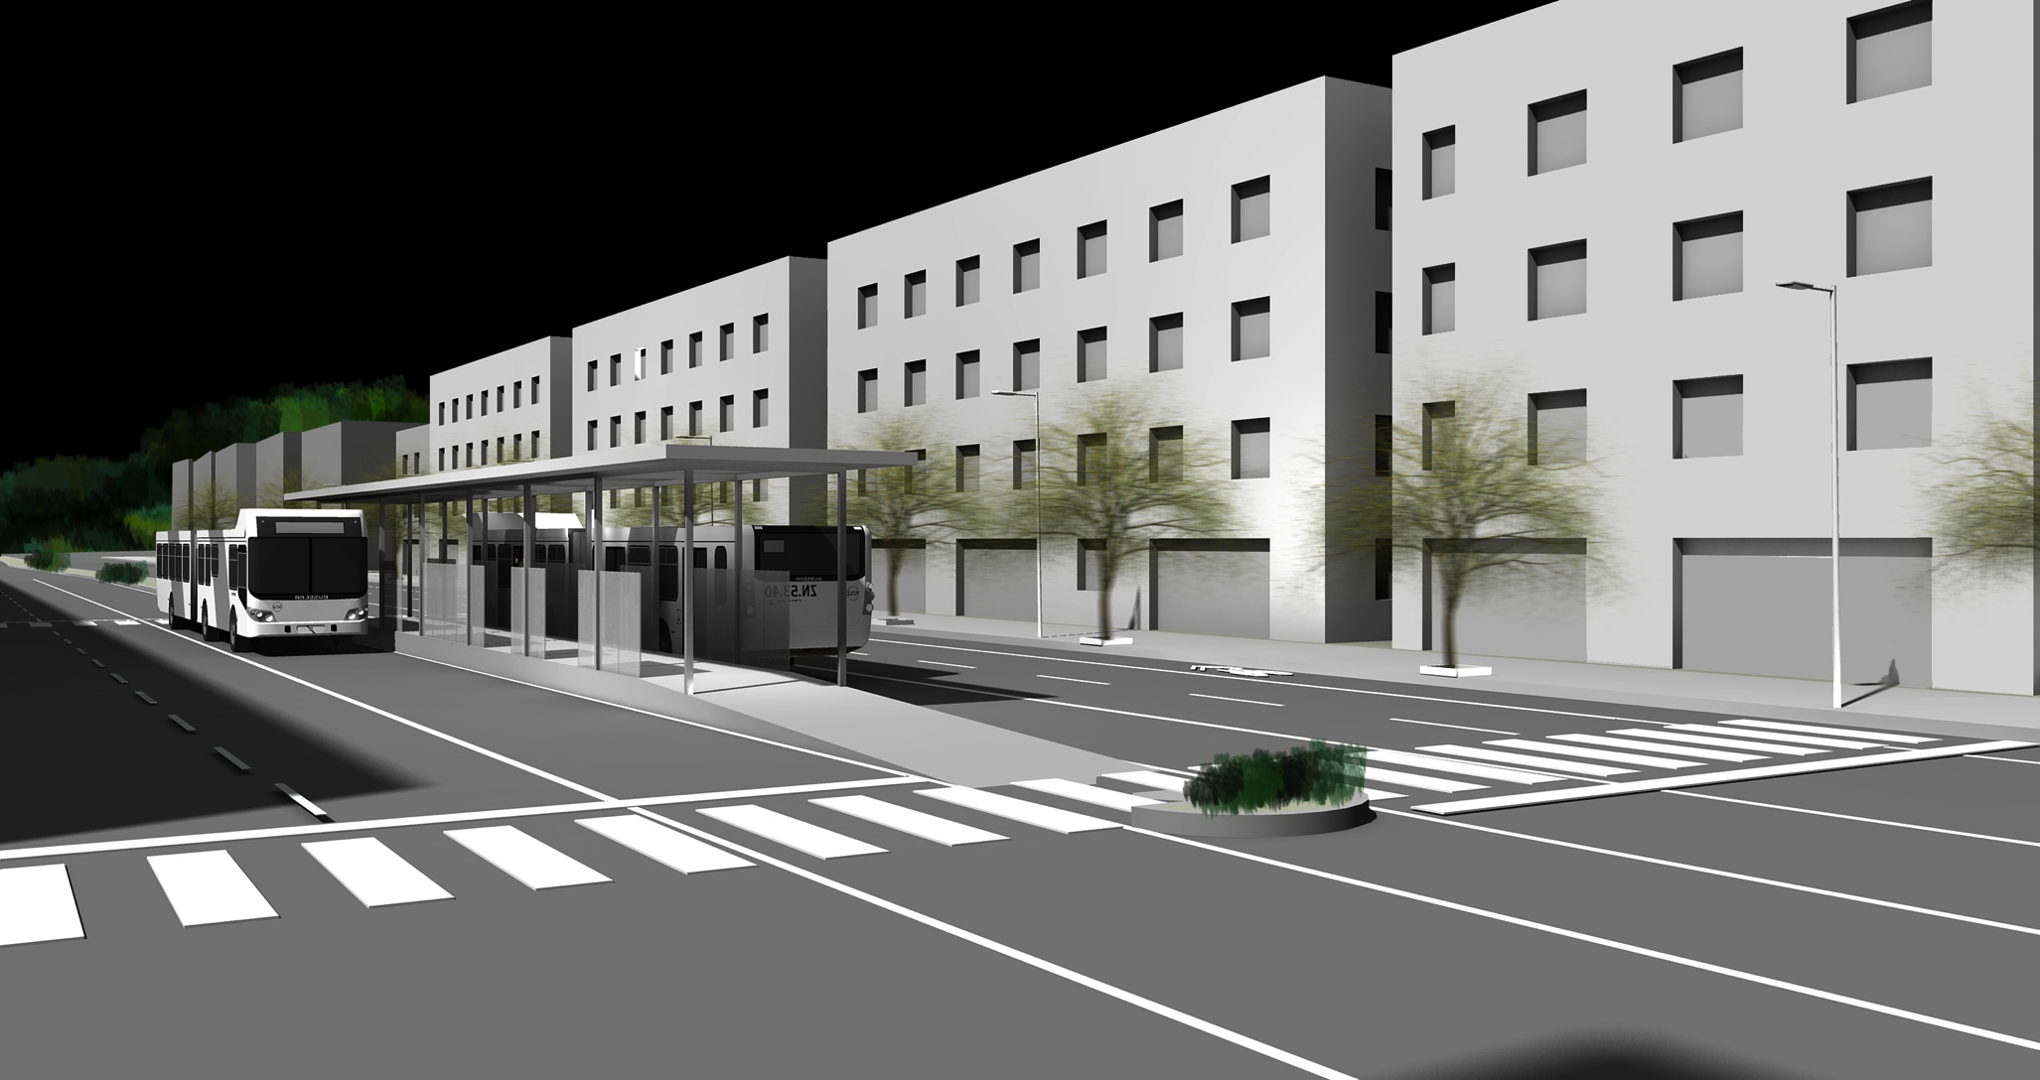

Slide 58
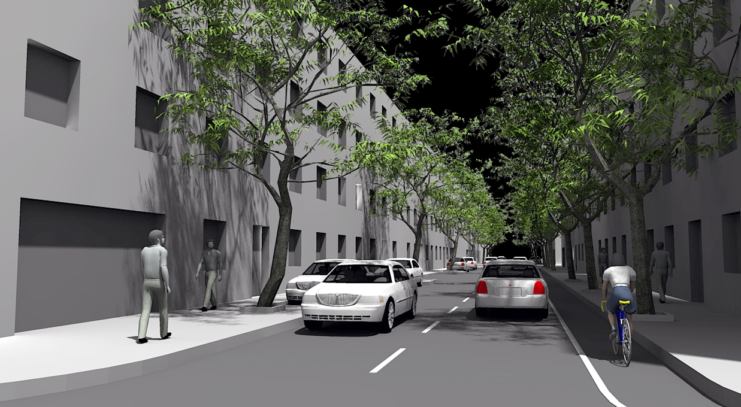

Slide 59
Thank you bibliography:
Duany, Andres, Jeff Speck, and Mike Lydon. The Smart Growth Manual. 1st ed. McGraw-Hill Professional, 2009. Print.
Hilberseimer, Ludwig. The New City: Principles of Planning. Chicago: P. Theobald, 1944. Print.
Jacobs, Jane. The Death and Life of Great American Cities. Vintage, 1992. Print.
Krier, Leon. The Architecture of Community. Island Press, 2011. Print.
Tachieva, Galina. Sprawl Repair Manual. Island Press, 2010. Print.
Whyte, William H. The Social Life of Small Urban Spaces. Project for Public Spaces Inc, 2001. Print.

Slide 61
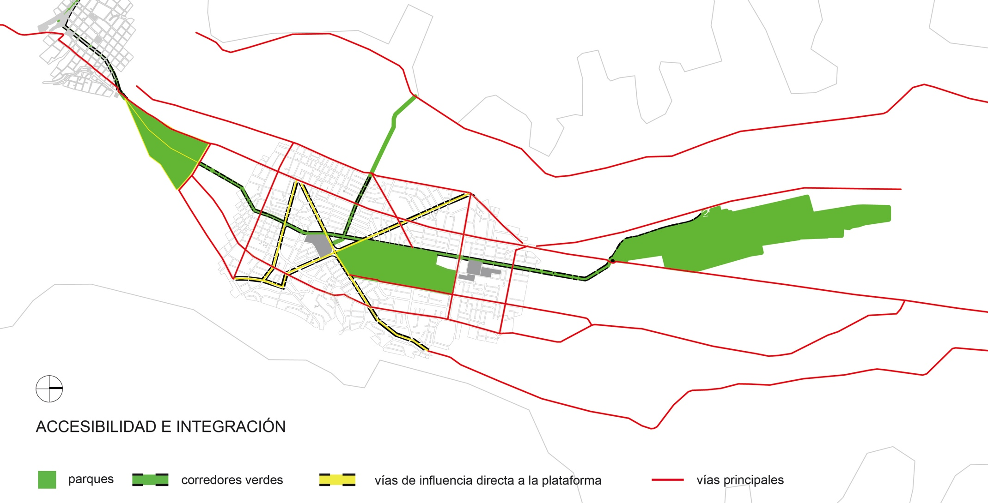

Slide 62
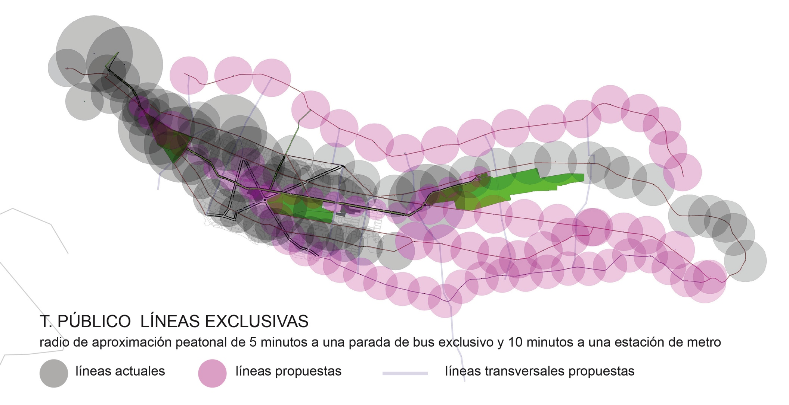

Slide 63


Slide 64


Slide 65


Slide 66


Slide 67


Slide 68


Slide 69


Slide 70


Slide 71


Slide 72


Slide 73


