Slide 1
Planning for Green Infrastructure: Finance and Implementation
Becki Retzlaff, AICP
Auburn University
Notes:
Hi. My name is becki Retzlaff, and I work at Auburn university in their community planning program.
I am going to talk about implementing and financing green infrastructure plans

Slide 2
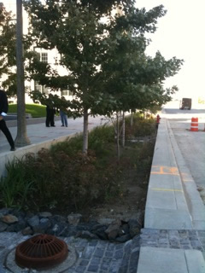
Presentation Outline
Financing green infrastructure
Public funding
Private funding
Market incentives
Innovative implementation
Little River Watershed
Notes:
So this is the outlone for my talk today.
1. First I am going to talk about methods that are used to finance green infrastructure plans. - Three primary ways are typically used:
- the expenditure of public funds
- tapping in to private funding
- and economic incentives
2. In the second part of my talk, I will do a case study of a city that has done a good job of implementing their green infrastructure plan through innovative measures.
- The case study that I am using here is in Alabama, by the Top of Alabma Regional Council of Governments, in the little river wateshed

Slide 3
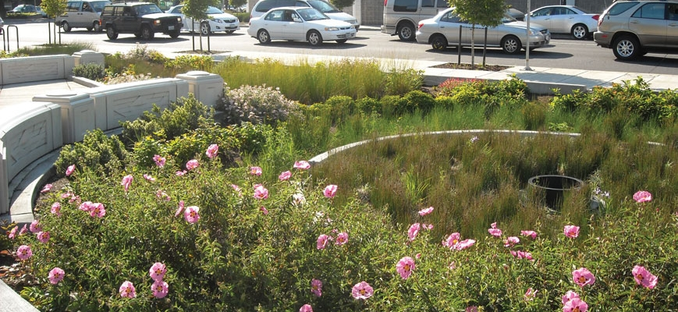
How do we pay for green infrastructure?
Public resources
Private funding
Market incentives
Notes:
SO to begin, I want to look at the ways that we typically use to pay for implementation of green infrastructure plans.
There are many methods, most of which fall into one of these three categories.
First, there are techniques that are aimed at expanding and creating new public resources.
Next, there are techniques that use private funding, such as funding from individuals, foundations, and different types of private incentives.
Finally, there are techniques that use market incentives to pay for green infrastructure

Slide 4
Public Resources
Taxes and fees
New sources of revenue
Special districts
Bonds
Tax increment financing
State revolving loan funds
Notes:
So for the category of using public resources to pay for green infrastructure.
A lot of cities are also looking at ways to broaden their resource base, and create new bases of public funding for green infrastructure.
because relying on just one or just a few methods is getting more and more difficult.
It is pretty common for green infrastructure plans to be funded, at least in part, by general funds.
Taxes, and fees are also used. Taxes can include:
Real estate transfer taxes
Park taxes
Hotel/motel taxes
Water bills
Park usage fees (for park activities or rentals)
Aside from those methods that are very commonly used, some places create new sources of revenue, through things like:
Reallocate storm water and sewer fees based on contributions to runoff.
Development exactions
Transportation exactions
“one percent for Art” except use it for green infrastructure instead of traditional art.
Easements (cheaper than purchasing outright green space)
Utilization of existing park-like amenities such as golf courses
Fees such as licensing fees and permit fees
Partnerships such as vendor advertising space.
Also, the creation of special districts have bee used by some to implement green infrastructure programs.
This includes things like Business improvement districts
Another failly common method of financing is general obligation bonds, and revenue bonds,
And also more innovative alternative, such as:
Tax increment financing, although it is unclear to me if TIF is ever used in Alabama.
A potential untapped source of funding for green infrastructure is also the clean water and drinking water state revolving loan funds, which administer grants from the EPA. I do note that bioswales green roofs, land conservation, and permeable pavements, are all eligible uses for the state revolving loan funds.

Slide 5
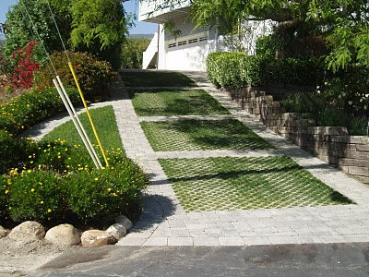
Private Resources
Grants
Programs
Notes:
there are always grants. This includes earmarks and competitive funding. If it can’t be used for the purchase of land, maybe it can be used for planning.
Programs that include things like education and technical assistance have proven to be helpful at getting private landowners to help make their own green infrastructure improvements.

Slide 6
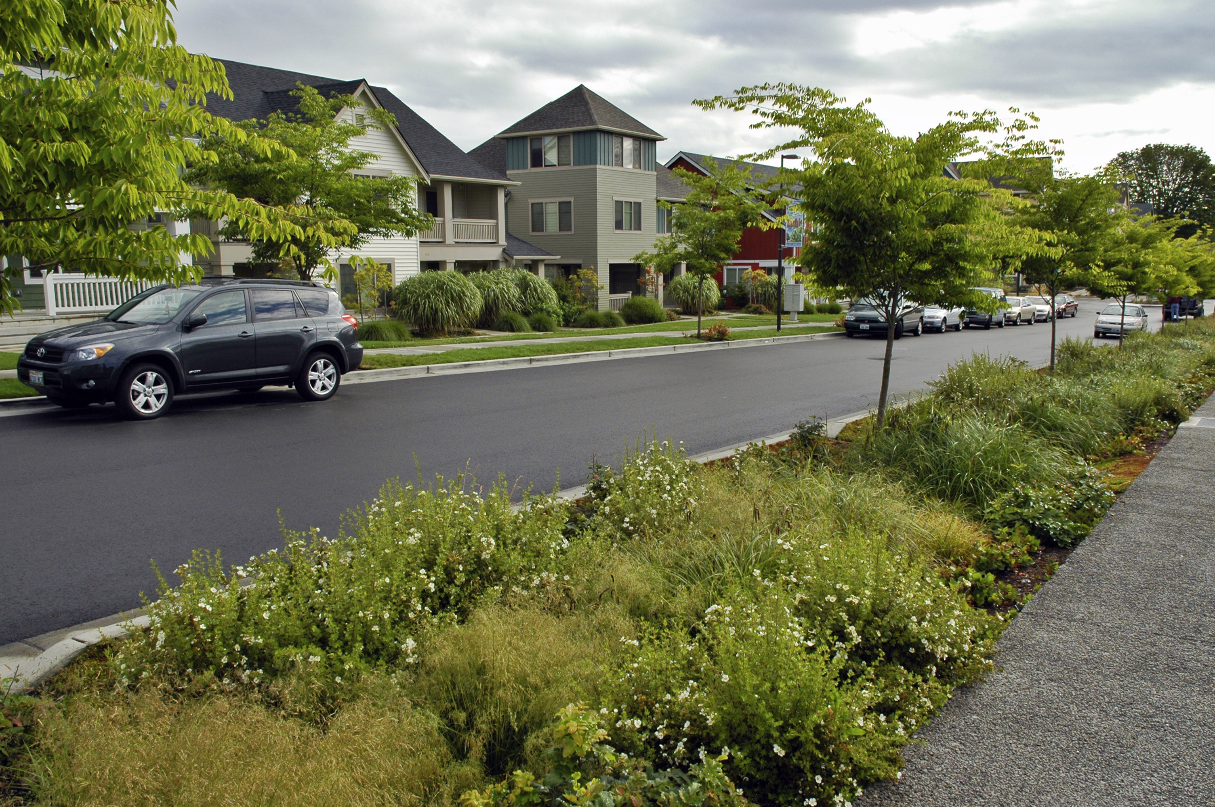
Market Incentives
Taxing authority
Regulations
Fees
Notes:
Finally, there are methods for tapping into private funds through market incentives.
As you know, many cities in Alabama are using their power to abate taxes for economic development, but we can also use it for green infrastructure improvements.
We can also require green infrastructure improvements as a condition for receiving tax incentives. But there is really nothing too new about that.
Another way to spur private investment in green infrastructure is to change zoning and subdivision codes to require it.
These can be things like bonuses (“green factor bonuses”)
Also requirements or optional improvements (like allowing the option of cluster development, as my hometown of Auburn does, or even requiring it).
Also, changing fee structures for things like utilities and water fees to incentivize green infrastructure improvement, can help.

Slide 7
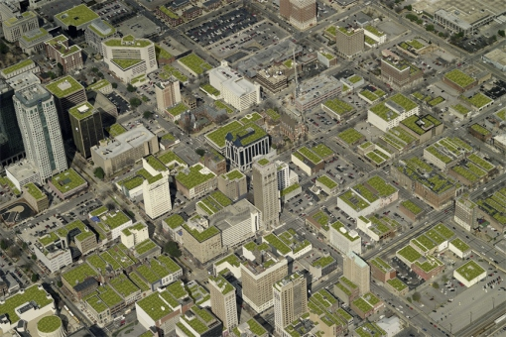
Implementing Green Infrastructure
Notes:
So a lot of this is already being done in Alabama, but some places are not as comprehensive in how hey are approaching green infrastructure financing and implementation.
And in fact, many places are doing it in absence of a proper green infrastructure plan.
For example, ADEM has used state drinking water revolving loan funds for green infrastructure projects.
In fact they list it specifically as a desired funding objective.
And of Course Charlene’s work with Mobile’s green streets is one more example.
This is a picture that I found online that somebody named Brian Phelps made showing what Birmingham would look like if the buildings had green roofs.

Slide 8
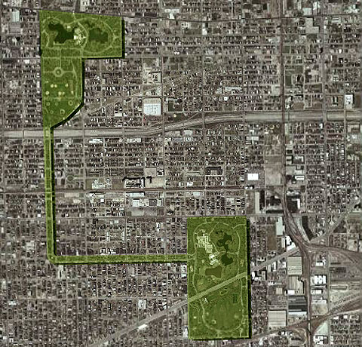
Notes:
So when I was researching cities that were doing innovative green infrastructure planning, a lot of the usual suspects came up – Chicago, Portland, Montgomery county, MD, etc…
But when you look at a lot of those plans – they are amazing and very forward thinking – but much of their implementation relies on just general expenditure of public funds to purchase greenways and parks.
I was curious what types of tools are out there to implement green infrastructure that may not rely on the expenditure of public funds.
And I was curious about who was doing it.

Slide 9
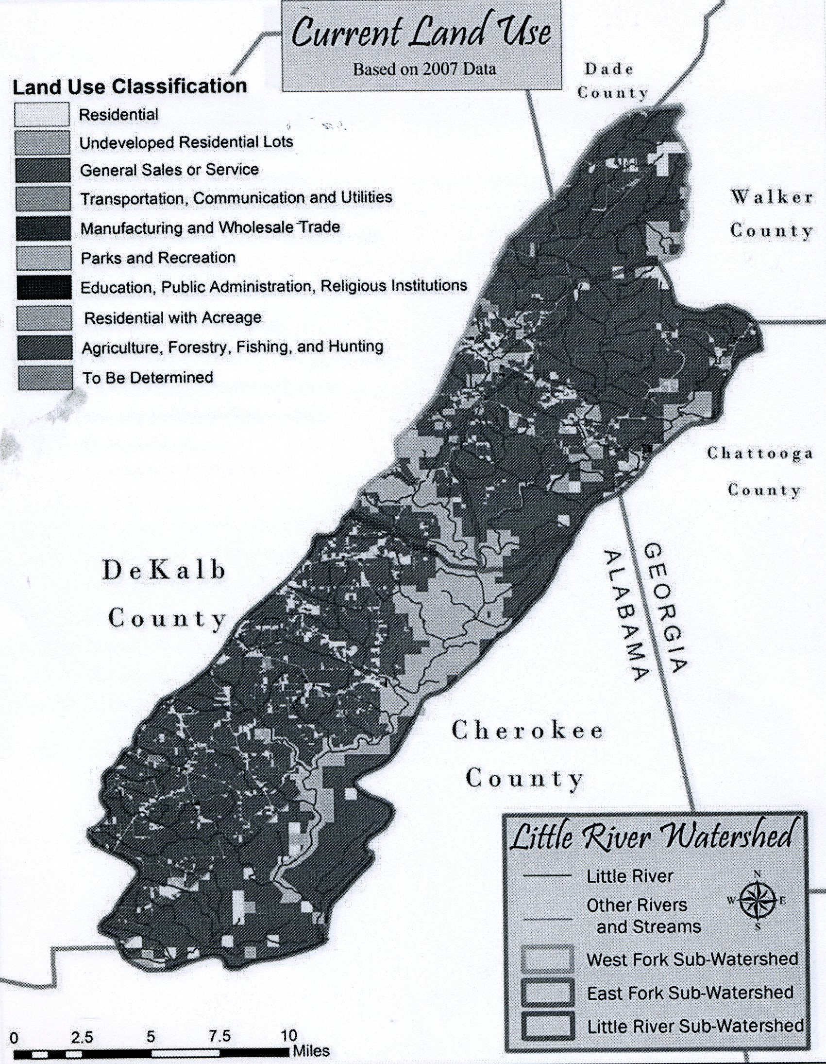
Case Study: Little River Watershed
Notes:
The little river watershed is in the northeasten part of coosa watershed in northern alabama
- the headwaters are in Dade, Walker, and Chattooga counties in georgia.
- the water flows to the southwest into Alabama, and finally into Weiss Lake.
Most of the river flows through Decalb county.
It flows thorough Desoto State park, which is one of the busiest parks in Alabama
- and also through the River canyon national preserve.
The area is mostly rural, but it does have a fast growth rate predicted in the future.

Slide 10
Concerns
Low impact development
Erosion and sediment control
Rural planning
Urban sprawl
Increased tourism
Land use
Water quality
Notes:
The plan addressed many concerns, all of which are interrelated.
The plan was an attempt to find solutions for:
- low-impact development
- erosion and sediment control
- rural planning, and preserving rural character
Also, the communities in the watershed were concerned about the impacts of urban sprawl and increased tourism, and what that would mean for their lives and the environment and economy.
The plan was also done in conjunction with a number of studies, which addressed land use and water quality protection issues.

Slide 11
Studies
Sub watershed studies:
West Fork of the Little River (2005)
Little River (2006)
East Fork of the Little River (2007)
Land use study
Notes:
The watershed is pretty big and diverse, so they broke it up into three smaller studies to study issues, but coordinated it with the same format, including implementation strategies.
They also did a separate land use study to see where growth was taking place, and the rate of growth.
- they did this by comparing areal photographs from 2003-2007.
- they found some areas that experiences a lot of growth, which needed extra attention.
- the main reason for the growth was retirement homes, and vacation homes.

Slide 12
Implementation
Identified actions, timeframes, partners, and funding.
Measures of success
Annual work program
Annual Review
Notes:
The implementation of the plan used both government funding sources, and non-government sources, and also activities that needed no or little funding to do.
The plan identified tools for implementation in a very strategic way
- it identified specific actions
- it indicated timeframes for tasks
- it listed partners, and their roles.
- it listed funding sources
The plan also contains very detailed measures of success – in order to know that the plan is working.
- examples include percentage loads for water quality
- the numbers of people participating in planned workshops and tours.
- surveys of public awareness and learning.
Another key aspect of implementation is the annual work program
- the plan’s coordinator, and the stakeholder committee prepare an annual work program.
- this consists of activities that are going to be taken within the year.
- and the objective that those activities complete or work toward.
Also, around the same time as the annual work program is being done, the annual review of the plan also takes place, to make sure that its contents are still relevant.

Slide 13
Conclusions
Funding – private v. public funds
Case study of Little River Watershed
Notes:
So, finally, some conclusions about my research into innovative financing and implementation of green infrastructure programs.
First, there are so many techniques for funding available, it makes a lot of sense to not only rely on public funds to implement green infrastructure programs.
Also, the plan that I briefly reviewed was a good example of effective implementation because:
- it was very specific about who was going to do implementation tasks
- including funding, lead responsibility, the timeline for implementation,
- it was also not a static plan, it was based on annual review and change,
- the implementation was not static, and it was strategic.
- the annual work program meant that progress could be reevaluated annually, and if an agency was not implementing the plan, they could assign that task to somebody else or find a way to help

Slide 14
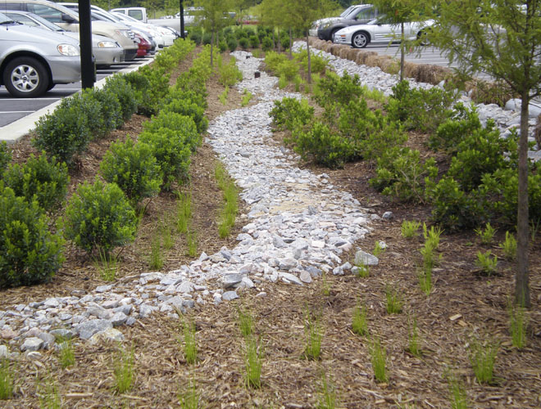
Questions?
Notes:
Questions?

