Slide 1
Selling Transportation to a Consumer Based Generation
An argument for an aesthetic based mass transportation design
Juan Castillo Jr.
University of Florida

Slide 2
Agenda
Section 1
Introduction – Marketing, aesthetics, experience making
Section 2
The Automobile – Understanding consumers
Section 3
Mass Transit – Attempt and evaluation
Section 4
The potential is there – Employing Marketing, Aesthetics and Experience
Section 5
Conclusion – Recap

Slide 3
Mass transit in the US
Since 1995 transit has been experiencing a steady growth in ridership
59.2% of people who ride transit, do so to go to work
Buses are the largest fleet of vehicles in US transit with 66,506 vehicles available for peak periods
In 2009 transit in the US employed 329, 326 operating employees and 12, 619 capital employees
Transit reduces the annual fuel use by 4.2 billion gallons of gasoline
Information obtained from American Public Transportation Association

Slide 4
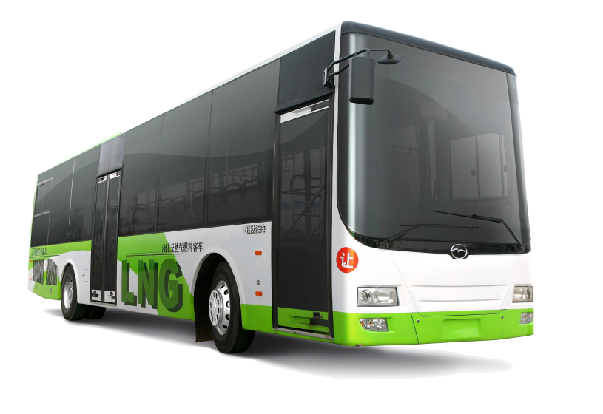
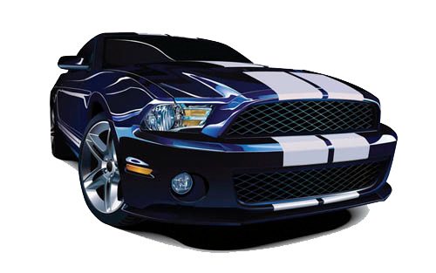
Mass Transit
The car
VS
15 percent of a household income
Involved in close to 34,000 deaths in the US (2009)
Major contributor to air pollution
Strong contributor to a sedentary unhealthy lifestyle
Everyone pays for the automobile even if they don’t own one
Helps in the development of an antisocial society
Annual savings of $10,116
Safer for patrons
Better for the environment
Better for health
Increases productivity
Social environment

Slide 5
What’s the problem
Still not enough ridership to support the costs of mass transit
Mass transit still has a negative cultural association

Slide 6
Service Oriented Design
Increase available routes
Increase available times
Increase bus frequency

Slide 7
Service Oriented Design
Increase available routes
Increase available times
Increase bus frequency
+
Marketing Oriented Design
Marketing
Aesthetics
Experience

Slide 8
Enter the automobile

Slide 9
The automobile industry understands:
Marketing affects the cultural definition of what's good thus by having a strong marketing push, you have a strong tool of attracting consumers.
Aesthetics is more than just something that looks pretty. Good aesthetics is something that moves the senses and influences consumer decisions.
Experience is what consumers want and are currently looking for. By offering to the consumer and experience as opposed to an item or a service, you clout rationality with the want.

Slide 10
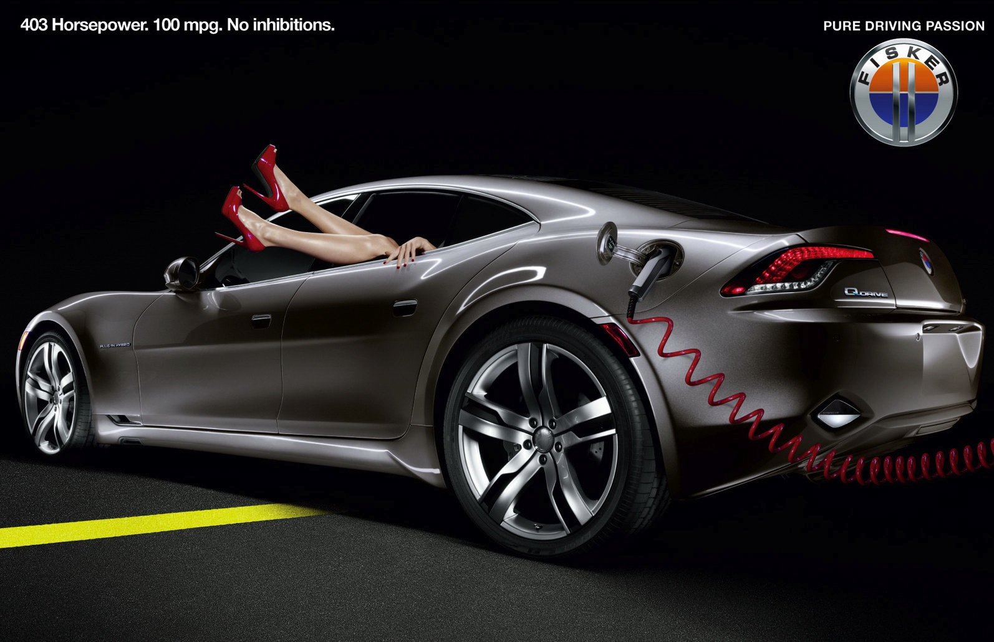

Slide 11
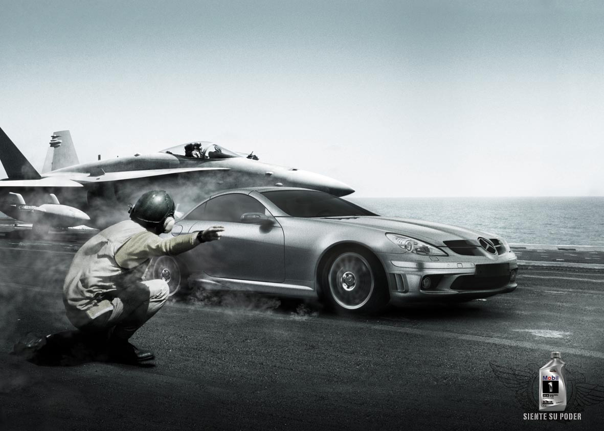

Slide 12
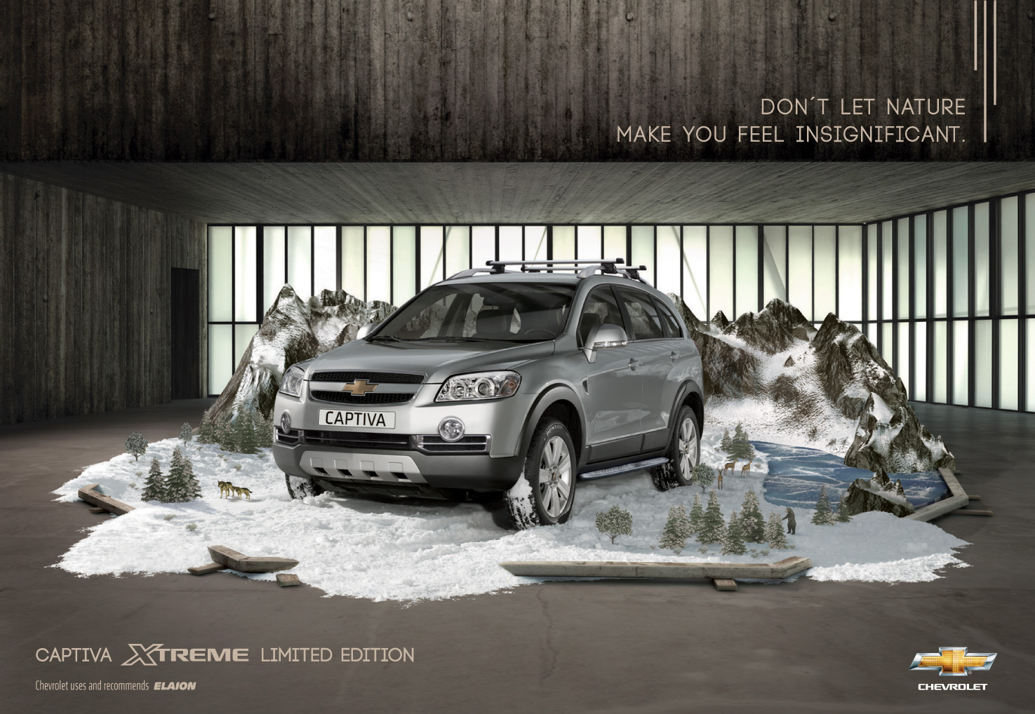

Slide 13
The Automobile industry employs:
Marketing
Aesthetics
Experience
“To create the best car, you need the ability to feel it, and to understand it. Think about food. If the first, middle, and last impressions—look, taste, and finish—are good, people remember it with a good feeling. Creating a vehicle is the same.” - Hiromu Naruse

Slide 14
What about Mass Transit?

Slide 15
VS

Slide 19
Marketing, Aesthetics, Experience
Marketing
Needs to be professional looking with designs that appeal to emotion rather then rationality
High design and implied service
Prevalent action of “smear the brand”
Be bold, innovative and contemporary (target your audience)
Aesthetics
Design in such a way as to incorporate an intentional impact on the five sense
Aesthetics is crucial to all aspects of mass transit, from vehicle design to staging areas
Strive to impress with your “first impression”

Slide 20
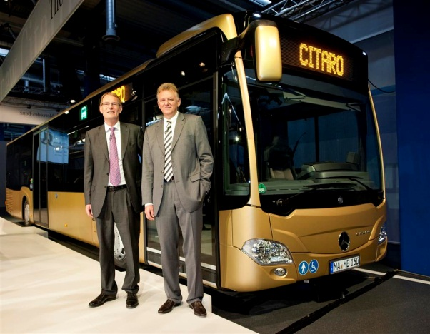
Marketing, Aesthetics, Experience, continued
Experience
It is what consumers are looking for and it is what they remember
Influences their decisions to “buy”
Can be unique to transit

Slide 21
The potential is there!

Slide 22
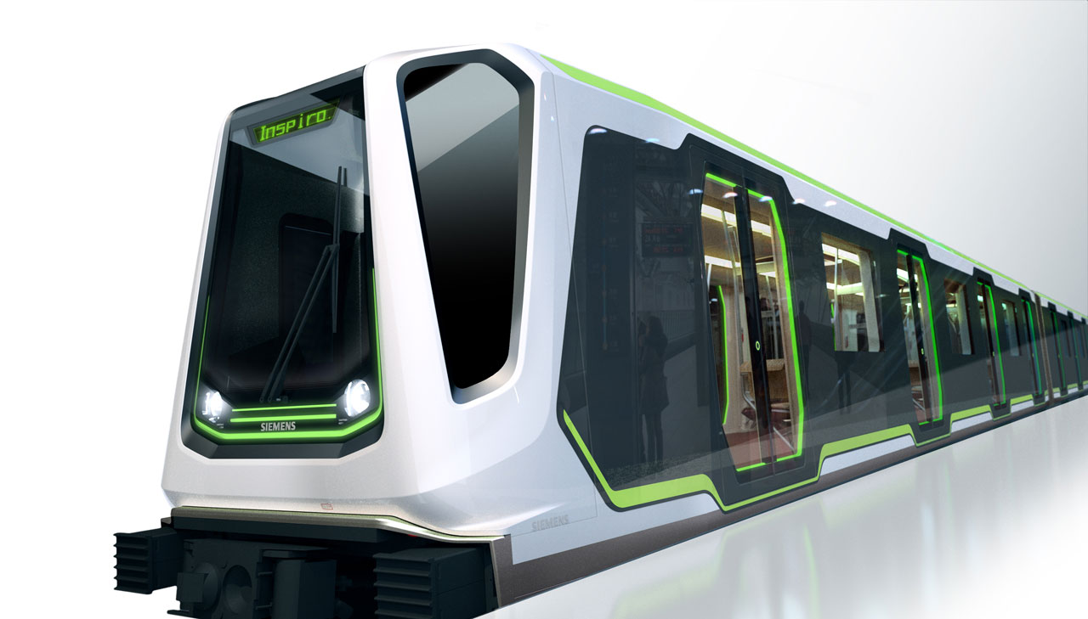

Slide 23
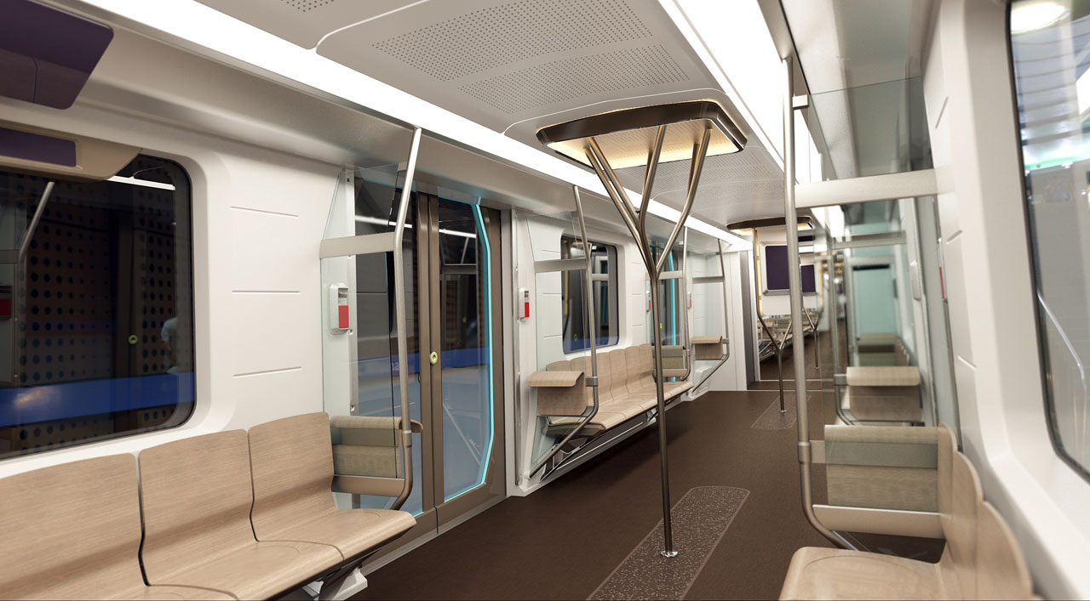

Slide 25
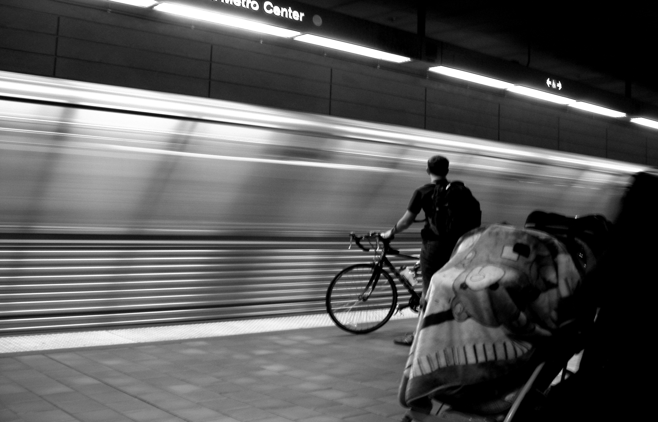

Slide 26
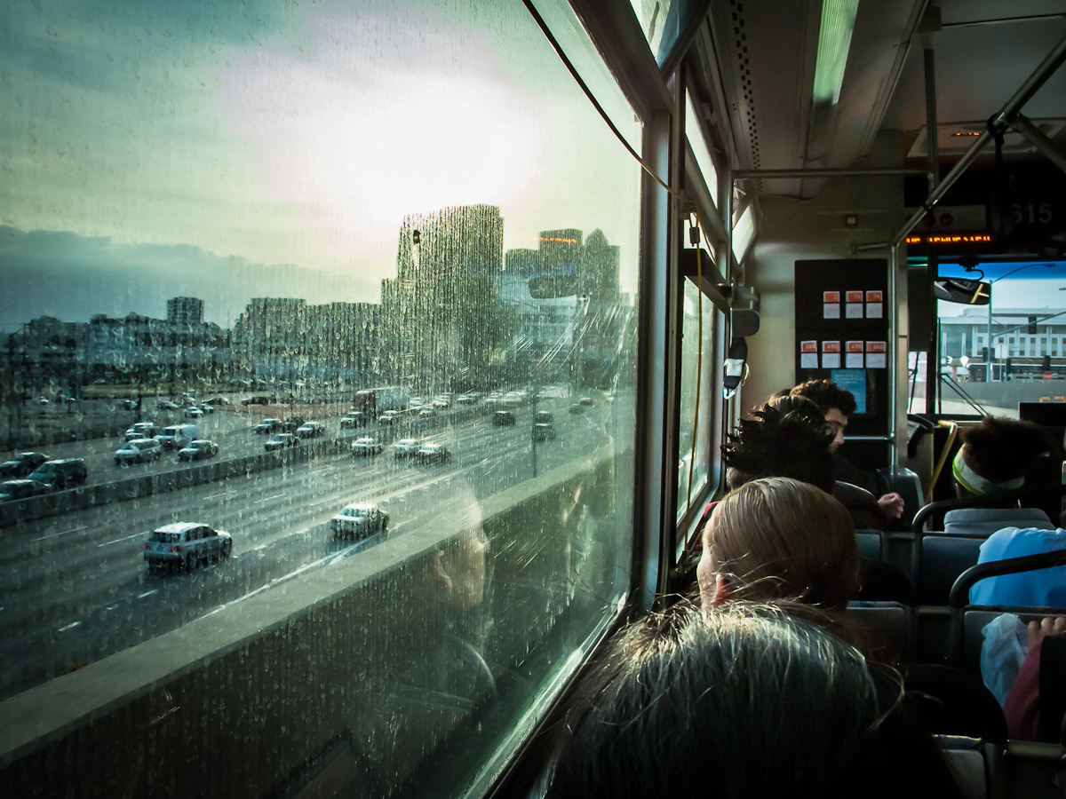

Slide 28
Review and Conclusion
We live in a consumer culture
Marketing
Professional looking designs with an appeal to emotion rather then rational
High design and implied service
Aesthetics
Design in such a way as to incorporate an intentional impact on the five sense
Aesthetics is crucial to all aspects of mass transit, from vehicle design to staging areas
Strive to impress with your “first impression”

Slide 29
Experience
It is what consumers are looking for and it is what they remember
Influences their decisions to “buy”
Can be unique to transit

Slide 30
Midttrafik Bus Comercial

Slide 31
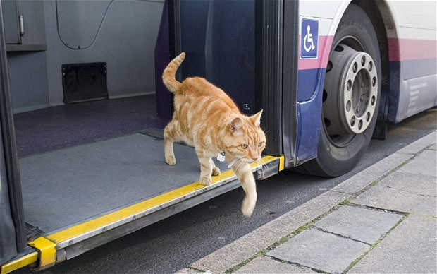
Thank you!
Juan Castillo Jr.
Jc3719@ufl.edu

