Slide 1
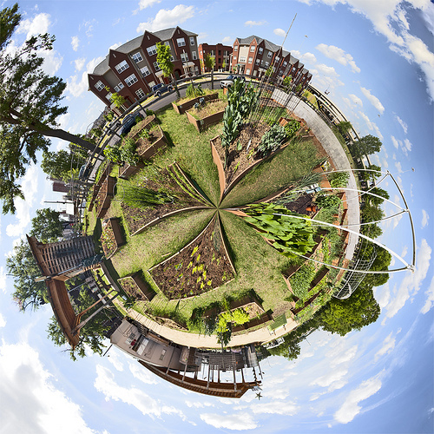
The Next Step to
Sustainable Practices:
Urban Farming
Jes Laing &
Jaime Larzelere

Slide 2
Urban Farming: Addressing Public Health
Obesity rates rise 15-27% from 1980 to 1999, provides active lifestyles and outdoor exercise
Farm-to-School programs increase in popularity; Farm to School Network estimates 12,429 throughout the 50 States
“Healthy occupation”, used as a type of therapy for those suffering from mental health problems and drug or alcohol addictions
Food produced organically and consumed locally, only in season, reduce carbon dioxide emissions by as much as 22 %

Slide 4
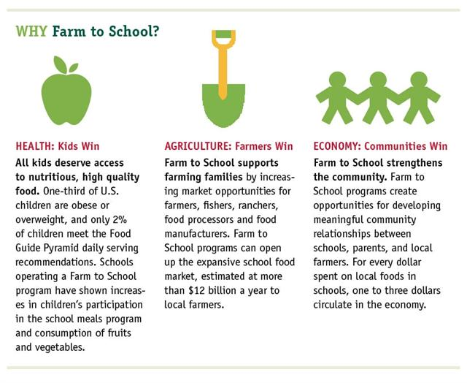

Slide 5
Economic Benefits of Urban Farming
Job creation
The United States’ urban gardening program estimates that a $1 investment in food-growing projects yields $6 of produce
Producing food within the city shortens the distance between consumer and producer = lower prices and greater access (more of population can afford to buy)
Revitalization of areas through farmers markets or local mom-and-pop grocery stores

Slide 6
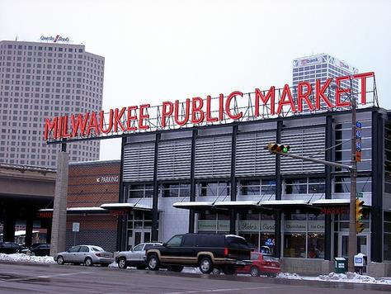
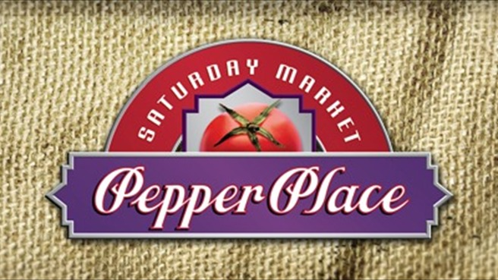
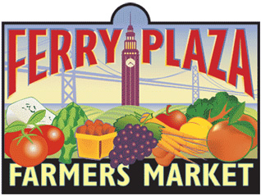
Birmingham, AL
San Francisco, CA

Slide 7
Policy & Planning Implementation
Sustainable planning practices are being preached nationwide - American Planning Association has adopted the “Policy Guide on Community and Regional Food Planning”
Changing local food and agriculture policies, an example is growing community food systems
Land use planners can suggest policies to facilitate community gardens or use growth management strategies to preserve farm lands as a method to address the abundance of vacant land
Land banks used by local government to promote urban farming and increase their green practices locally.

Slide 8
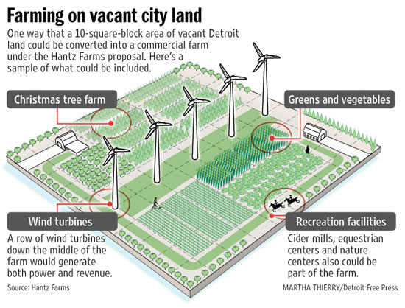

Slide 9
Current Examples
Milwaukee, WI
Birmingham, AL
Detroit, MI
Los Angeles, CA

Slide 10
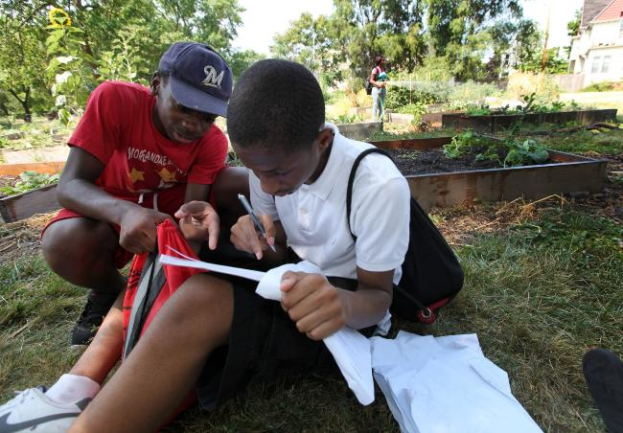
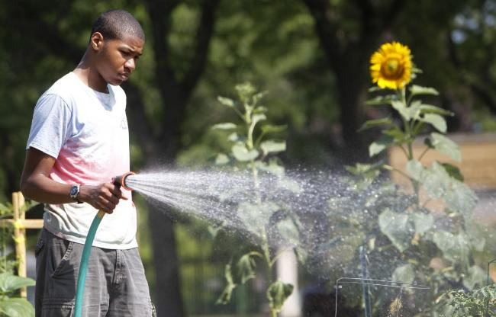
Young Farmers
Program
Milwaukee, WI

Slide 11
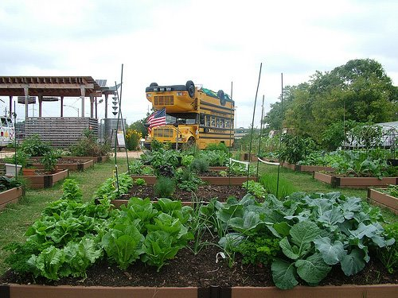
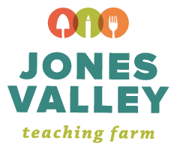
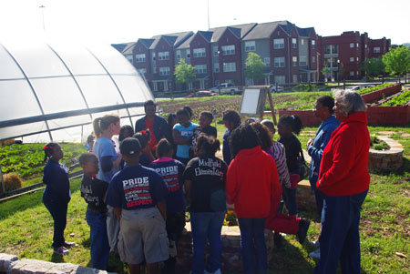
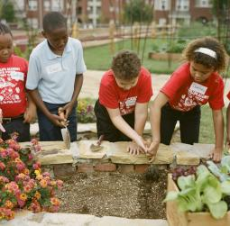
Birmingham, AL

Slide 12
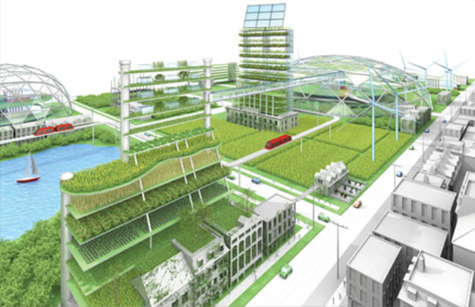
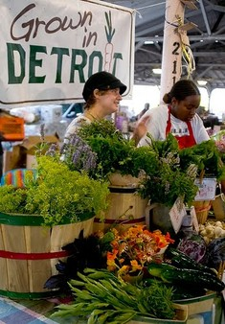

Slide 13
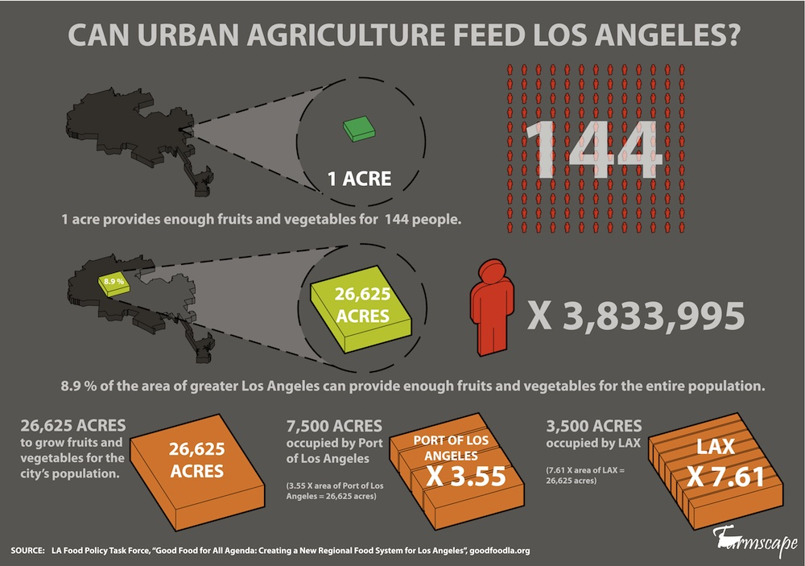

Slide 14
Sources
APA (American Planning Association). Policy Guide on Community and Regional Food Planning. accessed
February 25, 2012. http://www.planning.org/policy/guides/pdf/foodplanning.pdf.
Bellows, Anne C., Katherine Brown, and Jac Smit. “Health Benefits of Urban Agriculture.” Community
Food Security Coalition. Last modified December 18, 2004.
http://www.foodsecurity.org/UAHealthArticle.pdf.
Bonfiglio, Olga. “Delicious in Detroit.” Planning: The Magazine of the American Planning Association
(August/September 2009): 32-37.
Doron, Gil. “Urban Agriculture: Small, Medium, Large.” Architectural Design 75 no. 3 (2005): 52-59.
Flisram, Greg. “A Serious Flirt with Dirt: Urban Farming Makes a Comeback.” Planning: The Magazine of
the American Planning Association (August/September 2009): 14-19.
Garrett, Steven. Growing a Community Food System. Pullman, WA: Washington State University
Cooperative Extension, 1999.
Hanson, David, Edwin Marty, and Michael Hanson. Breaking Through Concrete: Building an Urban Farm
Revival. Berkeley: University of California, 2012.
Hodgson, Kimberley. “Where Food Planning and Health Intersect: Welcome to the Next Big Trend.”
Planning: The Magazine of the American Planning Association (August/September 2009): 8-13.

Slide 15
Sources, Cont.
Jacobs, Karrie. “Back to the Land.” Metropolis Magazine. Last modified October 15, 2008.
http://www.metropolismag.com/story/20081015/back-to-the-land.
Mendes, Wendy, Kevin Balmer, Terra Kaethler, and Amanda Rhoads. “Using Land Inventories to Plan for
Urban Agriculture: Experiences From Portland and Vancouver.” Journal of the American Planning Association 74 no. 4 (Autumn 2008): 435-449.
Mougeot, Luc J.A. Growing Better Cities: Urban Agriculture for Sustainable Development. Ottawa:
International Development Research Centre, 2006.
Samanian, Sanam. “Carrot City: A Recent Exhibition at Toronto’s Design Exchange Presented a Cross-
Section of Current Ideas Associated With Urban Agriculture.” Canadian Architect (June 2009):
26-28.
Shandas, Vivek and W. Barry Messer. “Fostering Green Communities Through Civic Engagement:
Community-Based Environmental Stewardship in the Portland Area.” Journal of the American
Planning Association 74, no. 4 (Autumn 2008): 408-418.
Shigley, Paul. “When Access is the Issue: What Cities Are Doing to Get Healthy Food Into Underserved
Neighborhoods.” Planning: The Magazine of the American Planning Association
(August/September 2009): 26-31.
Vallianatos, Mark, Robert Gottlieb, and Margaret Ann Haase. "Farm-to-School: Strategies for
Urban Health, Combating Sprawl, and Establishing a Community Food Systems
Approach." Journal of Planning, Education and Research 23 (2004): 414-23.
Worrel, Gabriela. “Food Groups.” Planning: The Magazine of the American Planning Association (January
2012): 23-25.
Worrel, Gabriela. “Land Be Gone.” Planning: The Magazine of the American Planning Association
(August/September 2009): 20-25.

