Slide 1
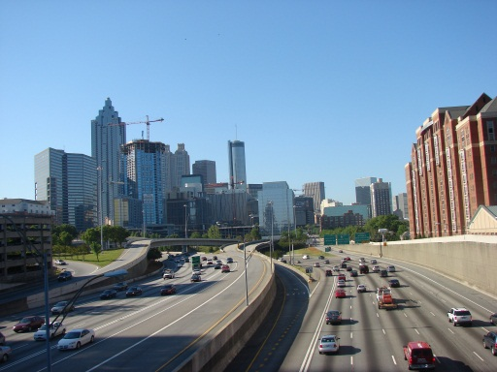
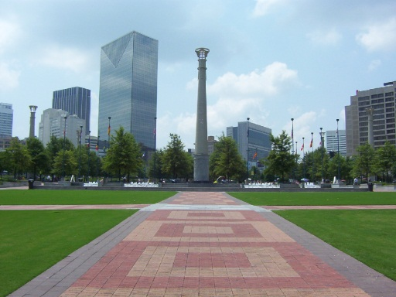
managing consultants without anyone crying presentation to the georgia chapter american planning association may 1, 2013

Slide 2
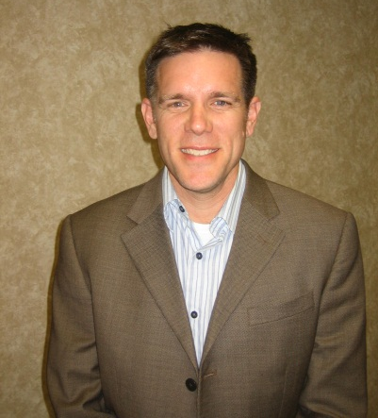
our presenters
Jamie Cochran, AICP
Sr. Vice President of
Transportation Planning
Gresham, Smith & Partners – Atlanta, GA
18 yrs. in government
19 yrs. in private sector
Christian Lentz
Planning Director
CSRA Regional Commission
Augusta, GA
17 yrs. in government
Whitney Shephard, PE, LEED AP
President /Co-Founder
Transport Studio
Savannah, GA
15 yrs. in private sector
Notes:
Whitney added her stuff

Slide 3
today’s session
understanding
the client environment
Understanding the consultant environment
better outcomes
(no tears)
overview of consultant management process
ethics vs. expectations vs. policies vs. laws
what the client needs from the process
what the consultant needs from the process
case studies and discussion

Slide 4
aicp code of ethics and managing consultants
…we shall accept the decisions of our client or employer concerning the objectives and nature of the professional services we perform unless the course of action is illegal or plainly inconsistent with our obligation to the public interest….”
“…we shall protect and enhance the integrity of our profession….”
“…..we shall describe and comment of the work and views of other professionals in a professional manner….”

Slide 5
the consultant management process
client activity
need is determined
scope/ad/evaluate/select
negotiation/NTP
pre-selling
strategy
team/submittal/interview
prime and sub contracts
consultant activity
potential tears

Slide 6
the consultant management process (cont’d)
client activity
project kick-off
coordination, meetings, reviews
wind-down/project close-out
kick-off prep
technical work, stakeholder contacts, and corporate project reviews
wind-down/project close-out
consultant activity
potential tears

Slide 7
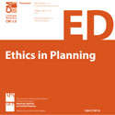
ethics vs. expectations vs. policies vs. laws
ethics :
am I acting in an honorable way?
expectations:
am I enabling “mistakes” (either real or perceived) that could harm myself, my client, or my employer?
policies:
am I following “the rules” as best I can?
federal and state laws:
will I look good in an orange jump suit?

Slide 8
aicp code of ethics
first approved in 2005; later revised in 2009
can be found at www.planning.org/ethics
four sections
A: statement of aspirational principles
B: rules of conduct to which we are
accountable
C: administrative process procedures
D: procedures for situations
regular certification maintenance requirement

Slide 9
what clients want
solid, experienced team
strong track record of success
meet schedule and budget
cutting edge/award-winning work
practical solutions
good team dynamics and communications
comfort level
respect for internal staff capabilities
political constraints
stakeholders’ issues
funding partners’ issues
“flexibility”
accountability
no surprises

Slide 10
what consultants want
financial success of project
relationship
long-term not short-term
repeat work
reliability
fairness
evaluation and selection
contract negotiations
reasonable budget given uncertainty
information
clear client goals
project “drivers”
hints on what is really important

Slide 11
case studies
what are the ethical dilemmas for the planner(s)?
how could have the situation been handled more ethically?
what are the planner’s obligations?

Slide 12
rfq/rfq process: love you/love you not

Slide 13
background
regional commission administers an rfq/rfp process for a small rural town.
process involves selecting a consulting firm to prepare a corridor design for a thoroughfare (engineering/planning).
project is an implementation step of a plan prepared by the regional commission.
GDOT owns the corridor right-of-way.

Slide 14
background (cont’d)
town never previously conducted competitive process for type of service being requested.
town maintains an “on-call” contract with an engineering firm for other services.
town may be pre-disposed to “local preference” in selection process.
regional commission previously worked with handful of consulting firms likely to respond to the RFQ/RFP.
regional commission may be pre-disposed to preferences based on prior working relationships.

Slide 15
(possible) ethical dilemmas:
(aicp code of ethics and professional conduct)
Section A: Principles to Which We Aspire
2. …our responsibility to our clients and employers:
c) we shall avoid a conflict of interest or even the appearance of a conflict of interest in accepting assignments from clients or employers.
…our responsibility to our profession and our colleagues:
c) we shall describe and comment on the work and views of other professionals in a fair and professional manner.

Slide 16
(possible) ethical dilemmas:
(aicp code of ethics and professional conduct)
Section B: Our Rules of Conduct.
8. …we shall not, as public officials or employees, engage in private communications with planning process participants if the discussions relate to a matter over which we have authority to make a binding, final determination if such private communications are prohibited by law or by agency rules, procedures, or custom.
19. …we shall not fail to disclose the interests of our client or employer when participating in the planning process. Nor shall we participate in an effort to conceal the true interests of our client or employer.

Slide 17
implemented solution
regional commission prepares and distributes RFQ and RFP.
regional commission consultant contact for the RFQ and RFP is a staff person (A) with no direct ties to engineering/planning firms.
regional commission pre-qualifies firms responding to the RFQ.
pre-qualified firms submit proposal to regional commission contact (A).
second regional commission staff person (B) concurrently works with city for technical explanation of proposal content and to advise on interview procedure.
A
B

Slide 18
implemented solution
City short-lists consultants absent Regional Commission input.
city conducts interviews in chosen manner. regional Commission staff person (B) participates in interviews.
city requests further revisions/ clarifications of interviewed consultants absent regional commission input.
city negotiates final cost for services and selects consultant.
regional commission sends notice of selection to remaining candidate firms.

Slide 19
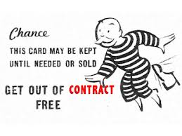
stickin’ to the scope or stickin’ it to the scope

Slide 20
background
county contract with consulting firm for county-wide transit feasibility study
managed by county traffic engineering staff
administered by RC
funded with fta program funds
separate contract for land use master plan
managed by planning and development staff
consultant manager is senior planner

Slide 21
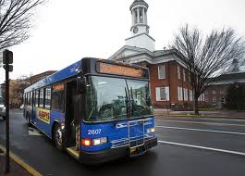
Background (cont’d)
it is apparent that local elected officials are more interested in new development than in transit service
consultant senior planner has attitude that FTA funds are his to use for land use master plan
OR

Slide 22
(possible) ethical dilemmas:
(aicp code of ethics and professional conduct)
Section A: Principles to Which We Aspire.
2. Our Responsibility to Our Clients and Employers
We owe diligent, creative, and competent performance of the work we do in pursuit of our client or employer's interest.

Slide 23
(possible) ethical dilemmas:
(aicp code of ethics and professional conduct)
3. our responsibility to our profession and colleagues
i) we shall systematically and critically analyze ethical issues in the practice of planning.
section b: our rules of conduct
25. …we shall neither deliberately, nor with reckless indifference, commit any wrongful act, whether or not specified in the rules of conduct, that reflects adversely on our professional fitness.

Slide 24
SCENARIO NUMBER ?: ALL IN THE FAMILY
all in the family

Slide 25
background
new city planner charged with overseeing two (2) city contracts for the provision of services to the homeless.
services contracted through sole source process to a non-profit agency (the kitchen.)
contract A: planning and administrative services related to homelessness.
contract B: call center services (open door program.)

Slide 26
background (cont’d)
Mid-level manager oversees open door and other programs.
after six months, open door coordinator resigns and mid-level manager hires a member of their household as new coordinator (per approval of the kitchen board.)
new open door coordinator is qualified and services provided to the satisfaction of the city.
upon review of contract, new city planner notices contract language that states that: “…no one can derive direct or indirect financial benefit from…”

Slide 27
(possible) ethical dilemmas:
(aicp code of ethics and professional conduct)
Section A:
Principles to Which We Aspire
Our Responsibility to Our Clients and Employers:
c) We shall avoid a conflict of interest or
even the appearance of a conflict of
interest in accepting assignments from
clients or employers.

Slide 28
(possible) ethical dilemmas:
(aicp code of ethics and professional conduct)
Section B: Our Rules of Conduct.
#6. We shall not perform work on a project for a client or employer if, in addition to the agreed upon compensation from our client or employer, there is a possibility for direct personal or financial gain to us, our family members, or persons living in our household, unless our client or employer, after full written disclosure from us, consents in writing to the arrangement.
#14. We shall not use the power of any office to seek or obtain a special advantage that is not a matter of public knowledge or is not in the public interest.

Slide 29
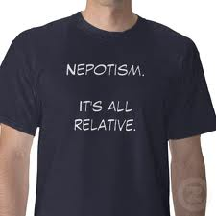
implemented solution
in spite of satisfactory performance by the vendor, planner can not ignore contract terms.
legal counsel confirms that the employment situation is in violation of the terms of the contract.
planner informs the executive director of the kitchen of the contract discrepancy.
verbal notification of need to address the conflict is supported in writing.

Slide 30
implemented solution
the executive director of the kitchen provides written solution to which parties agree.
the mid-level manager’s job description and work program for the kitchen are revised so that they are not responsible for supervision of the open door program.
per agreement by multiple parties, the open door program is transferred to a separate non-profit entity.

Slide 31
billability target practice

Slide 32
background
county contracted with consultant to update census geography and submit revised geo-database to census staff
contract managed by consultant planner A, who develops the boundaries
planner B is not meeting her assigned billability/utilization target and is not familiar with County demographics or GIS software
planner B goes to department head who assigns task to planner B

Slide 33
(possible) ethical dilemmas:
(aicp code of ethics and professional conduct)
A: Principles to Which We Aspire
2. Our Responsibility to Our Clients and Employers
…we owe diligent, creative, and competent performance of the work we do in pursuit of our client or employer's interest.
c) We shall avoid a conflict of interest or even the appearance of a conflict of interest in accepting assignments from clients or employers.
Notes:
Dilemma dilema

Slide 34
(possible) ethical dilemmas:
(aicp code of ethics and professional conduct)
3. our responsibility to our profession and colleagues
a) …we shall protect and enhance the integrity of our profession.
section b: our rules of conduct.
1. …we shall not deliberately or with reckless indifference fail to provide adequate, timely, clear and accurate information on planning issues.
10. We shall neither deliberately, nor with reckless indifference, misrepresent the qualifications, views and findings of other professionals.
Notes:
Dilemma dilema

Slide 35
summary
ethical
outcomes
understand expectations
know the AICP Code
ask for advice
know the rules
“do the right thing”

Slide 36
thank you for being with us today

