Slide 1
Aerotropolis Planning for
Atlanta’s Southern Crescent
MAY 1, 2013
Nancey Green Leigh, PhD, FAICP
Professor and PhD Program Director
School of City & Regional Planning
Georgia Institute of Technology
ngleigh@coa.gatech.edu

Slide 2
Aerotropolis Concept
John Kasarda, UNC professor, popularized term:
  recognizes in addition to traditional aviation services, major airports develop significant non-aeronautical commercial facilities, service and revenues.
Spin-off from “megalopolis”
  large and densely populated urban area that can include multiple independent administrative districts
  airports are increasingly the eye of multi-functional urban centers and global corporate destinations.
“Aerotropolis” and “airport city” are used interchangeably, but aerotropolis is more appropriate for Southern Crescent of Atlanta.
Notes:
--Aerotropolis is focused on role of airport in surrounding region: a mutually beneficial strategy for airport and impacted region
-–For an airport city, planning typically limited to airport property, but coordination and regional planning with property owners/jurisdictions that
are adjacent to the airport will drive the highest and best use model
--Focus on Atlanta is an INFILL DEVELOPMENT airport area; different than some other regions, especially internationally, but should provide ideas for other airports.
– Development potential can be limited by existing regional plans and intergovernmental agreements

Slide 3
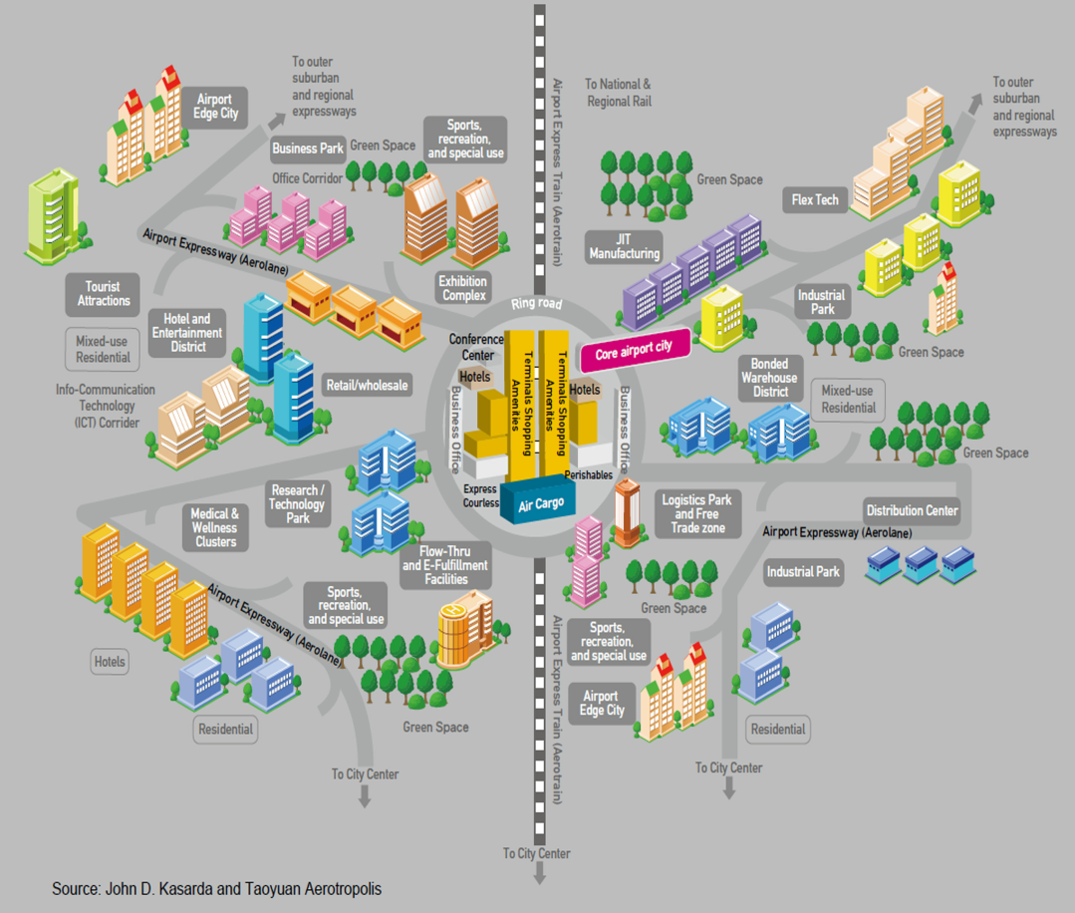
Southern Crescent Needs an Aerotropolis Strategy
A new urban form placing airports in the center of urban regions growing around them, connecting workers, suppliers, executives, and goods to the global marketplace is happening both organically and strategically across the globe.
Notes:
Aerotropolis: The Way We'll Live Next (2011)

Slide 4
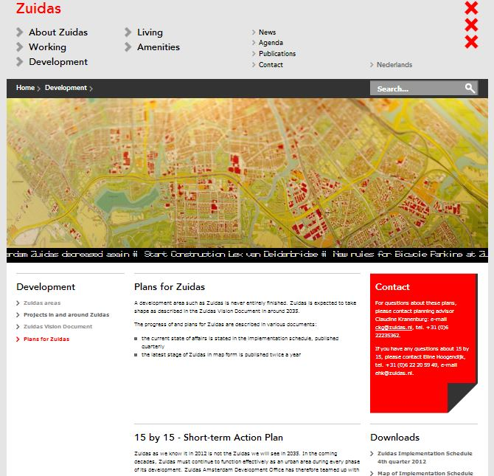
Schiphol, Amsterdam
Notes:
--Zuidas, their target development area, is only six minutes away from Schiphol International Airport. The city is designed to be the prime location for global companies and business development.
--Over 450 companies, many of them leading names, are already established here. They include Google, AkzoNobel and ABN AMRO (Zuidas, 2013).
--The district has a total capacity of up to 13. 8 million square feet of real estate, including existing properties and those that are under construction or in the pipeline. Much of this potential will be realized in the coming years. Around 2040, Zuidas should reach completion, in line with the 2009 Zuidas Vision Document (Zuidas, 2013).
--With between 8,000 and 9,000 housing units, Zuidas is due to become Amsterdam's second most prominent residential location. At present, over 600 apartments have been completed with a total living area of 300,000 square feet (Zuidas, 2013).
http://www.amsterdam.nl/zuidas/english/

Slide 5
Companies at Zuidas
ING
Loyens Loeff
Blinck
Baker & McKenzie
TATA
YACHT
The Boston Consulting Group
Michael Page International
Mead Johnson Nutritionals
Simmons & Simmons
Deloitte
APX Group
Infosys
Suzlon
RBS
JCDecaux
Google
ABN AMRO
American Express
Mitsubish
JP Mordan Chase
TD Waterhouse
Notes:
--Zuidas, their target development area, is only six minutes away from Schiphol International Airport. The city is designed to be the prime location for global companies and business development.
--Over 450 companies, many of them leading names, are already established here. They include Google, AkzoNobel and ABN AMRO (Zuidas, 2013).
--The district has a total capacity of up to 13. 8 million square feet of real estate, including existing properties and those that are under construction or in the pipeline. Much of this potential will be realized in the coming years. Around 2040, Zuidas should reach completion, in line with the 2009 Zuidas Vision Document (Zuidas, 2013).
--With between 8,000 and 9,000 housing units, Zuidas is due to become Amsterdam's second most prominent residential location. At present, over 600 apartments have been completed with a total living area of 300,000 square feet (Zuidas, 2013).
http://www.amsterdam.nl/zuidas/english/

Slide 6
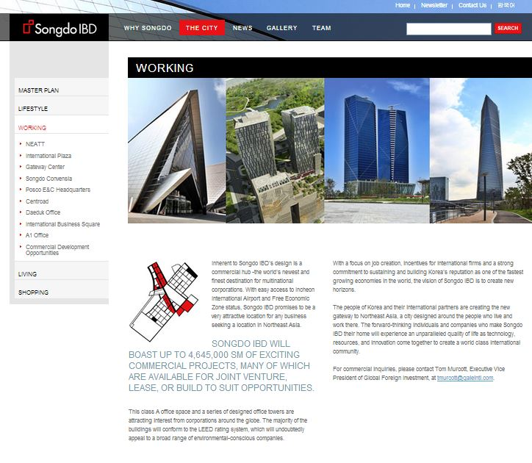
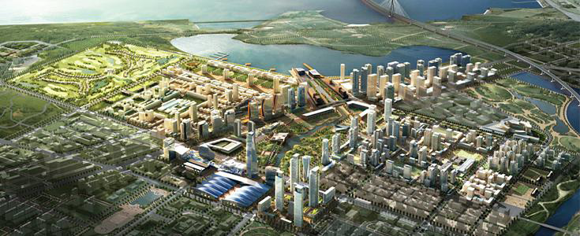
Incheon, South Korea
Notes:
--Air City is being developed as South Korea’s New Songdo City, 40 miles from Seoul.
--Joint venture between a NYC-based developer, Gale International and South Korea’s largest steel producer at around $30 billion.
--Designated as an International Free Economic Zone.
-
--Plans for 100 million square feet development, consisting of a commercial, residential, retail, hospitality, and public space blend. (Songdo IBD, 2011).
http://www.songdo.com/

Slide 7
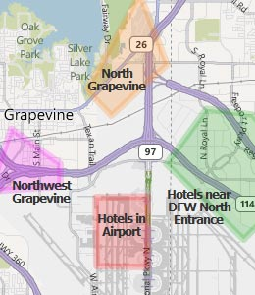
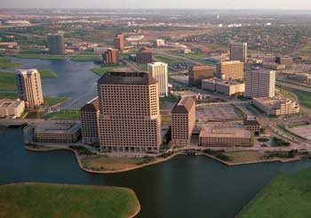
Dallas-Fort Worth & Las Colinas
Notes:
-- DFW officials envision an aerotropolis around 3 new rail stations that will connect the airport to Dallas & Fort Worth when they open in the next 3 years (DFW Airport Board, 2012).
--Many of nation's largest industrial landlords hold more than 500,000 sf around airport. Cargo volume is immense.
--Airport owns a land mass larger than Manhattan, has zoned 6,000 acres for industrial parks, retail & restaurants, hotels & entertainment to be developed over 20 yrs.
--About 1,000 acres already developed, incl. hotel, golf course, cargo & commerce park. (DFW Airport Board, 2012).
--Low Colinas is a 12,000-acre, DFW airport-linked community has 22.3 million sq. ft. of Class A office space, 8.5 million sq. ft. of light industry, 1.3 million sq. ft. of retail, over 14,000 single-and multi-family residences, 3,800 luxury and business-class hotel rooms, 75 restaurants, and 2 golf courses (Kasarda, 2008).
http://www.dfwairport.com/development/index.php and http://www.lascolinastexas.com/

Slide 8
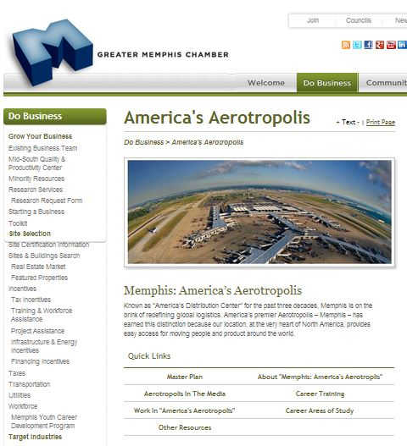
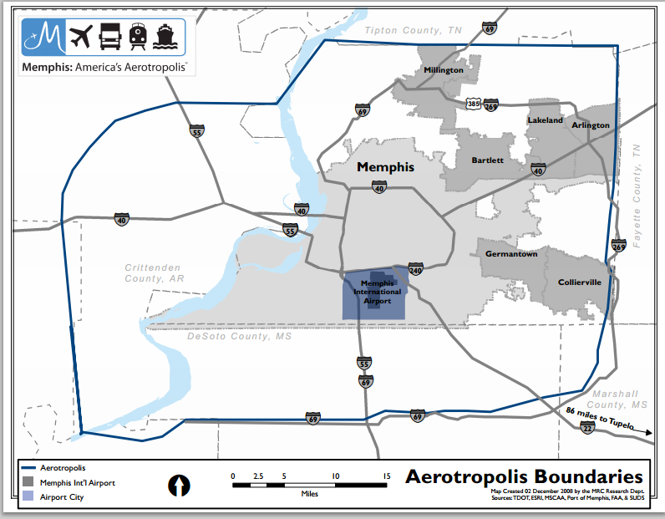
Memphis
Notes:
--Memphis now brands itself as "America's Aerotropolis,“ and takes a regional approach to development around the airport.
--An Aerotropolis Steering Committee was formed in 2006 by the Greater Memphis Chamber to capitalize on the region’s logistics assets and initiate revitalization efforts of the neighborhoods bordering the airport.
--As an arm of the Greater Memphis Chamber, the focus is on infrastructure improvements, job creation, and creating positive first and last impressions of Memphis on visitors arriving by air.
http://www.memphischamber.com/Economic-Development/Aerotropolis.aspx

Slide 9
Selected Memphis Aerotropolis Goals
Upgrade surroundings to clustered commercial campuses with logistics, manufacturing, and cargo handling physically separated from business and leisure travelers.
Airport area zoning to encourage location of airport oriented firms and industries and address aesthetic and social problems.
Plan for additional close-in core logistics space by land banking.
Consolidate airport area hotels into cohesive zones with ready access to adjacent entertainment areas and transit.
Local governments work together as single entity because Aerotropolis is a single integrated market economy,
  prevent companies from playing jurisdictions off one another to detriment of their tax bases and their residents.

Slide 10
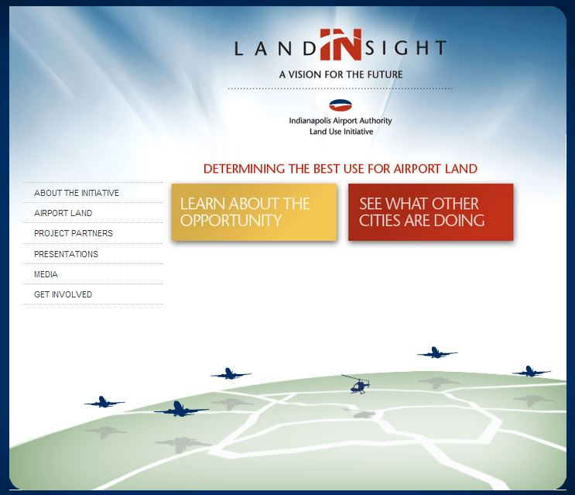
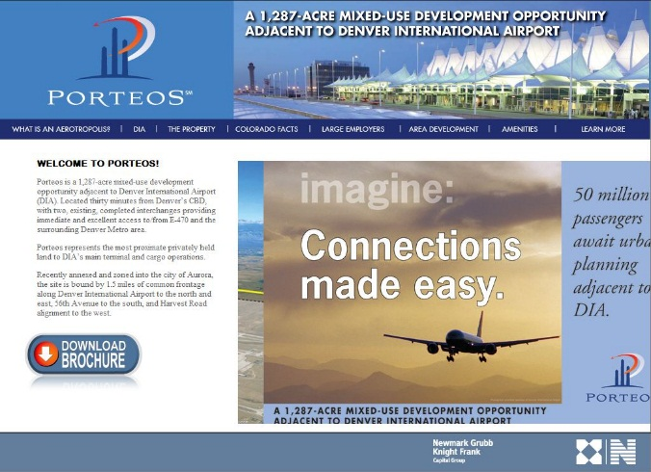
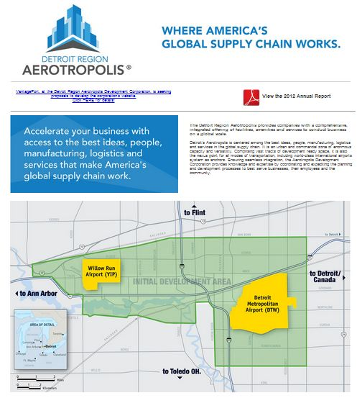
Other Regions in Early Stages
Hong Kong
Frankfurt
Indianapolis
Denver
Detroit
Notes:
--Pictures are from websites of Indianapolis, Denver and Detroit Aerotropolis Organizations.

Slide 11
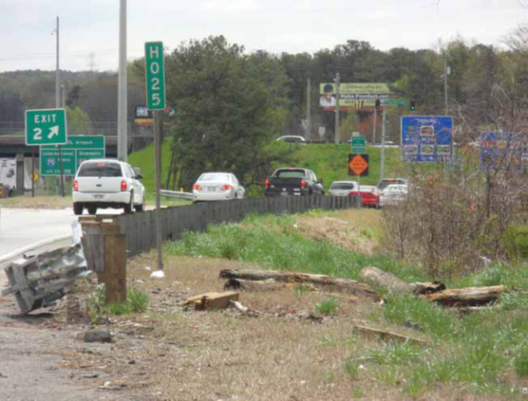
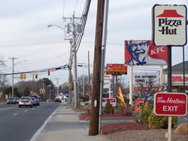
Atlanta’s Current
Airport Area Conditions
Notes:
--World’s Largest airport by passenger traffic since 1998 serving ~89 million passengers annually.
--Located 7 miles south of the Atlanta Central Business District; but in reality the metro region’s true business center has been shifting to the north.
--The area around the airport is the immediate gateway to the metro region from the airport, yet not easy to fly into or out of, particularly when compared to other world-class cities.
--This area is disproportionately characterized by extreme road congestion, dead shopping centers, vacant industrial properties, and run down neighborhoods.
--It doesn’t have to be that way, and in fact, we have an opportunity to turn that around if we get serious about a regional development strategy centered on the airport.
--Hartsfield-Jackson is the largest employer in the state of Georgia. There are over 58,000 airline, ground transportation, concessionaire, security, federal government, City of Atlanta and Airport tenant employees. Hartsfield-Jackson has a direct economic impact of more than about $32.5 billion for the metro Atlanta area economy (H-JAIA, 2013).

Slide 12
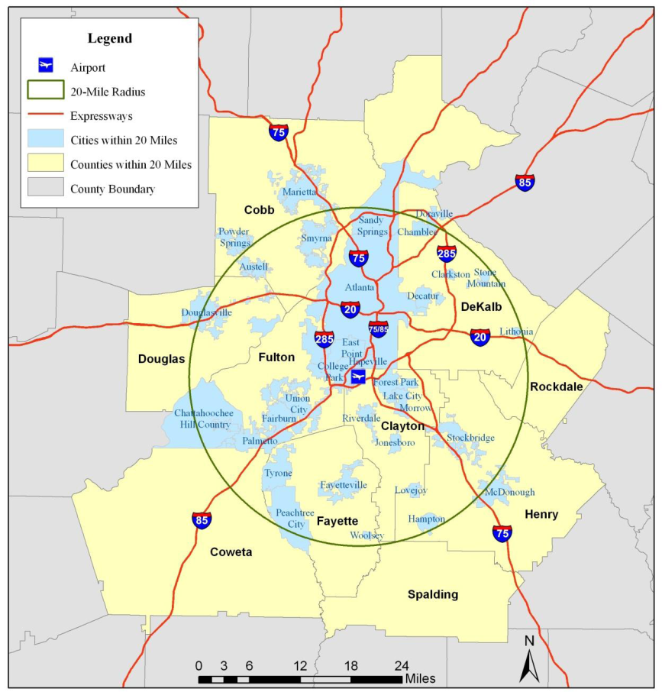
H-JAIA
Role Within Metro Region
Notes:
--This Map shows just a 20 mile radius.
--Northern communities like Sandy Springs and Perimeter DEPEND on H-JAIA , and have thrived off of it. Where would they be without the airport?
--Yet the communities immediately adjacent and further south appear to come up with the short end of the stick: these are the Southern Crescent and they have .
--Next 3 slides partially convey what we all know intuitively: there is significant inequality between the Northern and Southern Crescent of the region.

Slide 13

Southern vs Northern Crescent
Notes:
Southern Crescent is basically a majority minority region.

Slide 14
Southern vs Northern Crescent
Notes:
Median household income of southern crescent is significantly lower than northern. Chatt Hills is an outlier but has less than 3000 people, whereas Alpharetta, Dunwoody, Decatur and Sandy Springs ranges from about 50,000 to 90,000.

Slide 15
Southern vs Northern Crescent
Notes:
Southern Crescent’s cities unemployment rates tend to be significantly higher than the Northern Crescent.

Slide 16
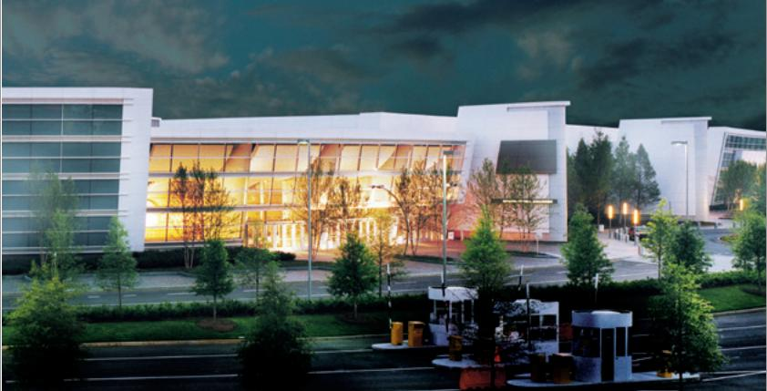
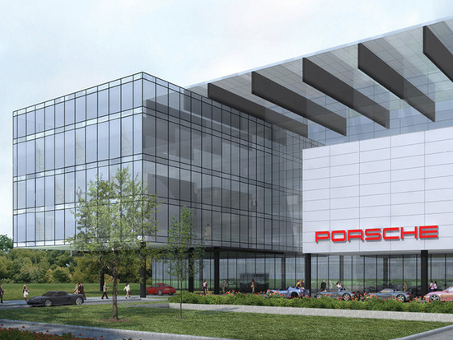
Catalyst Projects
Notes:
--In 2009, H-JAIA’s Automated People Mover, SkyTrain, began operation, transporting visitors from the airport to the GICC, this hotel opened in 2010.
--The decision to build a $100 million complex on the grounds of the former Ford assembly plant in Hapeville is not only a glitzy marketing move for the German carmaker, it is also an endorsement of the city and state.
--Construction broke ground in December 2012; expected completion mid-2014. Porsche's North American Headquarters will move from Sandy Springs.
--The new complex will be comprised of modern office facilities for a workforce that will eventually number 400 employees, including a Technical Service and Training Center, as well as a leading-edge Customer Experience Center that will feature a handling road course to show-off the capabilities of Porsche’s industry-leading vehicles.
http://www.gicc.com/history.asp and http://dedeporsche.wordpress.com/tag/hartsfield-jackson-atlanta-international-airport/

Slide 17
First Round Jurisdictions for SCA
Hartsfield-Jackson International Airport
Fulton County
Clayton County
Department of Aviation
FAA
Atlanta
College Park
East Point
Forest Park
Hapeville
Lake City
Morrow
Fairburn
Riverdale
Union City
Notes:
10 cities, 2 counties, 3 chambers

Slide 18
Key Partners
Businesses
Institutions
Delta Airlines
Coke
Chic-Fil-A
CNN
Porsche
UPS
FedEx
Many others
H-JAIA
Georgia Power
ARC
Chambers of Commerce
Research Universities
GA Economic Dev. Dept.
Invest Atlanta
Many others

Slide 19
Issues for Planners
Coordination
  Joint planning between jurisdictions and other organizations around the airport.
Development and Redevelopment
  Prospects for infill redevelopment require substantial coordination and policy.
Transit and Transportation
  Lack of transit access from the airport to hotels, restaurants, and downtowns.
Aesthetic Improvements
  Improve pedestrian experience, landscaping, way finding, gateway signage.

Slide 20
Tools for Developing Aerotropolis Plan
Comprehensive Transportation Plan (CTP)
Regional Transportation Plan (RTP)
Enterprise and Opportunity Zones
Community Improvement District (CID)
Livable Centers Initiative (LCI)
Urban Land Institute Technical Assistance Program (ULI-TAP)
Partner with universities for research.

Slide 21

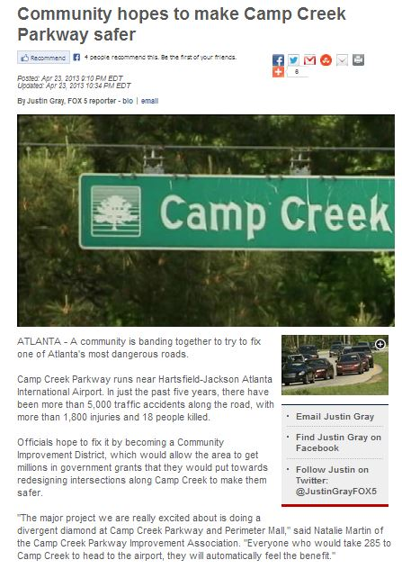
CID Development Underway
Notes:
--The private sector has already started to respond to the attention to the airport area and the Airport Area Task Force.
--Airport East and West CIDs are in the works, with the CCPIA having a new website up, and in conversations, as we speak, to get a CID appointment with the state legislature this month.
--There have been over 15 news stories related to this development in the past month.
--We need to ACT NOW to formalize partnerships and be holistic in aerotropolis planning, or else these communities might be subject to competing with each other rather than complimenting one another.
www.ccpia.org

Slide 22

Without planning, will there be take off?

