Slide 1
A Spatial Analysis of Atlanta's Same Sex Households & LGBTQ Institutions
Lauren Beduhn, Nathan Davis, and Roxanne Raven
Notes:
ND

Slide 2
Introduction & Background
Planning must incorporate the needs of diverse communities, and the unique spatial context each community exists in should inform planner’s processes and objectives accordingly. Unfortunately, the LGBTQ community has been historically ignored/hindered by planners.
The research on LGBTQ related planning is relatively nascent, but Dr. Petra Doan's research has highlighted the need to consider this community in the planning process.
Atlanta is known as the LGBTQ capital of the South where queer people have historically congregated out of fear of reprisal for their identity in their hometown.
Notes:
ND

Slide 3
Problem Definition & Objectives
Research suggests that the Atlanta LGBTQ community is being erased as several factors converge. Limited data on LGBTQ people has led to limited literature.
2011 Georgia Tech MCRP alum Zachary Adriaenssens wrote an analysis of Atlanta’s LGBTQ community. In our research, we aim to build upon previous literature and update Adriaenssens’ research.
The two central questions we ask are:
Has Atlanta’s LGBTQ community been dispersing?
What is the average proximate distance of same sex households to LGBTQ-serving institutions for each of the three categories we identified as well as overall?
Notes:
ND

Slide 4
Hypothesis
Atlanta’s LGBTQ community has continued to disperse but that the community continues to be well served by commercial services, health services, and community and civic organizations and spaces.
Notes:
ND

Slide 5
Methods & Procedures
First, we mapped 2000, 2010, and 2019 Census track-level data for Fulton and DeKalb County, Georgia. For 2000 and 2010, we use data on unmarried partner same-sex households (UPSSHs). For 2019, we use data on same-sex households. Using these data, we calculated the top three Census tracts that gained and lost percentages of same-sex households for 2010 to 2019.
Second, we determined the weighted average distance from Census tract centroids to the closest LGBTQ establishment for all categories: commercial services, health services, and community and civic spaces and organizations.
Notes:
RR
We chose these data because they are the best available data that serve as proxies for determining the queerness of a neighborhood

Slide 6
Study Area
The Same-Sex partner population of the greater Atlanta area.
We include an analysis of all of Fulton and DeKalb counties, which are the two counties that partially contain the City of Atlanta, because:
One characteristic that defines Atlanta’s demographic changes is the sprawling of a variety of identities, including the LGBTQ community.
Research highlights an increasingly suburbanizing queer population as rising rents force lower-wealth people out of their neighborhoods like Midtown and into neighborhoods outside of the boundaries of the City of Atlanta.
Notes:
RR

Slide 7
Assumptions for Analysis
UPSSHs and SSH's serve as surrogate data sources for measuring the LGBTQ population
The measures of UPSSH's and SSH's done by the Census bureau are accurate and comprehensive
Change in UPSSH/SSH population due to their movement rather than straight population increases
Our list of LGBTQ-serving institutions is accurate and comprehensive
Placing the household count at the centroid of the census track will give us the best measurement
Notes:
RR

Slide 8
Project Flow Chart
Find Data
Literature Review
Contacted Census Bureau
Map Data
Joined census data and tables
Symbolized UPHSS and SHH population percentages using graduate colors
Spatial & Statistical Analysis
Utilized 4 spatial joins to determine nearest establishment to each census tract point
Used summary statistics to analyze distances for each spatial join and sums
Geocoded institutional addresses from Damron Guide, GA Voice, Yelp, and other resources
Supplemented institutions with additional online repositories
Jurisdictional boundaries for city limits and neighborhoods from ARC
Employed table joins to census tract data to symbolize the UPHSS/SHH population normalized by total population
Created feature class for all LGBTQ establishments
Joined 1-1, target = establishment, feature class, join feature = census tract point, operation = closest
Utilized spatial joins to determine the number of establishments within various distances from the census tract centroid.
Notes:
RR

Slide 9
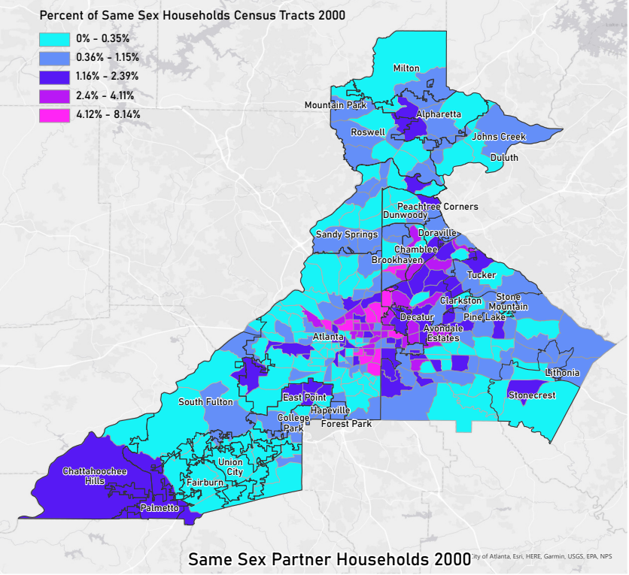
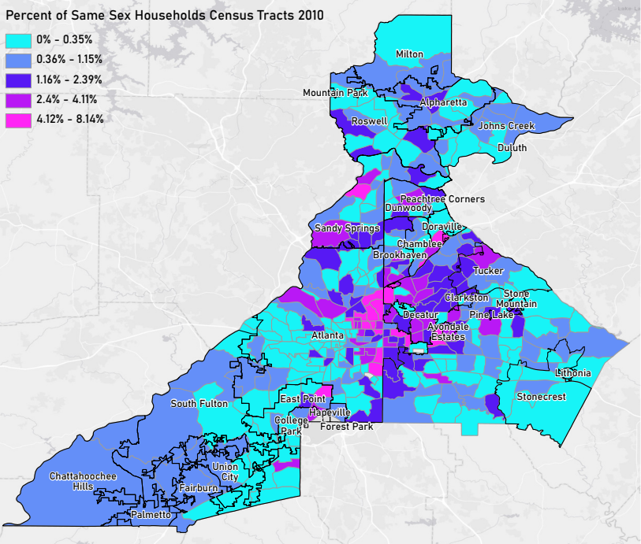
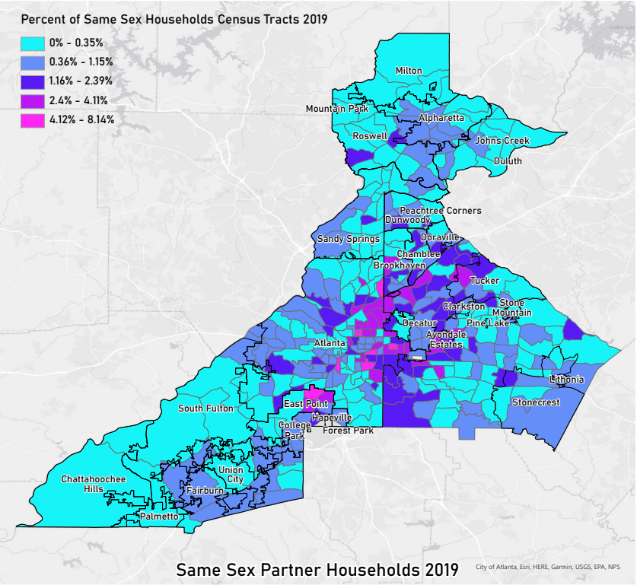
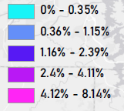
2000
2010
Percent Same Sex Households Per Census Tract
2019
Notes:
LB

Slide 10
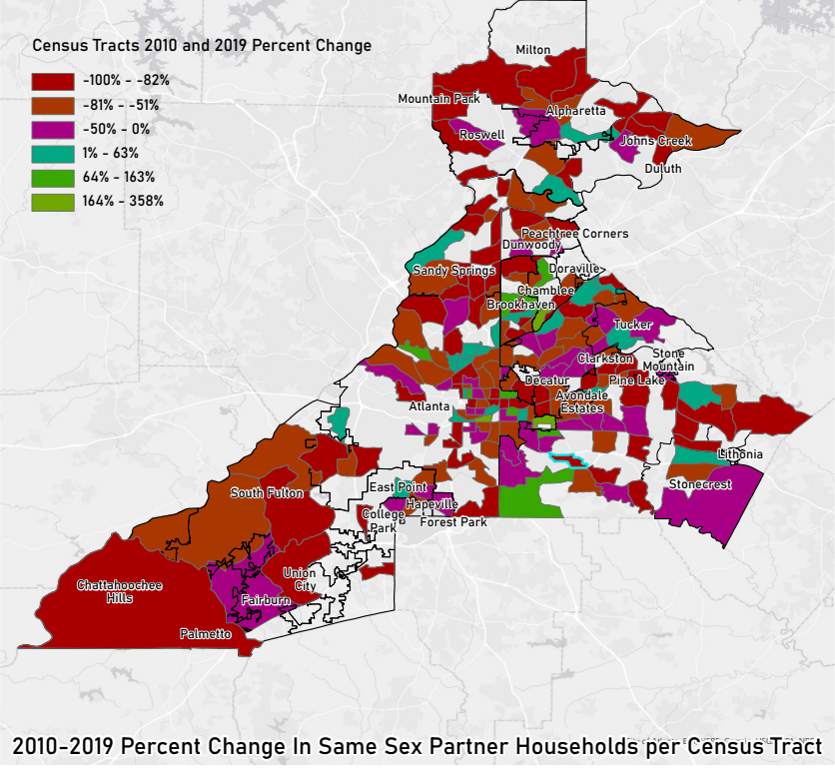
Results
Notes:
LB

Slide 11
Results
Top 3 Census Tracts: Percent Gained
Census Tract | Neighborhood | % Increase
32 | Cabbagetown & Reynoldstown | 358%
208 | East Lake | 218%
213 | South of Brookhaven | 215%
Top 3 Census Tracts: Total Population Lost
Census Tract | Neighborhood | # Of Households Lost
15 | Atkins Park | 73
232 | South of Pine Lake | 69
234 | South DeKalb County | 61
Notes:
LB

Slide 12
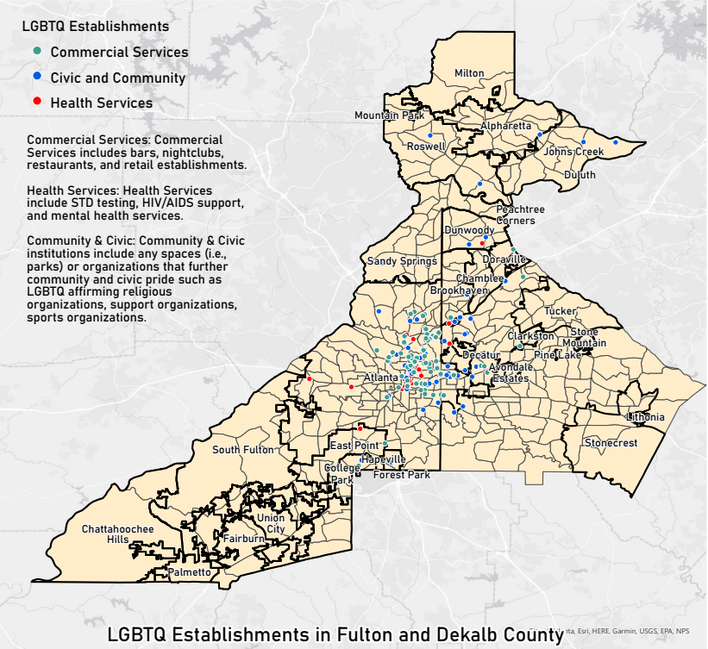
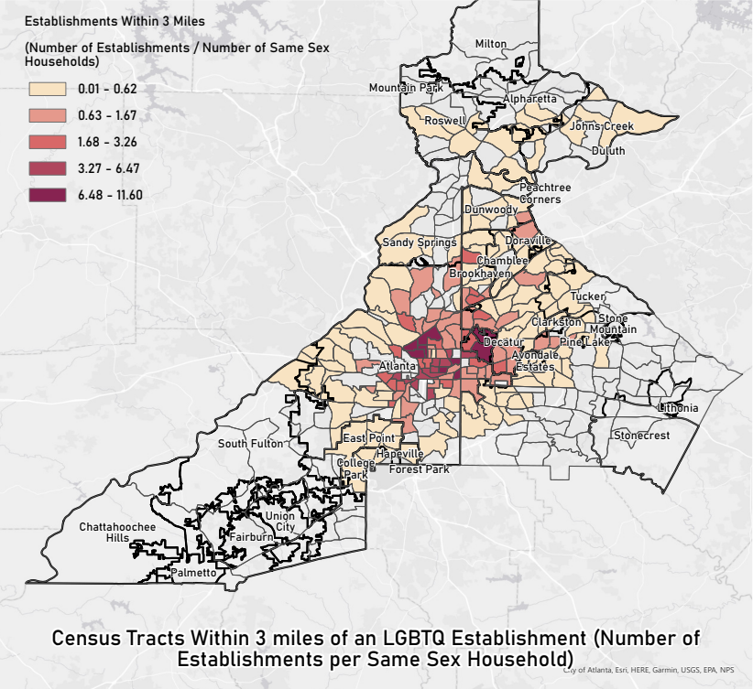
Results
Notes:
LB

Slide 13
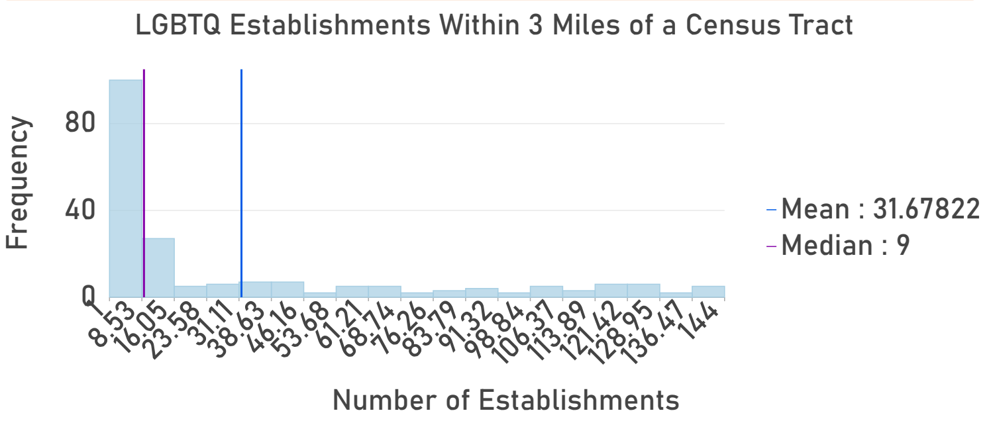
Results
LGBTQ Establishment Category | Weighted Average Household Distance to Nearest Establishment (Miles)
All | 1.73
Commercial Services | 2.68
Civic and Community | 2.09
Health Services | 2.97
Notes:
LB

Slide 14
Limitations
The major limitation of our research is that we only have data on UPSSHs for 2000 and 2010 and same sex households for 2019. Moreover, the Census Bureau does not collect data on the sexual orientation or gender identity of people.
We also had limitations with our data on the locations of LGBTQ-serving commercial services, health services, and community/civic sites and organizations. First, not all services and organizations had physical addresses, but still provided vital community resources. Another limitation of mapping LGBTQ institutions is the subjectivity of these places. A queer-friendly space is loosely defined as a space that makes LGBTQ people feel welcome, though defining and collecting this data is very difficult and time consuming.
Within the time and funding constraints of this project, our research maximized our ability to collect data that would assist our analysis.
Notes:
ND

Slide 15
Citations
Atlanta Regional Commission. (2019, February 14). Interactive Data & Mapping Tools. ARC. Retrieved December 10, 2021, from https://atlantaregional.org/atlanta-region/regional-data-resources/interactive-data-mapping-tools/.
Doan, Petra L., and Harrison Higgins. “The Demise of Queer Space? Resurgent Gentrification and the Assimilation of LGBT Neighborhoods.” Journal of Planning Education and Research 31, no. 1 (2011): 6–25. https://doi.org/10.1177/0739456x10391266.
Gatta, G. M. (2021). Search &gt; USA &gt; Georgia &gt; Atlanta. Damron: The First Name and Last Word in Lesbian and Gay Travel. Retrieved November 18, 2021, from https://damron.com/place/atlanta.
GayCities. “Gay Atlanta Guide - Gay Bars & Clubs, Hotels, Beaches, Reviews and Maps.” Gay Atlanta. GayCities. Accessed December 1, 2021. https://atlanta.gaycities.com/.
Georgia Voice Community, 2021. “Georgia Voice: Gay Atlanta News, Events, & Entertainment.” Georgia Voice - Gay & LGBT Atlanta News. The Georgia Voice, April 19, 2021. https://thegavoice.com/.
“Most Popular Atlanta LGBTQ Nonprofits and Charities.” GreatNonprofits. Accessed December 1, 2021. https://greatnonprofits.org/city/atlanta/GA/category:lgbtq/sort:review_count/direction:desc.
US Census Bureau, 2010 Census Tiger/Line shapefiles § (2000).
US Census Bureau, 2010 Census Tiger/Line shapefiles § (2010).
US Census Bureau, UNMARRIED-PARTNER HOUSEHOLDS BY SEX OF PARTNER §. Accessed December 1, 2021. https://data.census.gov/cedsci/table?q=B11009%3A%20COUPLED%20HOUSEHOLDS%20BY%20TYPE&g=0500000US13089%241400000,13121%241400000&tid=ACSDT5Y2010.B11009.
US Census Bureau, HOUSEHOLD TYPE (INCLUDING LIVING ALONE) BY RELATIONSHIP §. Accessed December 1, 2021. https://data.census.gov/cedsci/table?q=b09019&g=0500000US13089%241400000,13121%241400000.
US Census Bureau, Unmarried Partner Households by Sex of Partners § (2000). Accessed December 1, 2021. https://data.census.gov/cedsci/table?t=Same%20Sex%20Couples&g=0400000US13_0500000US13121%241400000&y=2000&tid=DECENNIALSF32000.PCT001&hidePreview=true.
Yelp. Yelp. Accessed December 1, 2021. https://www.yelp.com/.

Slide 16
Questions?

