Slide 1
ADVENTURES IN
SUSTAINABILITY
Presentation
2012 Annual Conference
Georgia Chapter, American Planning Association
September 27, 2012

Slide 2
Today’s Session
Session Introduction
Approaches to Sustainability
PEACH Roads Overview
Transportation Sustainability Rating Systems
Old School, New School – This Place, That Place
Transit-Oriented Development: The Key to Smart Growth
What We Know For Sure

Slide 3
Jamie Cochran, AICP
Senior VP – Transportation Planning
Gresham, Smith, and Partners
Our Panelists:
Jane Stricklin, PE
PEACH Roads Manager
Cobb County DOT
Jay Bockisch, PE, PTOE
Senior Associate
Gresham, Smith, and Partners
Adelee Le Grand, AICP
Associate Vice President
AECOM
Katherine Moore
Sustainable Growth Program
Georgia Conservancy

Slide 4
Sustainability is:
Different things to different people
A complex idea with many parts
Not well understood or accepted by Americans
A critical concept in planning

Slide 5
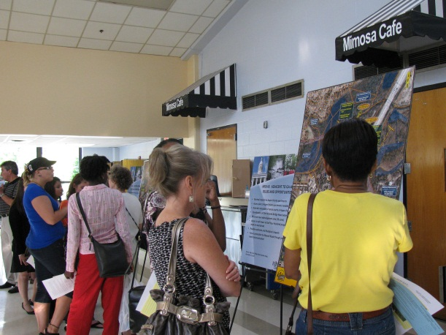
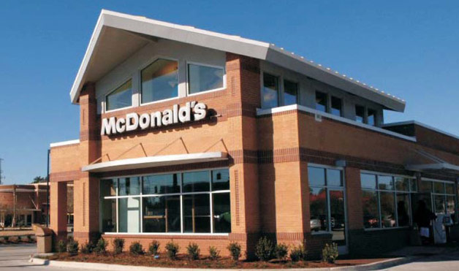
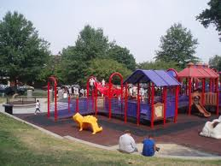
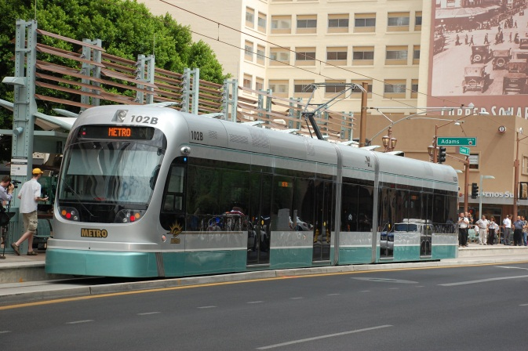
Sustainability is NOT just:

Slide 6
It’s the INTERSECTION of all this….

Slide 7
Good planners and
engineers understand
what people want….
Local businesses
Aging in place
Sidewalks
Energy-efficient homes
Availability of transit
Neighborhood parks
Source: “Planning in America”, APA, 2012

Slide 8
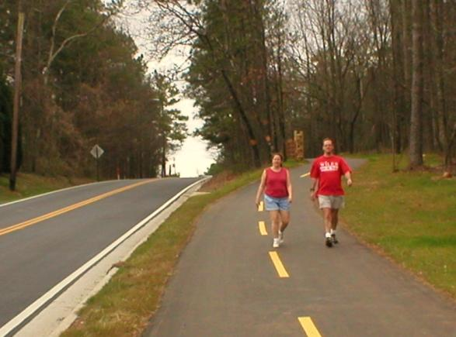
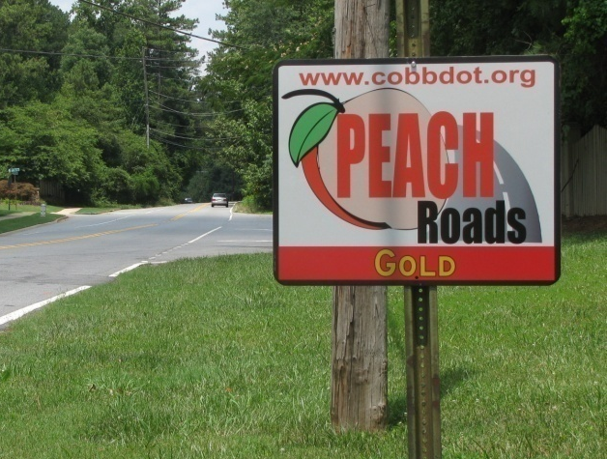
PEACH Roads Overview
Cobb County Department of Transportation
Jane Stricklin, P.E. , PEACH Roads Manager
September 27, 2012
Notes:
Photos:
Kennesaw Mountain Trail
Lower Roswell Road
Indirect Left Plans for Barrett Parkway
Overview of PEACH Roads Program

Slide 9
Jane Stricklin, PE – Cobb County Department of Transportation
Notes:
The Cobb County Department of Transportation (CCDOT) is committed to improving the quality of our transportation infrastructure in ways that minimize impacts to the environment, including the depletion of irreplaceable resources. To recognize transportation project designs, operations and maintenance practices that incorporate a high level of environmental sustainability, CCDOT has implemented “ PEACH Roads” a transportation environmental sustainability rating program.

Slide 10
How was PEACH Roads developed?
Triple bottom line of Sustainability
Balancing Environment, Community and Economy
Derived primarily from NYSDOT’s GreenLITES program, AASHTO and other sources
Adapted from GreenLITES to provide a custom fit for Cobb County and Georgia
Notes:
Triple bottom line of sustainability: cost effective approach to sustainability (balancing economy, community and environment)
Incorporates sustainability principles (human use of resources that doesn’t exhaust those resources)
Derived from U. of Washington’s GreenRoads, US Green Building Council LEED Program, AASHTO, other sources, and predominantly NYSDOT’s GreenLITES program
Adapted from GreenLITES but tailored to provide a custom fit for Cobb County and Georgia
CCDOT looked all over the country (i.e. research on internet) at various programs and GreenLITES was most suitable for Cobb and Georgia
GreenLITES program has been used in NY State since 2009

Slide 11
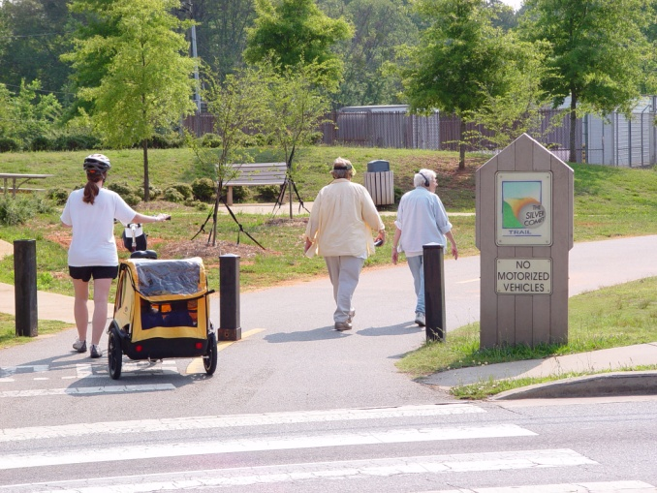
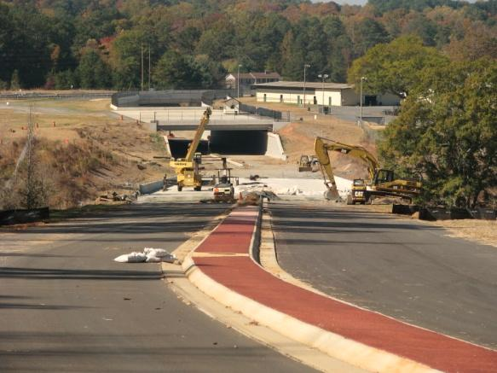
Design Philosophy
Protection and enhancement of the environment
Protection and enhancement of the environment
Conserving energy and natural resources
Promoting the effective and efficient use of limited public funds
Encouraging more public involvement in the various transportation processes
Integrating smart growth and sound land-use practices
Endorsing the use of recycled materials
Fostering long term big picture thinking regarding the future of transportation

Slide 12
Why implement a PEACH Roads program?
Build on Cobb’s tradition for cost effective solutions to quality of life issues
Minimize negative impacts to the environment and communities
Protection and enhancement of environment
Recognize transportation projects which meet PEACH Roads certification requirements
GDOT Partnership - implement statewide if Cobb pilot program successful
Cobb County’s First Roundabout at West Sandtown Road
Notes:
Photo – West Sandtown Road at Villa Rica Road

Slide 13
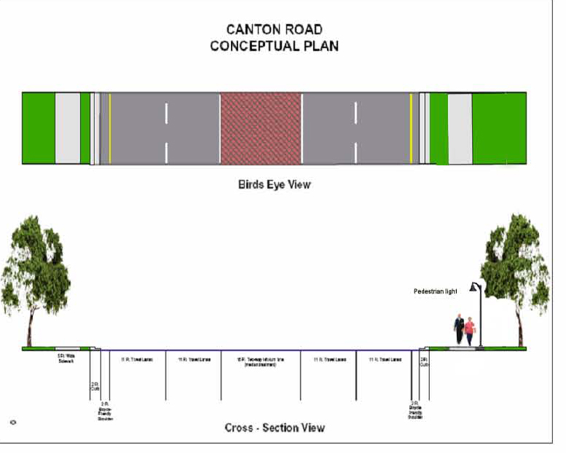
How will PEACH Roads work?
A self-assessment, metrics based certification program in partnership with GDOT
Similar to LEEDs program, points awarded based on criteria for each project before it bids
Implemented in stages: Design/Construction, Maintenance and Planning Tools
Notes:
Photos:
Canton Road conceptual plan – extensive public meeting involvement evolved concept
“Swale” picture

Slide 14
Certification
Four levels of certification
15-29 Certified
30-44 Silver
45-59 Gold
60+ Evergreen
Notes:
PM will score but PEACH Roads Program Manager (Jane Stricklin) will verify and certify as appropriate
<15 Non-certified – 2011: 5 & 2012: 7
15-29 Certified – 2011: 9 (8 Cobb, 1 Marietta) & 2012: 6
30-44 Silver – 2011: 4 & 2012:2
45-59 Gold – 2011: 2 (Lower Roswell Rd & Noonday Creek Trail 2C) & 2012:0
60+ Evergreen
BOC could use as tool to compare sustainability and cost effectiveness through comparison of PEACH Roads scores
Could use as Benefit/Cost= Peach score X ADT / $ Cost
Initially project will be in lower point range due to emergency contracts, unit price contracts and fixed budget committed projects
Report to BOC on annual basis (similar to Time-Travel Report)
Certification similar to Green Roads & LEEDS (platinum)
Only rate projects that are $100,000 and above.

Slide 15
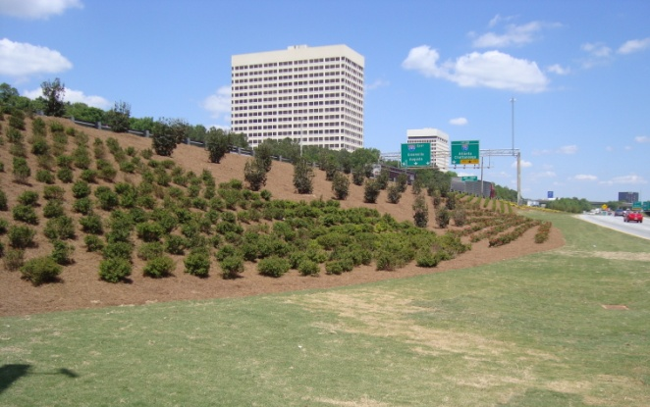
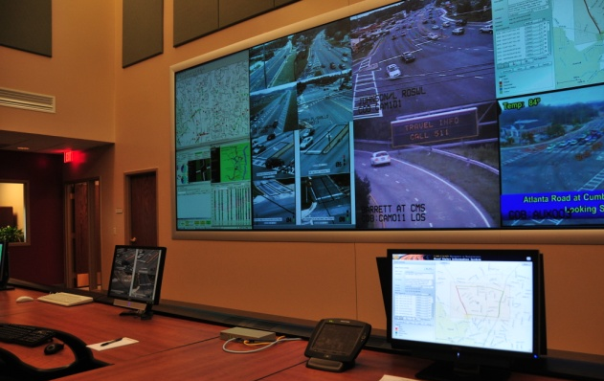
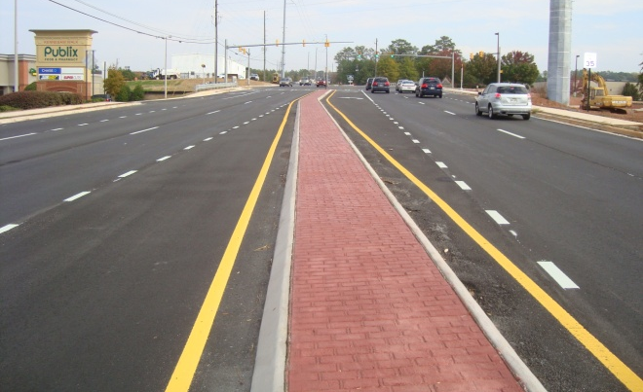
Practical Examples
Recyclable materials
Context sensitive design
Integrated land use and transportation planning
Use of Roundabouts, Indirect Left Turns, Queue Jumper Lanes and other innovative road designs
Other sustainability innovations including solar power and adaptive signal timing
Before/After landscaping improvements at I-285 and Cobb Parkway
Increasing traffic capacity through technology
Using recyclable materials
Notes:
Photos:
I-285 landscaping improvements – joint Cobb/GDOT/CID project - dramatic improvement
Cobb TMC video wall – using technology to get more capacity to handle incidents better
Resurfacing of Jiles Road with recycled asphalt – 40% maximum
Recyclable materials – resurfacing, steel truss bridge (East Cobb Park), concrete ground up for stone
Context sensitive design - is scaling the design to environment and community
Ex. Joe Jerkins Bridge in Austell and Lower Roswell Road East, Canton Road, Childers, Post Oat Tritt
Integrated land use and transportation planning
Innovative Design -
Roundabouts
Indirect Left Turn (Barrett Parkway and Burnt Hickory Road)
Hot in place asphalt
Adaptive Signal Timing
Queue jumper lanes
LED Traffic Signals, ATMS – Adaptive Traffic signals – increasing capacity from existing infrastructure
Solar Power – Pilot project on County Services Parkway – many commission interest
Other innovations –
What else can we come up with if we work on it? Promote creative and critical thinking.

Slide 16
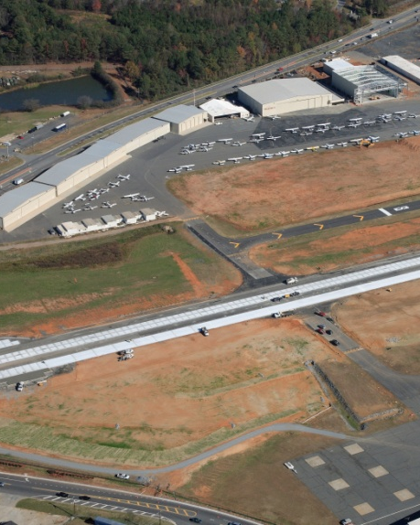
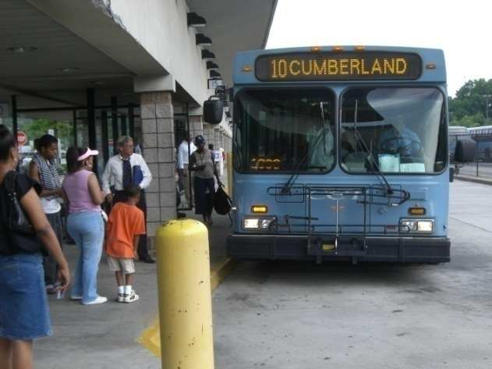
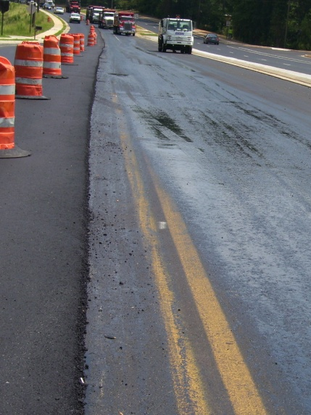
Benefits
Conserve energy, natural resources and promote use of recycled materials
Promote effective and efficient use of limited public funds
Provide more sidewalks, transit enhancements and other forms of alternate transportation
Increase use of roadway materials with longer life and less maintenance
Encourage more public involvement
Preserve Cobb’s Heritage as a quality place to live, work and play
Notes:
Work in transit
Transit alternate fuels
Cost-effective methods for transit - improve LOS of roadway network
Signal preemption and arterial improvements

Slide 17
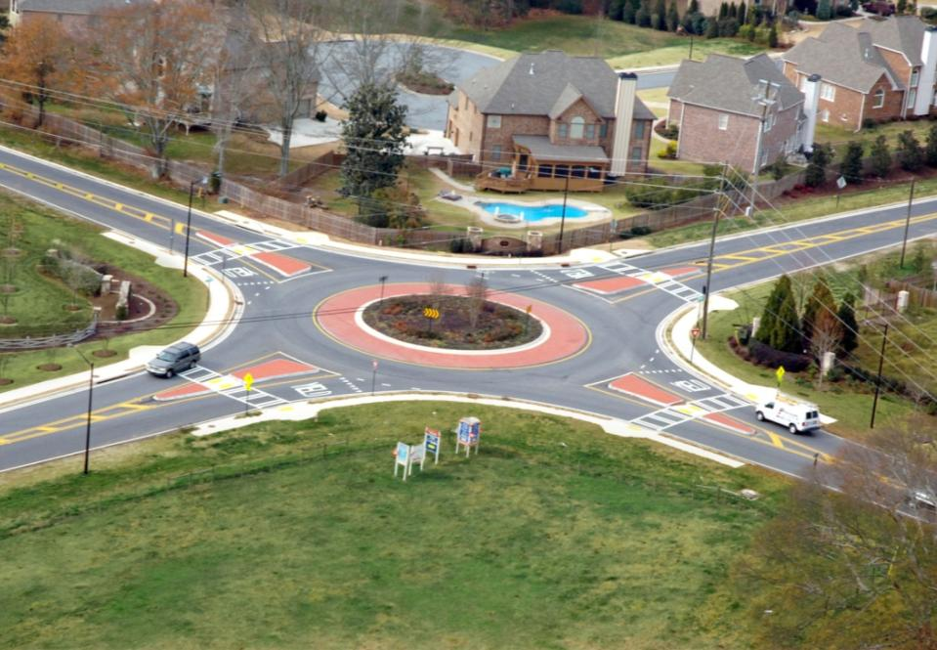
Transportation Sustainability Rating Systems
Presented by:
Jay Bockisch, PE, PTOE , Senior Associate
Gresham Smith and Partners
Alpharetta, GA

Slide 18
Transportation Sustainability Rating Systems
Introduction
Evaluation of four rating systems
Six projects
Comparison of rating systems & projects
Conclusions
Questions

Slide 19
How is Sustainability in Transportation Measured?
Sustainability is measured through a sustainability rating/certification system
There are various rating/certification systems have been developed at the national, state and local levels
These systems have been developed by academia, government and private entities

Slide 20
Why Evaluate the Different Sustainability Rating Systems?
Better understand the different systems
Can systems handle “real world” situations and tradeoffs?
How do different systems handle different types of projects?
Are there common trends among the different rating systems?
Are these systems sensitive to relatively small scale traffic engineering type projects?

Slide 21
Various Sustainability Rating Systems
National Level
Invest – FHWA
Envision – Institute for Sustainable Infrastructure & Harvard
LEED ND – US Green Building Council
State Level
Greenroads – Washington DOT, U of Washington & CH2M Hill
GreenLites – NY State DOT
I-Last – Illinois DOT
Local
Peach Roads – Cobb County, GA (based on GreenLites)
STARS – Portland, OR

Slide 22
Various Sustainability Rating Systems
National Level
Invest – FHWA
Envision – Institute for Sustainable Infrastructure & Harvard
LEED ND – US Green Building Council
State Level
Greenroads – Washington DOT, U of Washington & CH2M Hill
GreenLites – NY State DOT
I-Last – Illinois DOT
Local
Peach Roads – Cobb County, GA (based on GreenLites)
STARS – Portland, OR

Slide 23
Comparison of Transportation Sustainability Rating Systems
Introduction
Evaluation of four rating systems
Six projects
Comparison of rating systems & projects
Conclusions
Questions

Slide 24
Points Breakdown
Traffic Related Categories
Transportation Planning
Traffic Operations/ITS
Multi Modal
Intermodal/Truck
Safety
Emissions/Fuel Consumption
Roadway Related Categories
Design (Road, Bridge, Landscape)
Environment & Water Quality
Other Disciplines
Planning
Materials
Emissions/Fuel Consumption
Construction Methods

Slide 25
Points Breakdown – Traffic Engineering Related
Category | INVEST | Envision | GreenRoads | Peach Roads
Transportation Planning | 12% | 13% | 5% | 6%
Traffic Operations/ITS | 4% | 5% | 5% | 19%
Multimodal (Transit, Ped and Bike) | 4% | 4% | 8% | 3%
Intermodal/Truck | 6% | 0% | 0% | 2%
Safety | 9% | 2% | 2% | 0%
Emissions/Fuel Consumption - Traffic | 0% | 5% | 4% | 2%
Traffic Engineering Related Total | 35% | 29% | 24% | 32%

Slide 26
Points Breakdown – Roadway Design Related
Category | INVEST | Envision | GreenRoads | Peach Roads
Design (Road, Bridge, Landscape) | 8% | 10% | 13% | 30%
Environment & Water Quality | 17% | 25% | 15% | 15%
Roadway Design Total | 25% | 35% | 28% | 45%

Slide 27
Points Breakdown – Other Disciplines
Category | INVEST | Envision | GreenRoads | Peach Roads
Planning | 3% | 20% | 6% | 4%
Materials | 16% | 3% | 28% | 16%
Emissions/Fuel Consumption - Other | 9% | 8% | 5% | 2%
Construction Methods | 12% | 5% | 9% | 1%
Other Disciplines Total | 40% | 36% | 48% | 23%

Slide 28
Summary Comparison of Rating Systems
Category | INVEST | Envision | GreenRoads | Peach Roads
Traffic Engineering Related Total | 35% | 29% | 24% | 32%
Roadway Design Related Total | 25% | 35% | 28% | 45%
Other Disciplines Total | 40% | 36% | 48% | 23%

Slide 29
Comparison of Transportation Sustainability Rating Systems
Introduction
Evaluation of four rating systems
Six projects
Comparison of rating systems & projects
Conclusions
Questions

Slide 30
Overview of Projects Evaluated
Project Name | Type | Scale - Cost
Big Creek Parkway – Roswell, GA | New Road Corridor, Complete Street and Bike & Pedestrian facility | Large
North Peachtree – Dunwoody, GA | Traditional Intersection Improvement with Signal Upgrades and Bike & Pedestrian improvements | Medium
Grimes Bridge Roundabout – Roswell, GA | Non-Traditional Intersection with Bike & Pedestrian improvements | Medium
Roswell Shared Parking | Shared Parking with Pedestrian Path – Minimal Construction | Small
Dothan Signal Timing | Traffic Operations – No Construction | Small
I-85 HOT Lanes – Gwinnett County | ITS, Traffic Operations, HOT and Transit | Large

Slide 31
Big Creek Parkway

Slide 32
North Peachtree at Tilly Mill – Dunwoody, GA

Slide 33
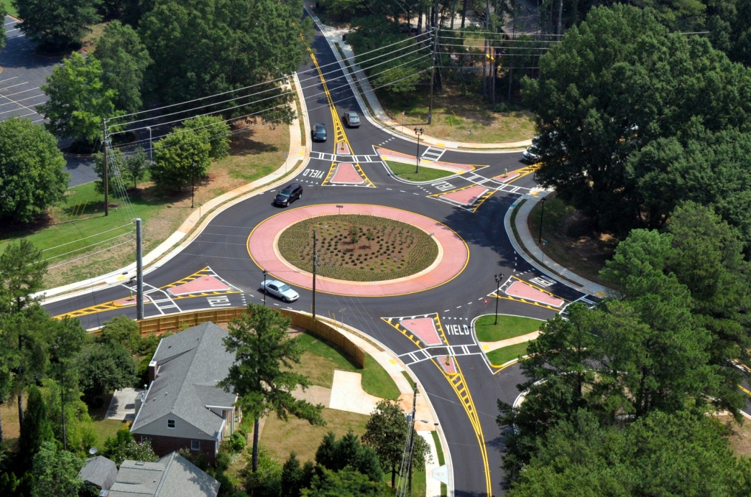
Grimes Bridge Roundabout

Slide 34
Roswell Shared Parking
Restaurant/Retail area
City Hall Parking

Slide 35
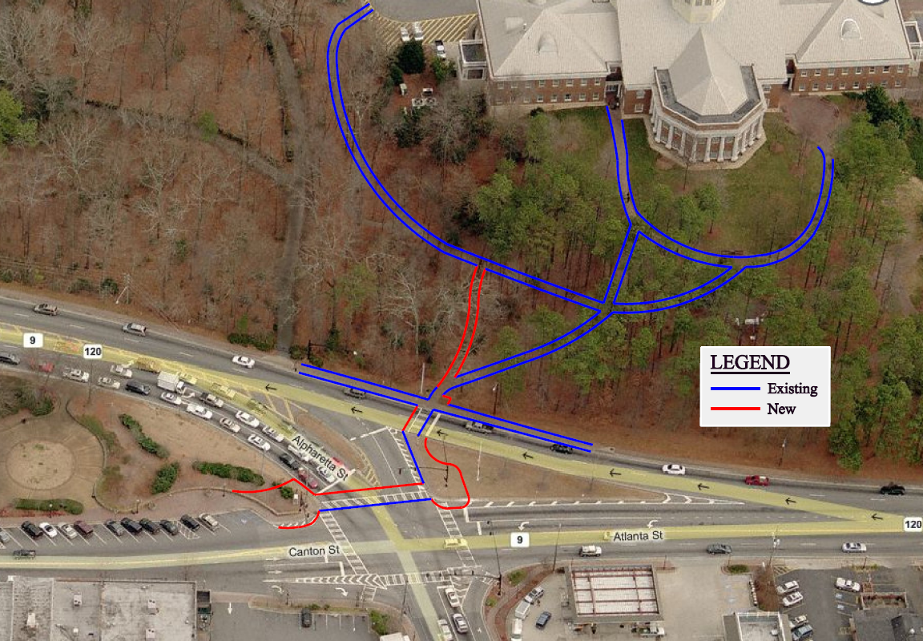
Roswell Shared Parking

Slide 36
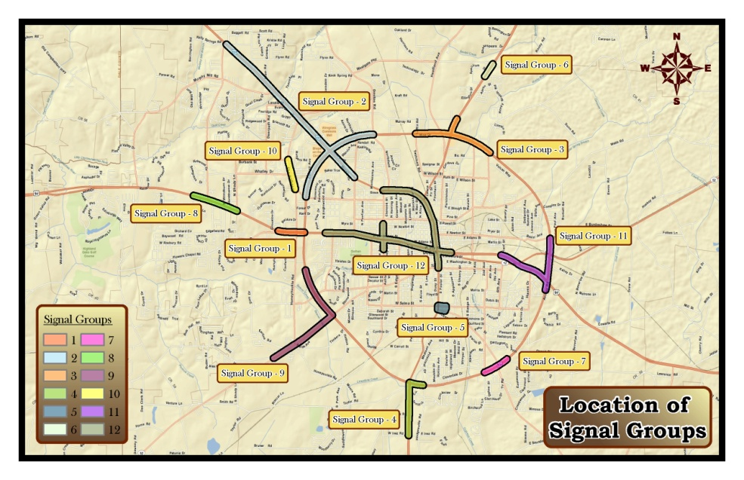
Dothan, AL Signal Timing

Slide 37
I-85 HOT Lanes

Slide 38
Comparison of Transportation Sustainability Rating Systems
Introduction
Evaluation of four rating systems
Six projects
Comparison of rating systems & projects
Conclusions
Questions

Slide 39
Ranking of Projects Evaluated – All Categories
Category | INVEST | Envision | Green Roads | Peach Roads | Combined
Big Creek Parkway – New Roadway Corridor | 1 | 1 | 2 | 1 | 1
North Peachtree – Traditional Intersection Improvement | 2 | 4 | 5 | 2 | 3
Grimes Bridge Roundabout – Innovative Intersection Improvement | 3 | 3 | 4 | 4 | 2
Roswell Shared Parking – Better Use of Existing Facilities (Minimal Construction ) | 6 | 2 | 3 | 3 | 4
Dothan Signal Timing - | 5 | 6 | 6 | 6 | 6
I-85 HOT Lanes – Managed Lanes with Transit Improvements | 4 | 5 | 1 | 5 | 5

Slide 40
Comparison of Transportation Sustainability Rating Systems
Introduction
Evaluation of four rating systems
Six projects
Comparison of rating systems & projects
Conclusions
Questions

Slide 41
Conclusions
Good planning and engineering is the essence of sustainability but may not be explicitly recognized
Areas that should be increased
Efficiency – ITS, Signal Timing, Managed Lanes/Tolling
Safety – Use of HSM
Multi Modal & HOV/HOT
No easy way to capture innovative concepts that reduce size, scope and impact of projects
DDI vs. New Bridge
CFI vs. New Interchange
Shared parking vs. New Parking structure
Scale of project impacts scoring
Peach Roads most applicable to roadway projects in GA

Slide 42
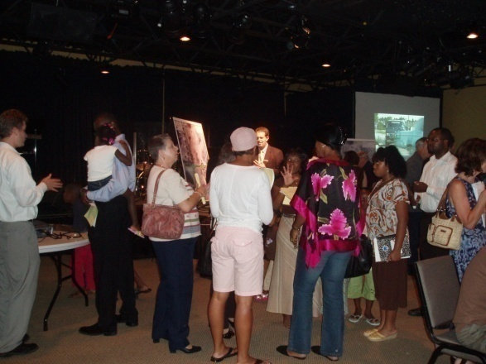
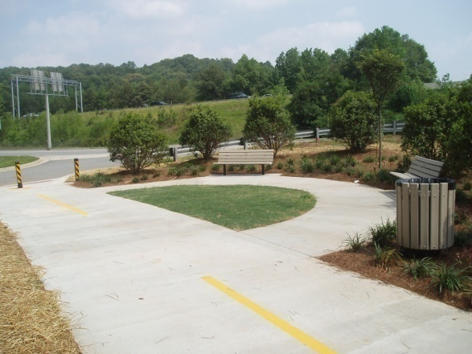
Questions?
Cobb County Department of Transportation
Jane Stricklin, P.E. , PEACH Roads Manager
770-420-6664
jane.stricklin@cobbcounty.org
Gresham, Smith, and Partners
Jay Bockisch, PE, PTOE
770-754-0280
jay_bockisch@gspnet.com
Notes:
Photos:
Public meeting
LED lights
Pocket Park
The Board of Commissioners authorized the Department to partner with the Georgia Department of Transportation to initiate the PEACH Roads Program as a pilot project for transportation sustainability for 2 years starting January 1, 2011.

Slide 43
Old School, New School This Place, That Place
An Overview of the
epa school siting guidelines
Katherine Moore, AICP
Georgia Conservancy, Sustainable Growth Program

Slide 44
acknowledgements
This project was funded by a grant from the
U.S. Environmental Protection Agency, Source Reduction Assistance Grant Program (Multi-Regions Projects)
Project Team
Consultant
Notes:
Acknowledgements
The development of this curriculum was funded by EPA with matching funding from the Arthur M. Blank Family Foundation and staff support from the Georgia Conservancy, Mothers & Others for Clean Air, and the US Green Building Council, Georgia Chapter. These three organizations formed the project team and worked closely with their consultant, Symbioscity, on the development of this curriculum. The project team also wishes to thank the National Trust for Historic Preservation and EPA, Region IV for their assistance.

Slide 45
School Siting
School siting refers to any and all decision-making about:
the location and configuration of new schools,
renovation vs. new construction and
reconfiguration and repurposing of existing schools.

Slide 46
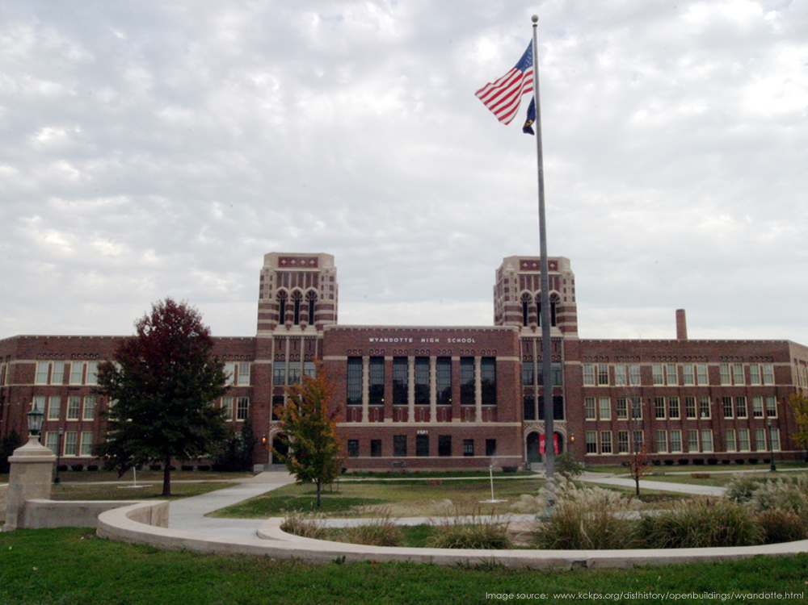
Old school in the
heart of town
Notes:
[These slides should be read in the pentameter of Dr. Seuss. Slide 16 is animated to scroll through the text.]

Slide 47
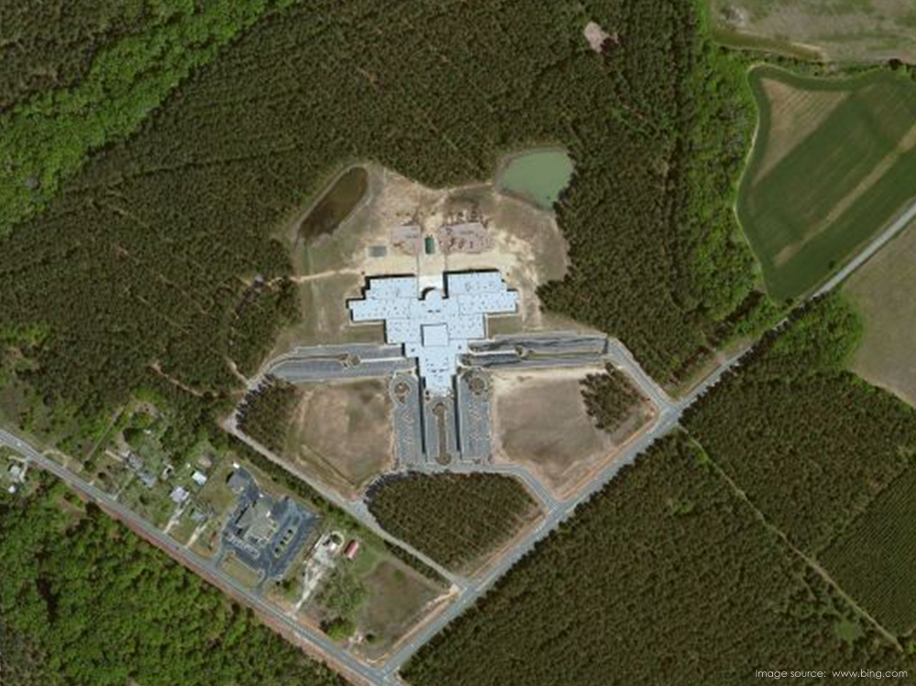
New school on land from Farmer Brown

Slide 48
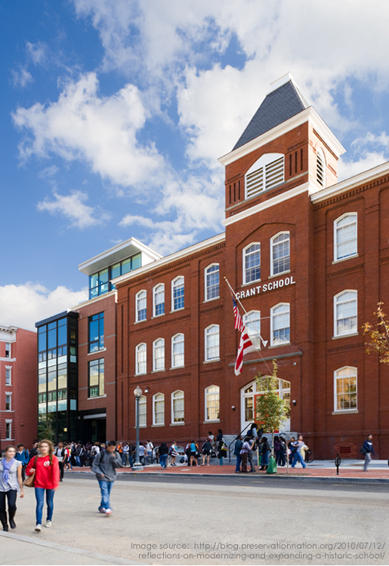
This place kids can walk and thrive.

Slide 49
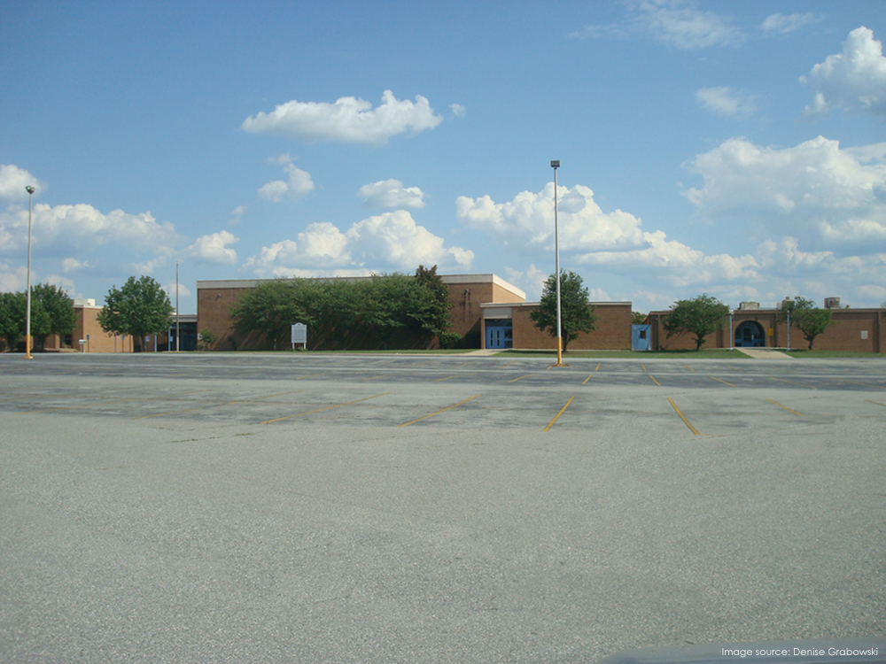
That place parents have to drive.

Slide 50
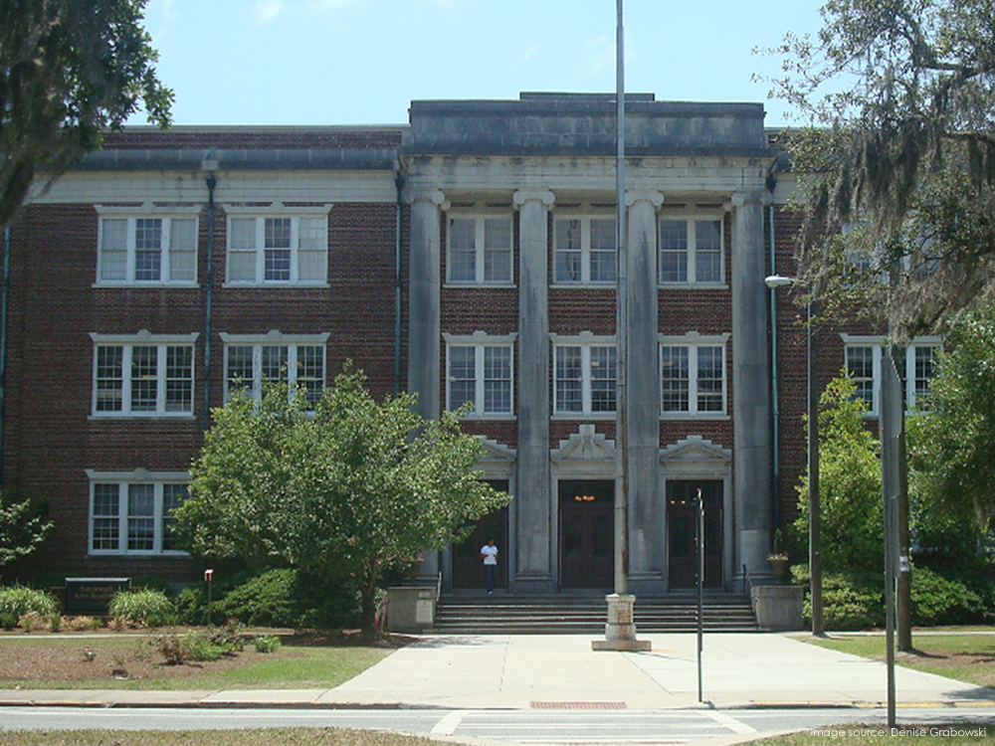
Old school is 3 stories tall

Slide 51
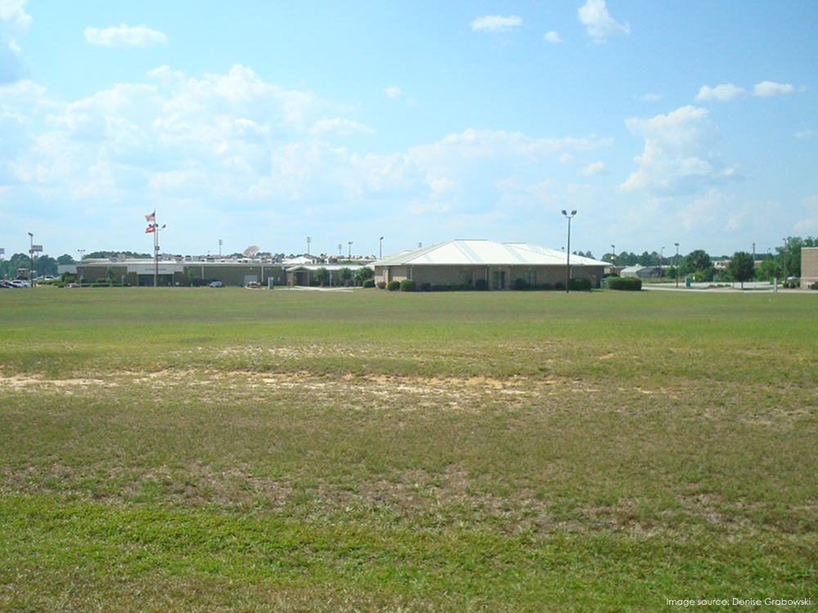
New school is one story sprawl

Slide 52
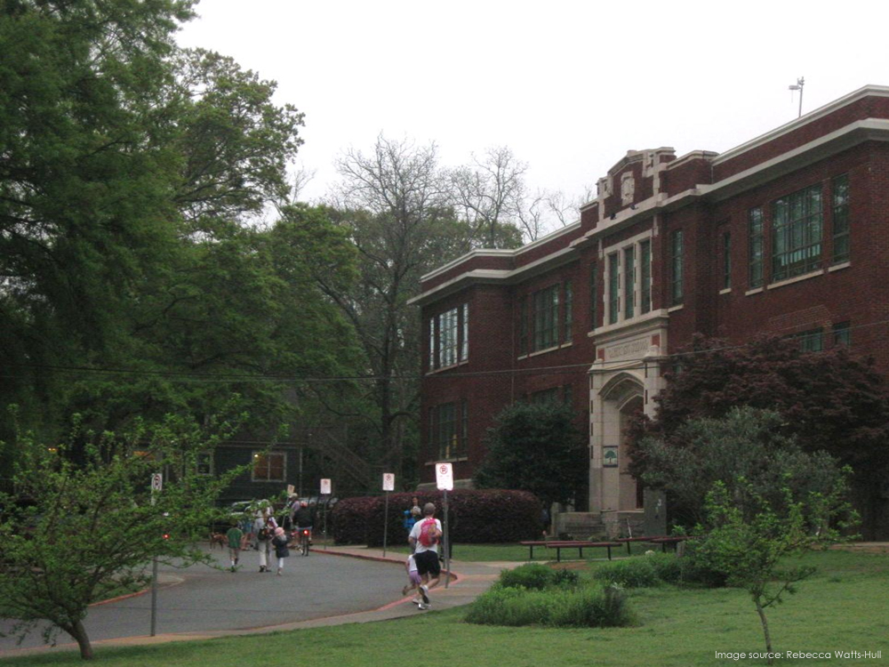
This place,
new buildings just won’t fit

Slide 53
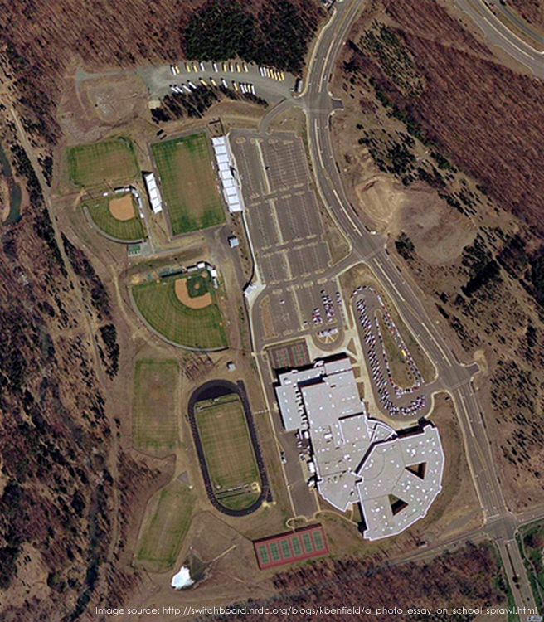
That place, space galore, for all of it
Notes:
{High school on a157-acre site - incidentally, is roughly twice the size of Disneyland in California and about half again as large as the Magic Kingdom at Walt Disney World in Florida. Source: http://switchboard.nrdc.org/blogs/kbenfield/a_photo_essay_on_school_sprawl.html}

Slide 54
Epa school siting guidelines
Voluntary
Directive from Congress to create model guidelines accounting for:
Special vulnerability of children to hazardous substances or pollution exposures
Modes of transportation available to students and staff
The efficient use of energy
The potential use of a school as an emergency shelter
Notes:
{EPA Guidelines – p.1}

Slide 55
These guidelines:
WILL | WILL NOT
Provide a resource | Mandate school location choices
Emphasize the need for public involvement | Provide a detailed guide on how to engage the public
Provide guidance on locating school facilities | Apply retroactively to previous siting decisions
Encourage holistic thinking | Specify clean up standards, etc. for sites
Notes:
The EPA School Siting Guidelines provide an excellent tool to initiate discussion about school siting issues in your community. While these guidelines cannot provide all the answers, the document is filled with many, many additional references and sources. Users of the electronic version of the document will benefit from the ease of the hyperlinks to additional information.

Slide 56
Trends in Georgia
Notes:
But before we jump into the guidelines, let’s look first at trends here in Georgia to provide some context for our discussions today.
The U.S. Department of Education estimates that the nation’s student population will top 60 million by 2030. Less certain is how many school buildings will be open by that time, for while the number of students has risen steadily, the number of schools is dwindling.

Slide 57
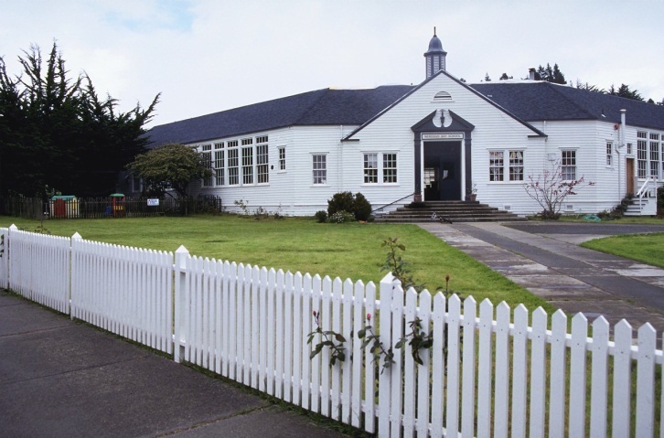
1953: 863,761 students
2011: 1,634,251 students
# of
Schools
# of
Students
1953: 3,113 schools
2011: 2,246 schools
Notes:
Consider that in 1930, some 262,000 schools were open in the U.S. Today, the total is not much more than one-third of this number at less than 95,000. Obviously the average school size has grown tremendously over the past 80 years, as have average class sizes.
{Kissane, John. Georgia School Siting White Paper, prepared for GeorgiaBikes!/Georgia Safe Routes to School State Network, March, 2011. p. 4}
In 1953, there were just over 3,100 schools in Georgia, serving 863,761 students.
[CLICK]
From 1953 to 2011, the number of students almost doubled, but in the same time period, the number of schools decreased by almost one-third.
[CLICK]
While the pros and cons of larger schools serving more students are continually under debate, what is more evident is the impact of larger schools on site selection and school design. In many places as schools move away from population centers, the white picket fences of neighborhood schools are replaced with security fences in sparsely populated areas.
{http://www.doe.k12.ga.us/Pages/By-School.aspx - 2010-2011 Report Card}
{Annual Reports of the Department of Education to the General Assembly of the State of Georgia, June 30, 1954}.

Slide 58
Contamination
Future of
existing school?
Equity
Can students
walk safely?
Student Population
Acreage Requirements
Access
Utilities
Construction Costs
Operating
costs
Coordinated
planning
Test scores
Learning
environment
Community
Values
Regional
transportation
Neighborhood
impacts
Diversity
Transportation
costs
Adjacent
land uses
Public
involvement
Cost-benefit
ratios
Air pollution
Renovate or
reuse instead
of new?
High performance,
healthy school
Politics
Attendance
zones
Notes:
At first glance, there seem to be some pretty basic criteria that influence where a school will go. You’ve probably seen this list before, right?
[CLICK]
But in reality, the complexities surrounding school siting are enormous. There’s seldom – if ever – such a thing as a perfect location. The discussions we will have today are only the tip of the iceberg and we cannot possibly address every single influence that plays into school siting in the time we have. But what we will do is provide information and resources that can help you and your community to better understand and address a range of school siting issues.
Because really at the end of the day…it’s all about community values.

Slide 59
www.epa.gov/schools/siting
Notes:
And that’s where the EPA School Siting Guidelines come in! You can download a free copy at the website shown on the screen and I strongly encourage each of you to do just that, if you haven’t already.

Slide 60
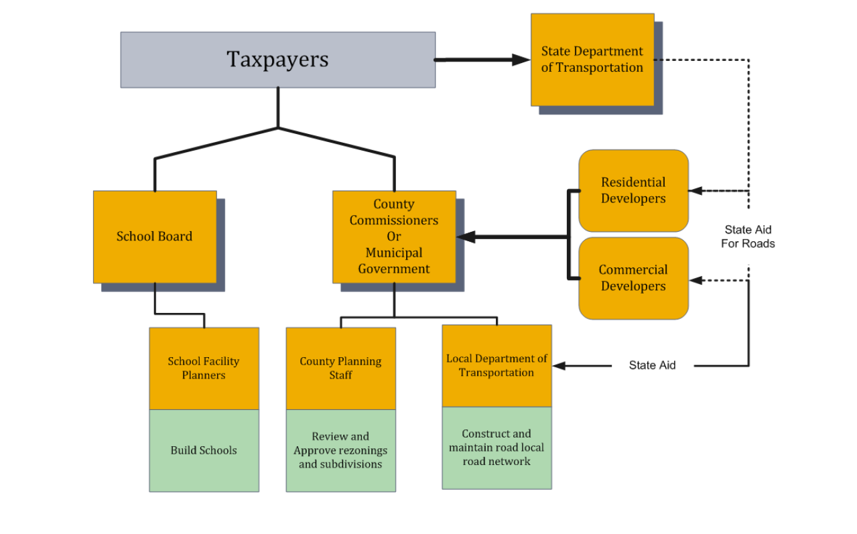
“School districts are chartered by the state constitution with their own governing bodies. County governments are chartered by the state constitution. They don‘t talk to one another very much. That is a symptom of the Home Rule provision in the state constitution. Sometimes staff wants to talk to each other, but their bosses—the elected officials—don’t want them to.”
Graphic: James Bartley Wagner
Notes:
In reality, however, over the past 35 years, school planning and land use planning have become separated fields. In high growth states, school facility planners are building multiple new facilities each year and sometimes build in areas just beyond the development frontier, primarily due to cost and land availability constraints. This can cause these areas to become more attractive to developers and result in transportation agencies filling the gap in infrastructure to serve the new development.
While some states have recognized this issue and implemented mandatory statewide planning initiatives to require school districts and county governments to work together, Georgia has not yet done so. In many cases, county planning staff and school planning staff have no formal communication and are forced to take reactive measures rather than plan cooperatively.
Ultimately school districts and county government are separate entities, chartered by the state constitution, and can operate autonomously. However, uncoordinated actions do not benefit the community. This flowchart illustrates the current institutional framework viewed from the taxpayer‘s perspective.
{Wagner, James Bartley. p. 1-2}

Slide 61
Notes:
A school is like a magnet. Additional school capacity and the location of new schools often influence the location of residential development. Schools built on the fringes of communities can contribute to outward migration from city centers, which can cause disinvestment in existing neighborhoods and can hurt local economies. This phenomenon is particularly common when new school sites require the extension of infrastructure, making undeveloped areas more attractive for residential and commercial development.
{p. 38}

Slide 62
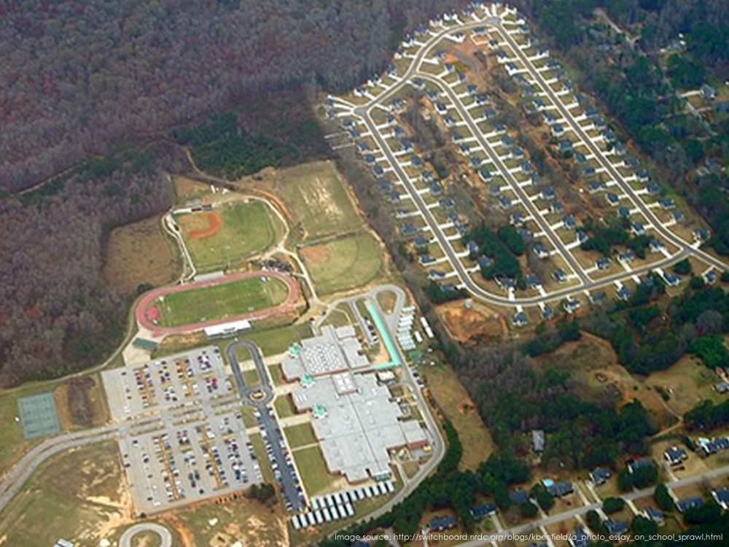
Notes:
{http://switchboard.nrdc.org/blogs/kbenfield/a_photo_essay_on_school_sprawl.html}

Slide 63
School site
Elementary School 5 acres
Middle School 12 acres
High School 20 acres
“Although minimum useable acreages are established, large acreages are highly desirable”
Plus one acre for each 100 children in FTE
Notes:
These are the school site standards found in the Georgia Department of Education’s Guidelines for Educational Facility Site Selection. Although it is possible to request a variance, the guidelines also state “Although minimum useable acreages are established, large acreages are highly desirable.”
As with many other states, these standards are based on recommendations developed in 1953 – at the height of the post-Second World War II suburban boom – by the Council of Educational Facility Planners International.
In 2004, CEFPI revised its guidelines, removing minimum acreage recommendations after recognizing that they are at odds with a variety of community goals and that they often raise transportation costs. Since then, a number of states have eliminated their minimum acreage requirements.
{Kissane, John. p.8}
{Reducing Costs in Kansas through Transportation Efficient School Siting, , p. 6}

Slide 64
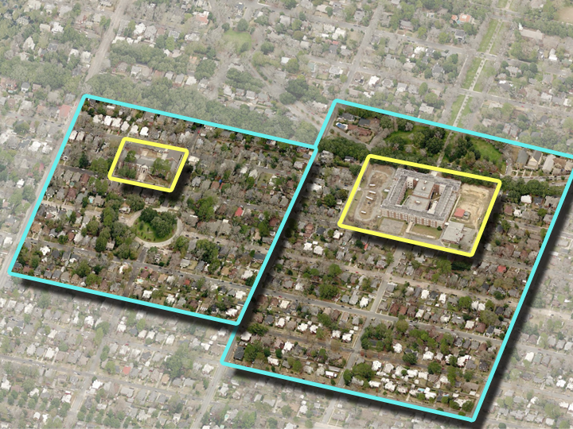
Notes:
So what if we had always had to adhere to those standards?
The areas in yellow show existing schools in a historic neighborhood. By today’s practices, these schools would consume the areas outlined in blue – clearly, the scale of our current practices are not in keeping with a neighborhood context. There are approximately 500 homes within the blue outlines shown.

Slide 65
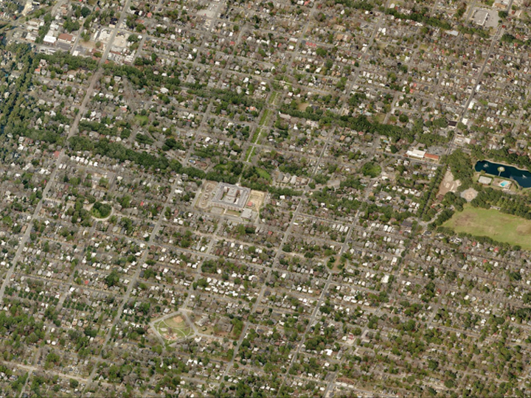
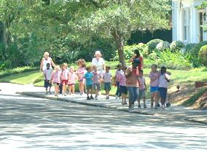
Notes:
The availability of public parks and walkability of the neighborhood streets certainly contribute to the functionality of these schools. The k-8 school [CLICK] frequently holds events and field trips at a nearby park [CLICK] that’s within walking distance. In fact, when an addition to the school took the school playground out of commission for 18 months, the smaller park [CLICK] a block away served as a temporary substitute.
The high school [CLICK] holds cross country practice running through the neighborhood and both schools utilize the nearby 75-acre city park [CLICK] for soccer practice, field day, and much more.
The schools even share with one another – basketball practice for the middle school students is often held at the nearby high school.
All of this is possible because the schools are compatible with the neighborhood scale, in close proximity to one another and to city parks and facilities, and through cooperation. What’s more is that the students can – and do – [CLICK] walk everywhere, fostering better health and saving bussing and transportation costs.

Slide 66
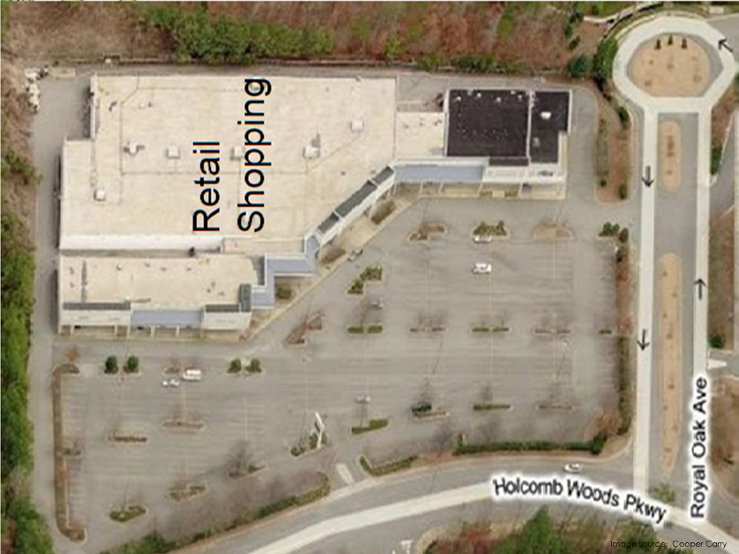
Notes:
Here we see an image of an old shopping strip mall with a furniture store outlet. With some creativity and vision, this former shopping mall was converted into a K-8 school. The excess parking area was converted into a playground complete with play fields, playground equipment and green space.

Slide 67
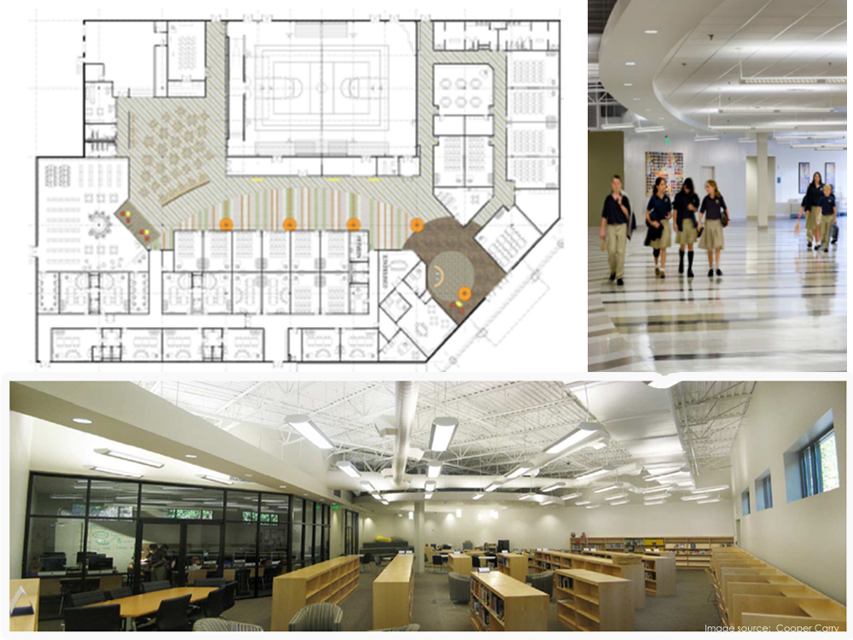
Notes:
Even though the building volume was large, the architect was able to create ‘Places of Encounter’ throughout the center spine with a successful main street concept which tied together classrooms and assembly spaces while using the existing structure and building skin. Of course this saved money allowing for higher performance finishes and site improvements. The main challenge for adapting a large structure such as a shopping mall is the lack of windows for each classroom. This can be rectified by including skylights, interior courtyards and new windows.

Slide 68
Modes
School Bus
Car
Walk
Bike
Impacts
Air Quality
Health
Costs
VMT
Notes:
So as we rely more on vehicular travel of buses and cars, our costs and VMT, or vehicle miles traveled, goes up, while air quality and health decline. As we discussed earlier, children are particularly susceptible to risks associated with poor air quality.

Slide 69
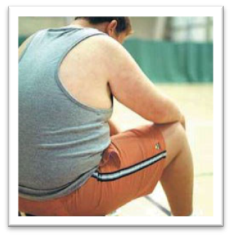
The prevalence of obesity among children and adolescents more than tripled from 1980 to 2008.
In 2008, more than one third of US children and adolescents aged 6–19 were overweight or obese.
Notes:
And then there’s the startling increase of obesity in our nation. The problem is not unique to adults.
Later in life, obese children are more likely to become obese adults, associated with a number of serious health conditions including heart disease, diabetes, and some cancers. Obesity in adulthood is likely to be more severe.
{Hedley AA, Ogden CL, Johnson C, Caroll M, Curtin L, Flegal K. Prevalence of overweight and obesity among US children, adolescents, and adults, 1999—2002. Journal of the American Medical Association 2004;291(23):2847–2850)(Ogden CL. Prevalence of high body mass index in US children and adolescents, 2007–2008. Journal of the American Medical Association 2010;303(3):242–249.) (http://www.cdc.gov/obesity/childhood/data.html}

Slide 70
Modes
School Bus
Car
Walk
Bike
Impacts
Air Quality
Health
Costs
VMT
Notes:
But there’s good news…a 2003 study by the Environmental Protection Agency looked at the environmental impacts of school siting including emissions and mode of travel to school by students. The conclusion of the study was that schools built close to students would reduce traffic, increase walking and biking by 13%, and could create a 15% emission reduction due to decreased travel to and from the school site.
{United States Environmental Protection Agency. "Travel and Environmental Implications of School Siting." Washington, DC: U.S. Environmental Protection Agency, 2003.}

Slide 71
Community
Collaboration
Creativity
Choices
Notes:
So I think by now we can all see that there’s not an easy, one-size-fits-all solution when it comes to school siting decisions. But I hope you will remember at least this:
[CLICK]
Schools are an integral part of the larger community and thus should reflect community values.
[CLICK]
Collaboration is key to the success of fully vetting these complex considerations. The entire community benefits from collaboration.
[CLICK]
Creativity can be part of your community’s solution. By viewing school siting from different perspective, we gain from creative approaches and new ways of looking at things.
[CLICK]
At the end of the day, it comes down to the choices we make. By working together as a community, collaboratively, and creatively, our choices are greater and so are our opportunities.
Thank you for your time today.

Slide 72
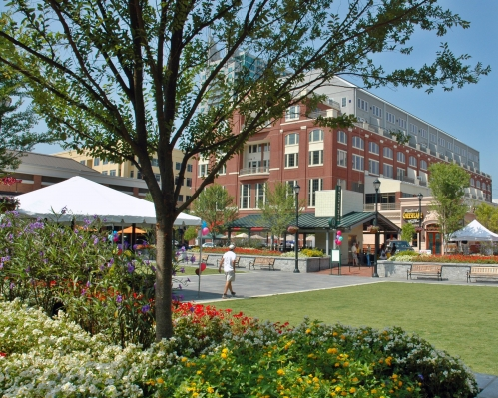
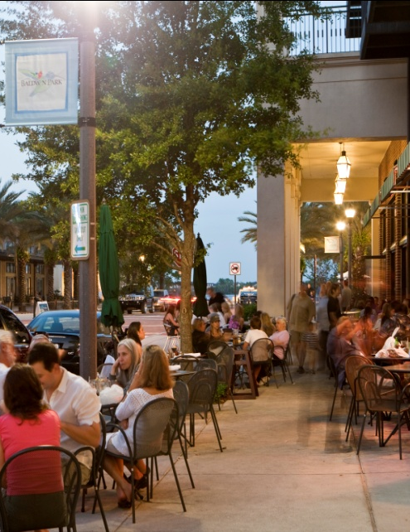
Transit-Oriented Development: The Key to Smart Growth
“Foundational Principles”
Adelee Le Grand, AICP
Associate Vice President - AECOM

Slide 73
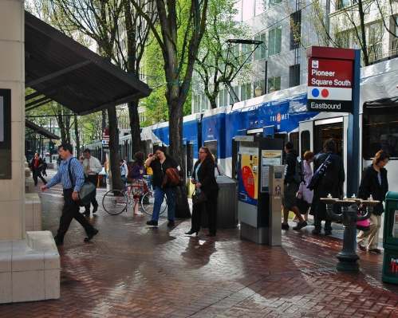
Foundational Principles of TOD
Station-area development that is compact and dense relative to its surroundings.
This doesn’t mean all TOD is uniformly big. Downtown Atlanta looks very different from historic Columbus or other local neighborhoods served by transit.
TOD seeks greater density compared to the surrounding areas.
More people live, work, shop, or go to school within walking distance of the station—driving less, using less gasoline, saving money.

Slide 74
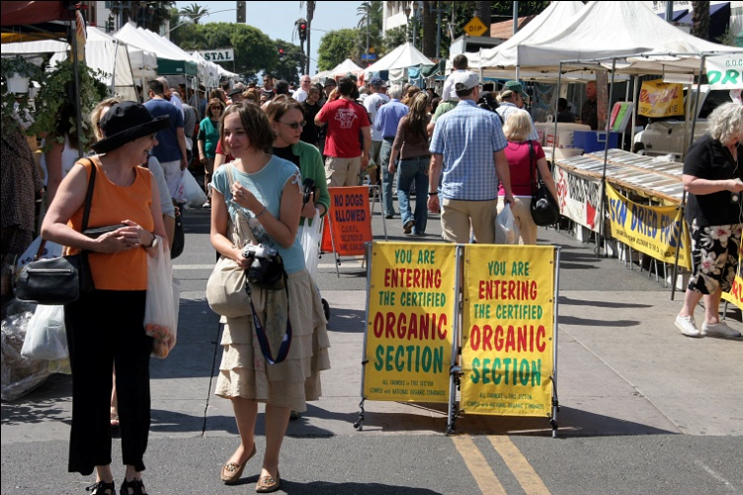
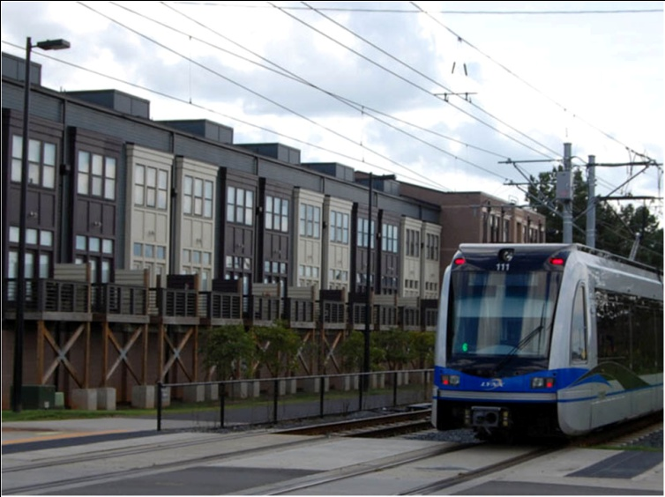
Foundational Principles of TOD
A rich mix of land uses—not just development, but “place-making” or “transit villages”.
Station areas become “24/7” places where people use transit at night and on weekends (and feel safe doing so).
Clustering allows people to combine everyday activities more conveniently. Whether you live there, take transit, bicycle, or “park once”—you walk!
Uses can be mixed vertically as well as horizontally; the street level is key.
Mixed-use stations or corridors also allow transit to run more cost-effectively—combining origins and destinations lets system carry rush-hour commuters in both directions, serving more riders with the same fleet.

Slide 75
Foundational Principles of TOD
A great public realm.

Slide 76
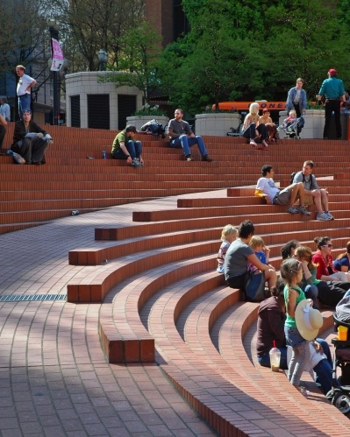
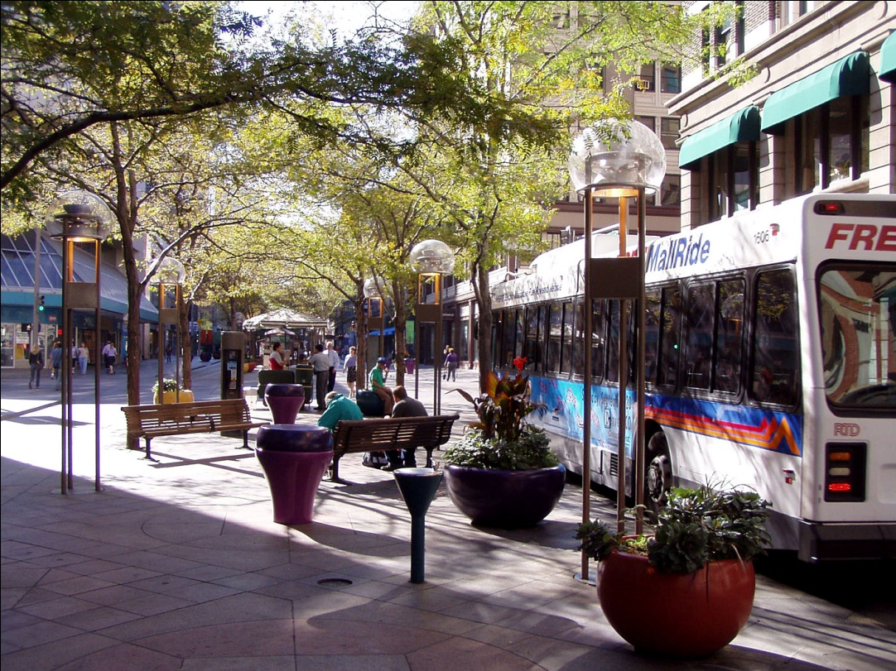
Foundational Principles of TOD
A great public realm.
TOD is pedestrian-oriented development, especially within the quarter- to half-mile radius that most people will walk in a daily commute.
A grid of small, navigable blocks has sidewalks throughout, with attractive amenities, lighting, and way-finding.
The streets, sidewalks, plazas, and stations are safe, active, and accessible.
There are no blank walls—the street level has shops, restaurants, and other active uses that bring the public realm indoors.
Bicycles are encouraged by the design of the street grid and by the provision of bicycle parking and amenities

Slide 77
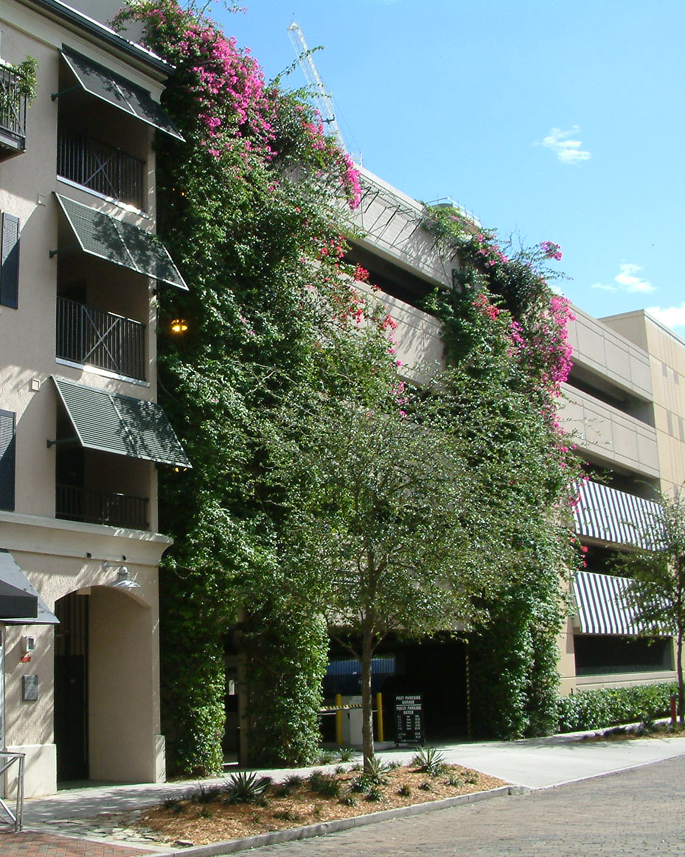
Foundational Principles of TOD
A new approach to parking.
TOD doesn’t mean “no cars”. Even with high transit utilization, many people will come and go by automobile and need a place to park.
A defining characteristic of TOD: less dedicated parking than similar development in non-transit locations.
Parking is shared as much as possible, taking advantage of dove-tailing uses and reducing further the actual number of spaces provided.
The parking that is required is designed so as not to dominate the visual or pedestrian environment.

Slide 78
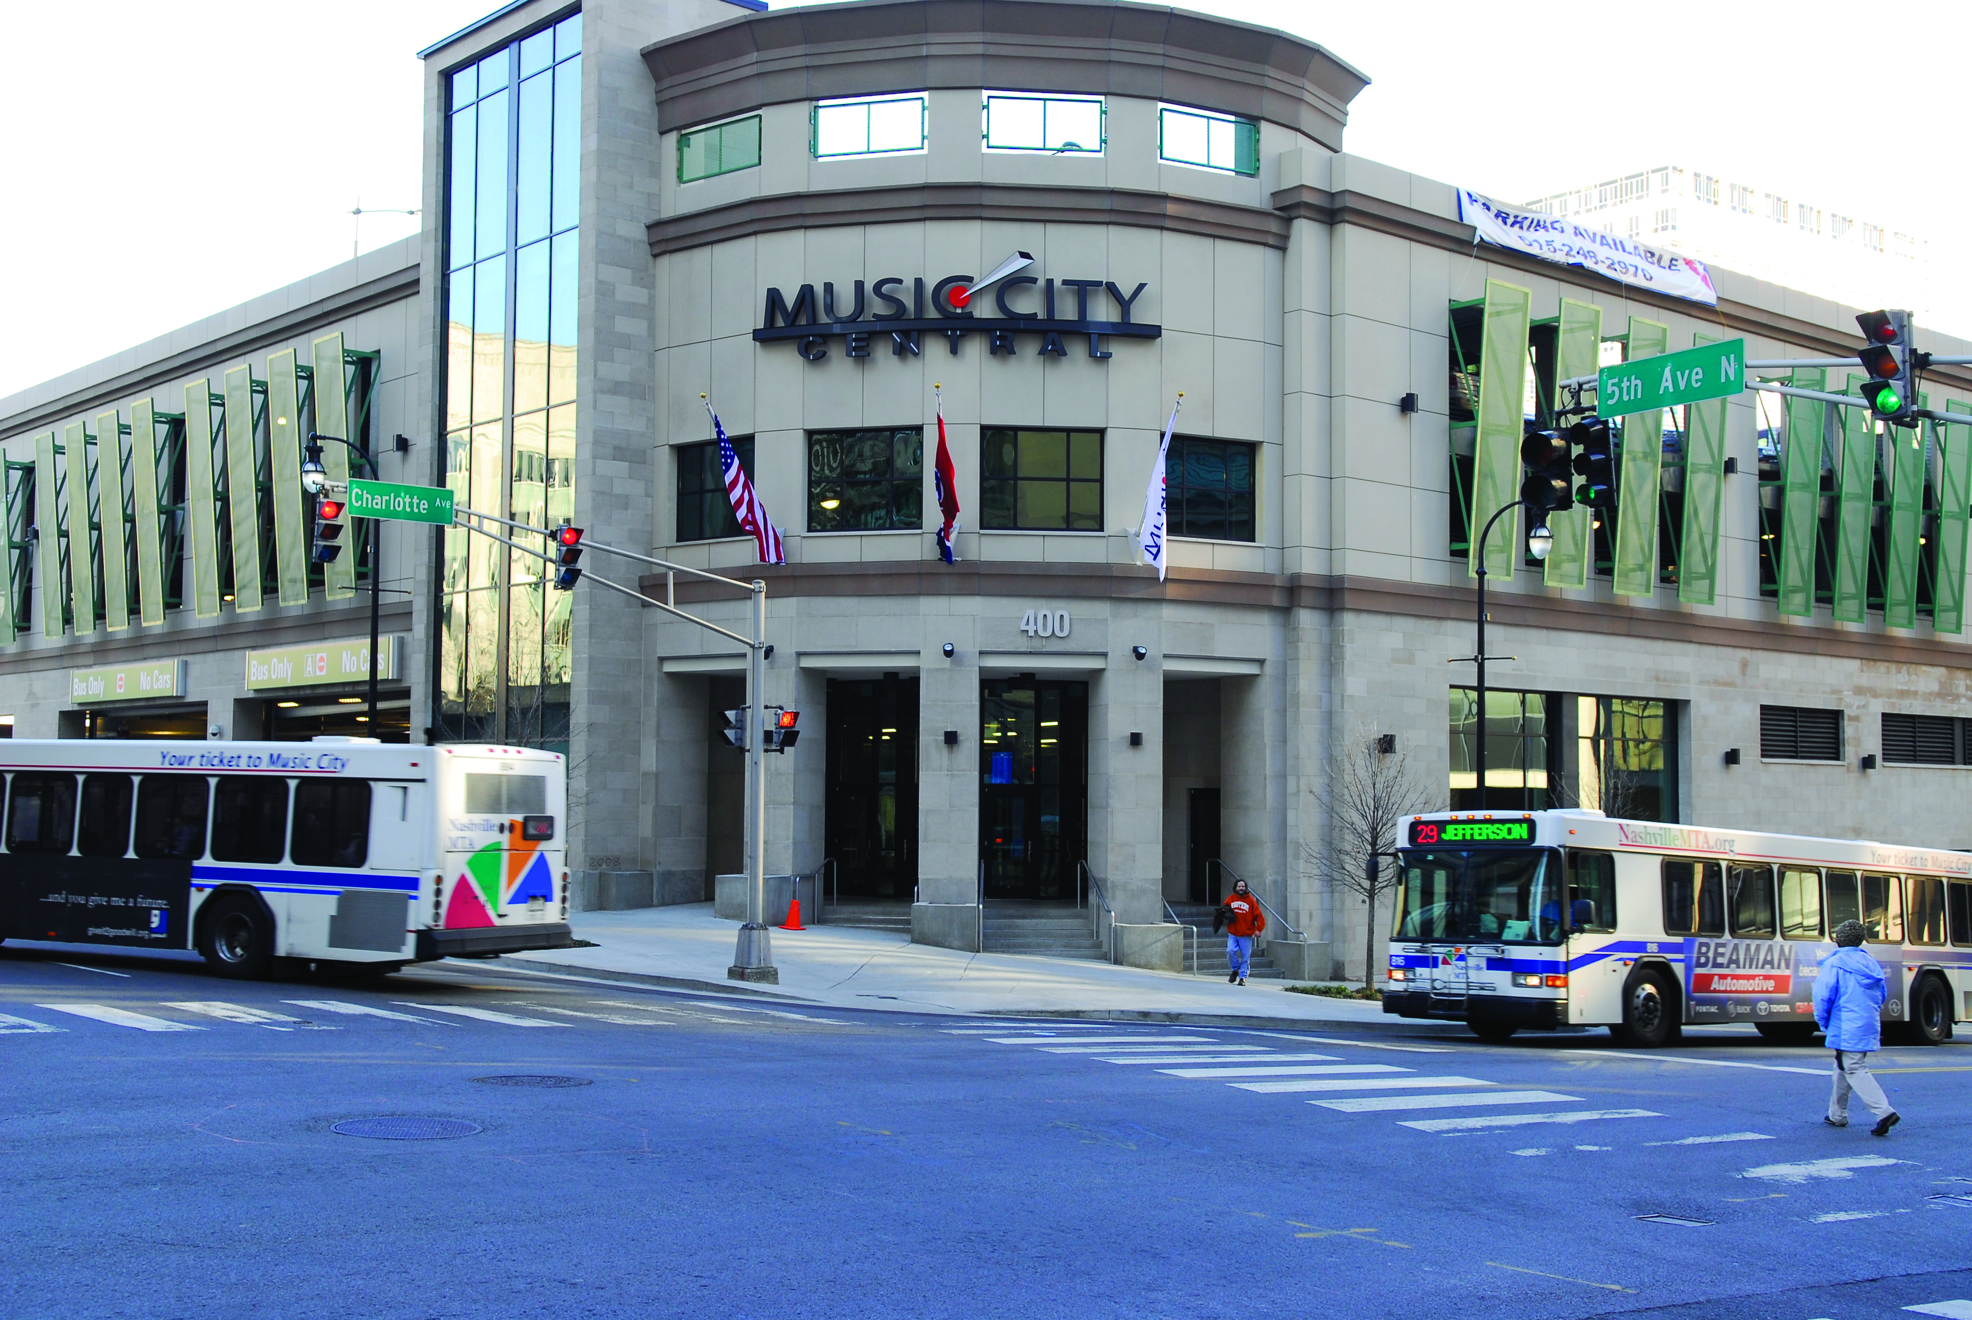
A new approach to parking.

Slide 79
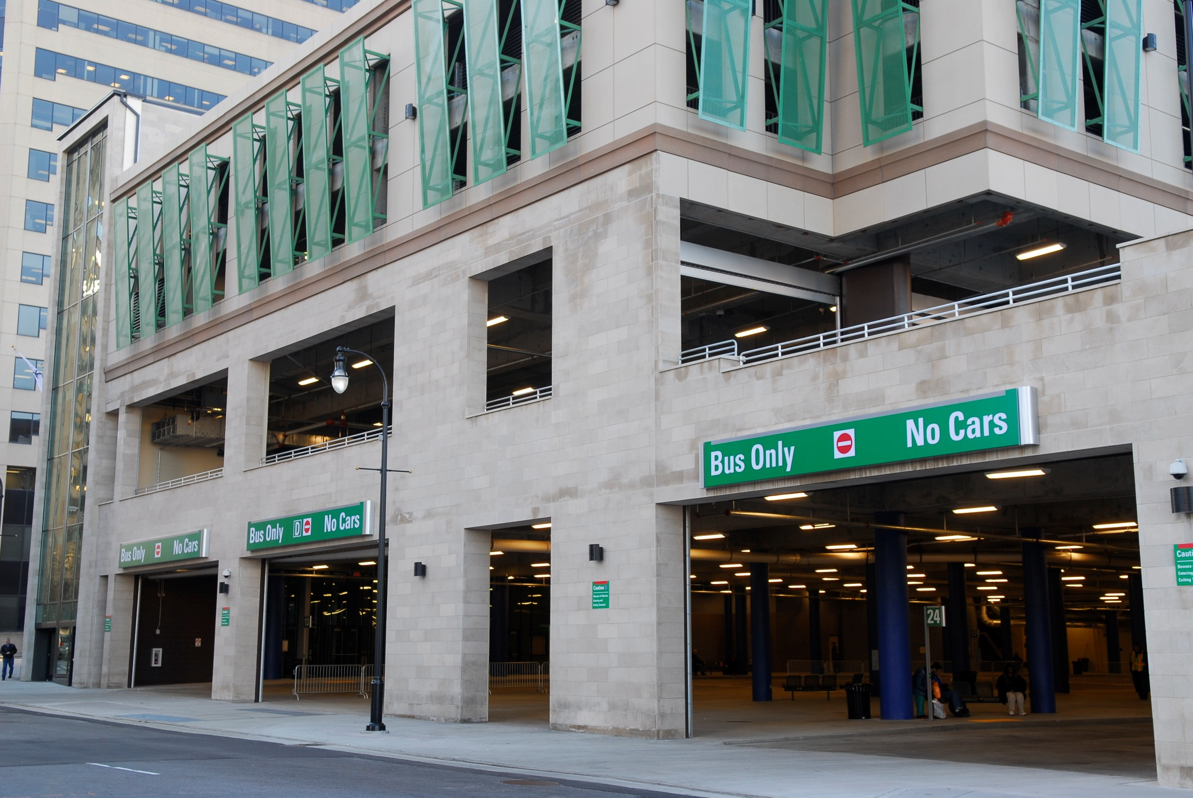
A new approach to parking.

Slide 80
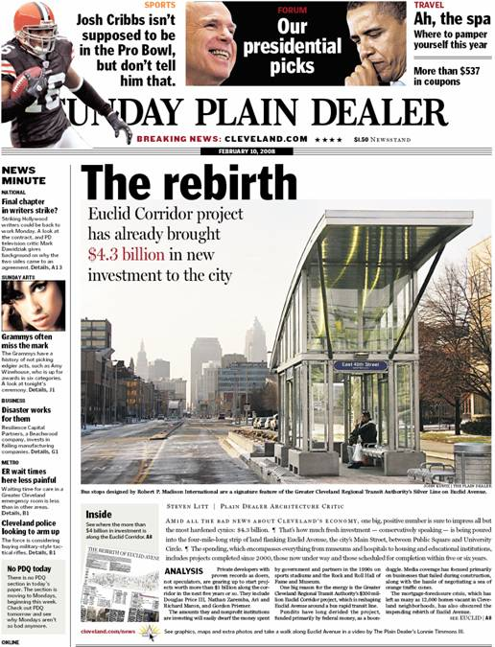

Slide 81
TOD the Key to Smart Growth
Unlocks Smart Growth by:
sparking economic development and revitalization
improving station area land values
increasing housing options and affordability
preserving open space
improving air and water quality
reducing the cost of infrastructure
reducing traffic congestion

Slide 82
Questions?
Katherine Moore, AICP
Sustainable Growth Program
Georgia Conservancy
kmoore@gaconservancy.org
404-876-2900 x 106
Adelee Le Grand, AICP
Associate Vice President
AECOM
Adelee.legrand@aecom.com
404-965-9729

Slide 83
What We Know
For Sure:
All of us can advance sustainability
There remains a lot to think about and do
Our kids and grandkids will thank us

Slide 84
Adventures in Sustainability
Question and Answer Period
Thank You for Joining Us Today!

