Slide 1
Quality of Life and Health in Atlanta
Susannah Lee
Audrey Leous, MCRP
Nisha Botchwey, PhD, MCRP, MPH
Subhrajit Guhathakurta PhD, MCRP
Center for Geographic Information Systems
School of City and Regional Planning
Georgia Institute of Technology
Jewelle Kennedy
Department of Planning & Community Development
City of Atlanta
Georgia Planning Association Meeting
Columbus, GA
9.26.2012

Slide 2
Outline of presentation
Background and purpose
Methods
Results
Discussion
Planning implications and applications

Slide 3
Purpose of study
Are neighborhoods with high quality of life also healthy environments?
What are the characteristics of places that provide both high quality of life and are healthy?
Quality of Life
Health
Transportation
Walkability
Economy
Morbidity
?
Amenities
Nutrition
Public Safety
Mortality
Housing
Image source: Authors.

Slide 4
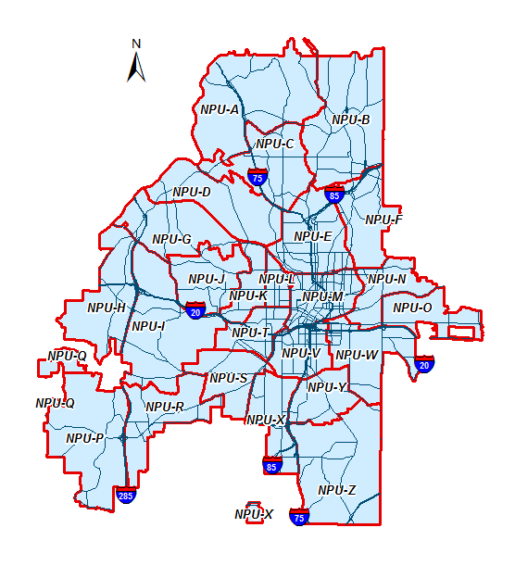
Scale of Study
City of Atlanta
25 Neighborhood Planning Units (NPUs)
Image source: Authors.
Notes:
How many neighborhoods are in ATL? 141???

Slide 5
Methods
Track objective indicators
Compare with resident perceptions
Evaluate health and quality of life of NPUs
Geographic Information Systems
Using coded responses from City of Atlanta Comprehensive Development Plan Update Survey
Controlling for socioeconomic characteristics
Image source: Authors.
Notes:
Small area analysis – scale of data ….

Slide 6
Comprehensive development Plan (CDP) UPdate
http://www.atlantaga.gov/index.aspx?page=376

Slide 7
Comprehensive Planning Legislation
The 1989 Georgia Planning Act calls for local governments to develop and adopt a Comprehensive Plan.
An adopted Comprehensive Plan is necessary to maintain the City’s Qualified Local Government (QLG) certification.
QLG Certification is needed to be eligible for various state and regional funding.
The City Charter mandates the preparation of a Comprehensive Development Plan every 3 to 5 years.
The City of Atlanta was one of the first in the state to require Comprehensive Planning.

Slide 8
Comprehensive Development Plan
Georgia State Department of Community Affairs (DCA) adopted new guidelines / requirements for local government comprehensive planning in 2005.
DCA sets the schedule for plan adoption.
The 2011 Comprehensive Development Plan was adopted by the City of Atlanta in October 2011 per 11-O-1234.
New standards added information and changed process.
Plans have a 20 year time horizon

Slide 9
Comprehensive Plan Components
Community Assessment
Community Participation
Community Agenda

Slide 10
Community Participation Program
The Community Participation Plan is the second part of the Comprehensive Plan.
This plan outlines the strategy for ensuring involvement by the public, i.e. stakeholders in developing the “Community Agenda”.
The plan has 3 components:
Identification of Stakeholders
Identification of Participation Techniques
Schedule for completion of the Community Agenda

Slide 11
Community Participation Program
Identification of Stakeholders
City Organizations: City Council, Mayor’s Office, City Departments
Community Groups: NPUs, residents, property owners
Advocacy Groups/Non-profits: PEDS, Park Pride, Georgia Stand Up
Civic Groups/Authorities: AHA, MARTA, CIDs
City Boards and Agencies: Invest Atlanta (ADA), ABI, BZA, AUDC, APABs

Slide 12
Community Participation Program
Identification of Participation Techniques
Informative – Website, printed information, public displays, Council and Cabinet presentations, presentations and announcements at NPU meetings, press releases, meeting notices, presentations, etc.
Public Input:
Public hearings
On-line survey

Slide 13
Community Participation Program
Identification of Participation Techniques
Interactive
Community meetings – each meeting held 3 times
Issues and Opportunities & review of vision
Identification of Character Areas
Visions for Character areas
City Council work sessions
Open House

Slide 14
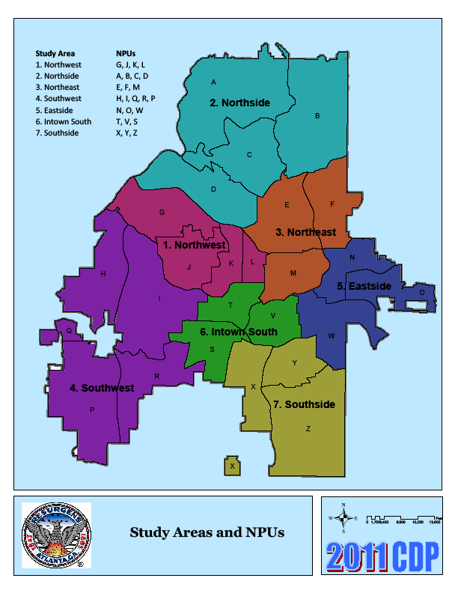
Community Participation Program
Meetings will be held by grouping study areas and/or individual study areas depending on topics of discussions
Image source: City of Atlanta Department of Planning. 2011 Comprehensive Development Plan Update.

Slide 15
Resident perceptions

Slide 16
ONLINE Survey
Prioritizing planning topics
Open-ended questions such as:
What do you like about your community?
What do you want the City of Atlanta to be like in 20 years?
What is/are your favorite part(s) of the City of Atlanta and why?
What do you NOT like about your community?
Notes:
Need to include information on the survey – how many submitted responses?
Do the results include the online survey and the workshop results?

Slide 17
Survey Results
What do you like about your community? |  |  | What do you want the City of Atlanta to be like in 20 years? |  |  | What is/are your favorite part(s) of the City of Atlanta and why?
Proximity to amenities | 190 |  | Walkability | 208 |  | Parks, greenspace and recreation | 105
Walkability | 160 |  | Parks, greenspace and recreation | 191 |  | Amenities | 104
Proximity to work | 142 |  | Public transit | 155 |  | Midtown | 100
Tree canopy | 137 |  | Safety | 115 |  | Piedmont Park | 77
Parks, greenspace and recreation | 97 |  | Vibrant urban city | 109 |  | Walkability | 71
Community | 70 |  | Abundance of jobs | 74 |  | Arts, Culture & Entertainment | 63
Location | 51 |  | Preserved neighborhoods | 63 |  | Virginia Highland | 57
Public transit | 40 |  | Bike access | 39 |  | Downtown Atlanta | 46
Mixed Use | 39 |  | Education | 38 |  | Buckhead | 44
History/historic | 30 |  | Transportation | 36 |  | Inman Park | 41

Slide 18
Survey Results
What do you NOT like about your community?
Safety | 143
Lack of code enforcement | 109
Lack of public transit | 89
Vacant properties | 88
Amenities | 70
Traffic | 67
Transportation | 57
Lack of walkability | 50
Not clean | 47
Streets | 38

Slide 19
Socioeconomic conditions (SEC) Index

Slide 20
SEC Indicators
Education
Income
College Degree Attainment
Median Household Income
Poverty
Employment
% Living in Poverty
Unemployment Rate
Photo sources: Wiki Commons, Mlive.com, saveafewbucks.com, www.nccendpoverty.org

Slide 21
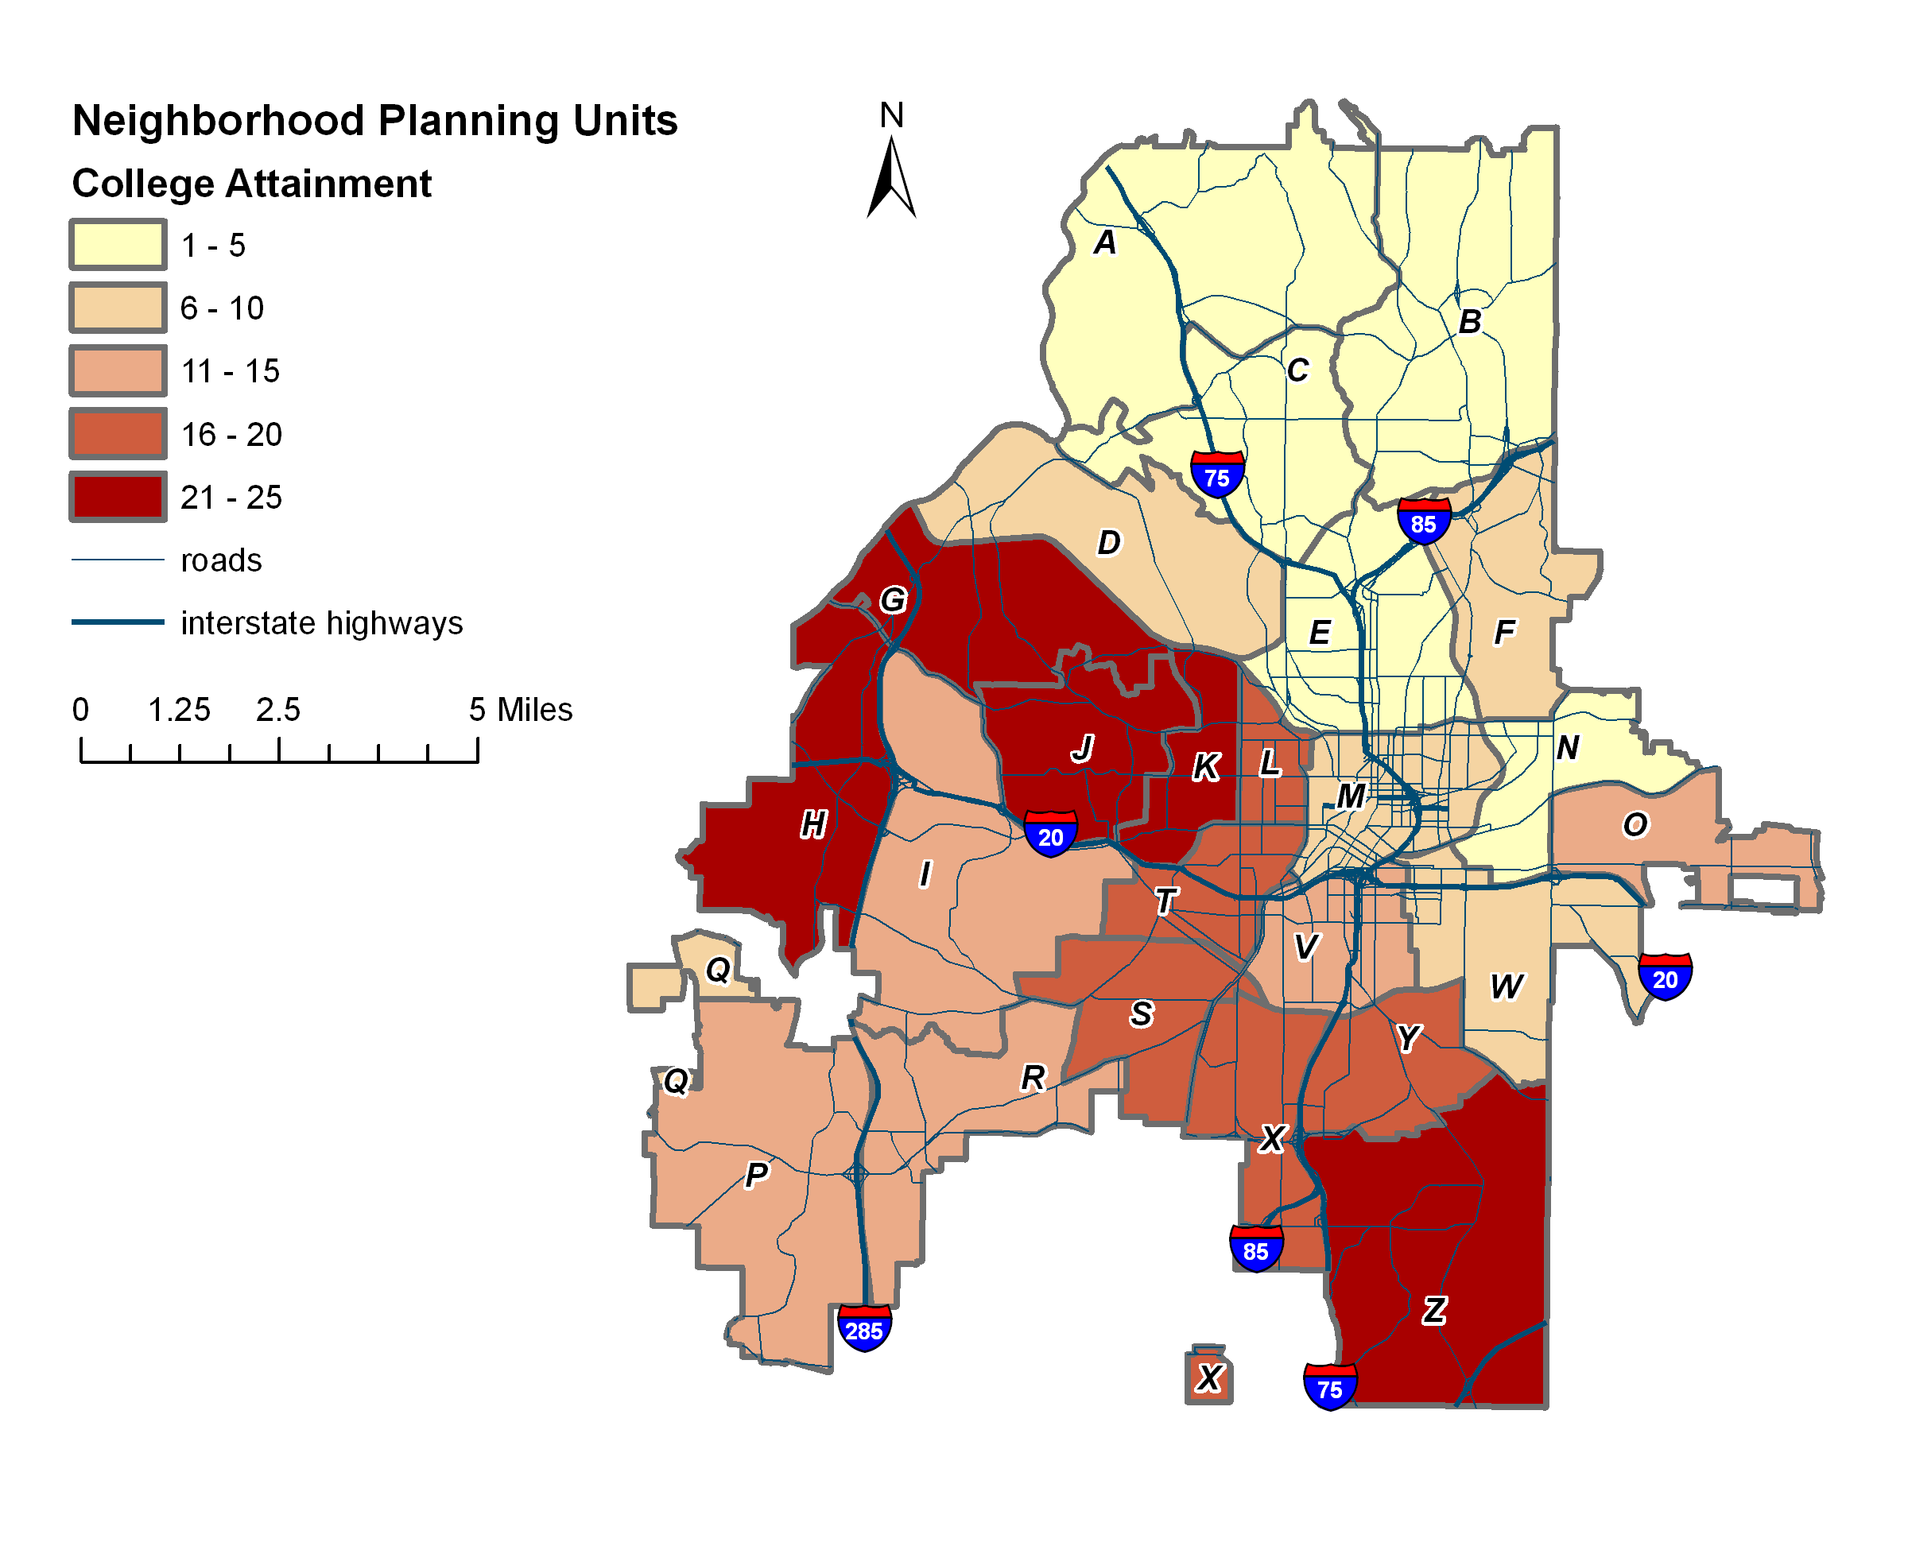
EDUCATION
Data Source: U.S. Census Bureau. ( 2010). Educational Attainment. Retrieved from www.factfinder2.census.gov

Slide 22
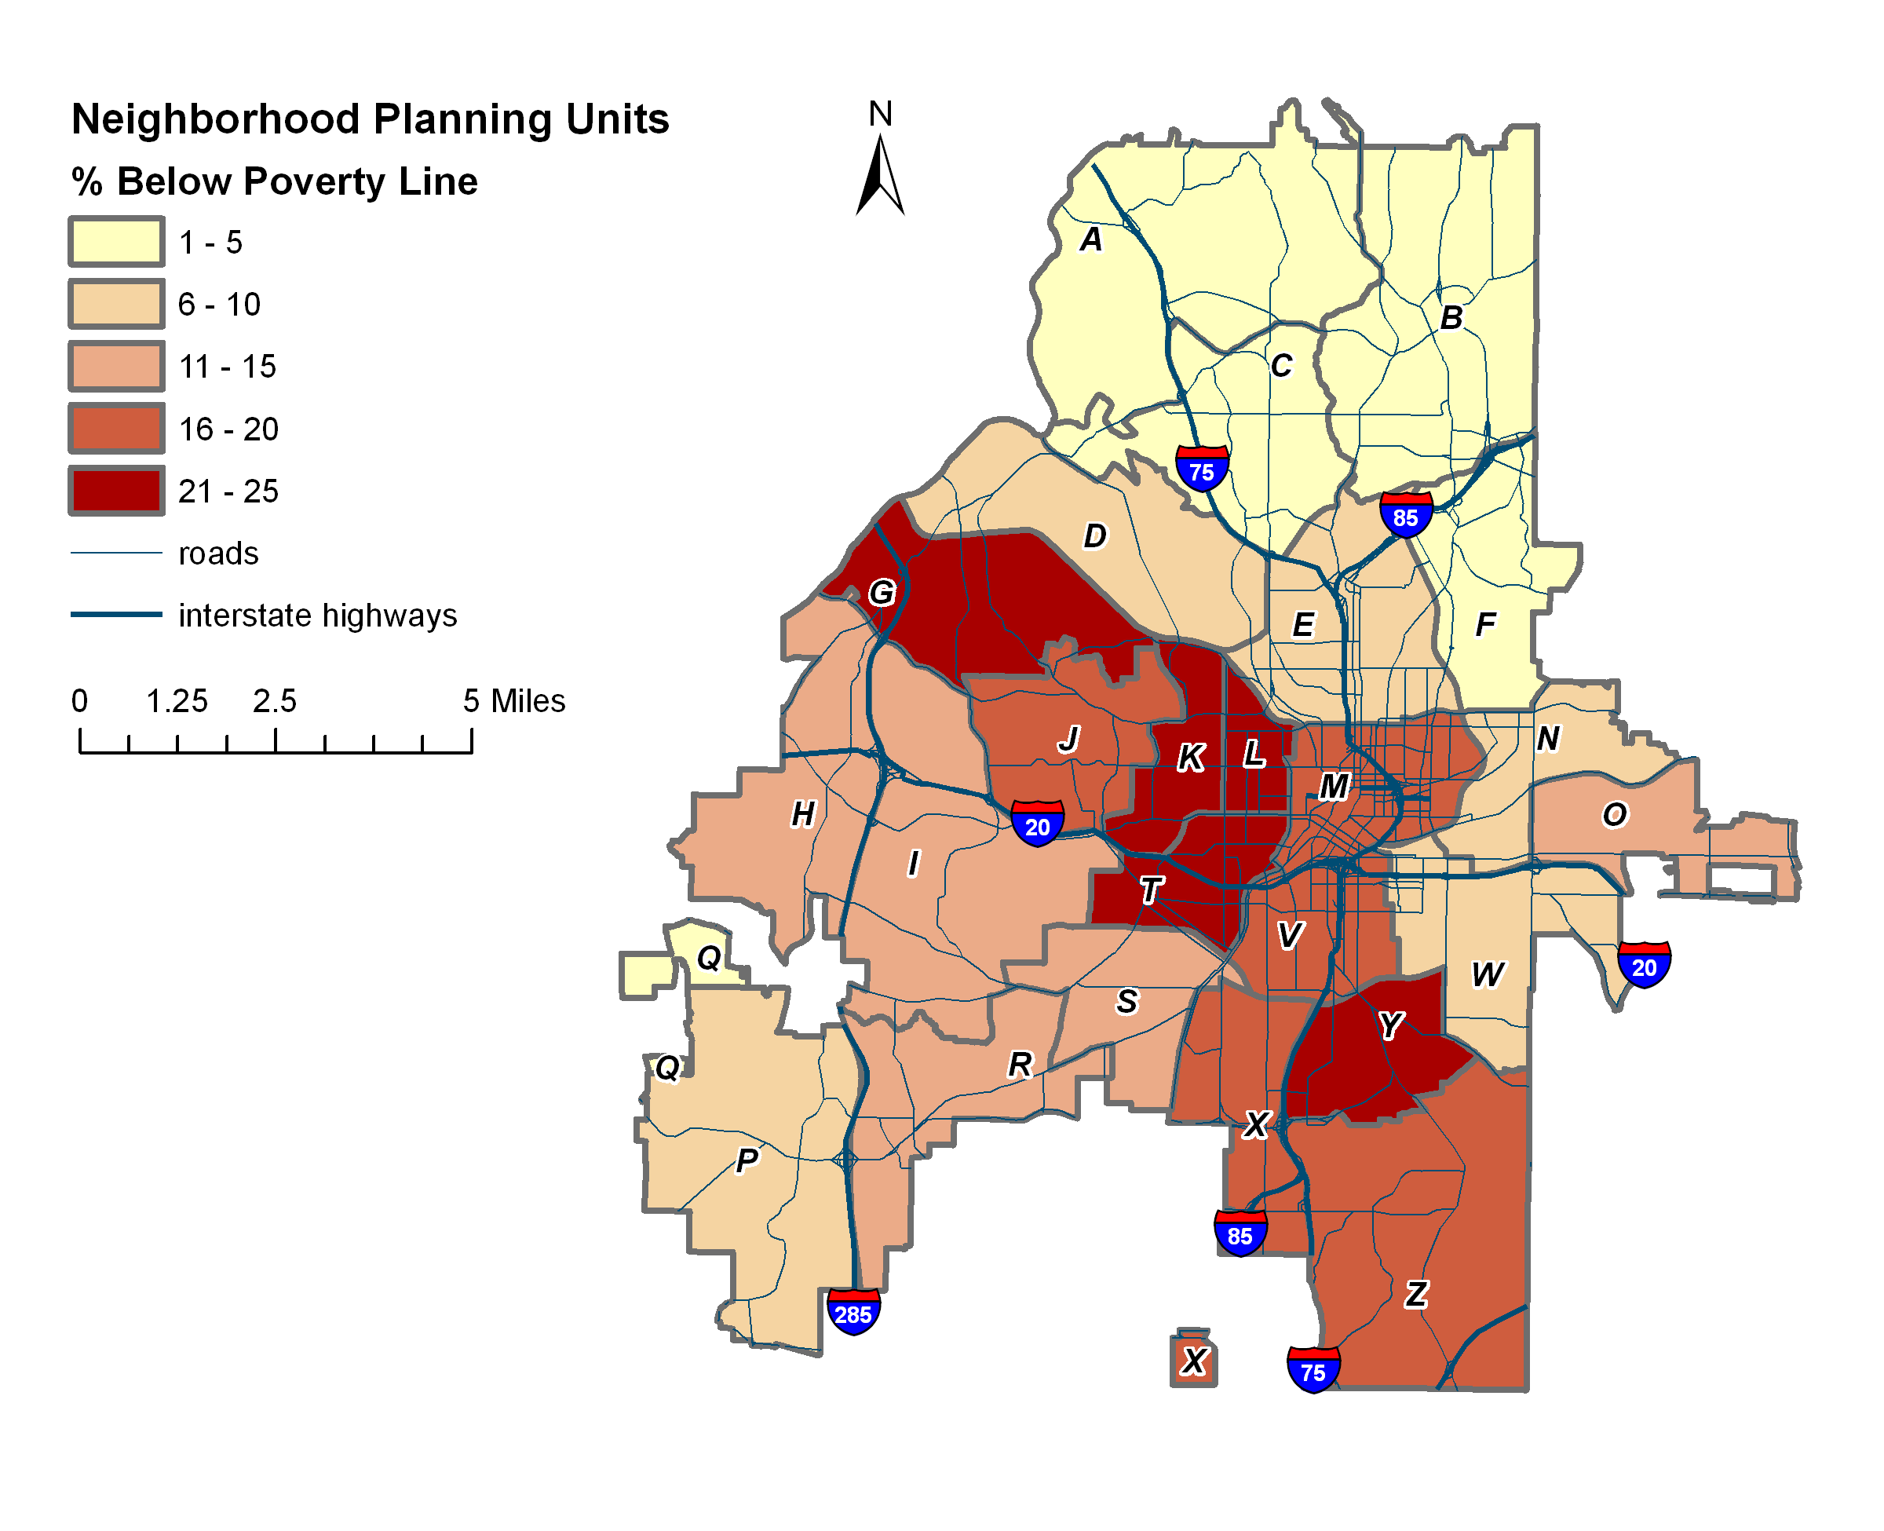
Poverty
Data Source: U.S. Census Bureau. ( 2010). 2010 American Community Survey 5-Year Estimates: Selected Economic Characteristics. Retrieved from www.factfinder2.census.gov

Slide 23
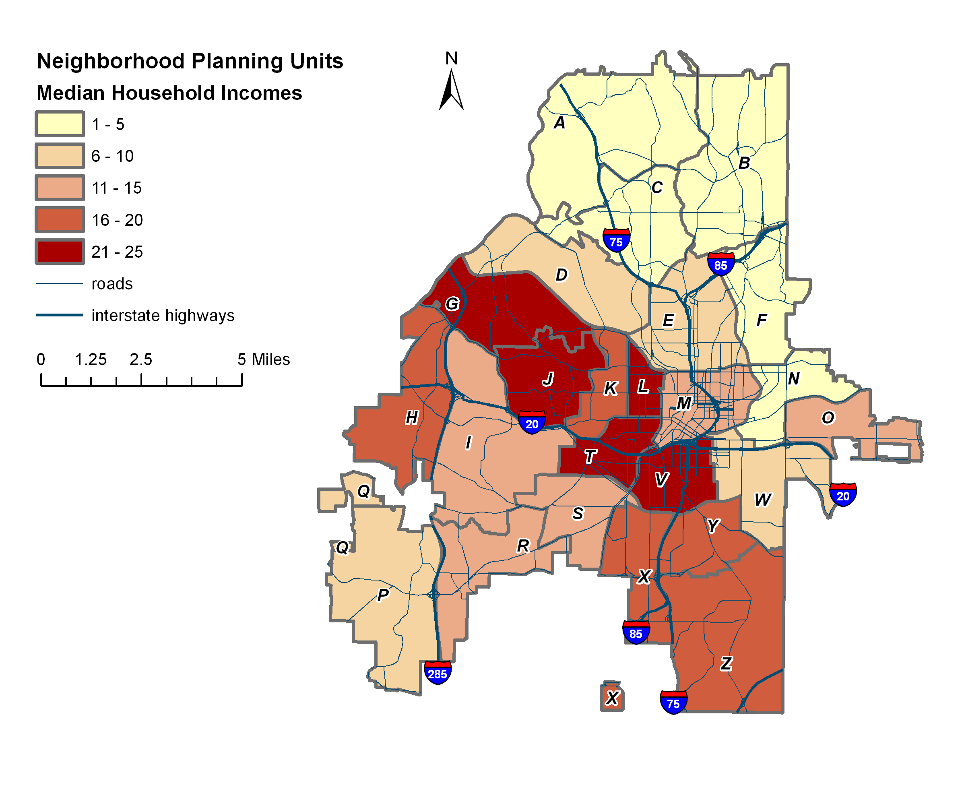
Household Income
Data Source: U.S. Census Bureau. ( 2010). 2010 American Community Survey 5-Year Estimates: Selected Economic Characteristics. Retrieved from www.factfinder2.census.gov

Slide 24
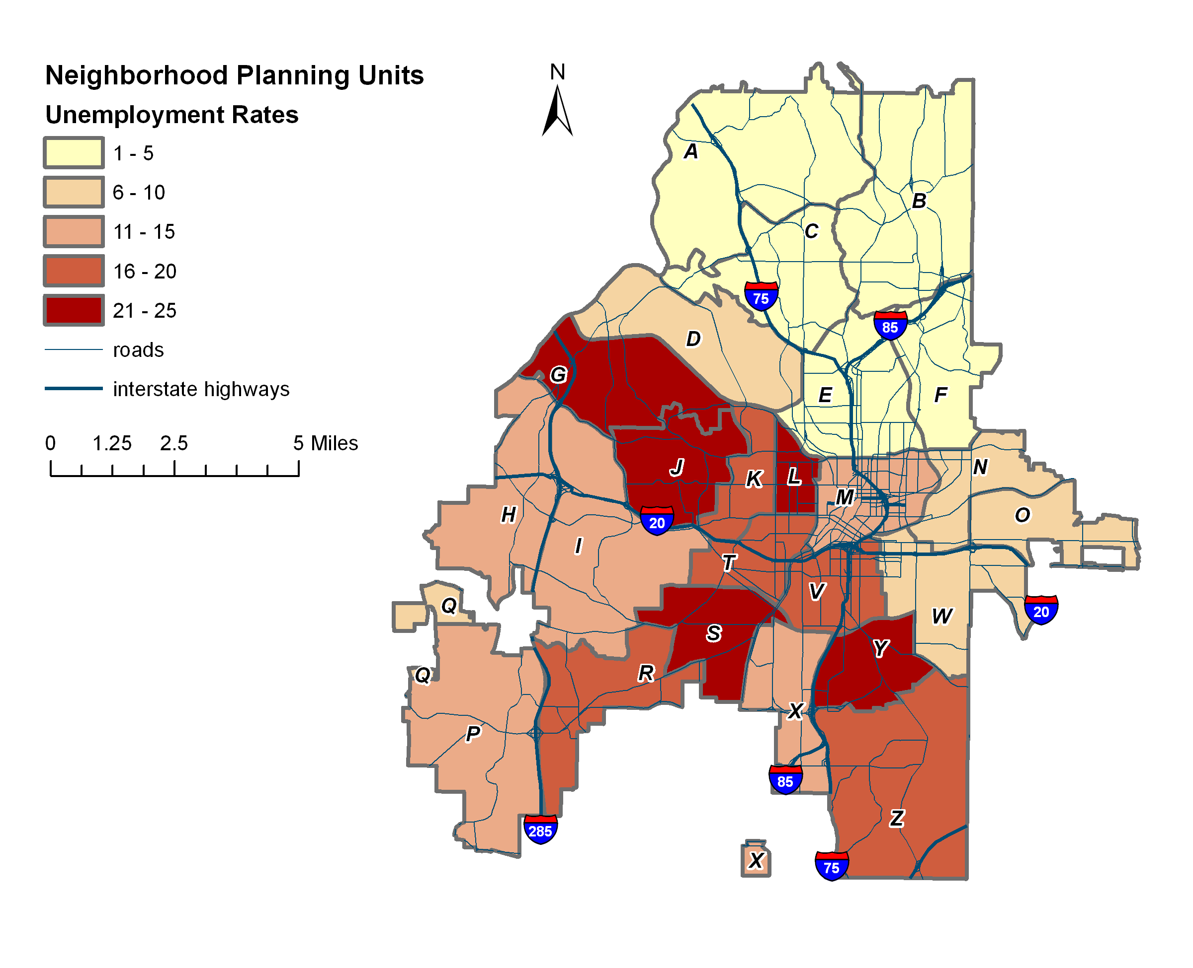
UNEMPLOYMENT
Data Source: U.S. Census Bureau. ( 2010). 2010 American Community Survey 5-Year Estimates: Selected Economic Characteristics. Retrieved from www.factfinder2.census.gov

Slide 25
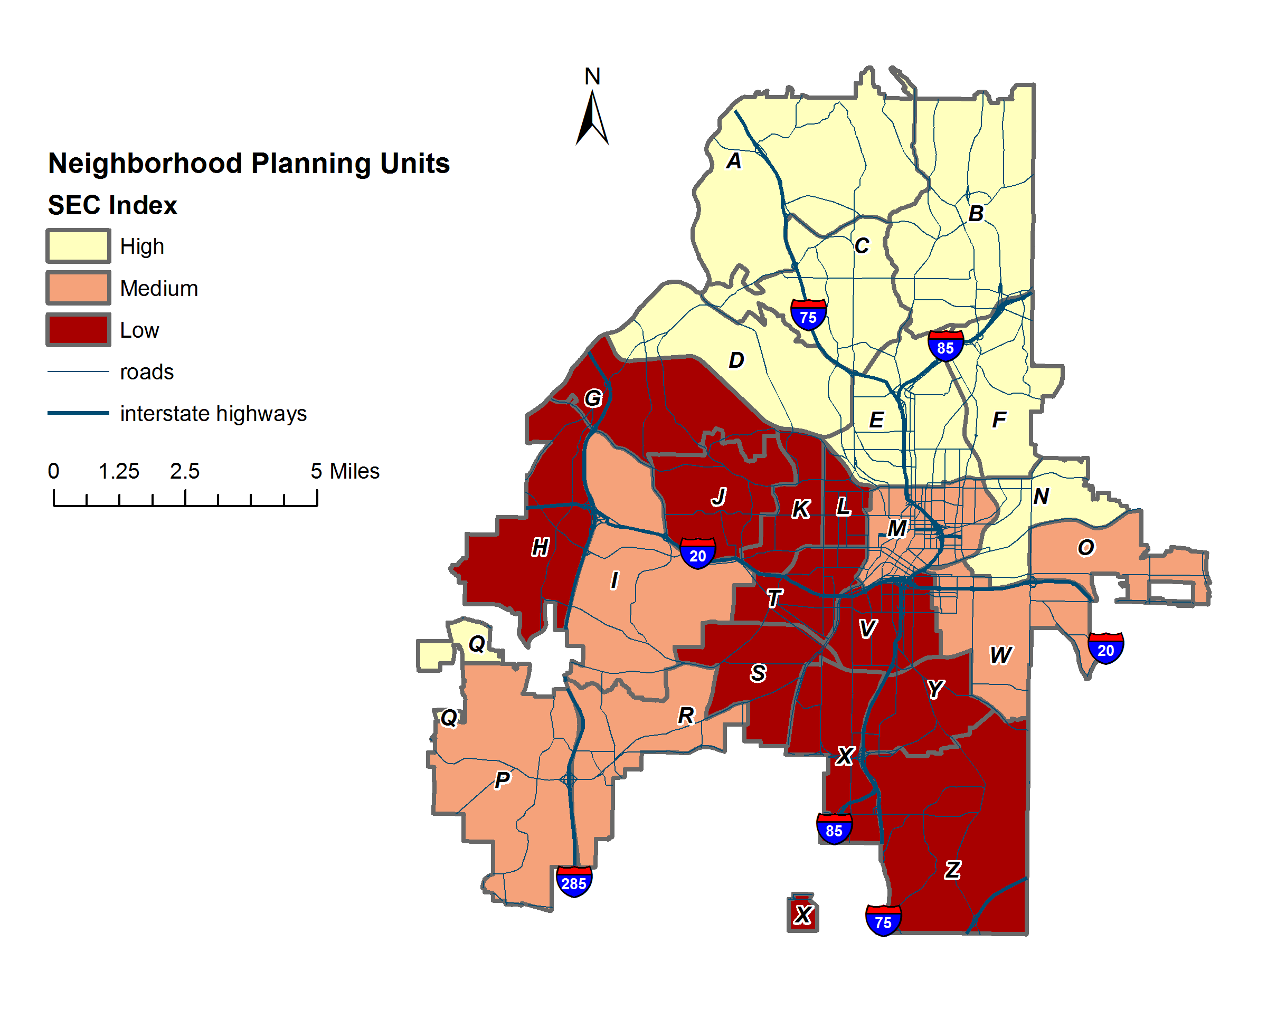
SEC INDEx
Grouped by standard deviations:
Low < -0.5 σ Medium ≥ -0.5 σ, ≤ 0.5 σ High > 0.5 σ
Source: Calculated by authors.
Notes:
8 high, 6 medium, 11 low
Standard deviation is a measure of the distance the data is from the mean. A z-score tells you how many standard deviations you are from the mean.

Slide 26
Neighborhood Quality of Life index

Slide 27
Quality of Life
What is Quality of Life (QoL)?
How can it be measured?
Of what use is it to planning?
Notes:
Three key questions

Slide 28
Defining QoL
Informed by both objective measurements and resident perceptions
Varies over time and space
Inherent linkage to place
Viable planning tool, since planning aims to further community development and wellbeing
Results can serve to inform targeted policy recommendations
Notes:
Objective and subjective
Indicator measurement to track longitudinal trends
place-based analysis to measure community conditions and inform policy

Slide 29
Indicator Selection
Indicators…
Should be valid at the neighborhood level
Should be associated with place
Should capture attributes of importance to residents

Slide 30
nQol Indicators
Indicators | Measures
Amenities | Greenspace access Retail Mix
Economy | Employment to labor force ratio
Housing | Home Affordability Rent Affordability Vacancy rates
Public Safety | Violent crime rates Property crime rates Traffic-related accidents
Transportation | Mean travel times to work Transit access

Slide 31
Atlanta Neighborhood Quality of Life Index Results

Slide 32
Amenities: Park & Recreation Access
Park and recreation access calculated with ¼ mile buffers and census blocks.
Data Source: U.S. Census Bureau. ( 2010). Profile of General Population and Housing Characteristics: 2010 Demographic Profile. Data Retrieved from www.factfinder2.census.gov

Slide 33
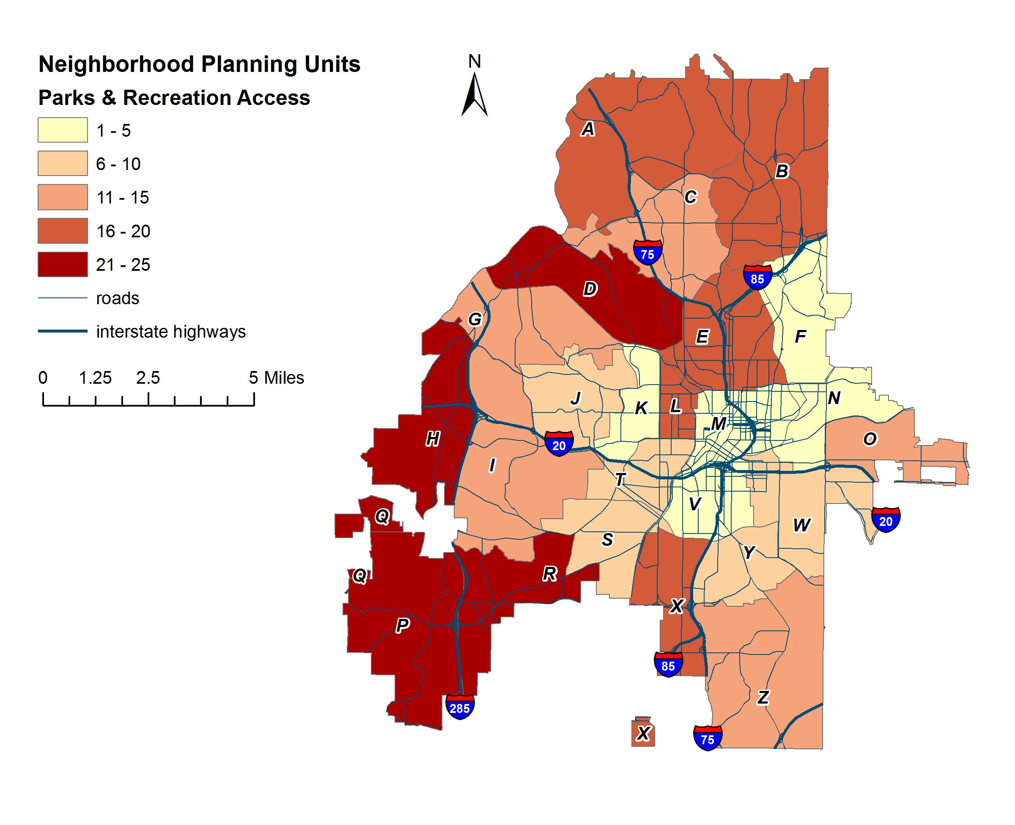
Amenities: Park & Recreation Access
Notes:
Equitable spread of greenspace for M, N, F

Slide 34
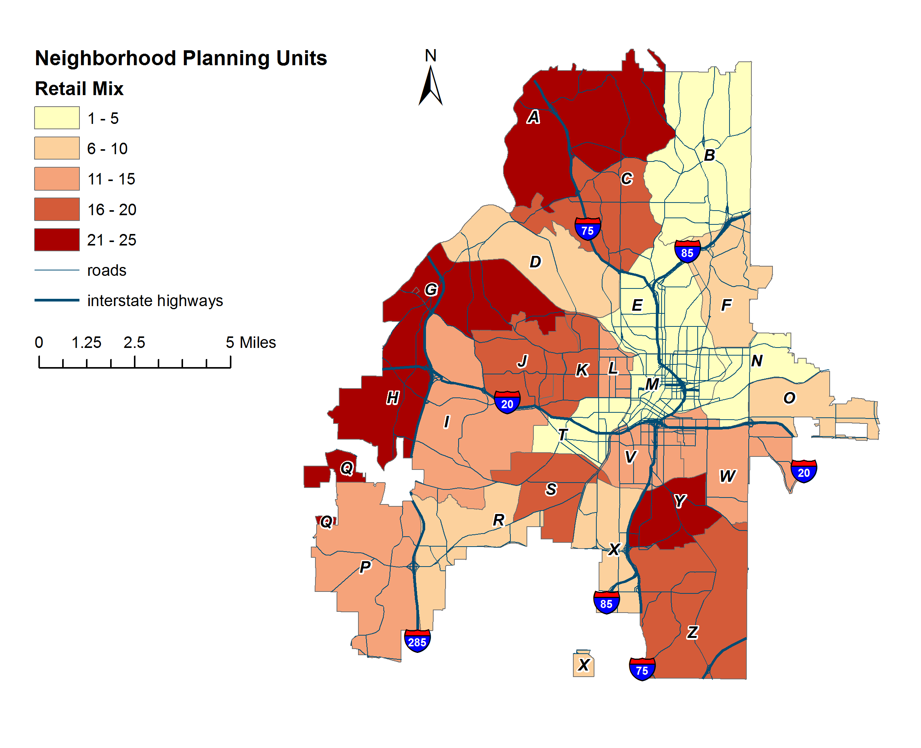
Amenities: Retail Mix
3-digit NAICS | Code Description | Examples
445 | Food and Beverage Stores | Kroger, Yogli Mogli
446 | Health and Personal Care Stores | Rite Aid, GNC
448 | Clothing and Accessories Stores | Old Navy, Footlocker
452 | General Merchandise Stores | Sam’s Club, Dollar Tree
453 | Miscellaneous Store Retailers | Office Depot, Goodwill
Reference USA. ( 2012). U.S. Businesses. Data retrieved from www.referenceusa.com

Slide 35
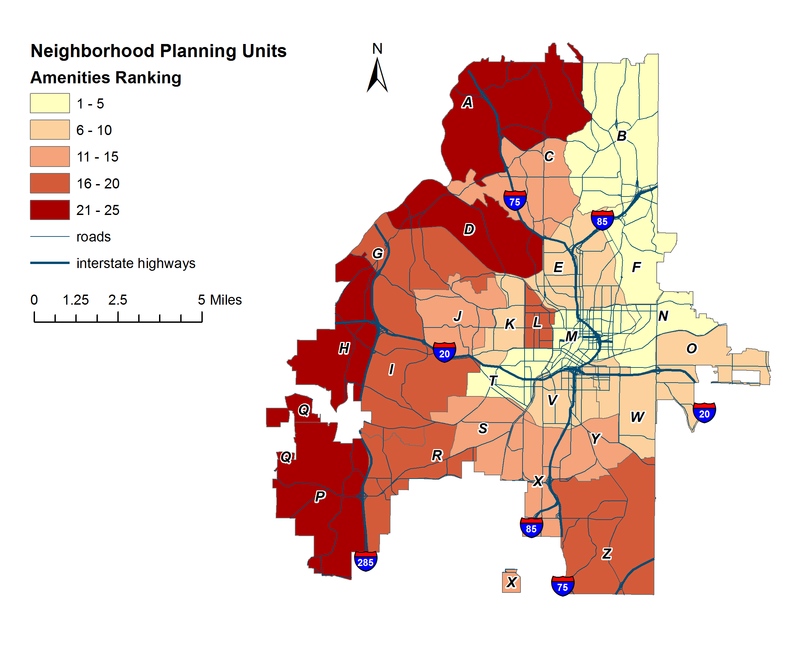
AMENITIES Ranking
Amenities Ranking | NPU
1 | B
2 | M
3 | N
4 | T
5 | F
6 | V
7 | O
8 | E
9 | W
10 | K
11 | S
12 | J
13 | C
14 | Y
15 | X
16 | Z
17 | I
18 | R
19 | G
20 | L
21 | D
22 | A
23 | H
24 | P
25 | Q
Source: Calculated by authors.
Notes:
Be prepared to explain how we computed the rankings

Slide 36
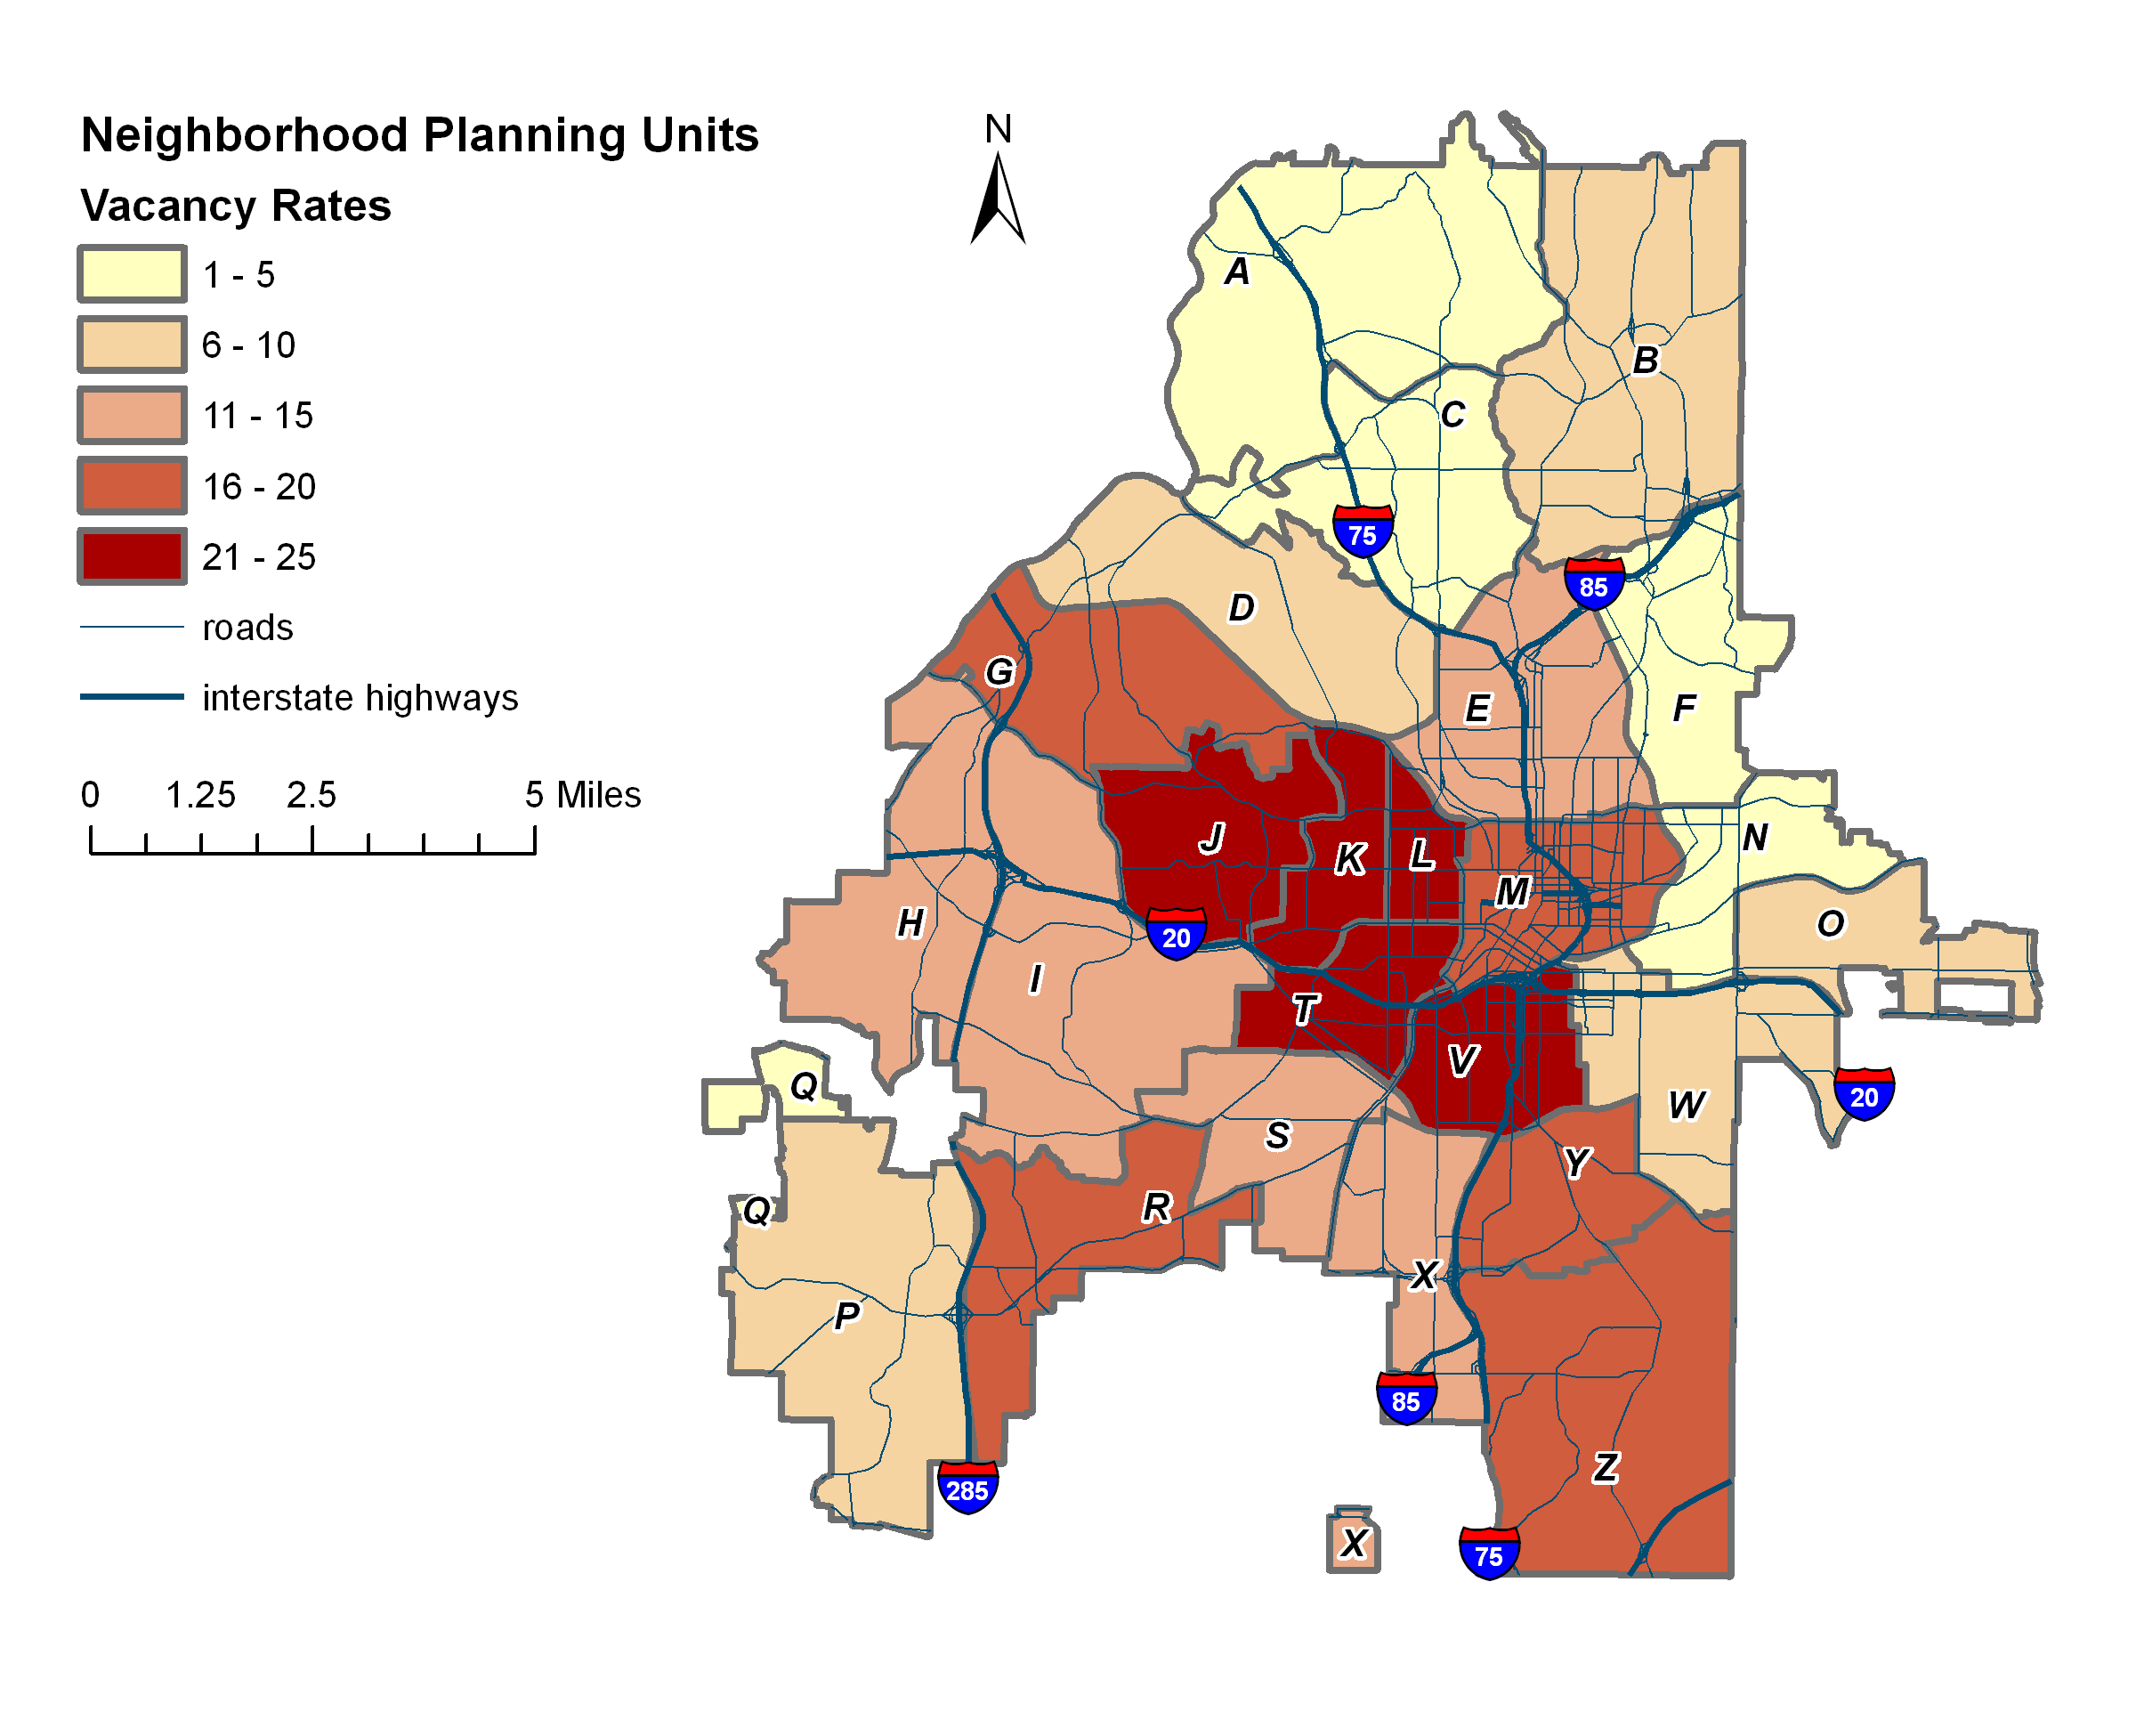
HOUSING: Vacancy
Data Source: U.S. Census Bureau. ( 2010). Profile of General Population and Housing Characteristics: 2010 Demographic Profile. Data Retrieved from www.factfinder2.census.gov

Slide 37
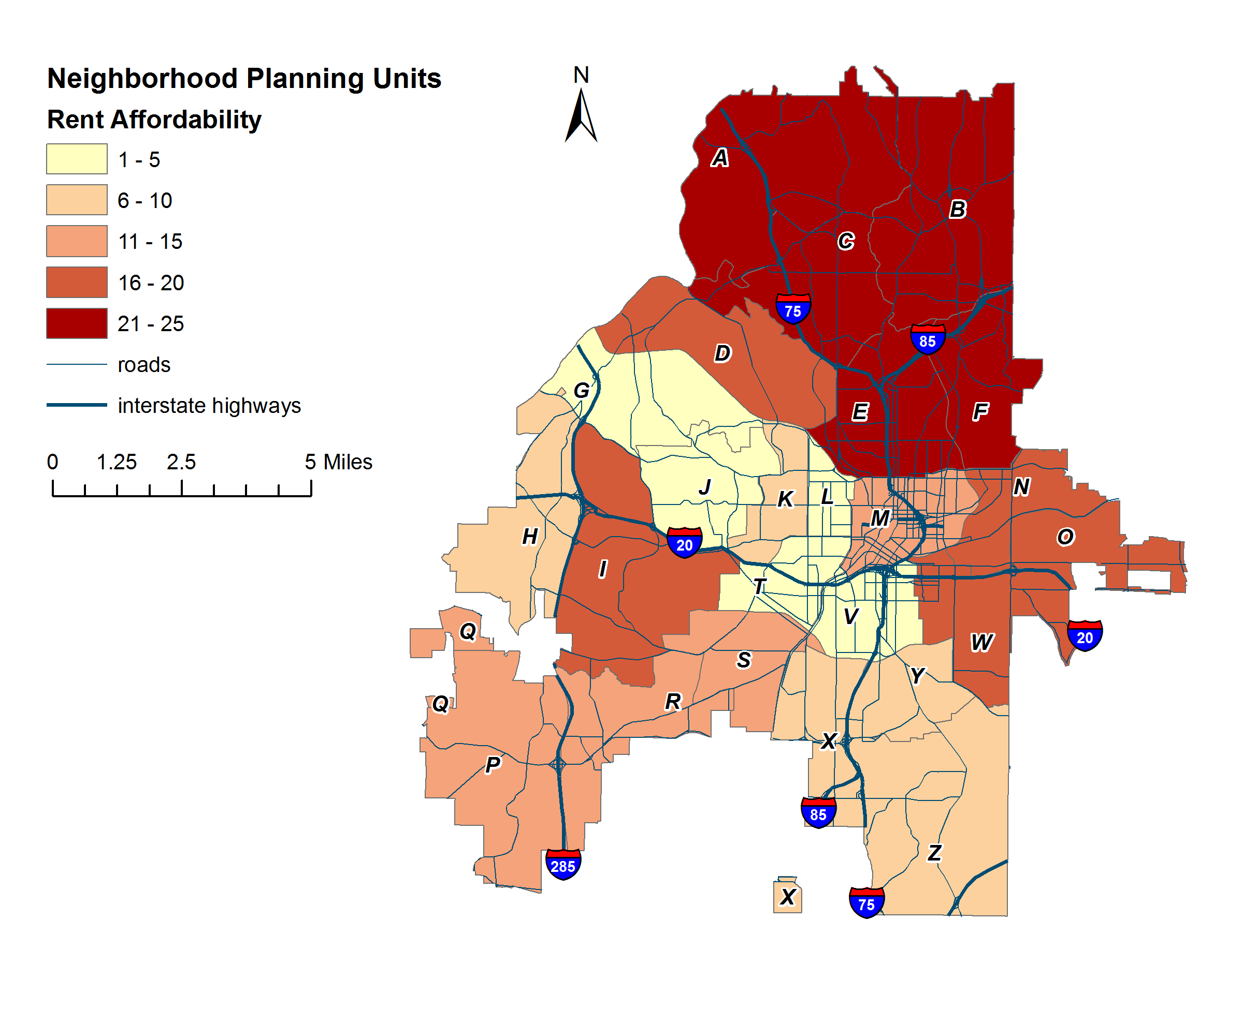
Housing: rent Affordability
Data Source: U.S. Census Bureau. ( 2010). Profile of General Population and Housing Characteristics: 2010 Demographic Profile. Data Retrieved from www.factfinder2.census.gov
Notes:
Rent as a share of income for average resident
median household in 2010 $45,171

Slide 38
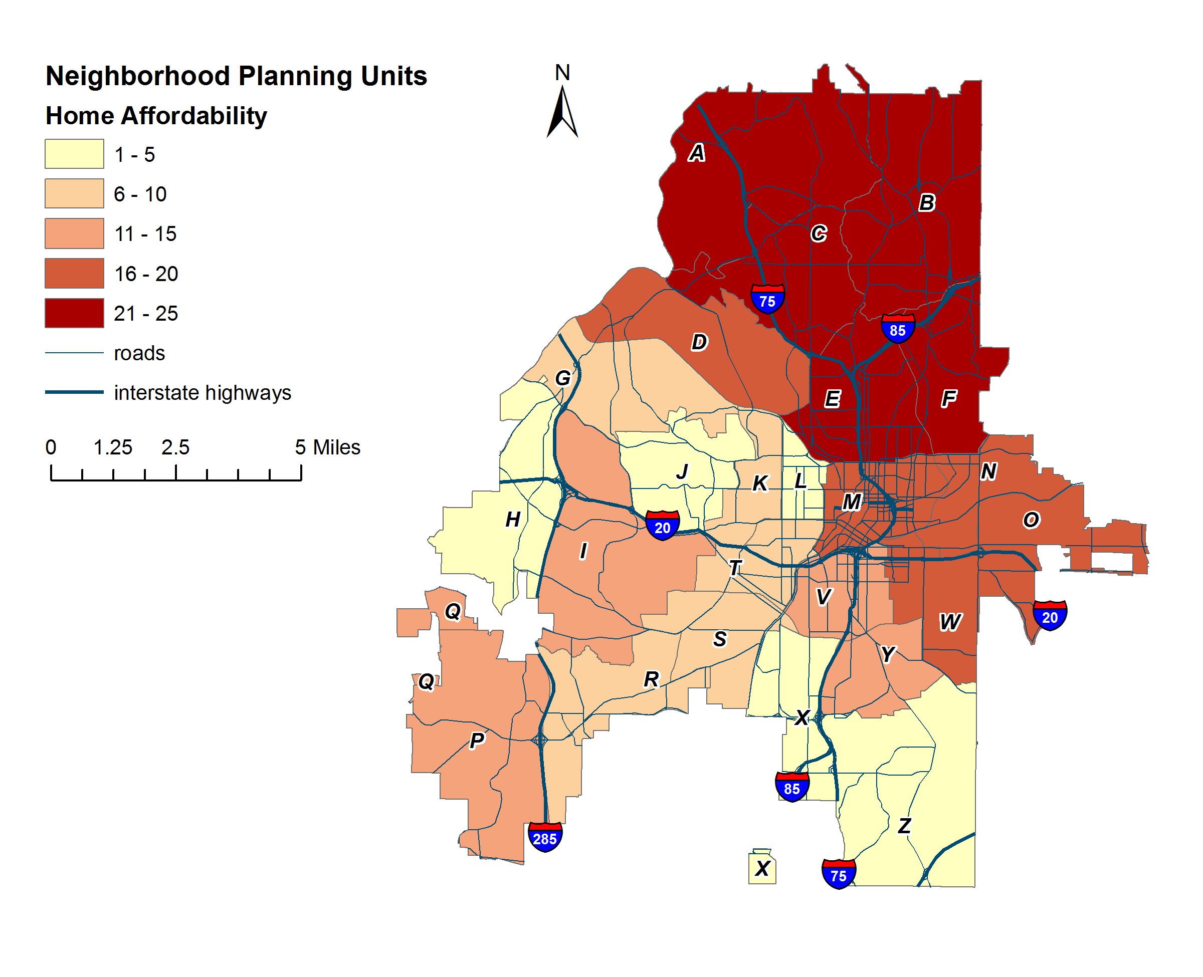
HOUSING: Home Affordability
Data Source: U.S. Census Bureau. ( 2010). Profile of General Population and Housing Characteristics: 2010 Demographic Profile. Data Retrieved from www.factfinder2.census.gov

Slide 39
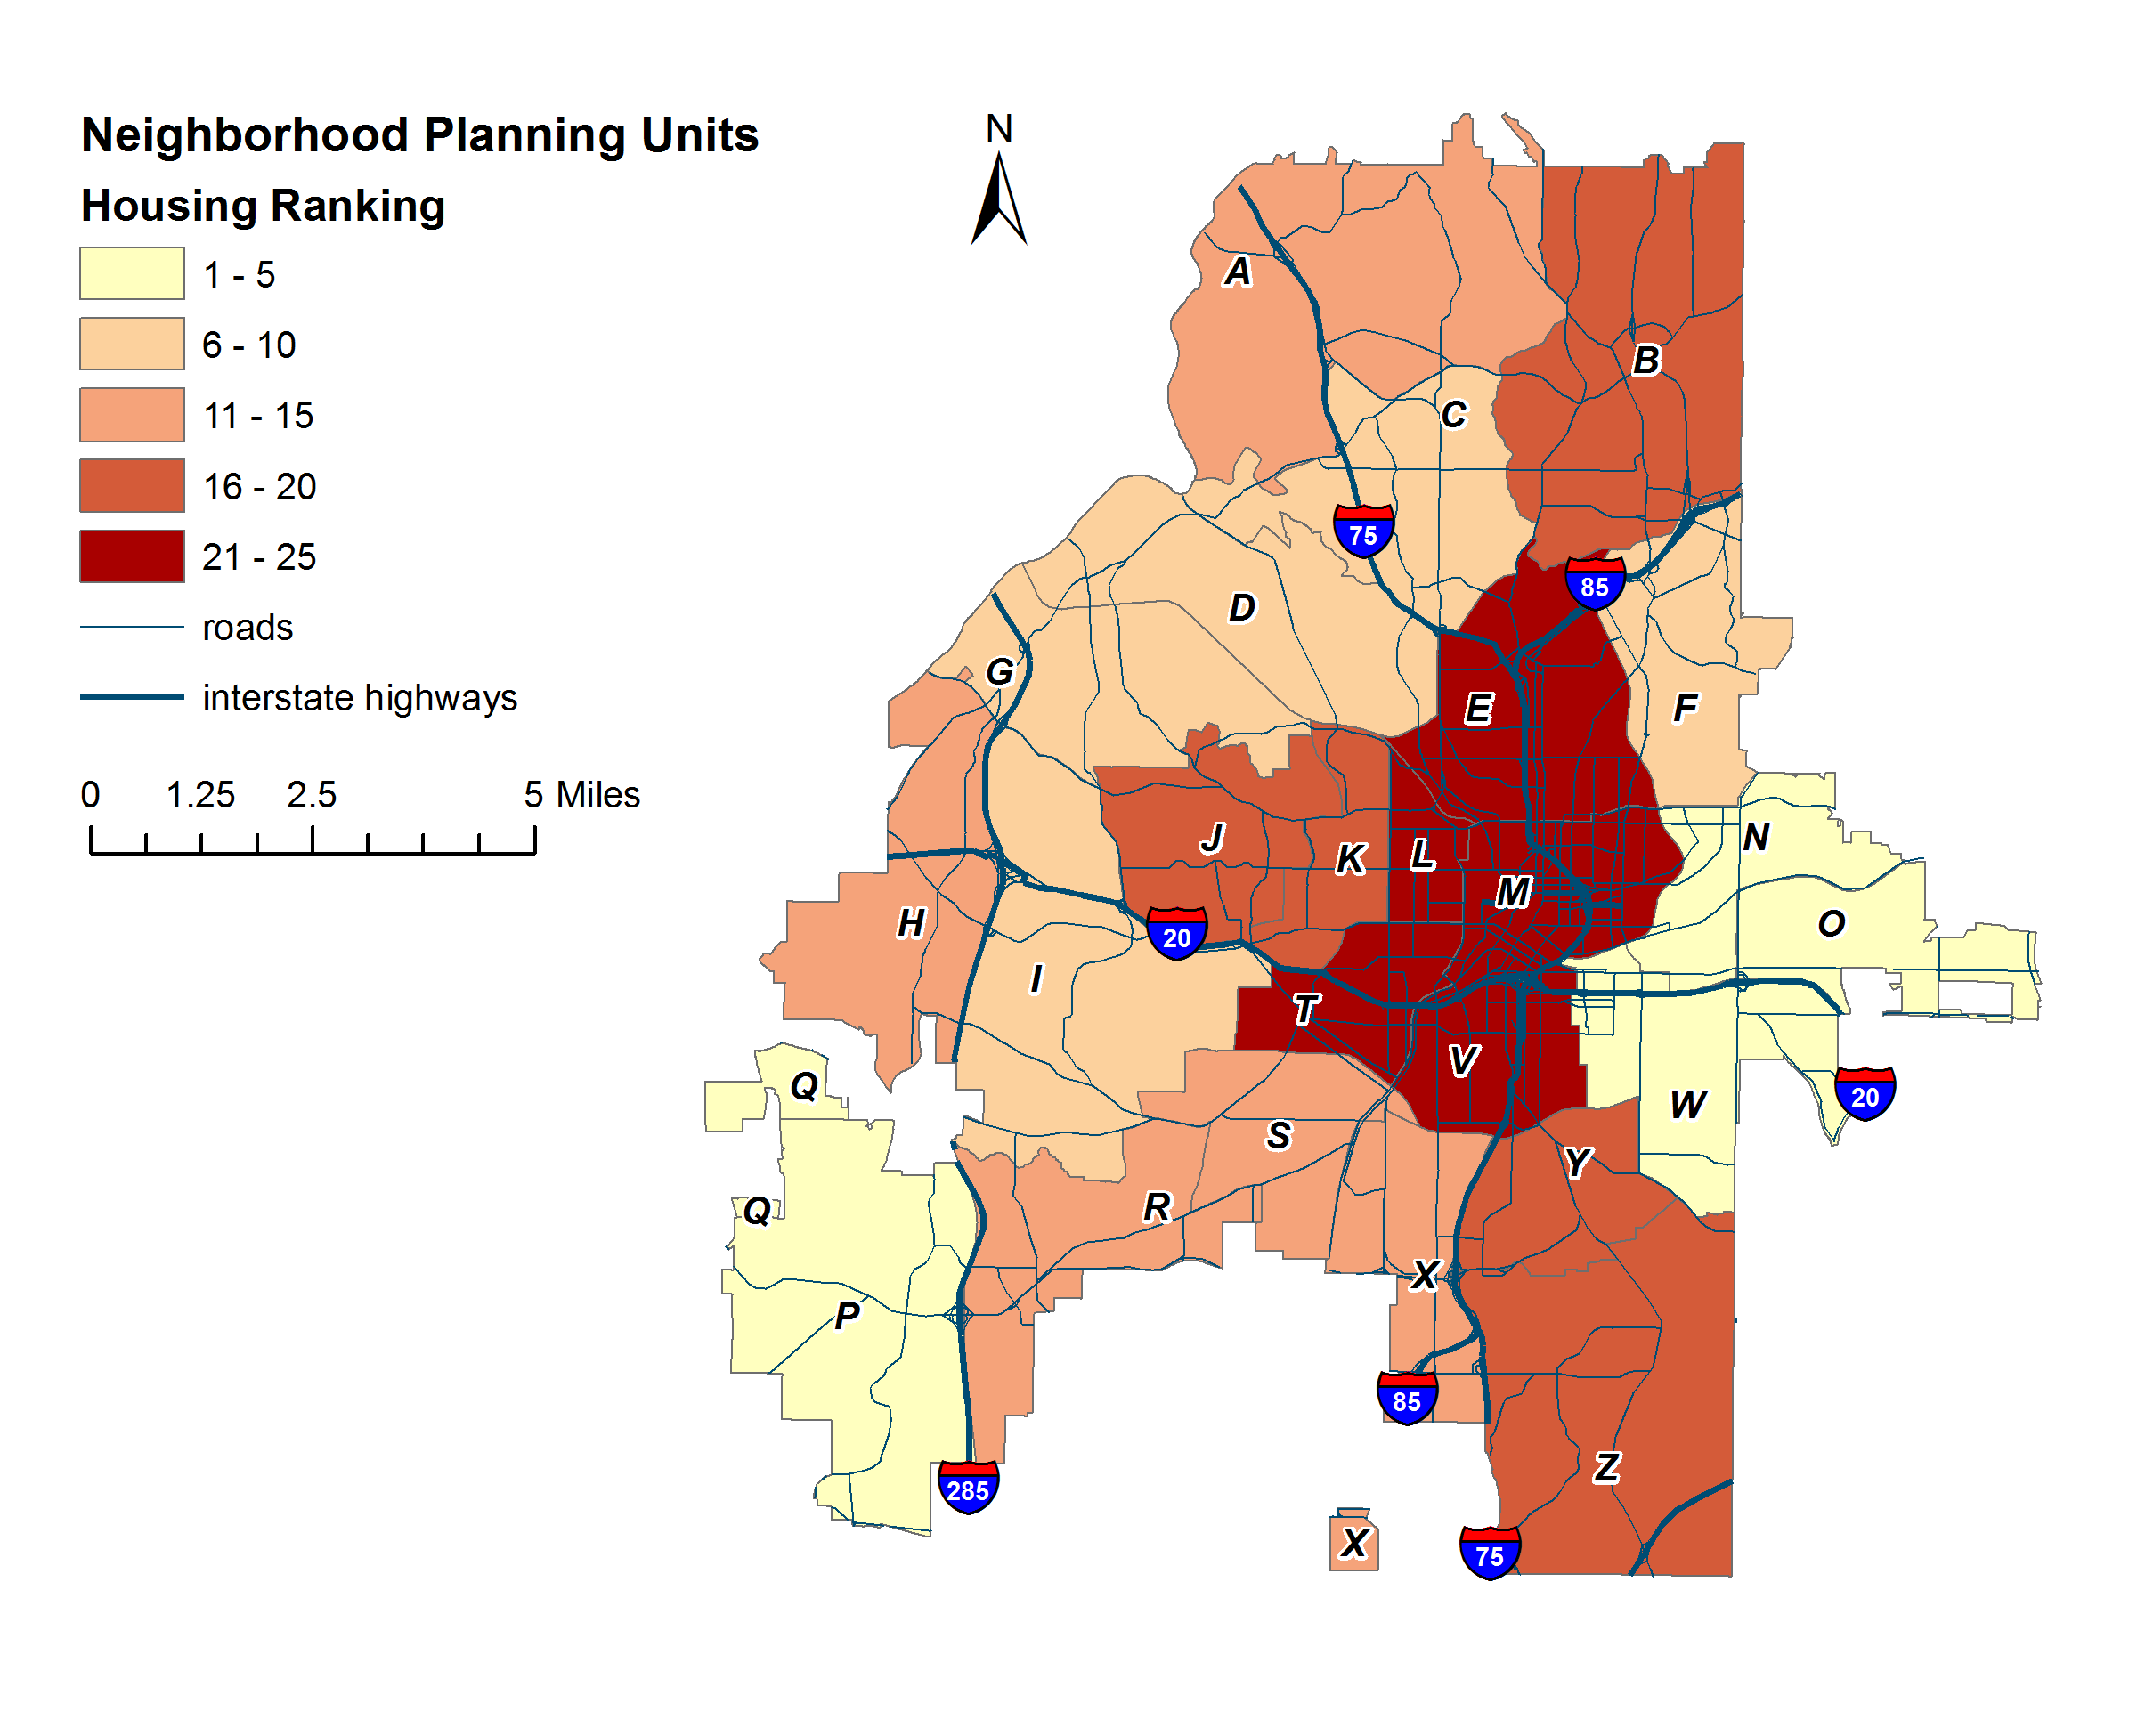
Housing ranking
Housing Ranking | NPU
1 | Q
2 | W
3 | P
4 | O
5 | N
6 | D
7 | C
8 | I
9 | G
10 | F
11 | H
12 | A
13 | X
14 | S
15 | R
16 | B
17 | Z
18 | Y
19 | K
20 | J
21 | V
22 | E
23 | T
24 | M
25 | L
Source: Calculated by authors.
Notes:
Vacancy and affordability diff results - > edge NPUs

Slide 40
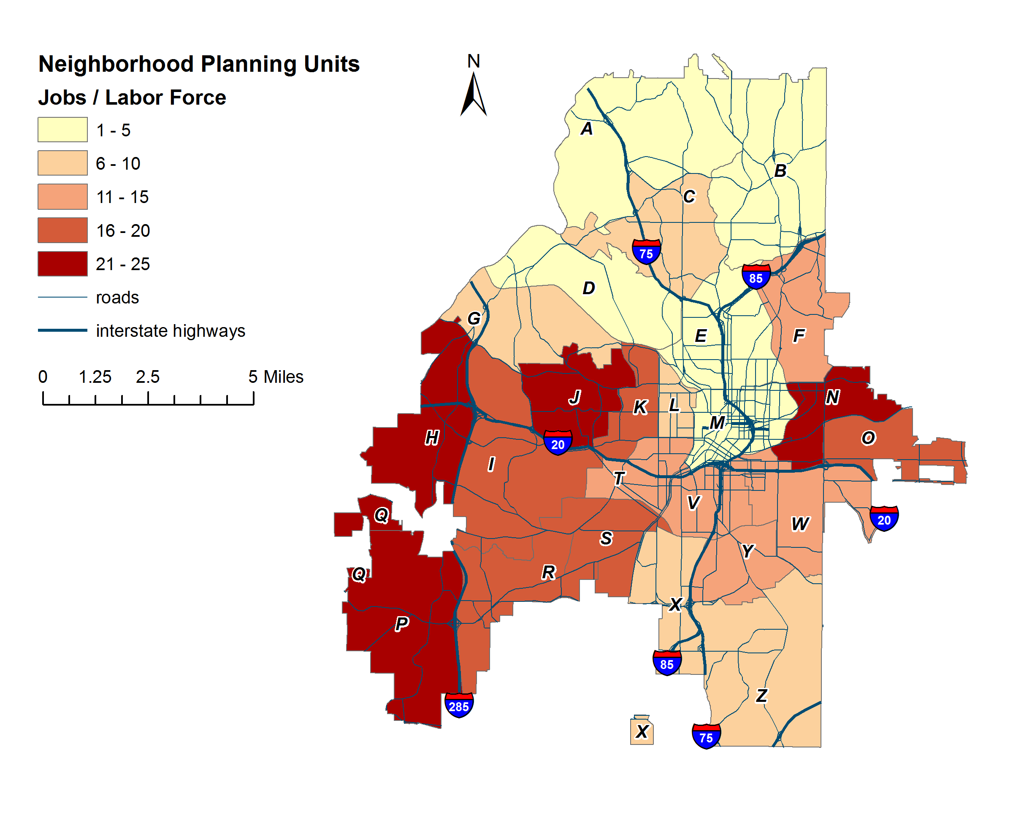
ECONOMY: Jobs to Labor Force Ratio
U.S. Census Bureau. ( 2010). 2010 American Community Survey 5-Year Estimates: Selected Economic Characteristics. Retrieved from www.factfinder2.census.gov
U.S. Census Bureau, Center for Economic . ( 2010). Work Area Profile Analysis: 2010 Primary Jobs. Retrieved from www.onthemap.ces.center.gov
Notes:
Jobs by location compared to # of residents in labor force

Slide 41
ECONOMY
Economy ranking
Economy Ranking | NPU
1 | M
2 | B
3 | E
4 | A
5 | D
6 | Z
7 | L
8 | G
9 | X
10 | C
11 | V
12 | F
13 | T
14 | W
15 | Y
16 | K
17 | O
18 | R
19 | I
20 | S
21 | N
22 | P
23 | J
24 | H
25 | Q
Source: Calculated by authors.

Slide 42
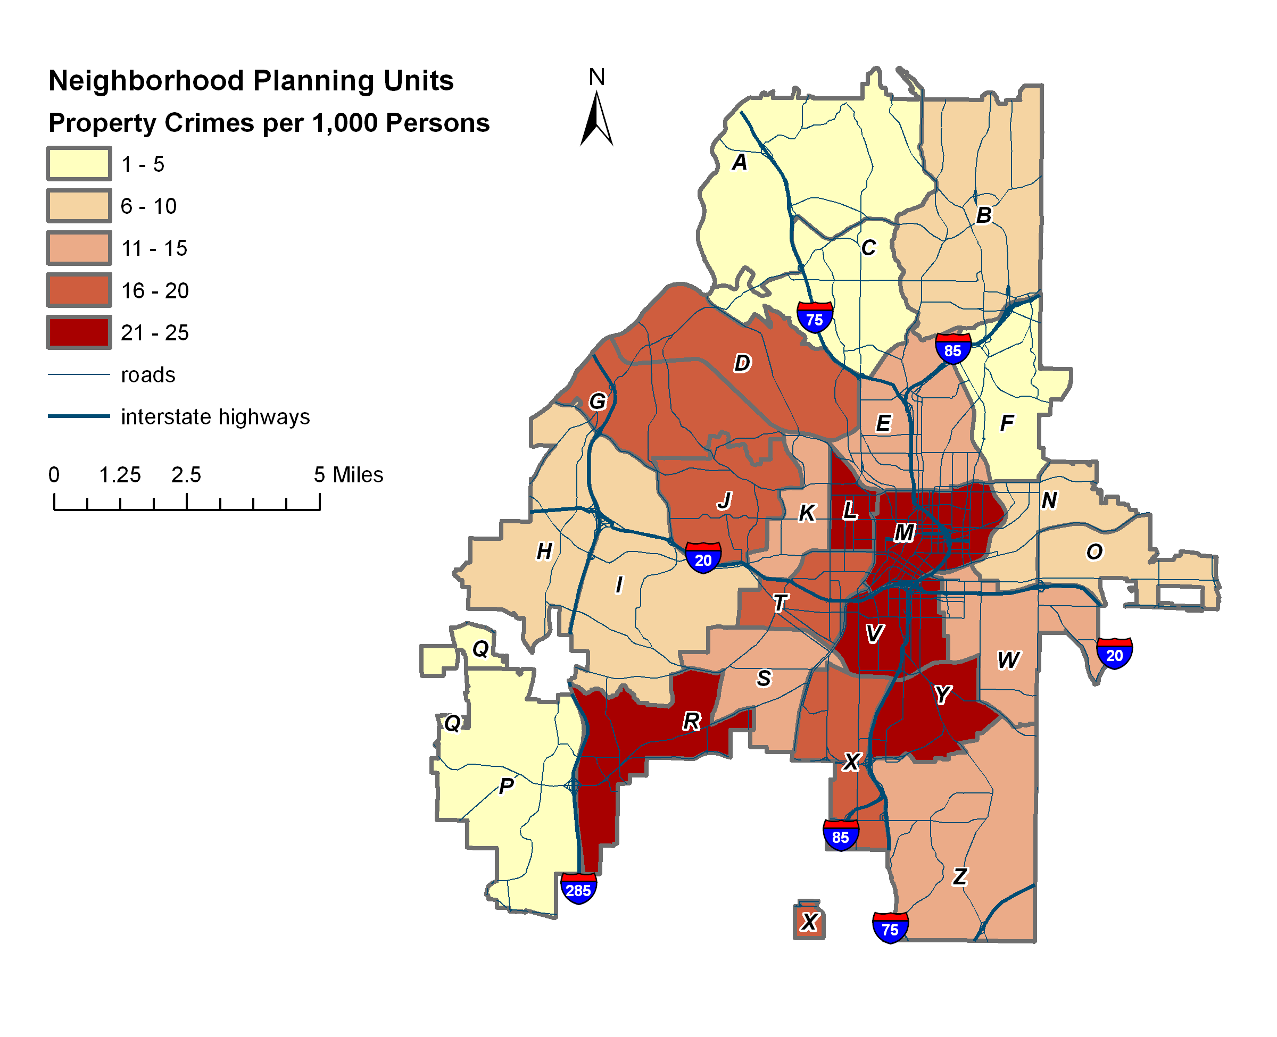
PUBLIC SAFETY: Property Crimes
Data Source: Atlanta Police Department
Notes:
arson, burglary, larceny-theft, and motor vehicle theft

Slide 43
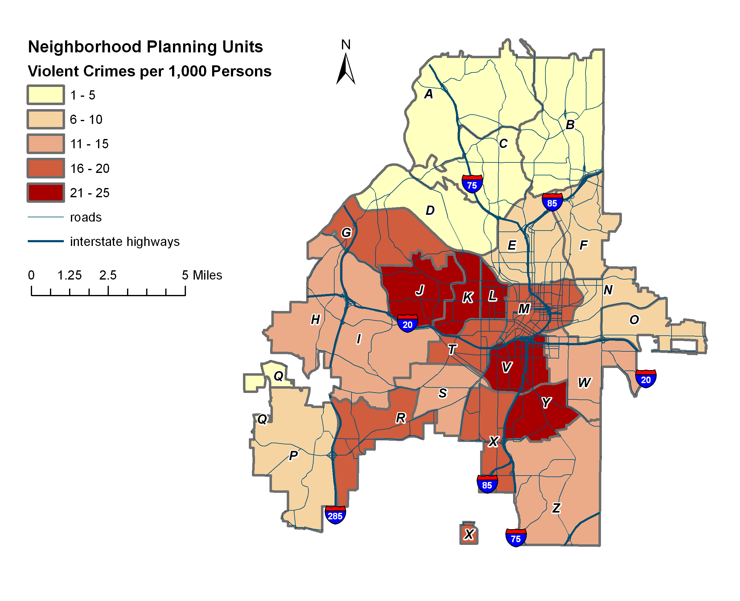
Public safety: violent crimes
Data Source: Atlanta Police Department
Notes:
Aggravated assault, forcible rape, murder, and robbery

Slide 44
PUBLIC SAFETY: 2010 Vehicle Crashes

Slide 45
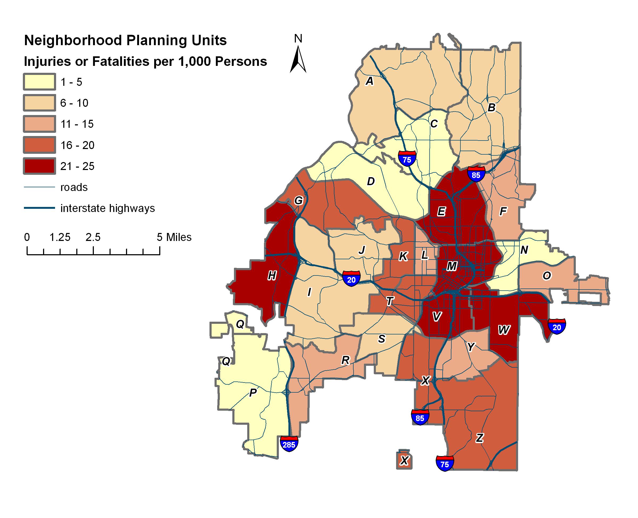
PUBLIC SAFETY: Vehicle Crash Injuries/Fatalities
Data Source: Georgia Department of Transportation ( 2012). Vehicle Crashes.

Slide 46
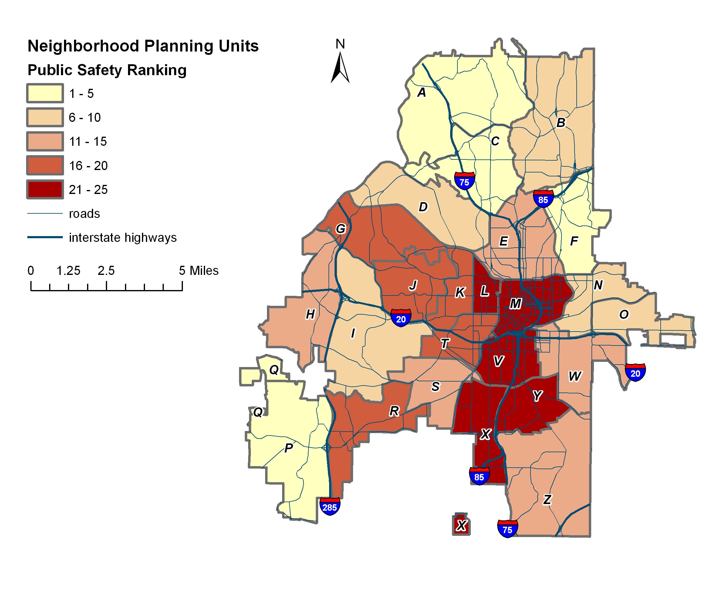
PUBLIC SAFETY ranking
Public Safety Ranking | NPU
1 | Q
2 | A
3 | C
4 | P
5 | F
6 | N
7 | B
8 | O
9 | D
10 | I
11 | H
12 | S
13 | W
14 | E
15 | Z
16 | K
17 | G
18 | T
19 | J
20 | R
21 | X
22 | Y
23 | L
24 | V
25 | M
Source: Calculated by authors.

Slide 47
TRANSPORTATION: Calculating Transit Access
¼ mile bus stop buffers & ½ mile rail station buffers
Population access determined by area weighted census blocks
Data Source: U.S. Census Bureau. ( 2010). ). 2010 American Community Survey 5-Year Estimates: Selected Economic Characteristics. Data Retrieved from www.factfinder2.census.gov
U.S. Census Bureau. ( 2010). Profile of General Population and Housing Characteristics: 2010 Demographic Profile. Data Retrieved from www.factfinder2.census.gov

Slide 48
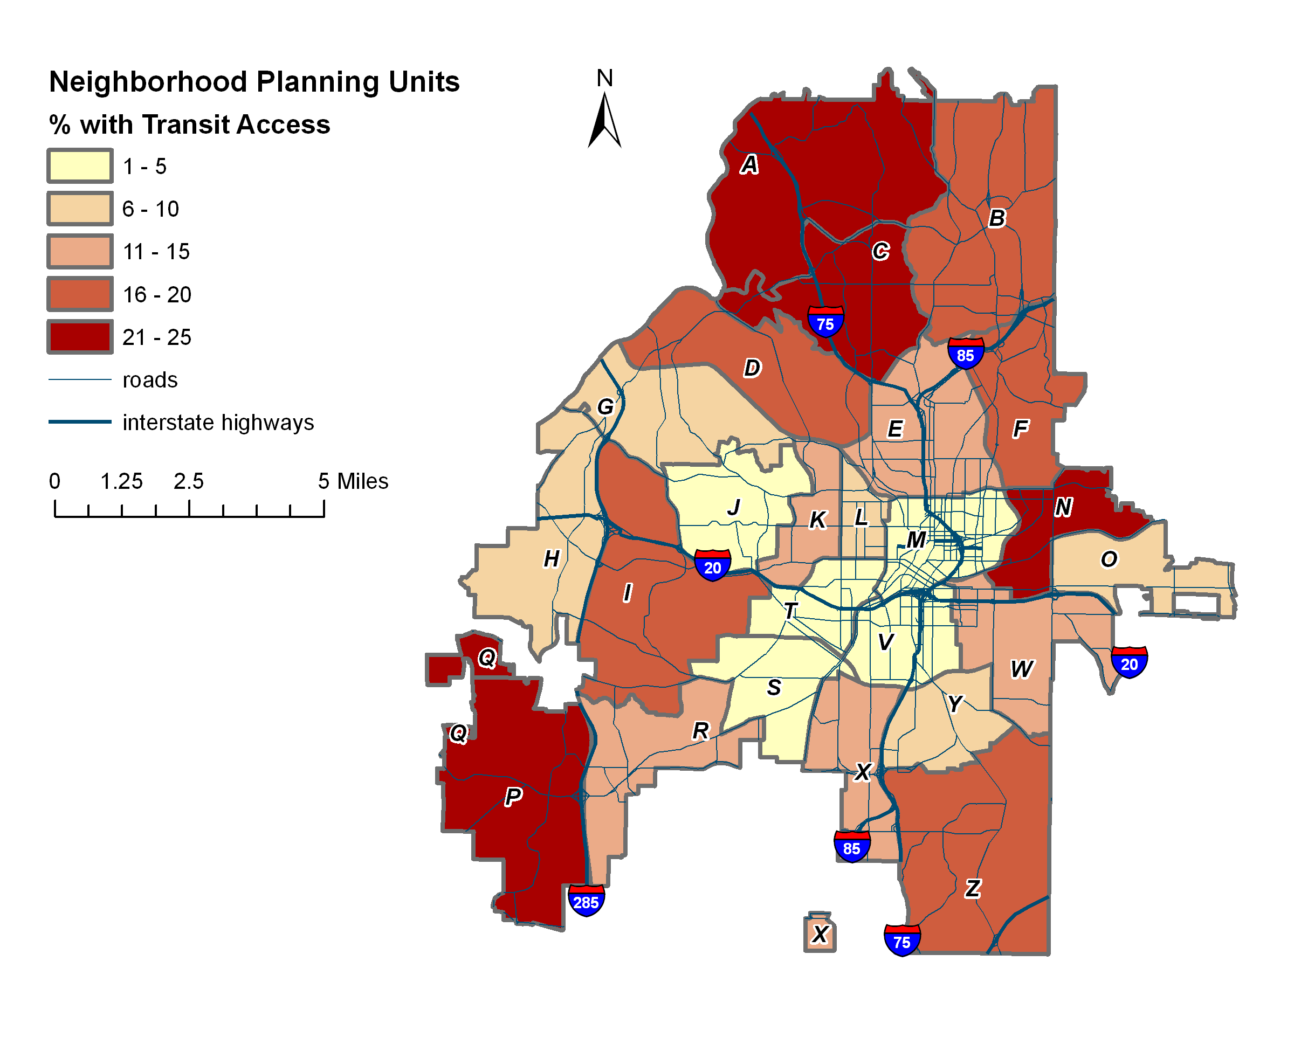
Transportation: Transit Access
Notes:
79% of Atlanta overall has good access to transit – good measured by ¼ - ½ mile buffers. …

Slide 49
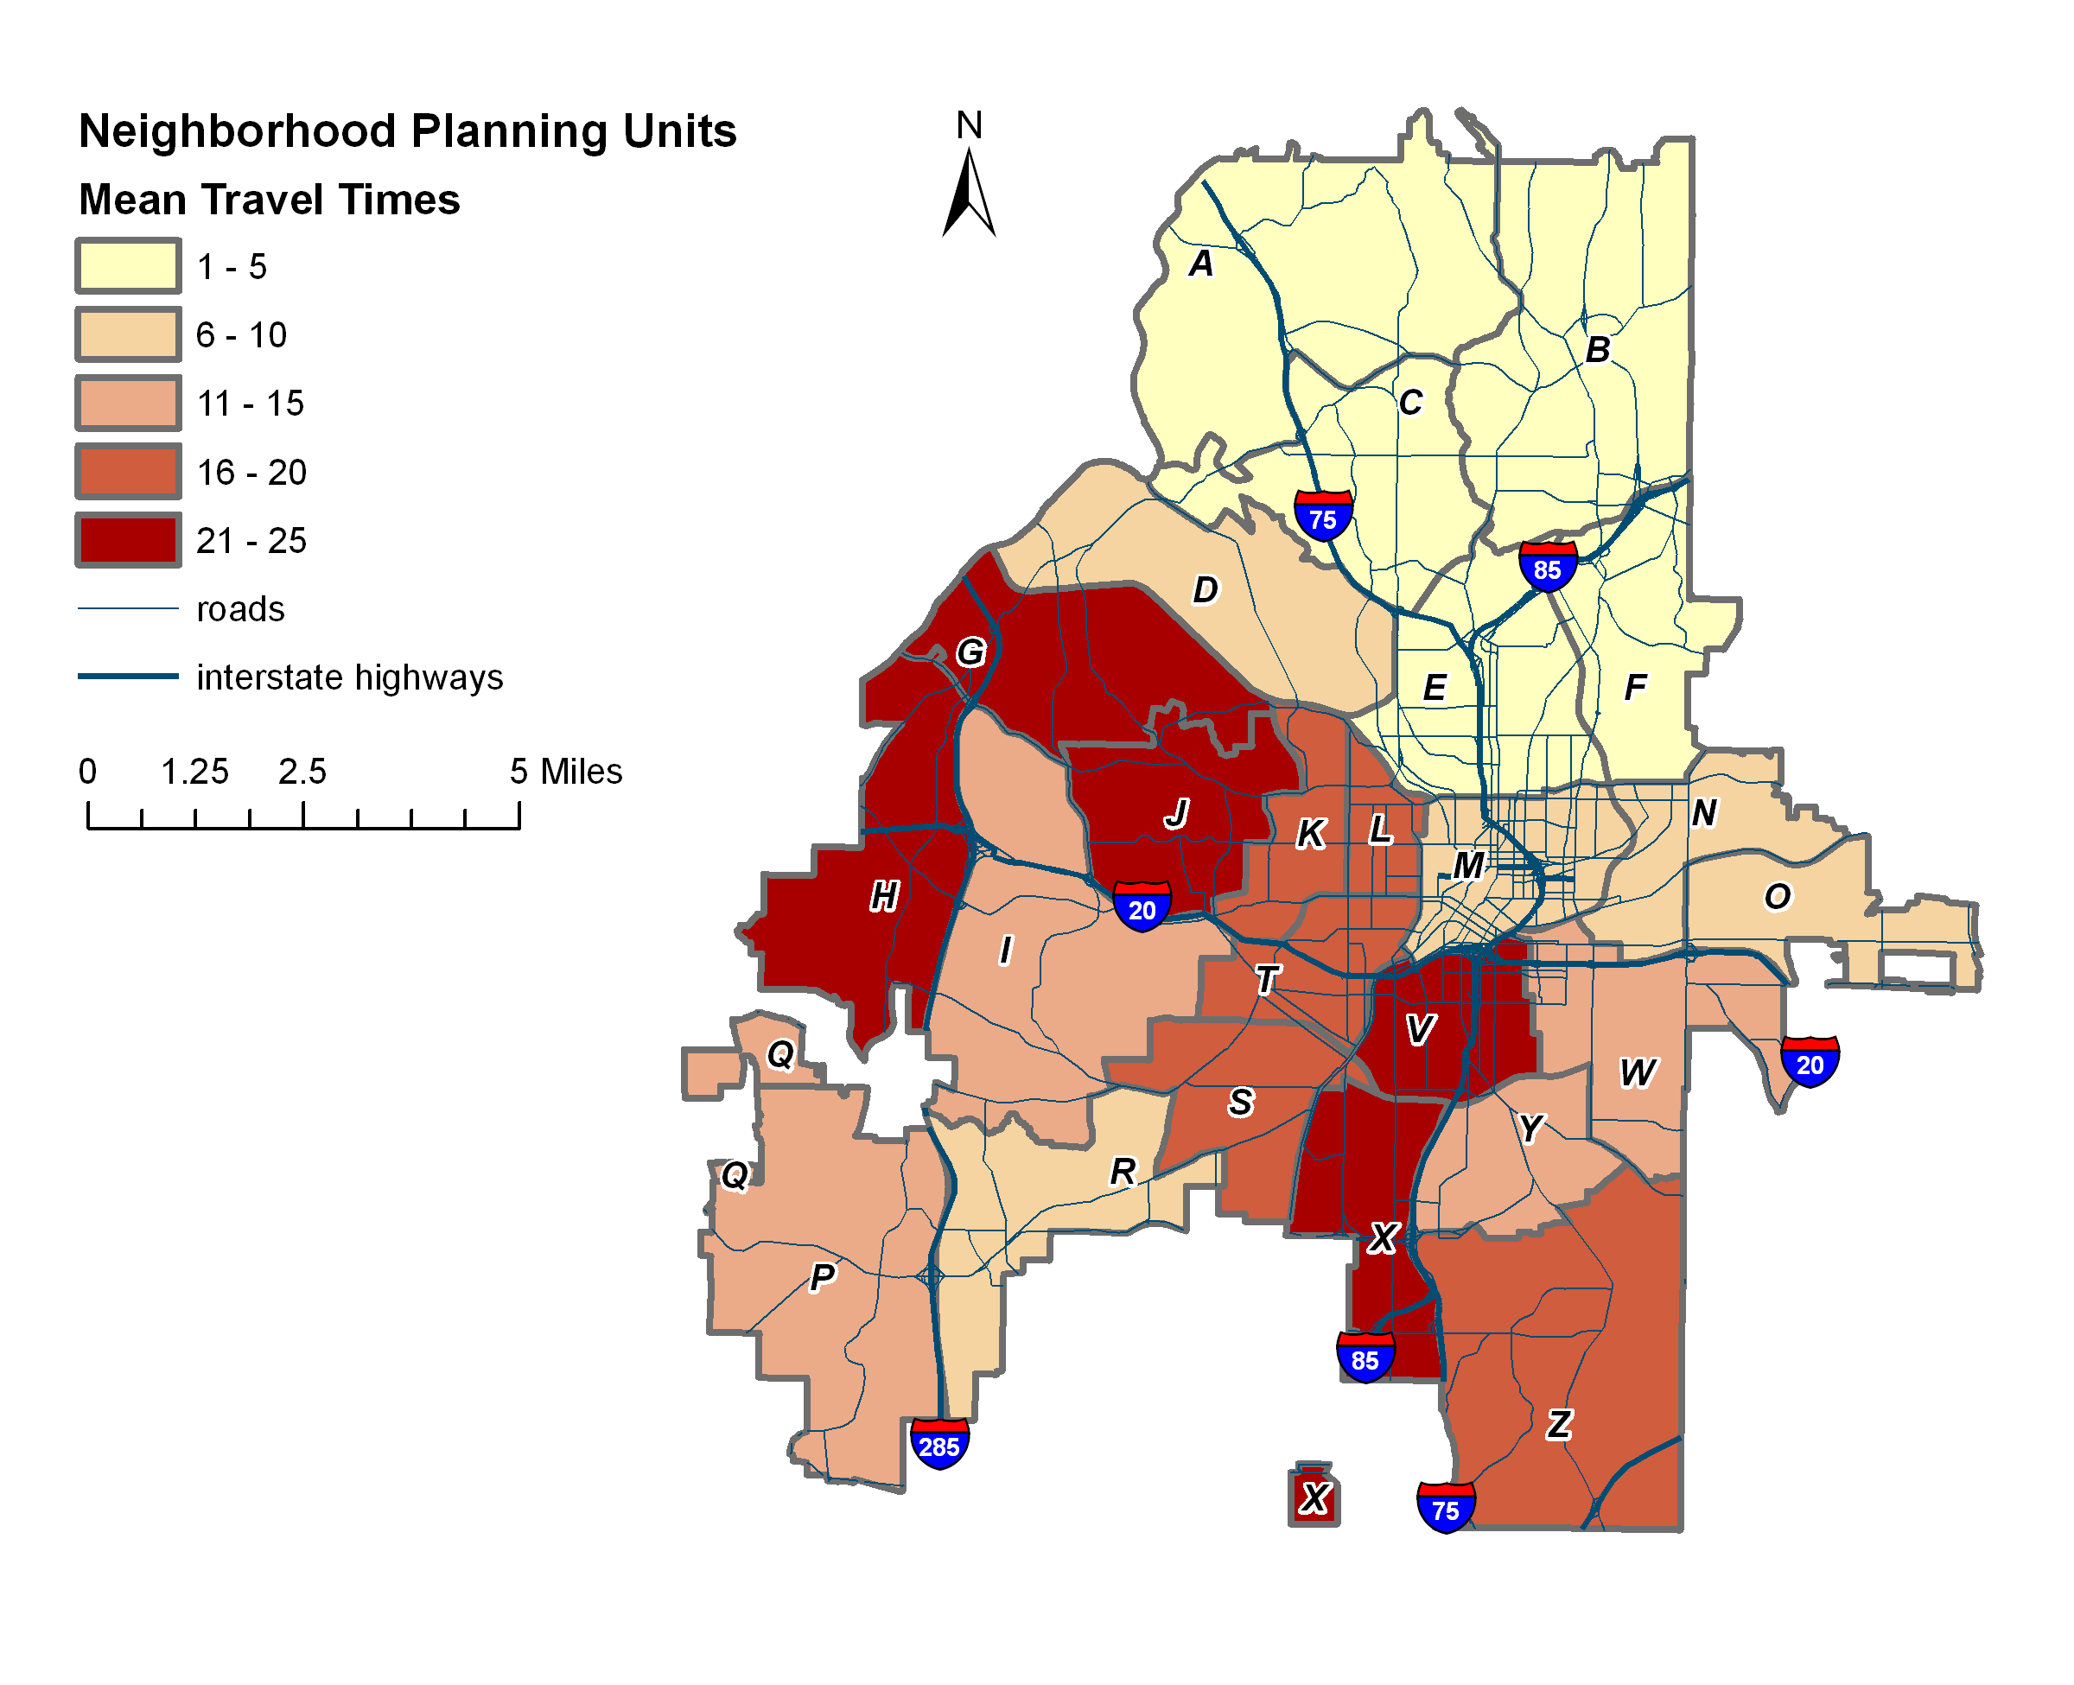
TRANSPORTATION: Mean Travel Times
Data Source: U.S. Census Bureau. ( 2010). ). 2010 American Community Survey 5-Year Estimates: Selected Economic Characteristics. Data Retrieved from www.factfinder2.census.gov
Notes:
see longer travel times in south, shorter in north for two possible reasons:
More jobs in north, and more private vehicle ownership

Slide 50
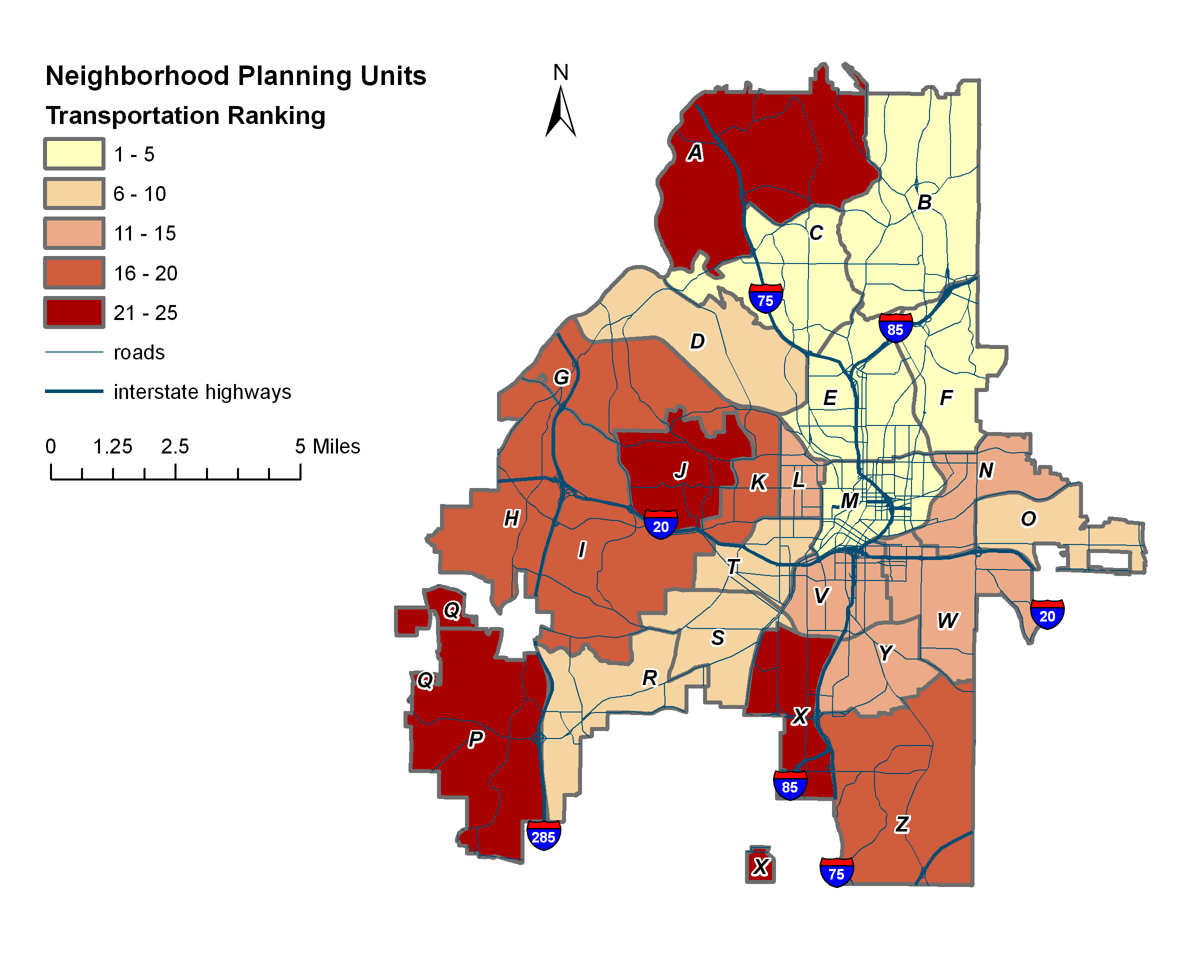
Transportation Ranking | NPU
1 | E
2 | M
3 | F
4 | B
5 | C
6 | O
7 | D
8 | T
9 | R
10 | S
11 | Y
12 | L
13 | N
14 | W
15 | V
16 | G
17 | K
18 | H
19 | Z
20 | I
21 | P
22 | X
23 | A
24 | J
25 | Q
TRANSPORTATION RANKING
Source: Calculated by authors.

Slide 51
NQOL Resident Priorities*
Attribute | City Resident Ranking | Indicator Classification | Weighting
Police Services | 4.3 | Public Safety | 25%
Fire Services | 4.2 | Public safety
Economic Development | 4.2 | Economy | 22%
Transportation | 4.1 | Transportation | 20%
Parks, Greenspace and Recreation | 4.0 | Amenities | 18%
Land Use | 4.0 | Amenities
Housing | 3.7 | Housing | 15%
* Based on City of Atlanta 2011 CDP Survey Results
Notes:
Land use = proxy for access to activity centers

Slide 52
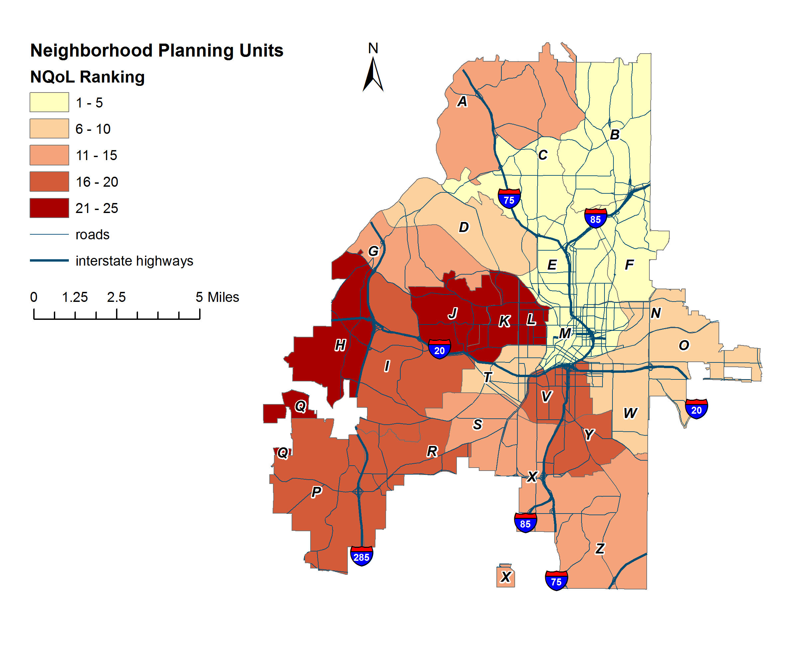
Neighborhood Quality of Life Index Ranking
High SEC | NQoL Ranking | NPU
 | 1 | B
 | 2 | F
 | 3 | E
 | 4 | C
 | 5 | D
 | 6 | N
 | 7 | A
 | 8 | Q
Medium SEC | NQoL Ranking | NPU
 | 1 | M
 | 2 | O
 | 3 | W
 | 4 | I
 | 5 | P
 | 6 | R
Low SEC | NQoL Ranking | NPU
 | 1 | T
 | 2 | S
 | 3 | G
 | 4 | Z
 | 5 | X
 | 6 | V
 | 7 | Y
 | 8 | K
 | 9 | L
 | 10 | H
 | 11 | J
Source: Calculated by authors.

Slide 53
Neighborhood Health Index

Slide 54
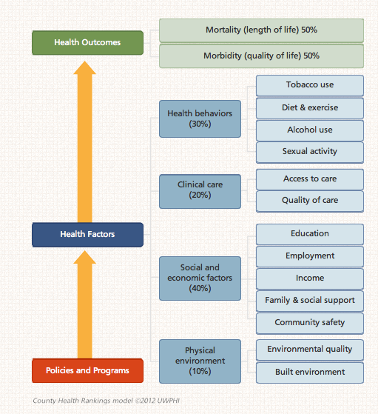
County Health Rankings
http://www.countyhealthrankings.org/our-approach
Notes:
In developing a health index for Atlanta, we surveyed other indexes and ranking systems to determine what variables are often used. One approach that has validated measures and national influence is the county health rankings.
County health rankings follows a three part approach in their calculations
Health outcomes : mortality that is best understood as one’s length of life morbidity, the quality of one’s life.
Health factors: health behaviors, (tobacco use, diet and exercise, alcohol use, sexual activity), clinical care (access to care and quality of care), social and economic factors (education, employment, income, family and social support and community safety), and physical environment (environmental quality, built environment)
54

Slide 55
County Health Rankings
Mortality
Premature Death, Years of Potential Life Lost 75 (YPLL75)
Morbidity
HRQL
Birth Outcomes (Low Birth Weight, LBW)
http://www.countyhealthrankings.org/our-approach
Notes:
55

Slide 56
County Health Rankings
Health Behaviors
Tobacco Use (BRFSS)
Diet & Exercise (BMI and leisure time physical activity, NCCDPHP)
Alcohol use (BRFSS)
Sexual activity (Teen Birth Rates and STDs, NCHS and CDC)
http://www.countyhealthrankings.org/our-approach
Notes:
56

Slide 57
County Health Rankings
Clinical Care
Access to care, under 65 w/out insurance and # people/PCP (HRSA)
Quality of care, preventive hospitalizations, diabetic screening, Mammography screening (Dartmouth Atlas)
http://www.countyhealthrankings.org/our-approach
Notes:
57

Slide 58
County Health Rankings
Social and economic factors
% 9th grade cohort w/ 4 year graduation
Average annual unemployment rate
Children in poverty
% adults w/o social/emotional support (BRFSS)
Single parent HH
Violent Crimes (FBI)
http://www.countyhealthrankings.org/our-approach
Notes:
58

Slide 59
County Health Rankings
Physical Environment
Unhealthy AQ days
Limited Access to healthy foods
Fast food restaurants
Access to recreational facilities
http://www.countyhealthrankings.org/our-approach
Notes:
59

Slide 60
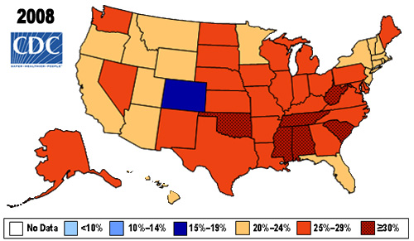
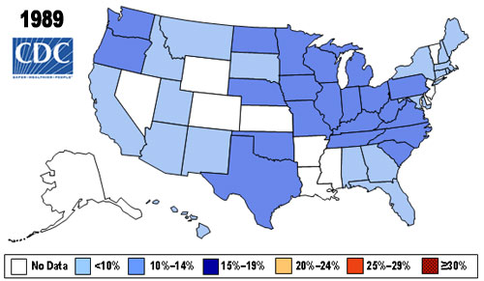
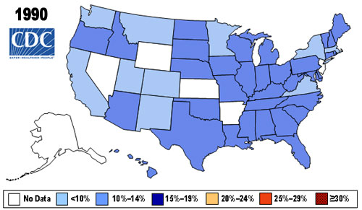
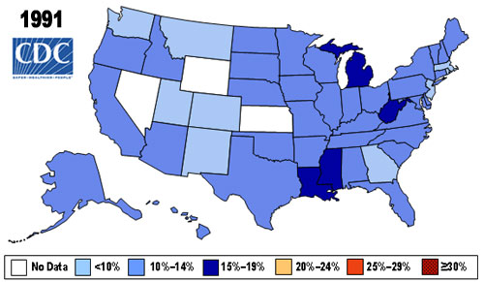
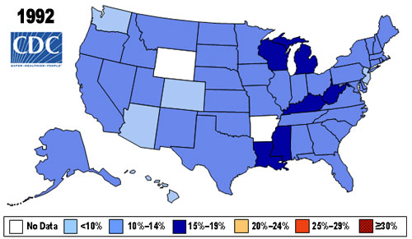
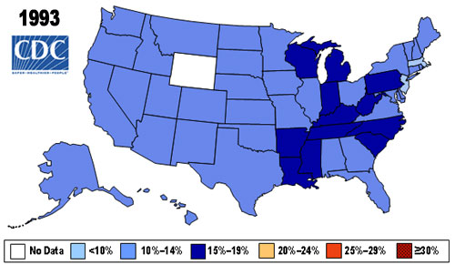
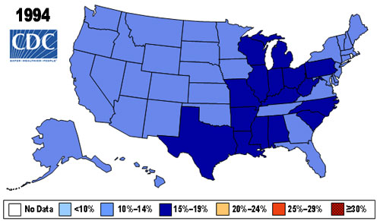
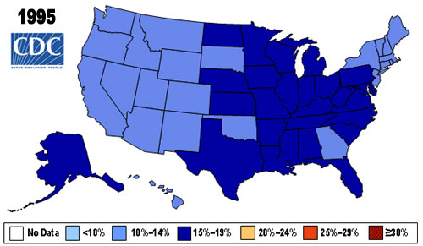
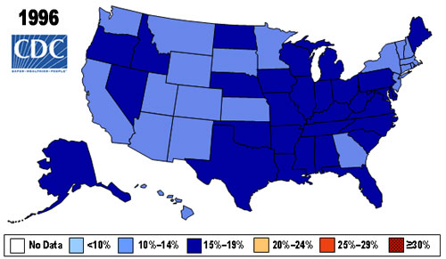
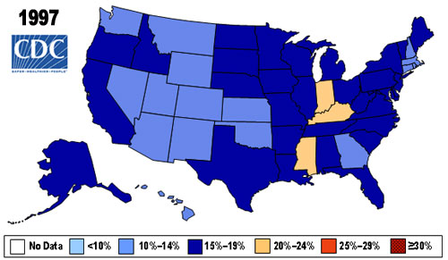
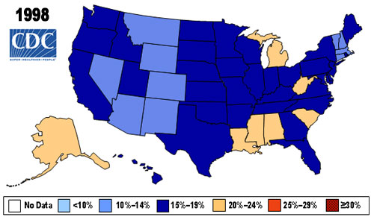
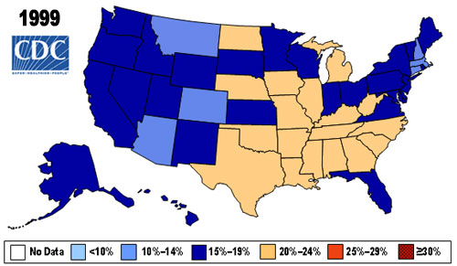
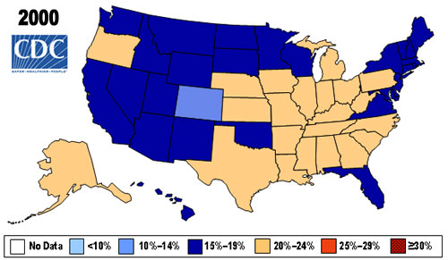
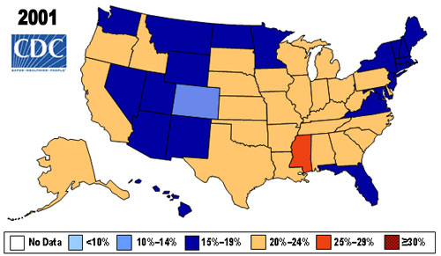
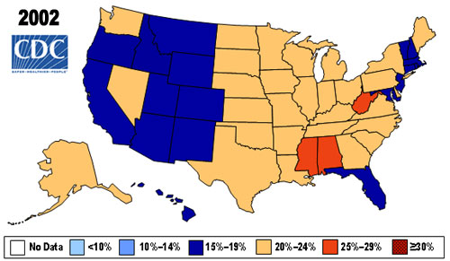
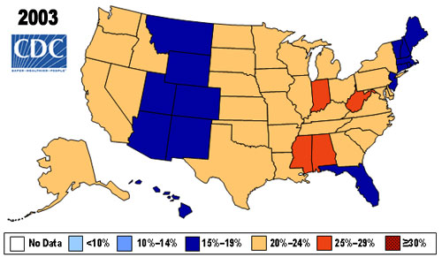
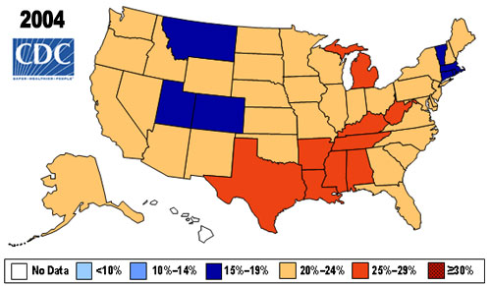
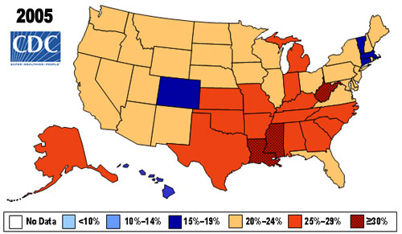
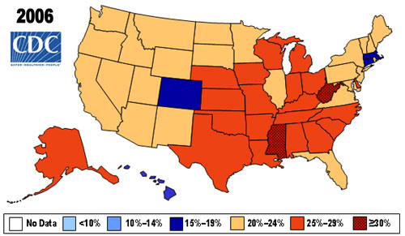
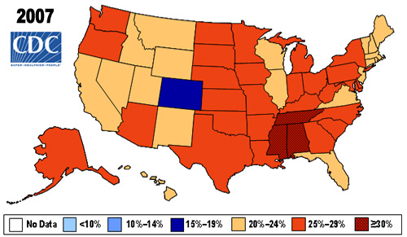
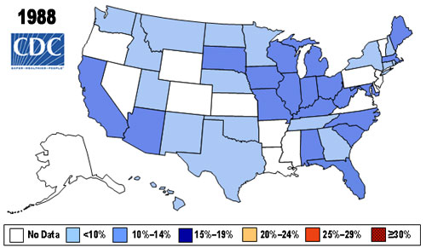
Obesity Prevalence by State

Slide 61
HEALTH Indicators
Indicators | Measures
Nutrition | % With Good Food Access
Physical Activity | Walkability
Morbidity | Diabetes Hypertensive Heart Disease Esophageal, Renal & Uterine Cancers
Mortality | YPLL 75 Rate

Slide 62
Nutrition: Food Access
Food destinations:
Supermarkets
Food markets and grocery stores
Farmers markets
Proximity: determined by average nearest distance from populations to food retail destinations.
Socioeconomic factors:
Poverty status

Slide 63
Distance From Populations to Nearest Food Destinations
Using the Near tool
Calculates distance from each block group centroid to nearest food destination
U.S. Census Bureau. ( 2010). Profile of General Population and Housing Characteristics: 2010 Demographic Profile. Data Retrieved from www.factfinder2.census.gov
Reference USA. ( 2012). U.S. Businesses. Data retrieved from www.referenceusa.com

Slide 64
Proximity
325 block groups in the city of Atlanta
262 food destinations
the range of access is 168 ft - 16,051 ft
The average nearest distance to a food market is 2357 feet or .45 mile.
U.S. Census Bureau. ( 2010). Profile of General Population and Housing Characteristics: 2010 Demographic Profile. Data Retrieved from www.factfinder2.census.gov
Reference USA. ( 2012). U.S. Businesses. Data retrieved from www.referenceusa.com

Slide 65
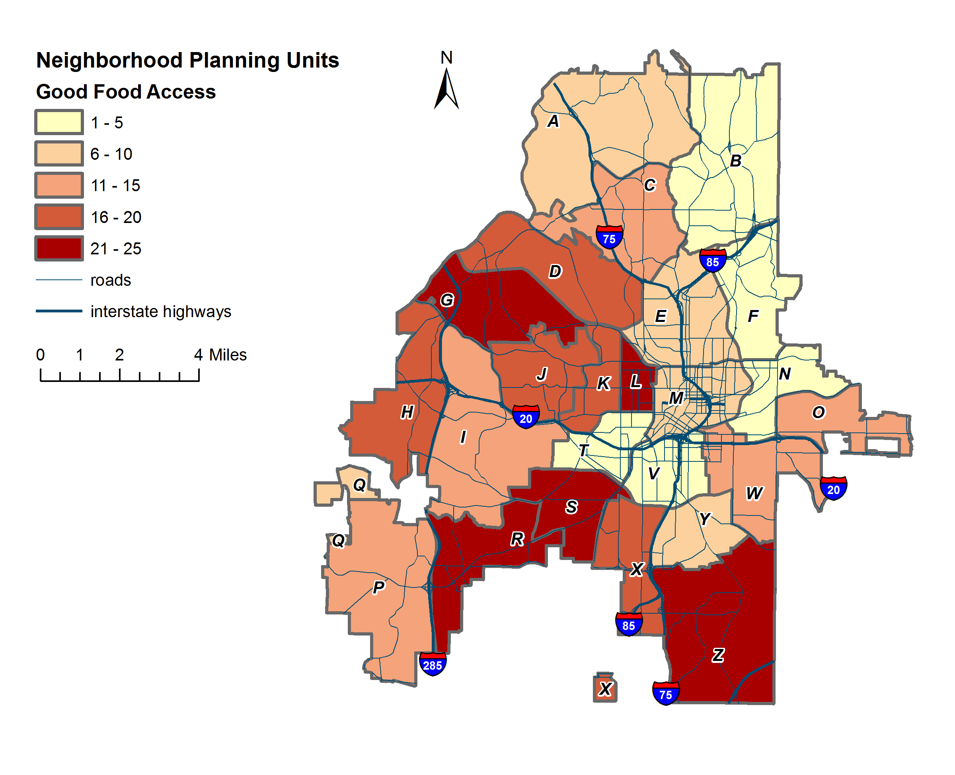
Nutrition: Good Food Access
Source: Calculated by authors.

Slide 66
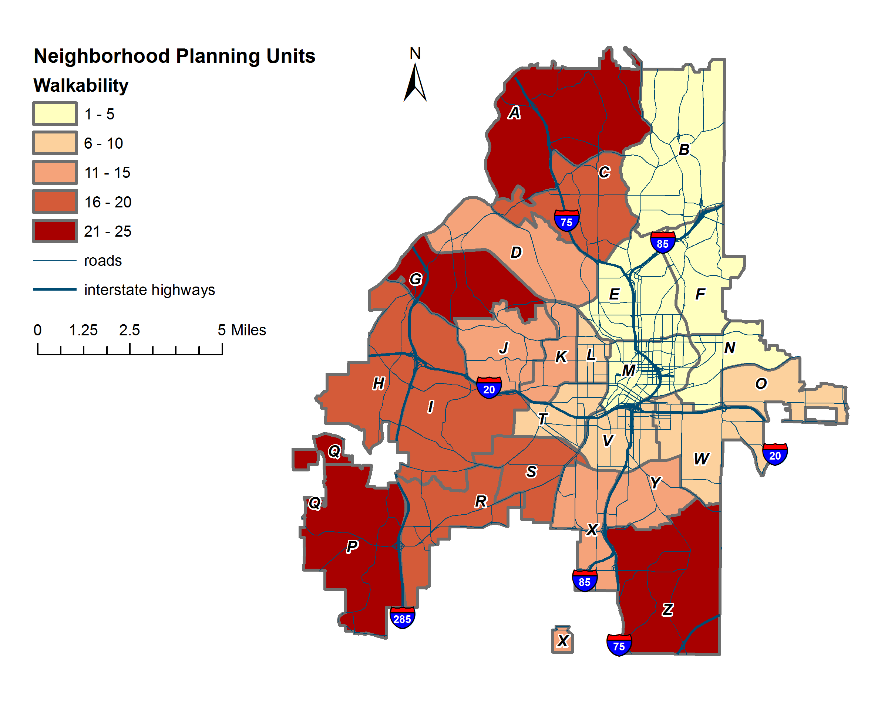
Physical activity: walkability
Data Source: Walk Score. (2012). Atlanta Neighborhoods. Data retrieved from www.walkscore.com
Notes:
Derived from averaging walkscores for neighborhoods within NPUs

Slide 67
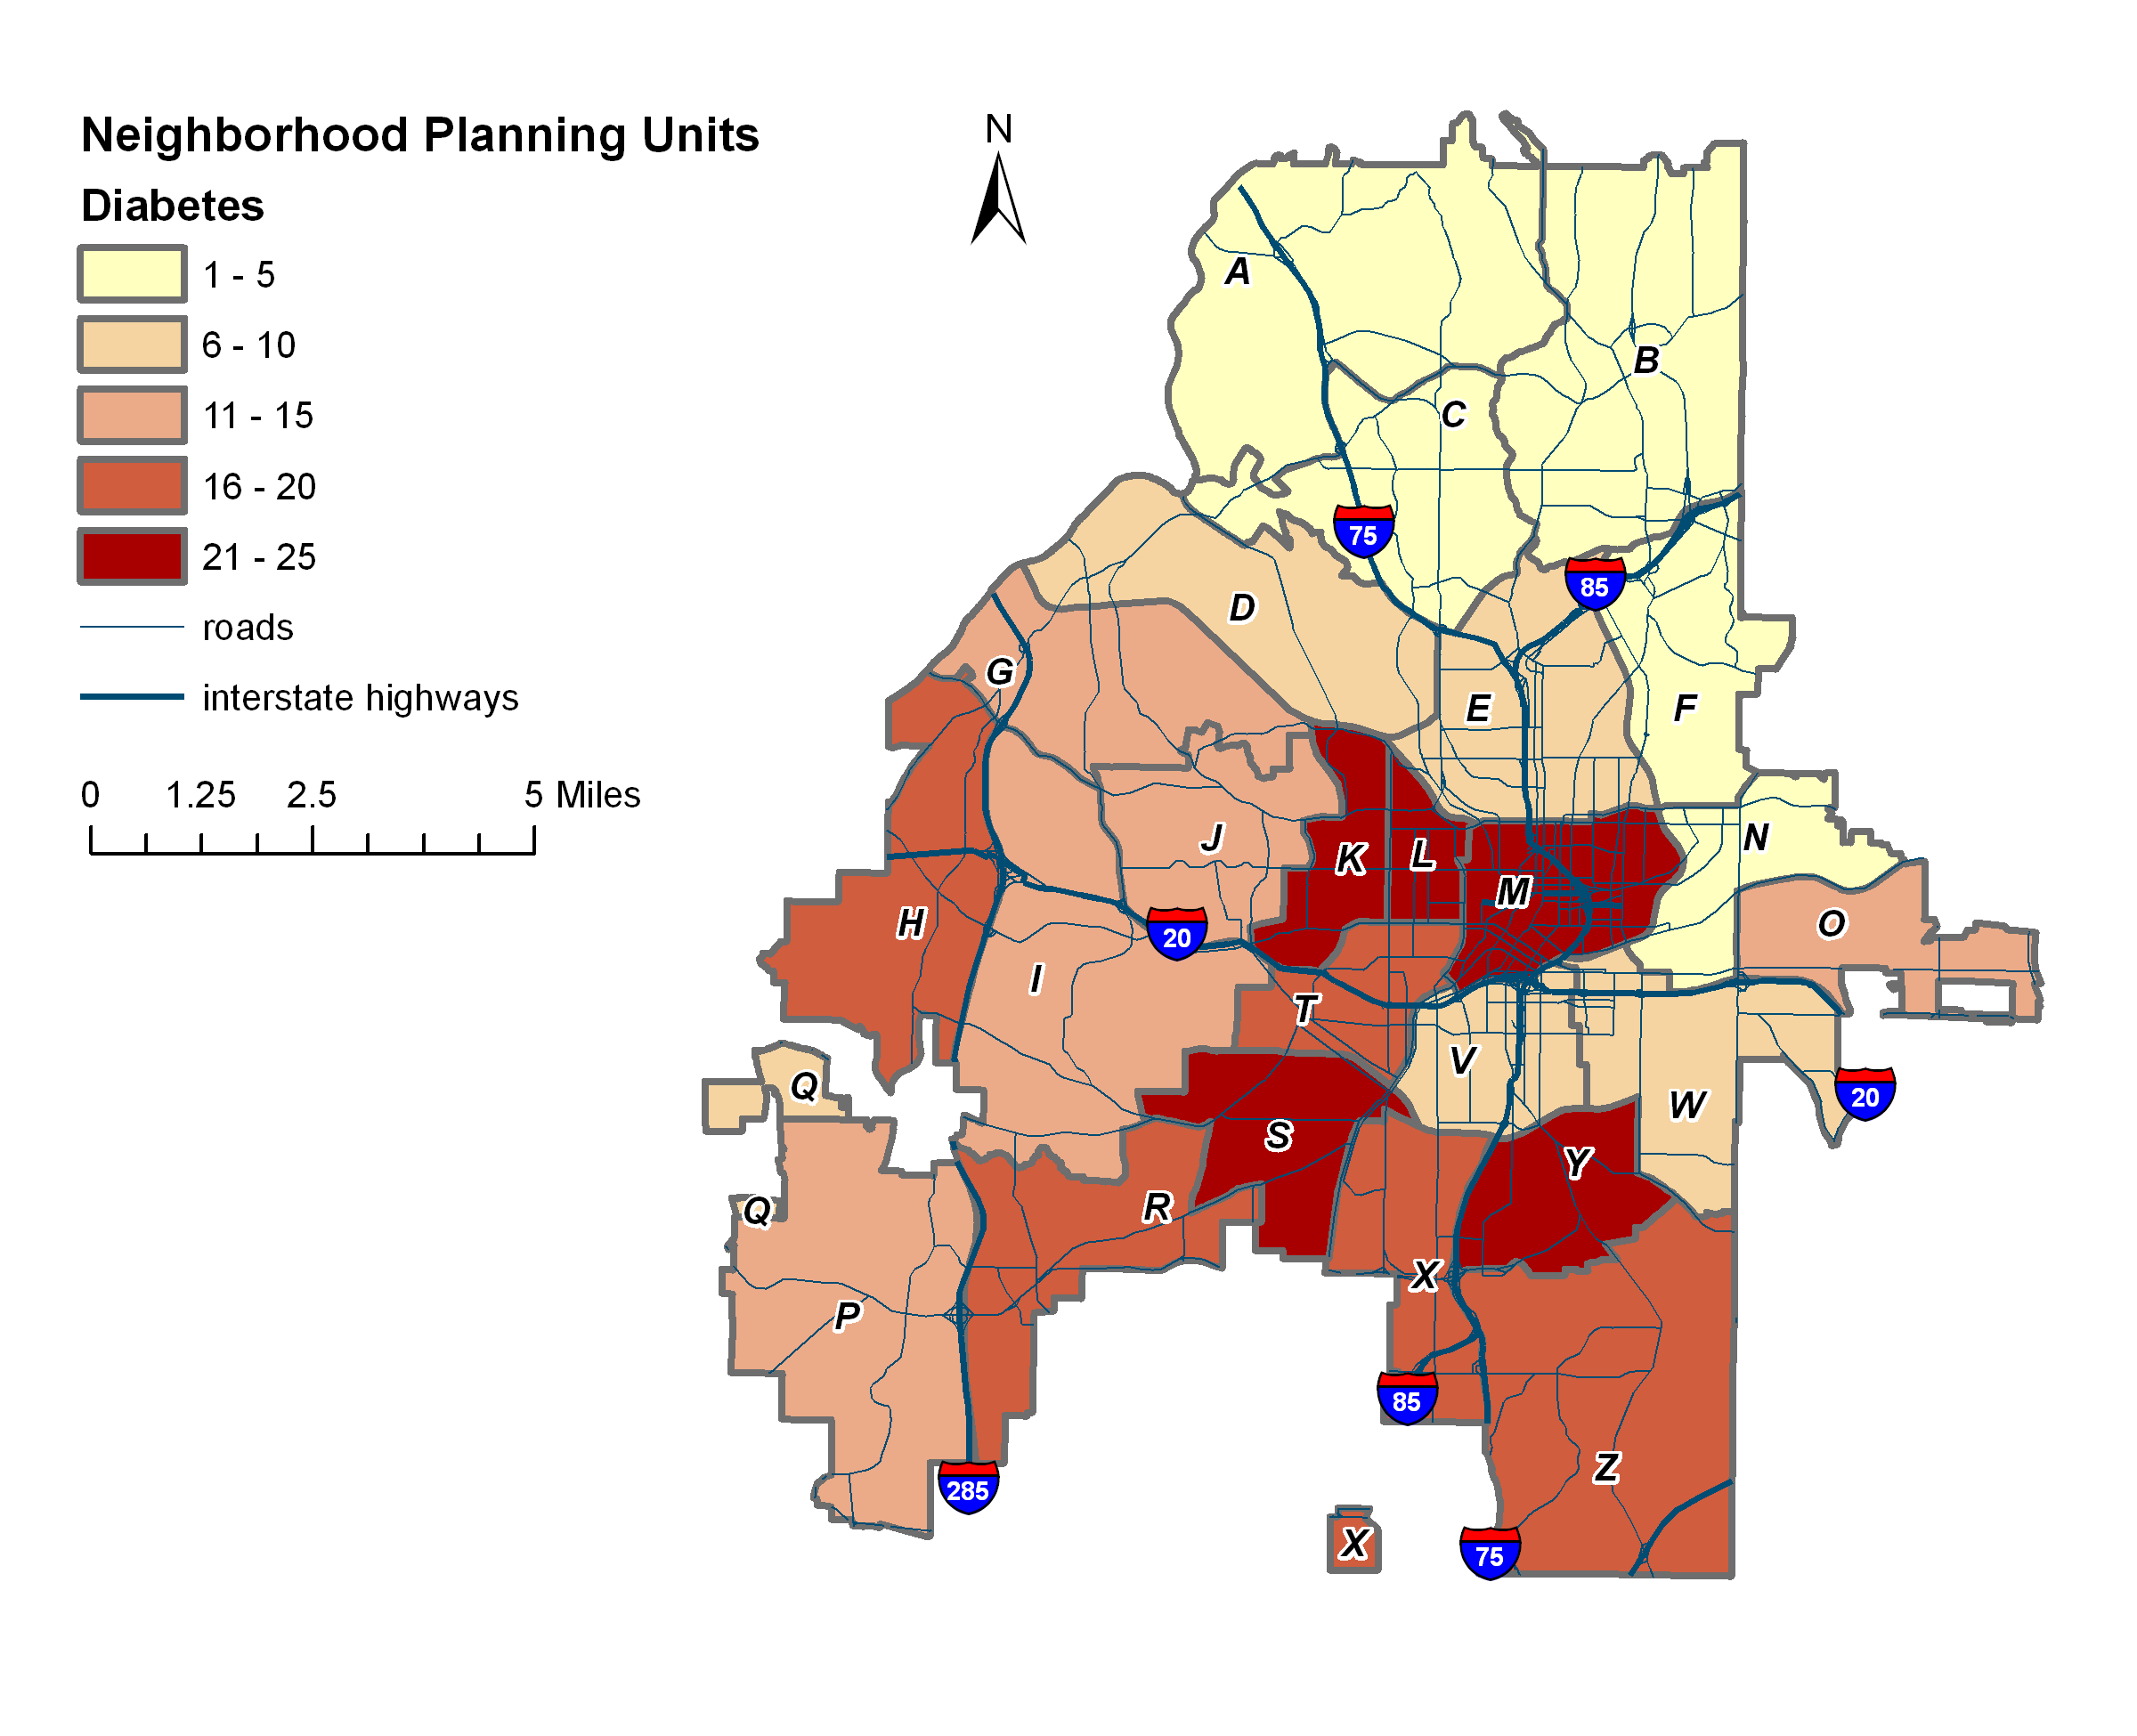
Morbidity: Diabetes
Data Source: Georgia Department of Public Health.

Slide 68
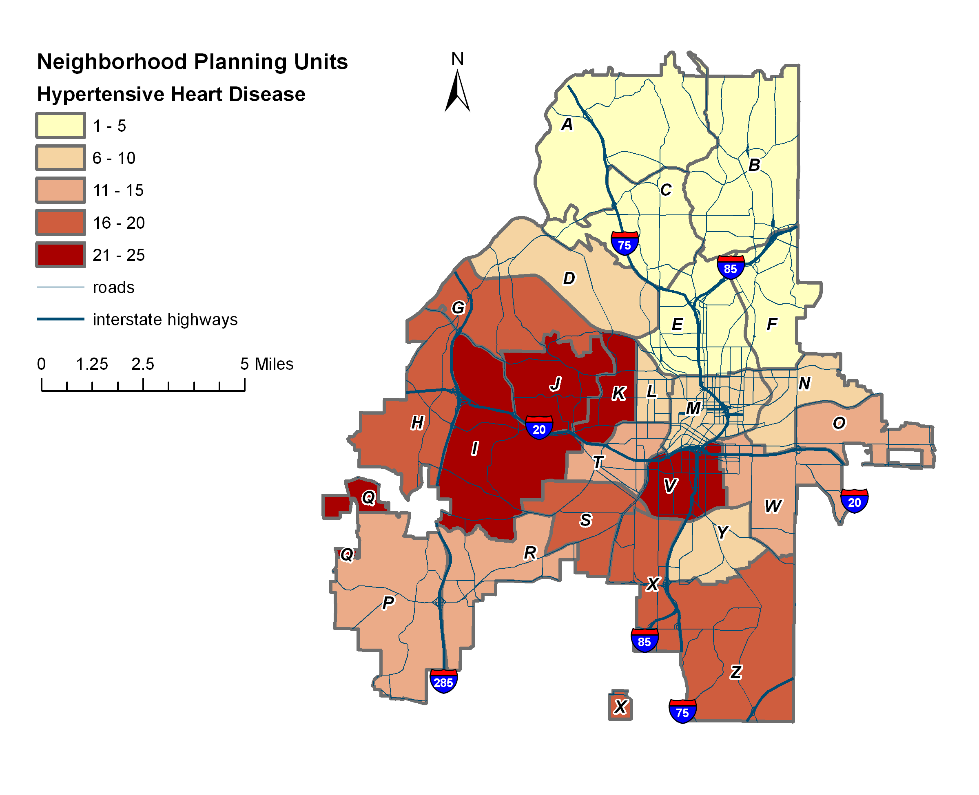
Morbidity: Hypertensive Heart Disease
Data Source: Georgia Department of Public Health.

Slide 69
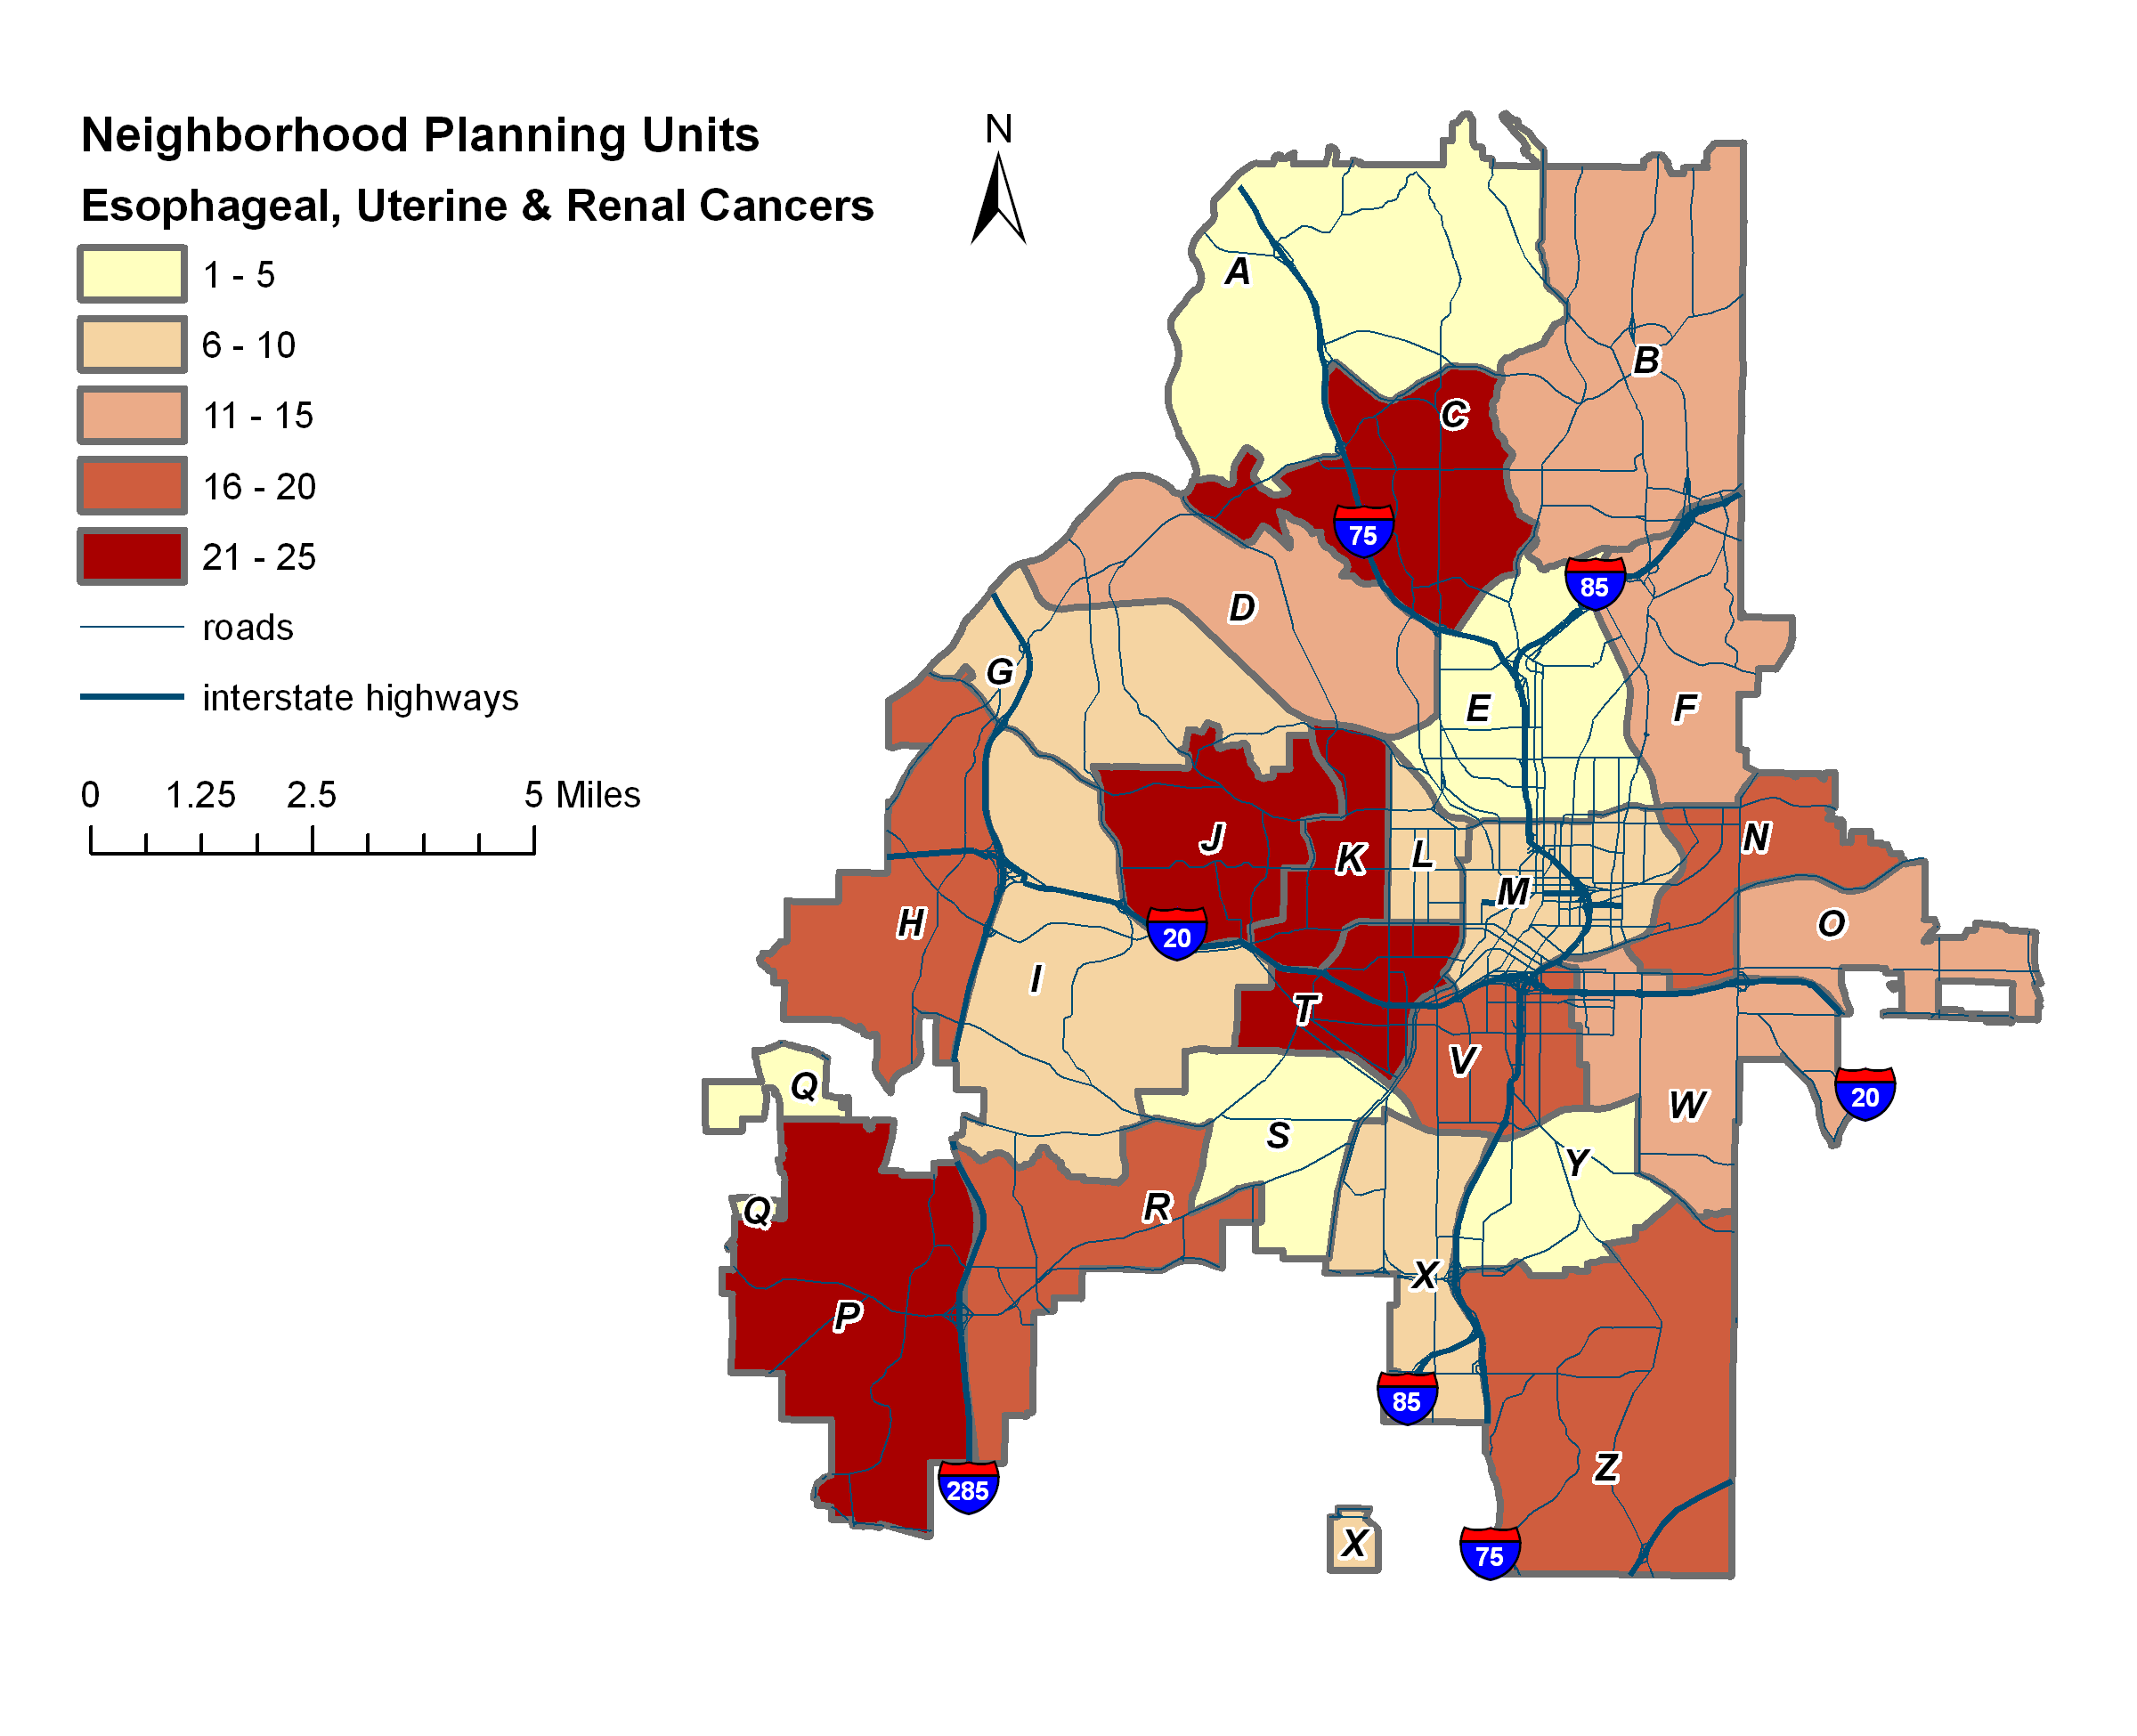
Morbidity: Esophageal, Uterine & Renal Cancers
Data Source: Georgia Department of Public Health.

Slide 70
MORTALITY: YPLL 75 rate
Data Source: Georgia Department of Public Health.

Slide 71
Neighborhood Health Index ranking
High SEC | NH Ranking | NPU
 | 1 | F
 | 2 | N
 | 3 | B
 | 4 | A
 | 5 | E
 | 6 | C
 | 7 | D
 | 8 | Q
Medium SEC | NH Ranking | NPU
 | 1 | M
 | 2 | O
 | 3 | W
 | 4 | P
 | 5 | I
 | 6 | R
Low SEC | NH Ranking | NPU
 | 1 | T
 | 2 | V
 | 3 | K
 | 4 | Y
 | 5 | L
 | 6 | S
 | 7 | X
 | 8 | J
 | 9 | H
 | 10 | Z
 | 11 | G
Source: Calculated by authors.

Slide 72
Discussion

Slide 73
Objective Vs. Subjective
Convergence of negative perceptions and conditions
Transit Access - NPUs in north Atlanta (A, B, E, F)
Housing - NPUs J, L, V
Crime – NPUs L, M, V, Y
Convergence of positive perceptions and conditions
Parks, Recreation & Greenspace – NPUs C, V
Proximity to work and short travel times – NPU E (Midtown area)
Walkability – NPUs F, N

Slide 74
Comparisons between QoL & health
Overlap matrix
NPUs with high NH & NQoL
SEC | High QoL | High Health | Overlap
High | B, F, E | F, N, B | F, B
Med | M,O, W | M, O, W | M, O, W
Low | T, S, G | T, V, K | T
Source: authors.

Slide 75
Attributes of npu f
Walkability
Amenities
Transportation
Public Safety
Nutrition
Image sources: http://www.itsmarta.com, http://www.atlantapd.org/, http://www.atlanta-midtown.com, http://www.cnuatlanta.org/streets-are-for-people-ll-atlanta-streets-alive-recap/
Notes:
Virginia Highland walkers & bikers; retail in virginia highland; morningside farmers market
Neighborhoods in NPU F: Atkins Park, Lindridge/Martin Manor, Morningside/Lenox Park, Piedmont Heights, Virginia Highland

Slide 76
Comparisons between QoL & health
Overlap matrix
NPUs with high NH & NQoL
SEC | High QoL | High Health | Overlap
High | B, F, E | F, N, B | F, B
Med | M,O, W | M, O, W | M, O, W
Low | T, S, G | T, V, K | T
Source: authors.

Slide 77
Attribute overlap: NPU M
Transportation
Walkability
Amenities
Economy
Image sources: http://www.itsmarta.com, http://www.loopnet.com/Listing/16794147/Broad-street-Atlanta-GA/, http://www.metrojacksonville.com/article/2012-feb-revitalizing-neighborhoods-atantas-castleberry-hill, http://www.atlantamagazine.com/history/story.aspx?ID=1195912, http://www.tcwfi.org/Gallery.aspx/Album/1
Notes:
Five points marta; broad street; retail in castleberry hill; Tcwf job fair
Neighborhoods in NPU M: Castleberry Hill, Downtown, Old Fourth Ward, Sweet Auburn

Slide 78
Comparisons between QoL & health
Overlap matrix
NPUs with high NH & NQoL
SEC | High QoL | High Health | Overlap
High | B, F, E | F, N, B | F, B
Med | M,O, W | M, O, W | M, O, W
Low | T, S, G | T, V, K | T
Source: authors.

Slide 79
Attribute overlap: NPU T
Amenities
Nutrition
Image sources: http://www.westendfarmersmarket.com/about.html, http://www.wrensnestonline.com/blog/marriott-in-west-end/
Notes:
West end retail and farmer’s market
NPU T: Ashview Heights, Atlanta University Center, Harris Chiles, Just Us, The Villages at Castleberry Hill, West End, Westview

Slide 80
Planning implications and applications
Do these results align with citizen priorities and feedback?
Applications for policy and resource allocation decisions
NPUs with high NH & NQoL
Notes:
Underinvestment in the west side neighborhoods

