Slide 1
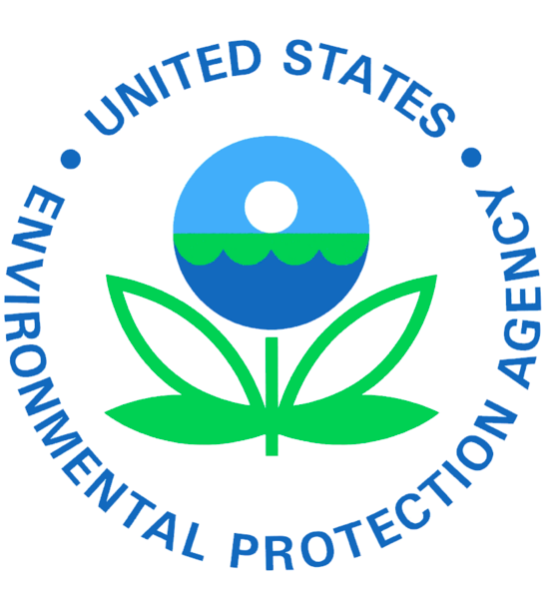
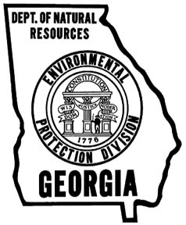
Local Wetland Programs: A Guide for Georgia Communities
Katie Sheehan
Notes:
- Need to note at the beginning that federal regulation of impacts to wetlands, which I’ll touch on a little bit here, is quite confusing and contentious. Would take too long to really delve into all of those issues so I’ll just be skimming them today. Guidebook will offer more explanation.

Slide 2
Guidebook Contents
Format: linked terms & case studies
1. Wetland basics
2. Existing protection tools and authorities
3. Wetland programs and planning activities (regulatory and non-regulatory)
4. Funding and technical assistance
5. How to avoid legal challenges
Appendices: Glossary, Resources, Who to Call, Model Ordinances, Wetland Invasives, Terms & Case Studies

Slide 3
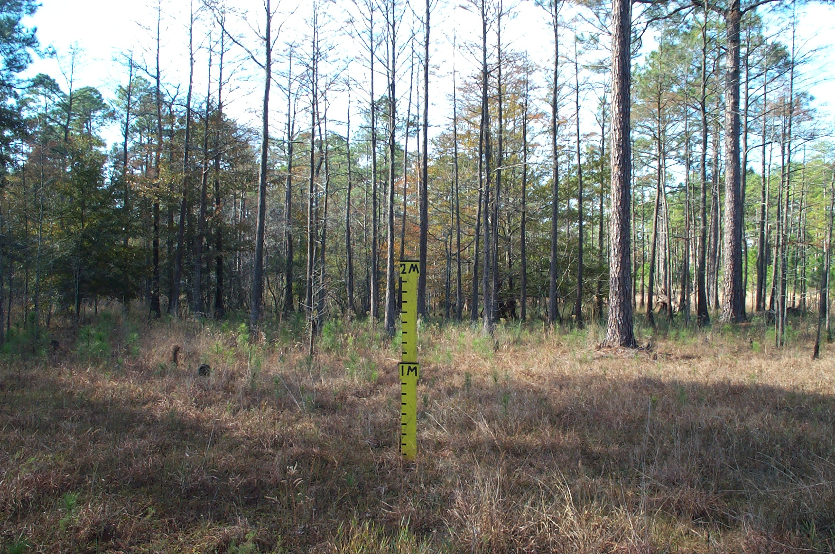
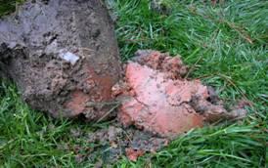
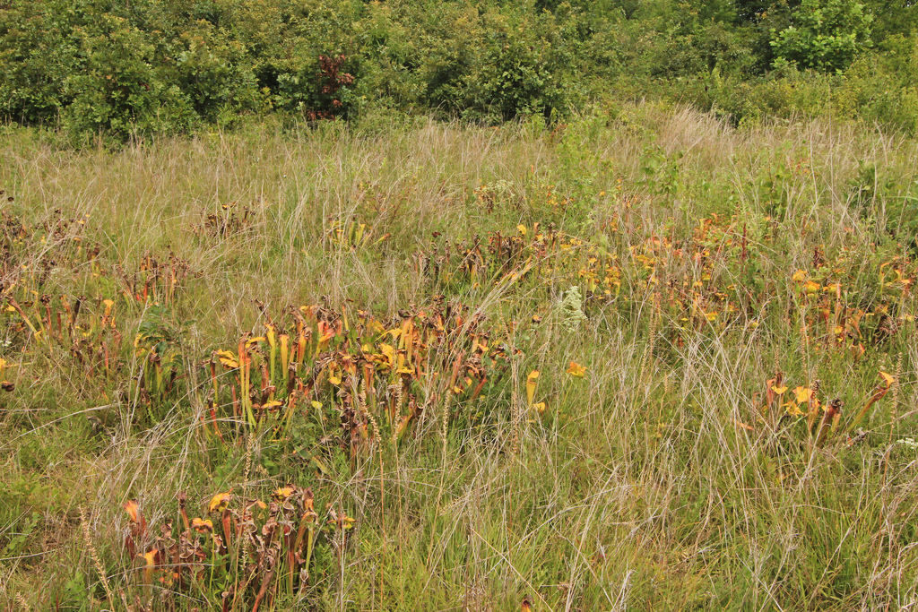
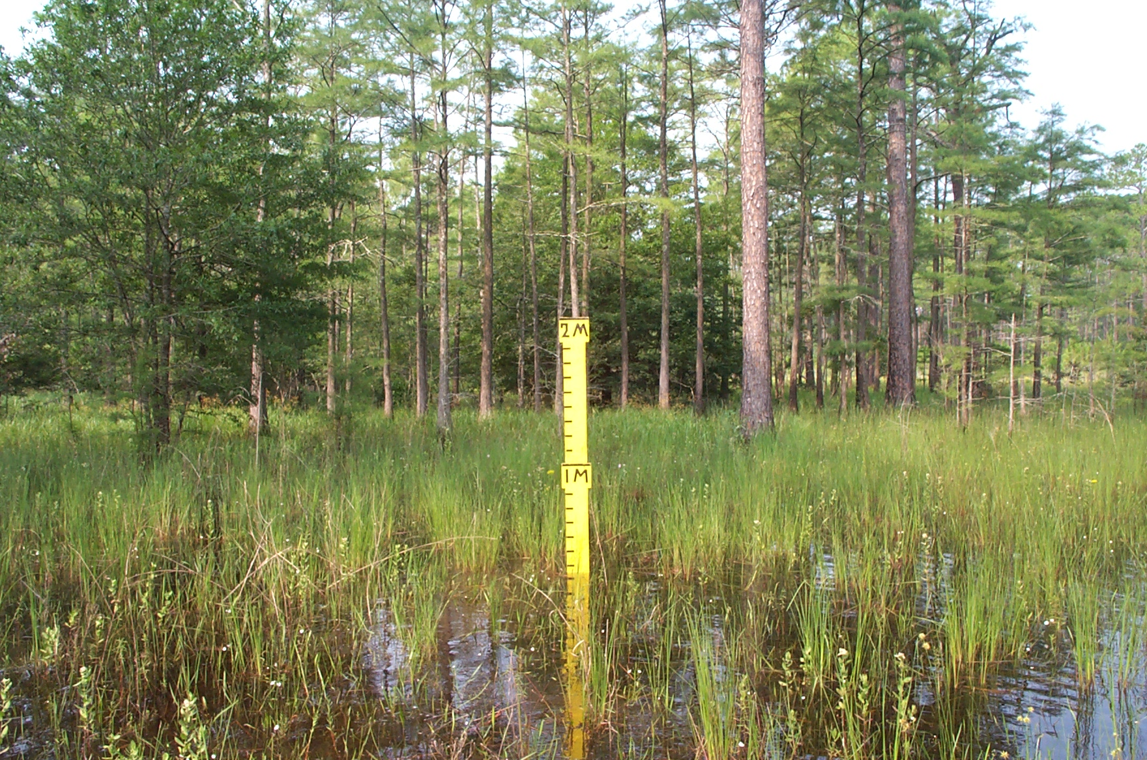
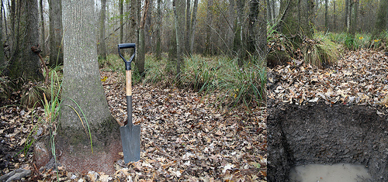
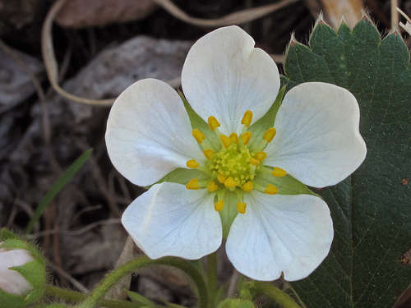
What are Wetlands? Scientific Definitions
Water
Soils
Plants
Notes:
Top Left: Okefenokee Top Center: Isolated agricultural wetland Top Right: Depressional isolated wetland in dry season
Bottom Left: Hillside seep bog Bottom Center: Riparian/floodplain wetland in ACC Bottom Right: Depressional isolated wetland in rainy season
Scientific Definition: hydrology, soils, hydrophytic vegetation
Legal: for CWA purposes, “jurisdictional” wetlands = surface water connection to “navigable waters” or “significant nexus” with navigable waters (don’t explain this; would take too much time); main point here is that so-called isolated wetlands, which by some estimates may comprise as much as a quarter of all wetlands in U.S. and, although usually smaller than other wetlands and not obviously connected to a larger surface water body, provide very important services (in Georgia, in particular, wildlife habitat; groundwater recharge may also be important)
Note that identifying wetlands can be difficult and often just determining their existence and boundaries is the most important and tricky task

Slide 4
What are Wetlands? Legal Definitions
Clean Water Act: “navigable waters”
U.S. Supreme Court cases - CWA jurisdiction over:
Relatively permanent or continuous surface water connection (Scalia); or
“Significant nexus” (Kennedy)
11th Circuit – significant nexus
EPA/Corps guidance, but determinations still fact-specific
Geographically isolated wetlands might be unprotected under CWA

Slide 5
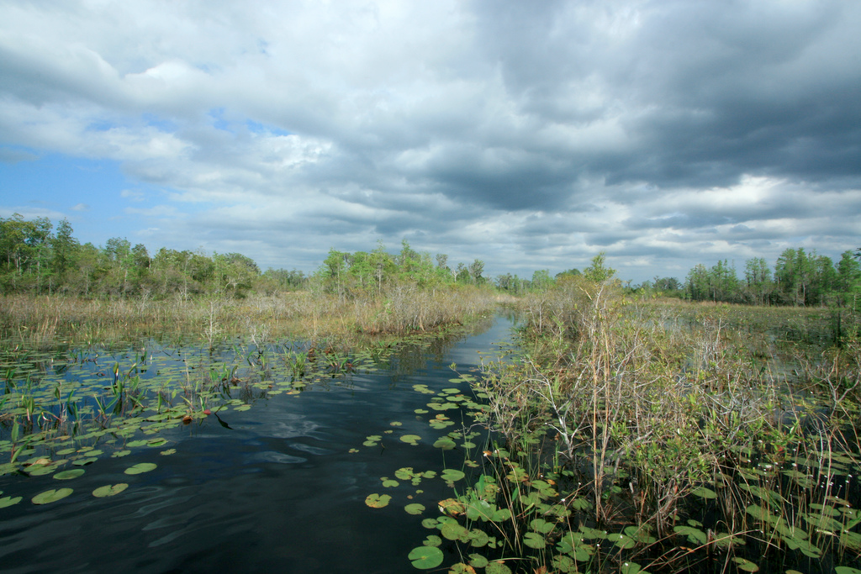
Wetlands in Georgia
Wetlands in Georgia
Coastal: salt, brackish, freshwater
Okefenokee: 427,000 acre peat bog freshwater swamp
Riverine: floodplains, bottomlands; narrow and steep in north, broad and flat in south
Inland: coastal plain; many geographically isolated

Slide 6
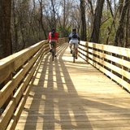
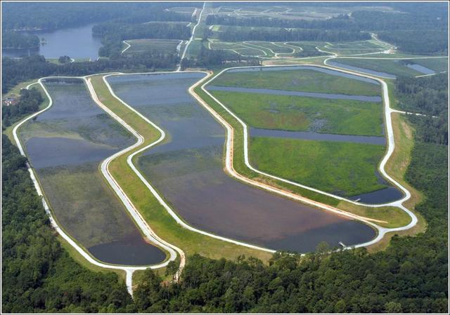
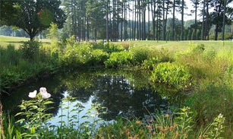
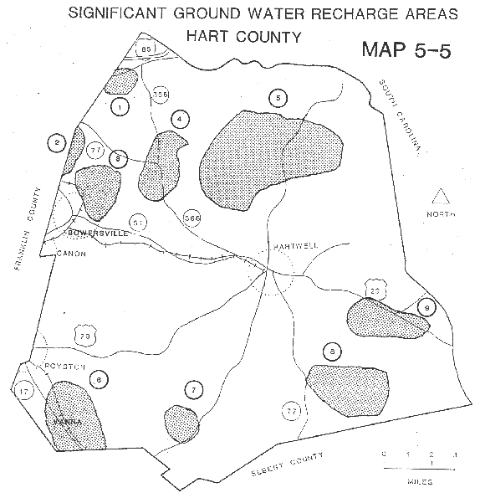
The Value of Wetlands
Notes:
Top left: endangered pitcher plant
Top right: fishing in Okefenokee (note gator)
Bottom: constructed wetland
Flood control: one acre wetland can store approx. one million gallons of water
Water quality: filter pollutants; Georgia – study of Alcovy River’s bottomland forested wetlands showed they significantly improved water quality that was severely degraded by human and chicken waste. The water pollution control value of the 2,300-acre swamp was estimated at $1 million annually
Groundwater recharge: both replenish and purify groundwater
Erosion prevention: riparian wetlands stabilize banks and help prevent erosion
Fisheries support: USFWS stresses that “the importance of both estuarine and freshwater wetlands to fish populations, and sport and commercial fishing, cannot be overemphasized.” Wetlands are an essential component of the life cycle of 75 percent of the fish and shellfish harvested for the U.S. commercial market, and up to 90 percent of fish caught for recreation. They provide spawning and rearing habitat, protective
cover, and food supplies.
Wildlife habitat: more than 1/3 of endangered and threatened species in U.S. spend entire lives in wetlands and ½ use wetlands during some part of life cycle
Recreation: …

Slide 7
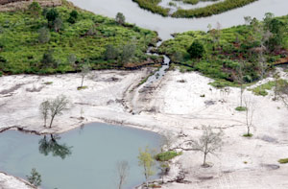
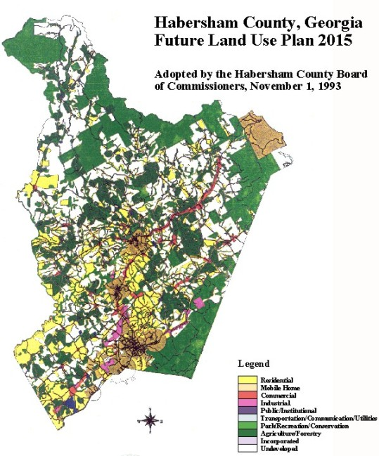
Why Local Programs?
Authority
Value to community
Fill protection gaps (CWA, buffers)
Tailor to community needs
Familiarity with resources, landscape, activities
Used to making land use decisions
But – technical expertise and resources
Notes:
Can protect wetlands unprotected by CWA. Can also require buffers. Top left pic: Carolina Bays are isolated wetlands found in coastal plain that are not protected by CWA.
Can tailor programs to community needs. Top center: If dumping in wetlands is a problem, education and increased fines could be a response.
Familiarity with community resources/landscape and activities in the area. Top right: McIntosh – if community protection program was in place could have put a stop to these activities
Used to making land use decisions. Bottom left: Habersham future land use map
But – some programs can take time and money (technical expertise and funding). Bottom right

Slide 8
Wetland Program Examples

Slide 9
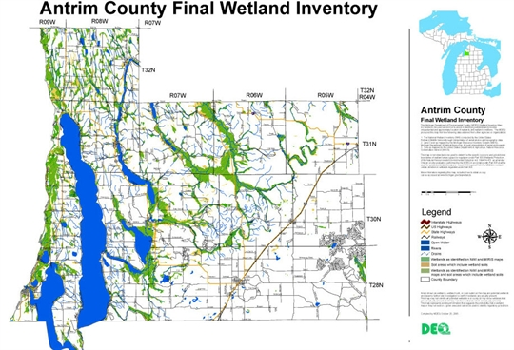
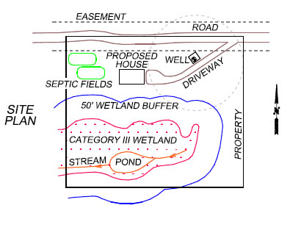
Inventories
Important definitions:
Mapping/inventories: used for planning; don’t usually show boundaries
Determination: assesses whether regulated wetlands are present; no boundaries
Delineation: location and boundaries of a wetland on a specific site

Slide 10
Inventories, cont’d.
Uses:
Identification of location, extent, types of wetlands;
Avoidance of unintended impacts;
Identification of candidate restoration sites;
Location for signage programs, acquisition, etc.;
Identification of those with important functions (flood storage, etc.);
Data for watershed planning;
Documentation of “significant nexus;”
Garnering support for local program (wetlands at risk, etc.); and
Promote/supply evidence for more state/federal protection.

Slide 11
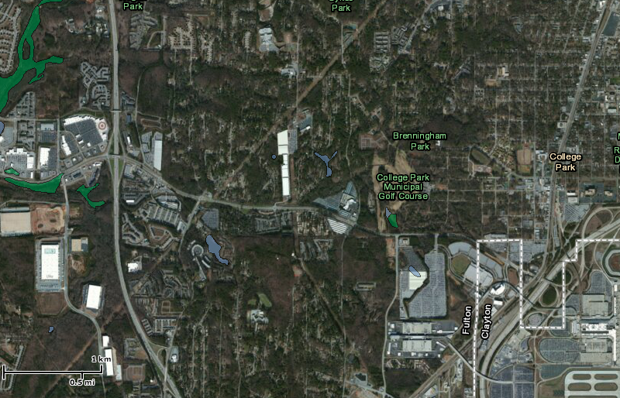
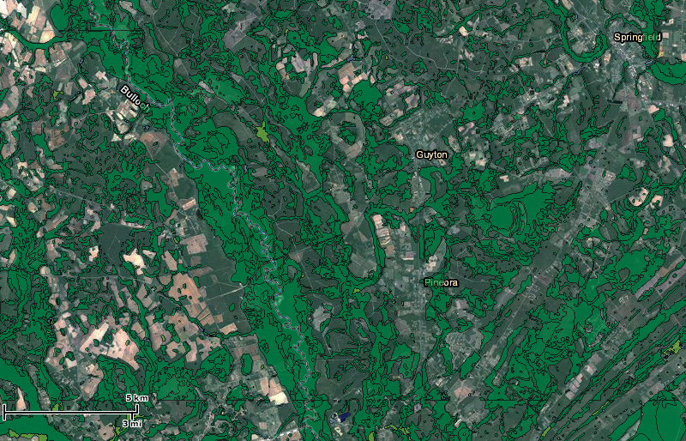
Inventories, cont’d.
Georgia Planning Act Pt. V Criteria – “Generalized Wetlands Map”
Most use National Wetlands Inventory
Issues with NWI:
Mostly outdated
Scale – small wetlands not shown; boundaries not delineated
College Park
Guyton

Slide 12
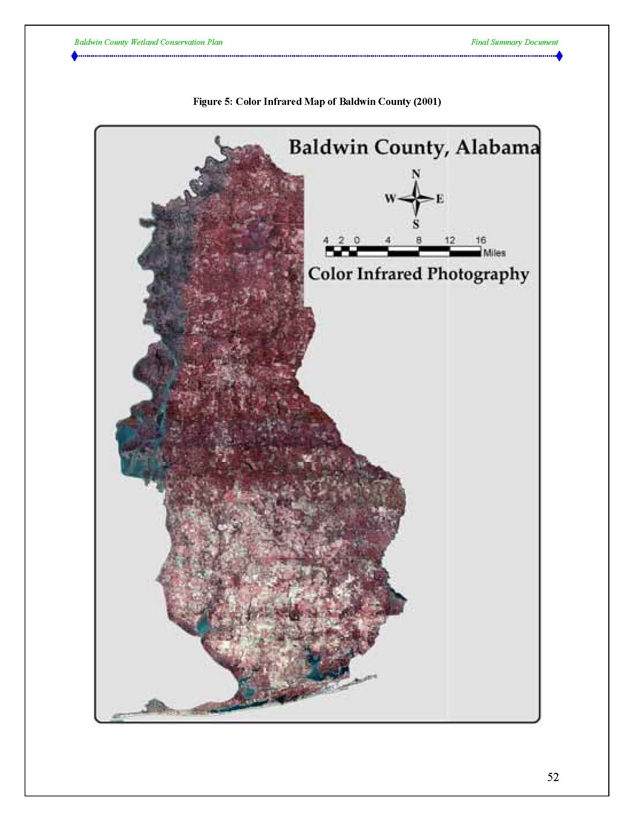
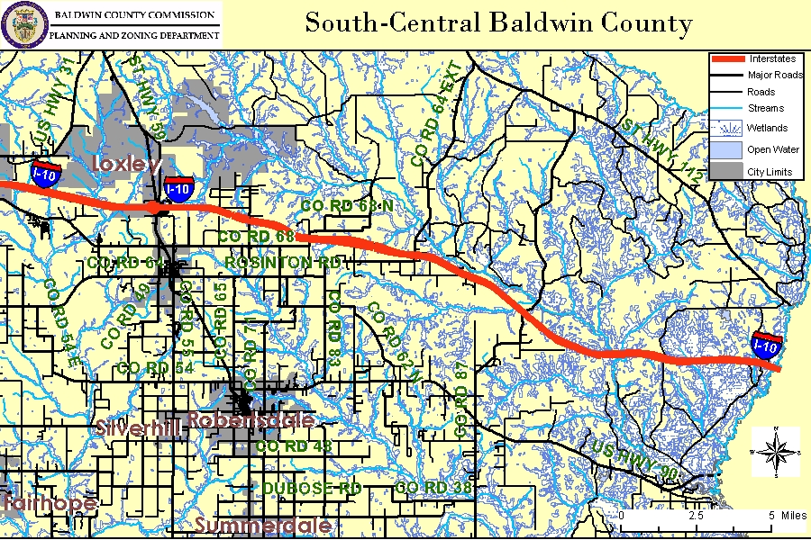
Inventories, cont’d.
Inventory options:
NWI/other maps into GIS
Above, plus other pertinent maps
Above, plus permit applicant delineations
Above, plus existing aerial survey analysis
Conduct new aerial surveys
Conduct field surveys

Slide 13
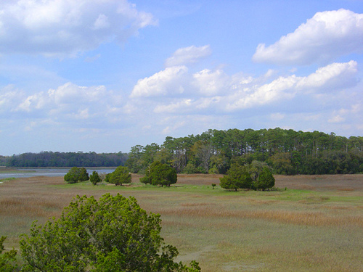
Prioritization
Best way to improve or maintain watershed health through restoration or conservation
Focuses efforts for optimal benefits; most bang for buck
Prioritization criteria:
Water quality: proximity/connection to headwaters, surface waters, protected areas; adjacent land use; size; etc.
Habitat: species; connection to natural open space; corridor; etc.
Practicality: current land use; potential for purchase; size; inclusion in greenspace plan; etc.
Notes:
- Look at Cuyahoga Wetlands Prioritization plan and talk about their criteria, etc.

Slide 14
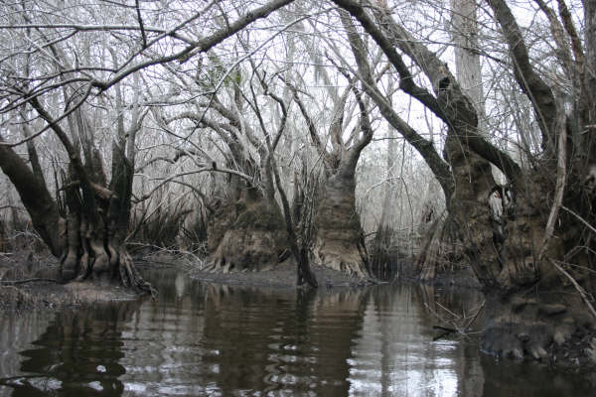
Prioritization, cont’d.
Wetlands-at-Risk Protection Tool:
Center for Watershed Protection, EPA
Five-step process that helps communities identify and protect at-risk wetlands
Shows local governments, watershed protection groups how to:
Update wetland maps;
Estimate losses;
Identify priority wetlands;
Estimate wetland values;
Protect wetlands.
http://www.wetlandprotection.org/

Slide 15
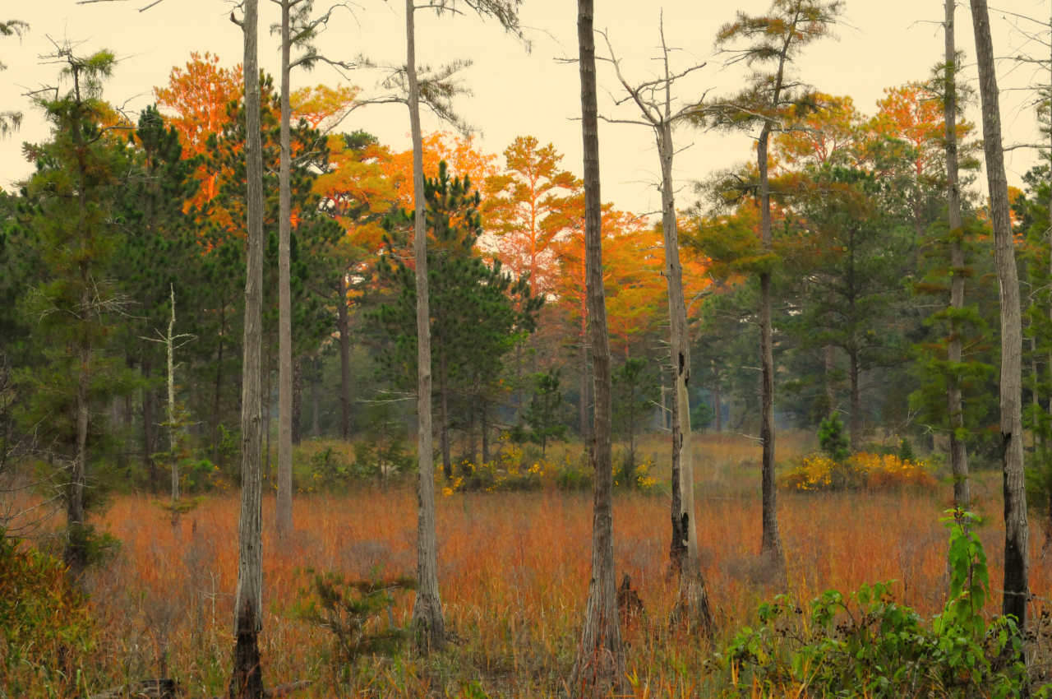
Planning Environmental Planning Criteria for Wetlands
Local governments must:
Map wetlands larger than 5 acres;
Consider potential impacts of land use; and
Identify acceptable and unacceptable long-term uses of wetlands.

Slide 16
Planning Environmental Planning Criteria cont’d.
How criteria are usually fulfilled:
Mapping: NWI; note no boundaries
Considerations: land use plan language re: decisions
Uses: list those provided in Environmental Planning Criteria (almost mirror CWA § 404)
1997 DCA model ordinance

Slide 17
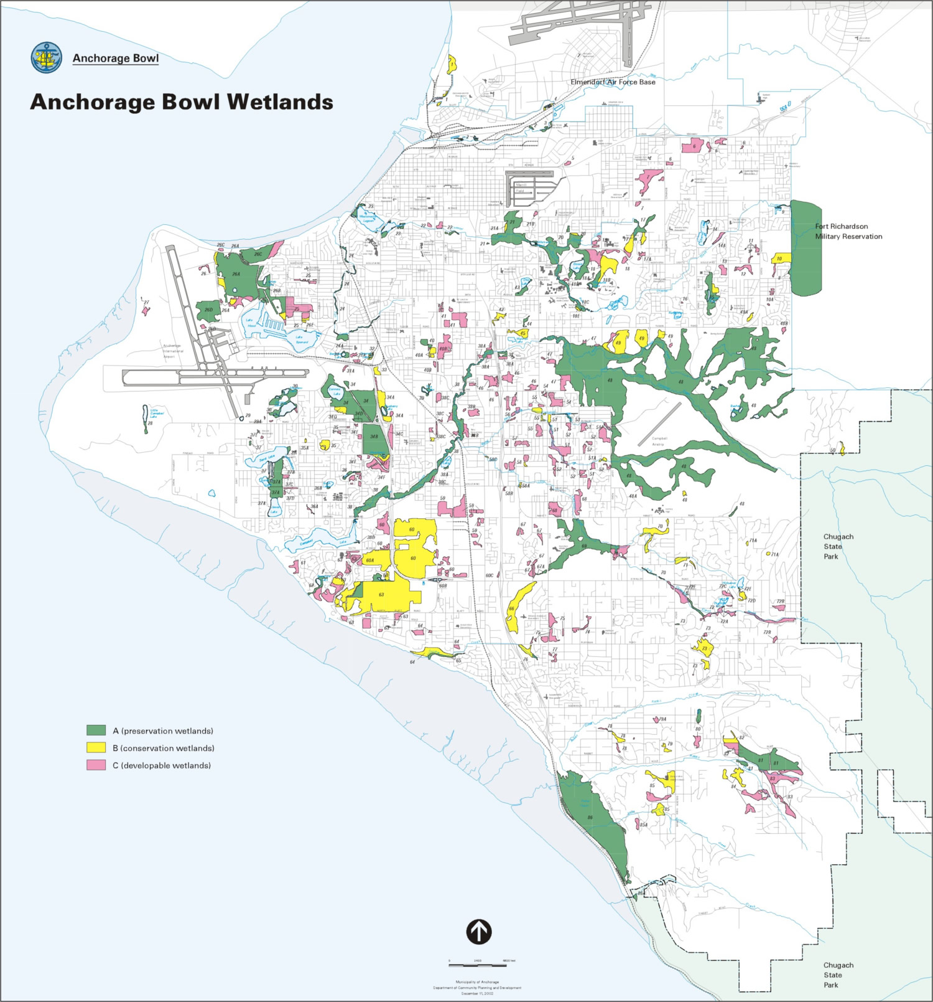
Planning Comprehensive Wetlands Planning
Warranted in communities with extensive wetlands
Particularly beneficial for multiple programs
Often include: mapping, education and outreach, land use policies, and regulations
Can help identify restoration and conservation sites

Slide 18
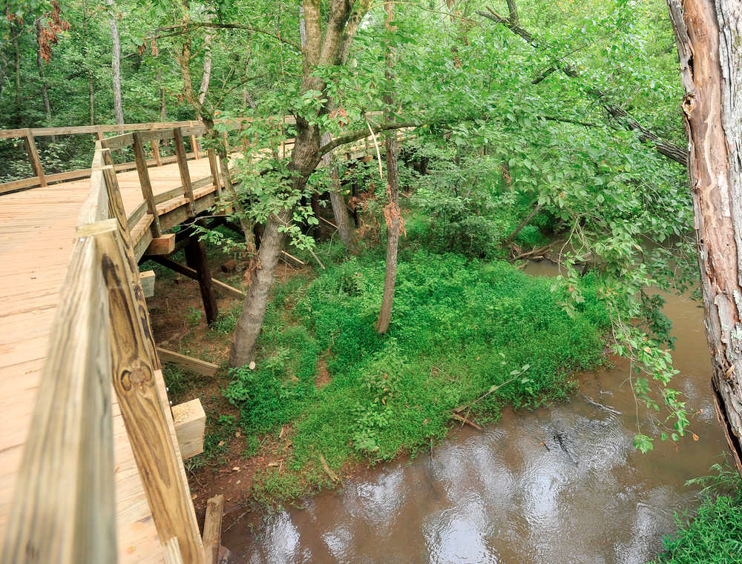
Acquisition
Reasons:
Conserve or restore wetland services
Part of a greenspace plan
Recreational/educational amenities
Mitigation banks
Often less expensive
Cannot acquire coastal marshlands

Slide 19
Acquisition, cont’d.
Funding:
General fund
SPLOST
Small property tax levy (Alachua County Forever program – ¼ mil)
State, federal grants and loans
Partner with in-lieu fee program sponsor
FEMA Hazard Mitigation Grant Program

Slide 20
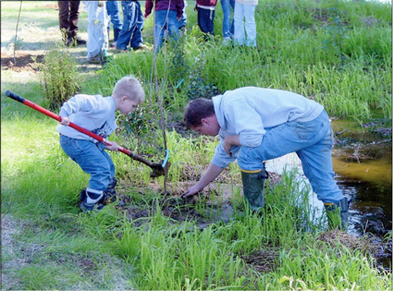
Restoration
Returning degraded or former wetland to naturally functioning condition, or as close as possible
Sometimes as easy as removing/filling drainage structures (ditches, etc.)
Technical assistance required, esp. for mitigation banks
Steps: planning, implementation, monitoring, management

Slide 21
Creation
Constructing a wetland where one did not exist before
Usually difficult
Can provide services typically provided by engineered, mechanical infrastructure at a fraction of the cost
Two categories: established and constructed

Slide 22
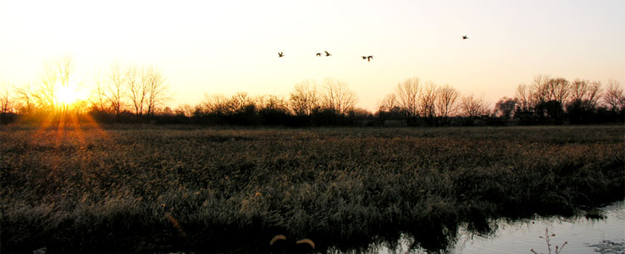
Creation, cont’d.
Established wetlands:
Habitat, other uses
Not for water filtration infrastructure
May be used for mitigation credits (only tidal wetlands in Georgia)

Slide 23
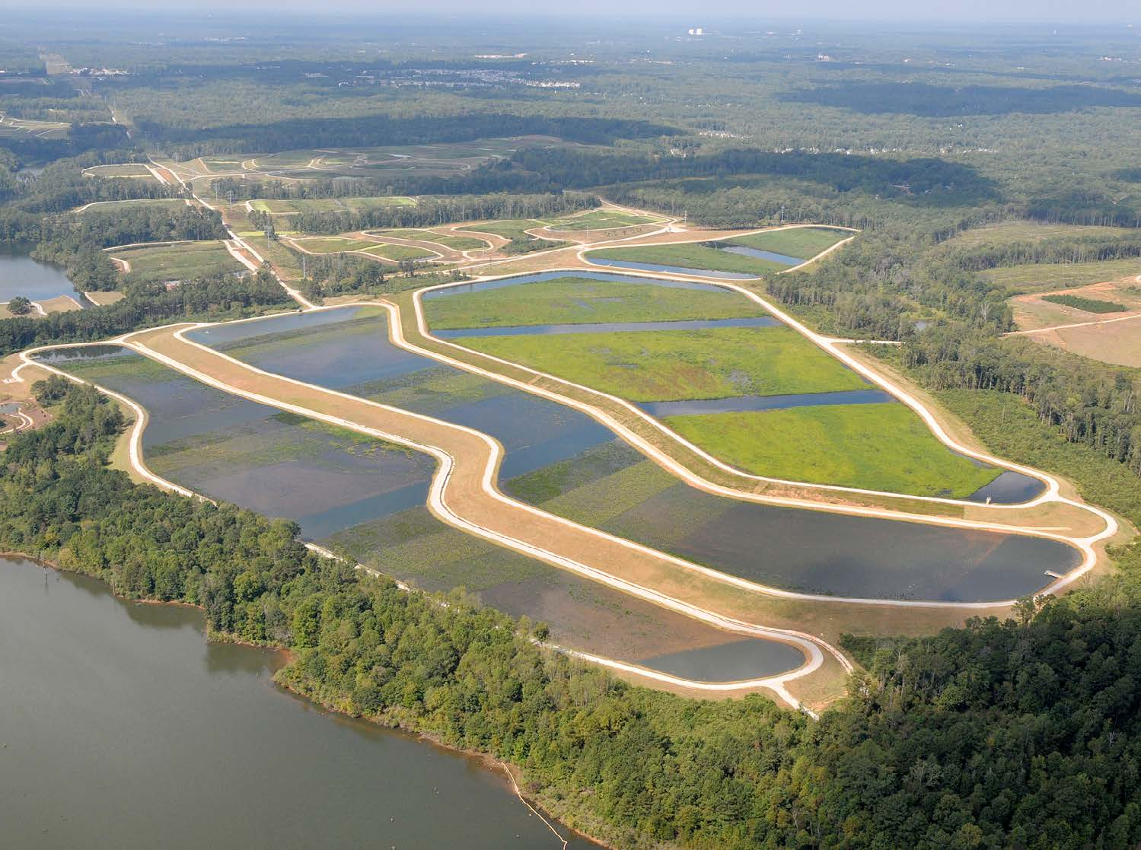
Creation, cont’d.
Constructed wetlands:
I.e., treatment wetlands
Usually created for water filtration
Urban, agricultural runoff or wastewater system effluent
Usually not eligible for mitigation credits
Can remove pharmaceuticals that traditional mechanical infrastructure cannot
Clayton County, Richmond Hill, Alpharetta

Slide 24
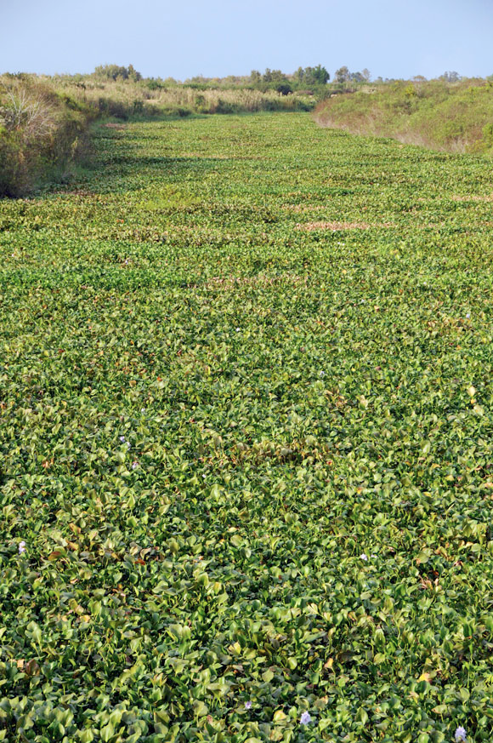
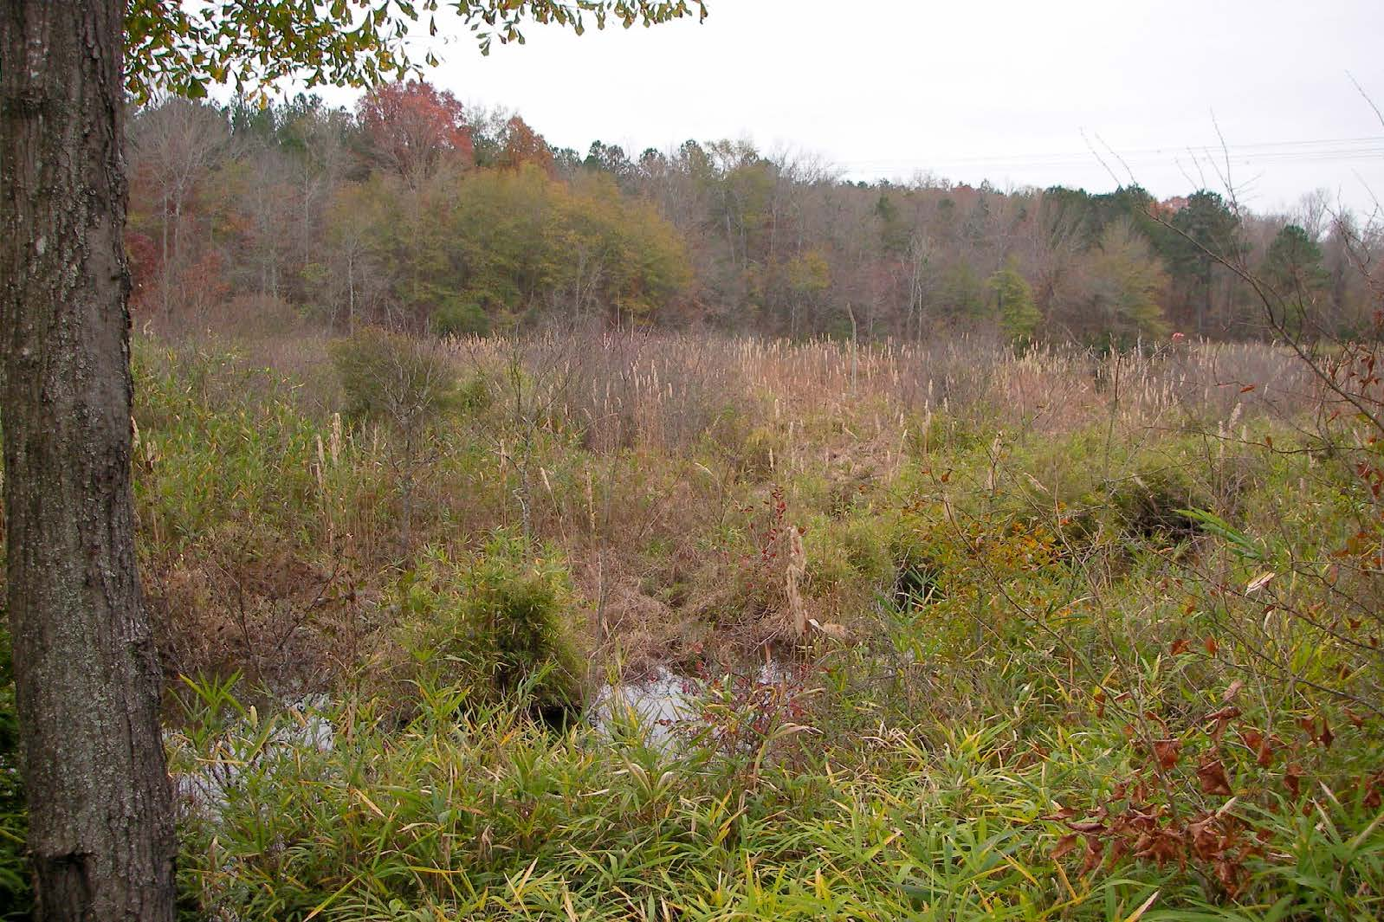
Incentives
Transferable Development Rights programs
Density bonuses

Slide 25
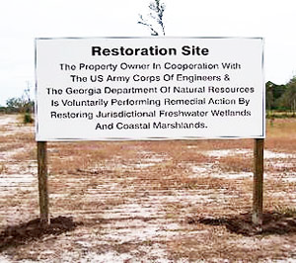
CWA § 404 Verification
Proof of USACE wetlands determination when wetlands may be impacted by development activities
Wetlands common: all development permits
Wetlands not common: permits for activities within specified distance from wetlands shown in community map/inventory

Slide 26
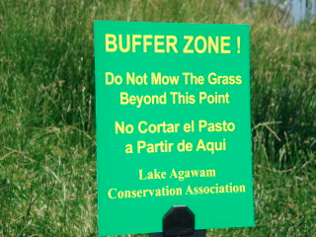
Buffers
Vegetated transition zones between uplands and wetlands/other waters
GESA requires 25 foot buffer (case pending)
Local governments can require larger buffers
Widths:
50-100’ – water quality
100-300’ (or more) – wildlife
Buffer averaging
Variance provisions

Slide 27
Buffers, cont’d.
Fixed-width
One width for all wetlands
Some too small, some too large; support may erode
Variable-width options:
Case-by-case
Based on adjacent land use
Hierarchical rating system

Slide 28
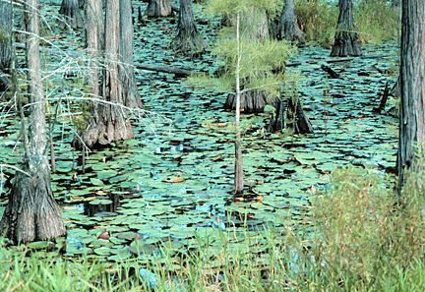
Permit Programs
CWA provides explicit authority
Two general types:
All wetlands
Only isolated (non-jurisdictional) wetlands
Standards can be stricter than CWA
Common reasons for permit denial: applicant failed to show impact is necessary; stormwater plan not sufficient to compensate; impacts to important or sensitive wetland

Slide 29
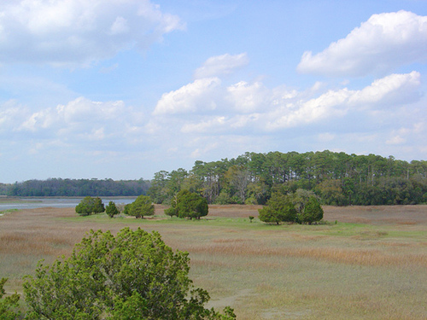
Zoning
Include wetlands-specific purpose and intent language
Incorporate wetlands considerations into rezoning decisions
Informal
Formal standards
Condition zoning approvals on CWA § 404 permits
Adopt wetland overlay zones

Slide 30
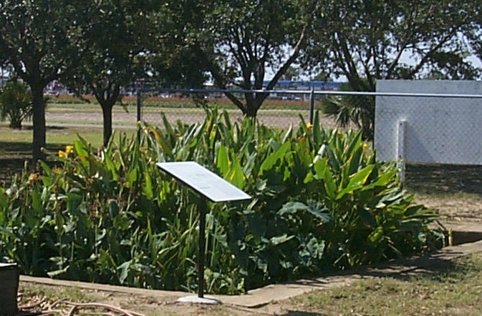
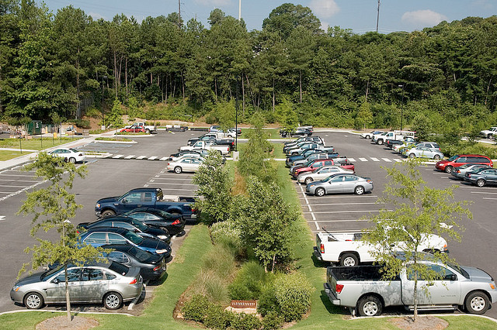
Low Impact Development
Can protect wetlands from impacts associated with increased runoff and incorporate constructed wetlands as green infrastructure

Slide 31
Funding & Technical Assistance
Grants:
EPA: Five Star Restoration, Wetland Program Development Grants, etc.
NFWF
NRCS
EPD: CWA § 319
CRD: Coastal Incentive Grants
Loans: GEFA
Property taxes, SPLOST, etc.
Cost-share: NRCS (EQIP, etc.)
Technical assistance: NRCS, National Parks Service, Georgia Land Conservation Program, DNR Private Lands Program
Private sources (foundations, corporations, etc.)

Slide 32
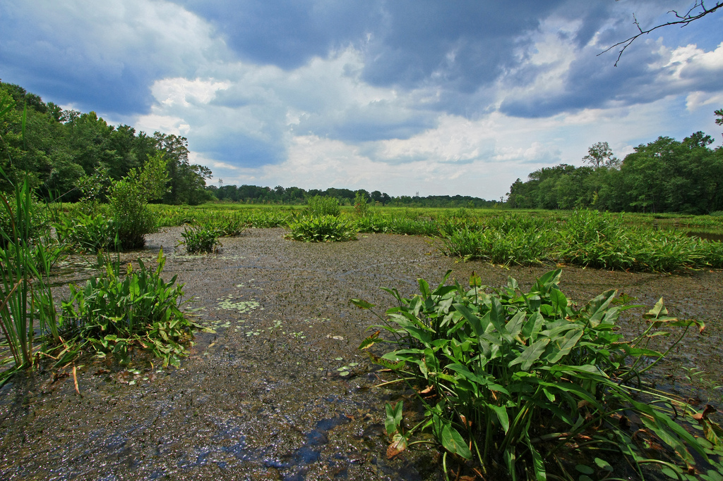
THANK YOU!
Questions?
QUESTIONS?

